Slide 1
Nautical Chart Cancellation Process, Timelines,
Strategic Approach
April 22, 2021
CAPT E.J. Van Den Ameele - Chief, Marine Chart Division
Julia Powell - Chief, Navigation Services Division
NOAA Office of Coast Survey

Slide 2
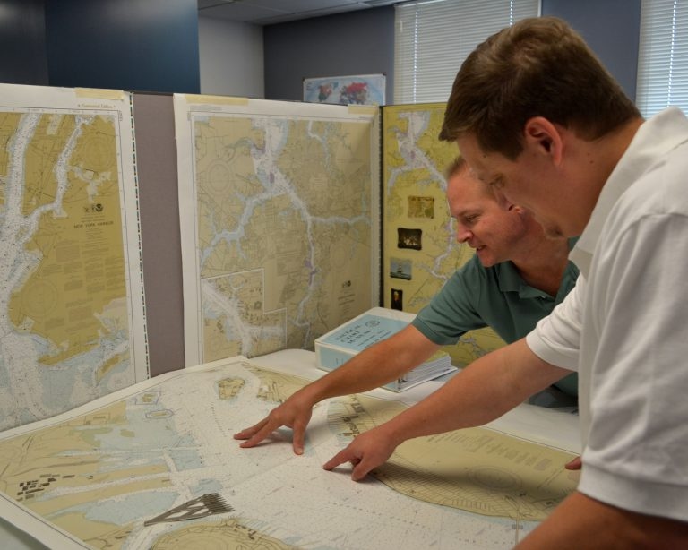
Products and Services being Discontinued
PRODUCTS
Print-on-demand (POD) paper nautical charts
Full-size chart PDFs
BookletChart™ PDFs
NOAA raster navigational charts (NOAA RNC®)
SERVICES
NOAA RNC Tile Service
Seamless RNC Services
Online RNC Viewer

Slide 3
2019 Raster Chart Sunset Timeline 2025
NOAA Custom Chart Prototyping
Raster Sunset Federal Register Notice
Nov 2019
Gather User Feedback
NOAA Custom Chart 1.0 Release
Systematically Cancel Traditional Paper Charts
Complete Raster Sunset Program - 2025
Now

Slide 4
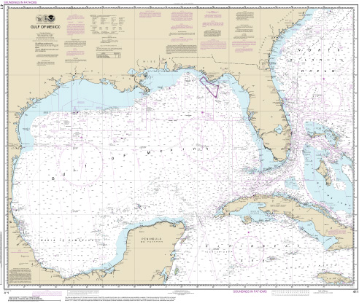
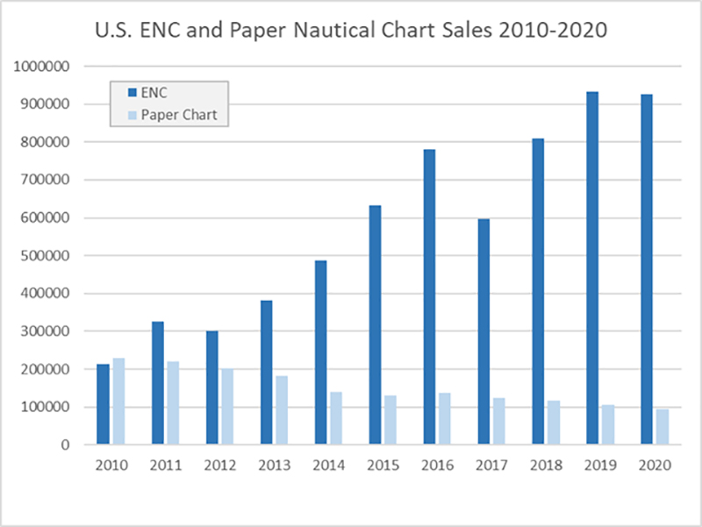
A Long Tradition in Transition

Slide 5
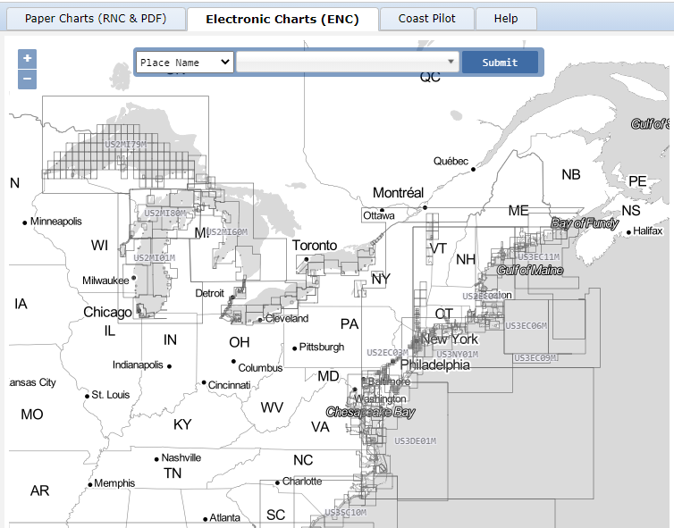
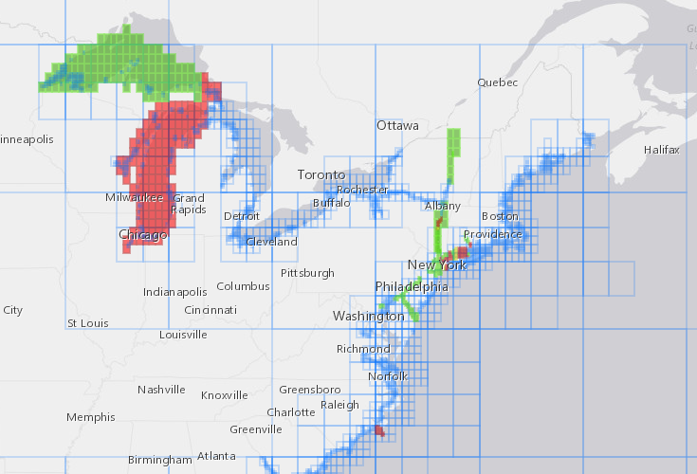
ENC Rescheming

Slide 6
Impact to Raster Charts
Discontinued application of routine data to raster charts
Continued application of CRIT and DTONs to raster charts
Raster charts are getting more out of synch with ENCs
Especially in the application of new Hydro and Shoreline surveys
Any chart that becomes a concern will be canceled

Slide 7
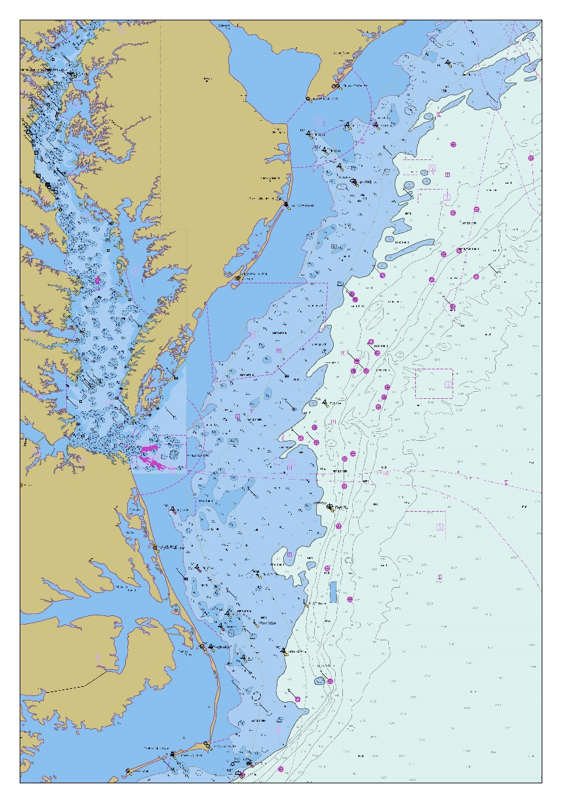
Some Considerations for Canceling Individual Charts
New larger-scale reschemed ENC coverage is created
Large amounts of new depth or shoreline data is compiled to the corresponding ENC
Large number of LNMs issued for the chart edition
Small volume of sales indicating low use of chart
Cancelations may be grouped together by region

Slide 8
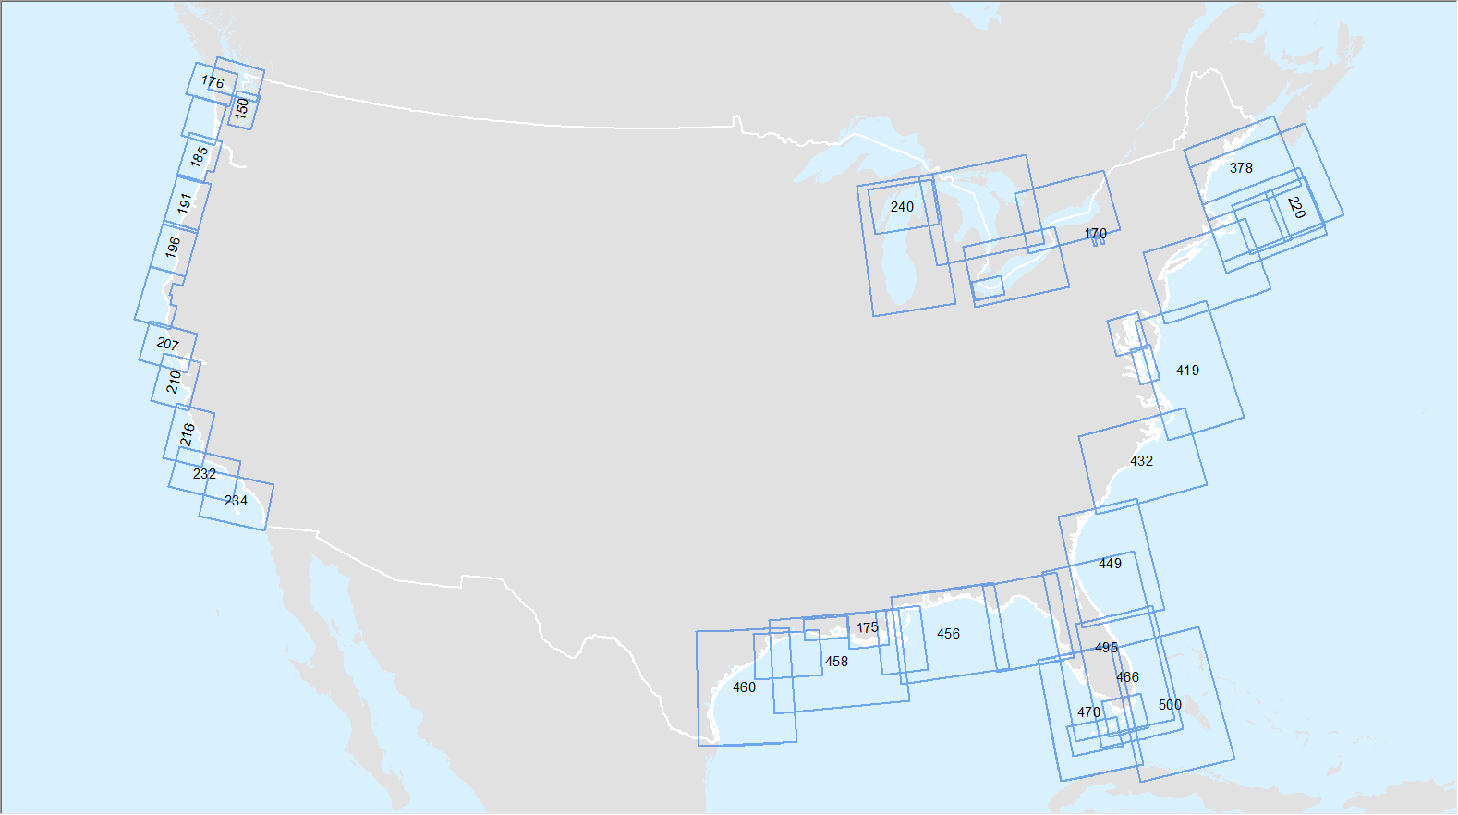
Smaller Scale Charts – to be Canceled Last
West Coast ~ 1:200K
Gulf & East Coast ~ 1:400K
Great Lakes ~ 1:400K-500K
500
400
500
400
400
456

Slide 9
How NOAA will Notify the Public of Pending Chart Cancellations

Slide 10
Chart Cancellation Chronology
Example of a typical chart cancelation
Thursday
Tuesday
Thursday
Tuesday
25
FEB
2
MAR
26
AUG
31
AUG
Last Edition
Note Added
LNM
Chart Canceled
LNM
26 Weeks
Last Edition Status

Slide 11
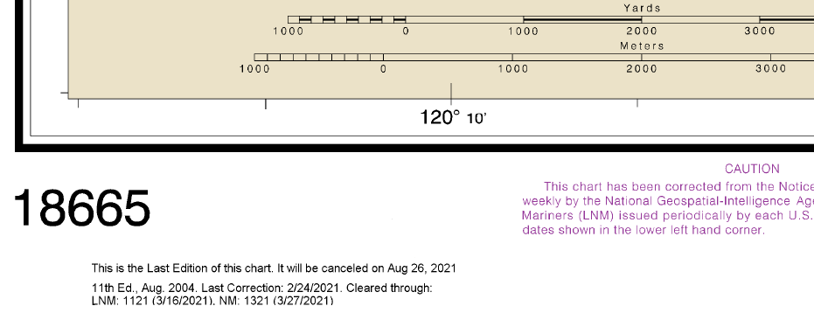
Last Edition Chart Note

Slide 12
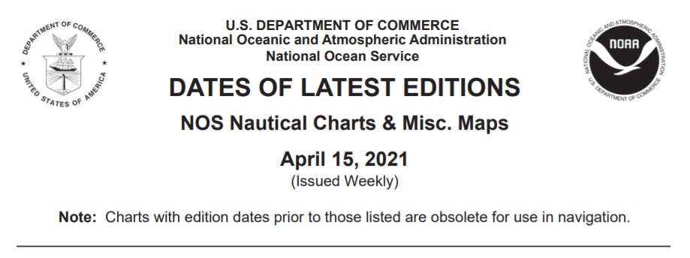
Dates of Latest Editions Publication (PDF Format)
When a chart is canceled, it is moved to a list of cancelled charts at the end of the DOLE

Slide 13
Dates of Latest Editions Publication (HTML Format)
When a chart is canceled, it is moved to a list of cancelled charts at the end of the DOLE

Slide 14
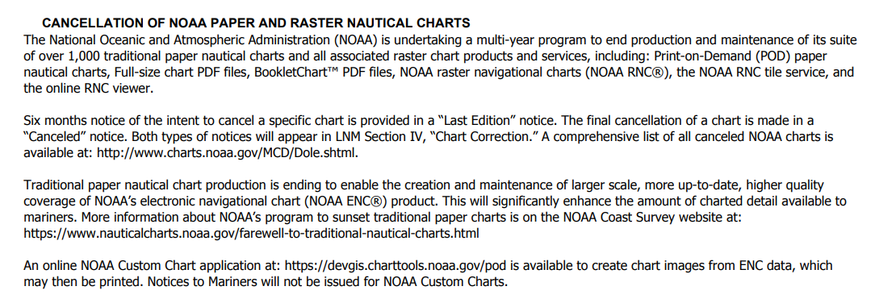
General Cancellation Notice LNM Section I in all Coast Guard Districts
Products to be canceled
Dates of Latest Editions (DOLE)
More Sunset Information
NOAA Custom Chart 1.0

Slide 15
Last Edition Notice in LNM Section IV of Coast Guard District that Chart is in

Slide 16
NOAA Chart Product Improvements

Slide 17
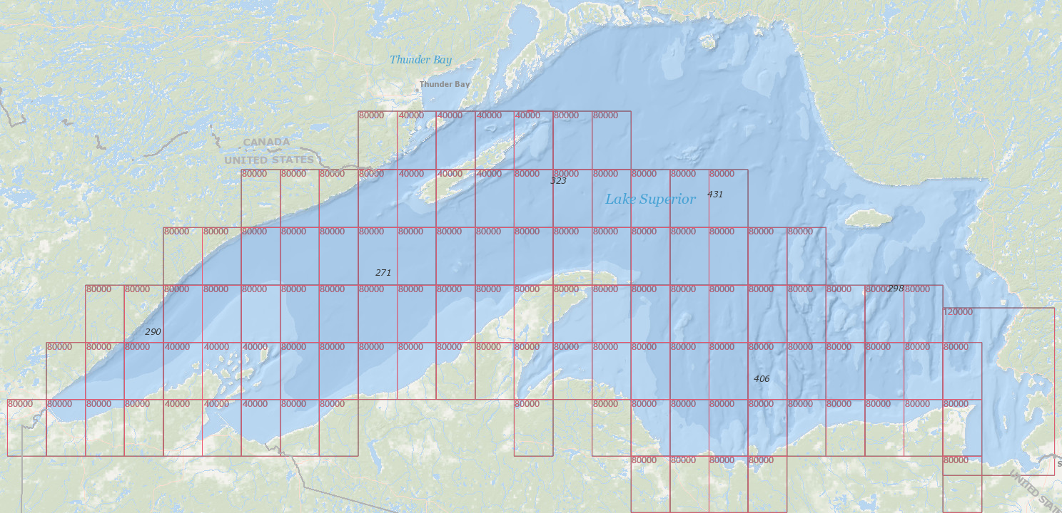
Improved Larger Scale ENC Coverage
107 newly reschemed ENC cells in Lake Superior
Largest scale chart coverage between Thunder Bay and Duluth:
Paper charts: 1:120,000
ENCs: 1:80,000 Isle Royale 1:40,000

Slide 18
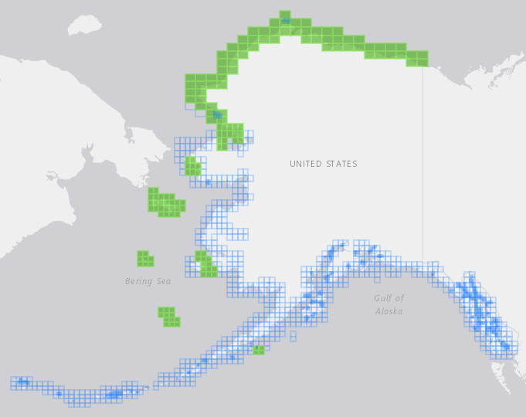
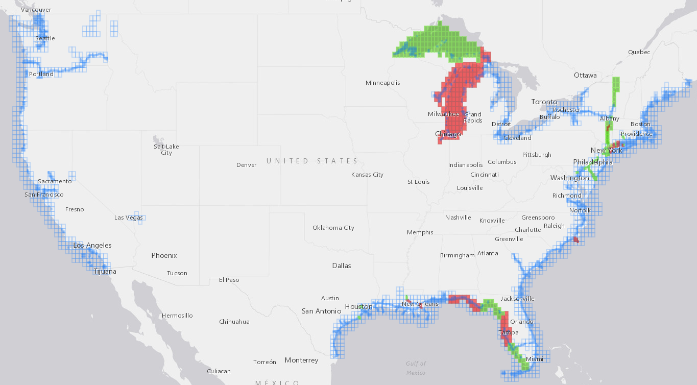
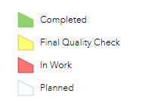
NOAA ENC® Rescheming Progress
https://distribution.charts.noaa.gov/ENC/rescheme/

Slide 19
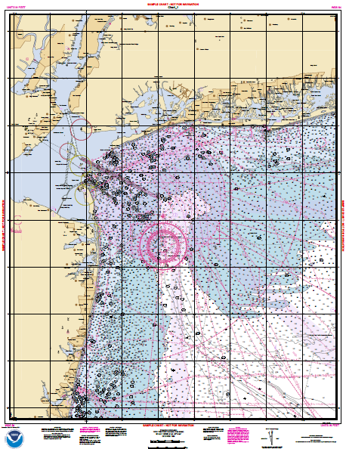
NOAA Custom Chart
Version 1.0 Released March 31st
Improvements
Familiar NOAA symbols for buoys and other features
Better portrayal of chart notes
Warnings for automation and carriage requirements
Improved user interface

Slide 20
Upcoming NCC Improvements
Additional paper sizes
Improved generation of the compass rose
Additional symbology and labeling improvements
Means for Print on Demand (POD) Agents to provide NCC charts
Ability to save custom charts
Subscription service / user accounts
Fixed areas of interest (AOI)
Considering an API

Slide 21
Shutdown of Raster Services
By Oct 1, 2021
Shutdown of RNC Tile Service
Shutdown of Raster Seamless Service
After Oct 2021, but Before Jan 2025
Shutdown of Online RNC Viewer
NOAA is encouraging navigation system and 3rd party data providers to adopt use of ENC data

Slide 22
Other Impacts

Slide 23
Changes to the Coast Pilot
Coast Pilot traditionally cross referenced information to the ENC and the traditional chart number
The ENC rescheming and the future of the paper chart required a closer look at how referencing was done
Making the Coast Pilot product agnostic
Focusing on waterway names rather than products

Slide 24
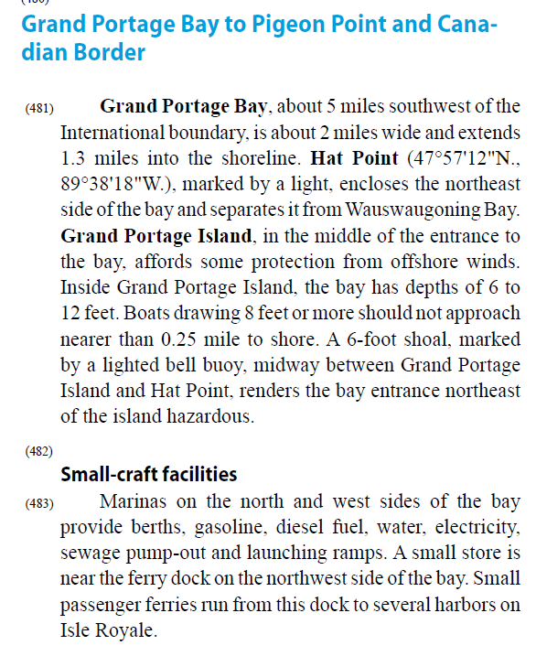
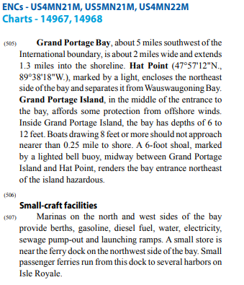
Changes to the Coast Pilot

Slide 25
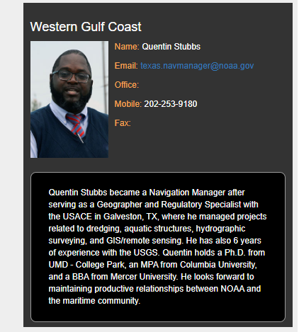
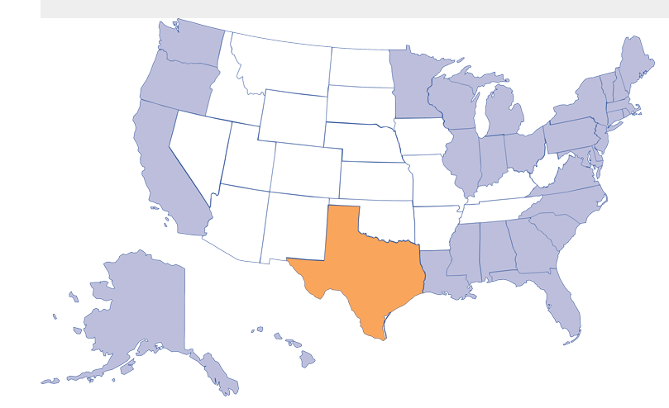
Ways to Engage
Regional Navigation Managers

Slide 26
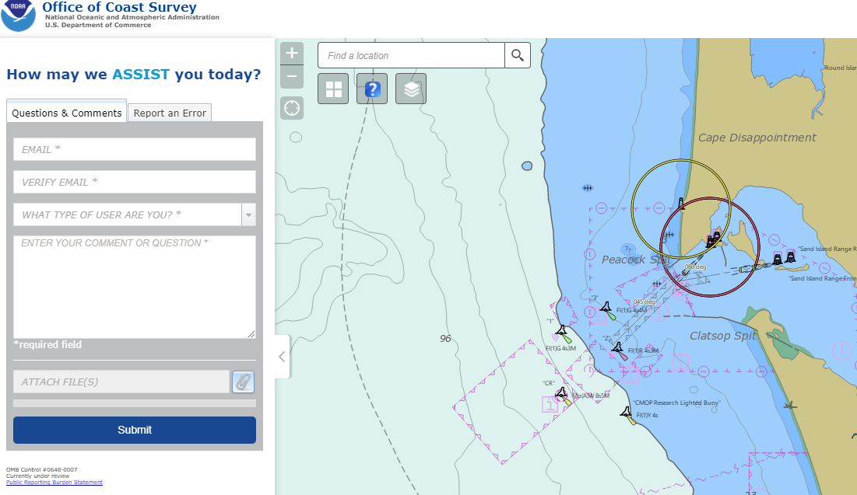
Ways to Engage
Through ASSIST - https://www.nauticalcharts.noaa.gov/customer-service/assist/

Slide 27
Upcoming Webinar Series
May 20, 2021 1:00PM EDT
NOAA Custom Chart Application

Slide 28
Questions

Slide 29
Additional / Alternative Slides

Slide 30
Upcoming Webinar
Nautical Custom Chart 1.0 Web Application
May 20, 2021
1:00 PM EDT
Register at https://attendee.gotowebinar.com/register/1127093290188198926

Slide 31
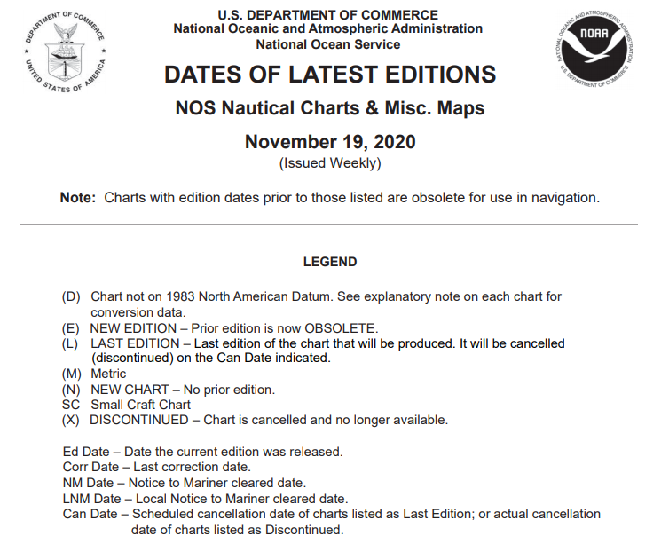
Dates of Latest Editions
New status labels added
Last Edition – Chart will be canceled 6 months after notice of being a last edition
Cancelation Date – Date when LNM will be issued canceling the chart and its removal from the OCS website

Slide 32
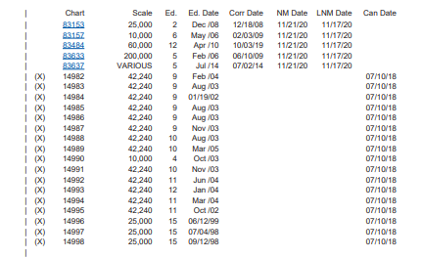
Dates of Latest Editions
Cumulative list of all charts canceled after July 2018
Appended to the end of the list of active charts

Slide 33
Life without Chart Numbers
Chart Number References:
Notice to Mariners
Light Lists
U.S. Coast Pilot®
Canceled charts no longer meet USCG carriage
Notice to mariners are not issued for canceled charts
References to canceled charts will not appear in LNMs, Light Lists, or the Coast Pilot
Changes to ATONs and other “notice-worthy” items will continue to arise
NOAA maintains over 1000 paper and raster nautical charts
Comprising over 2000 separate chart panels, compiled in over a 100 different scales
NOAA maintains over 1600 ENCs
Rescheming will improve quality of data, provide larger scale coverage
The completed ENC suite will consist of over 9000 ENCs
Producing and distributing raster charts
Requires separate computer software and data storage
Additional cartographic training and processing
NOAA can create and maintain enhanced ENC products
Redirecting resources previously used to update and distribute paper and raster nautical charts

Slide 34
Life without Chart Numbers
Still need a “general neighborhood” reference
Waterway Harmonization Project
USCG, USACE, NOAA, and others
Developing a common, standardized set of georeferenced points of interest in U.S. navigable waters
Names and positions / shapes of channels, reaches, bays, etc.
Waterway names will be used in
LNMs – ATON Discrepancies and other sections
Light Lists and U.S. Coast Pilot
ENC Names will be removed from Coast Pilot
NOAA maintains over 1000 paper and raster nautical charts
Comprising over 2000 separate chart panels, compiled in over a 100 different scales
NOAA maintains over 1600 ENCs
Rescheming will improve quality of data, provide larger scale coverage
The completed ENC suite will consist of over 9000 ENCs
Producing and distributing raster charts
Requires separate computer software and data storage
Additional cartographic training and processing
NOAA can create and maintain enhanced ENC products
Redirecting resources previously used to update and distribute paper and raster nautical charts

Slide 35
Nautical Chart Cancellation Process, Timelines,
Strategic Approach
April 22, 2021
CAPT E.J. Van Den Ameele - Chief, Marine Chart Division
Julia Powell - Chief, Navigation Services Division
NOAA Office of Coast Survey
^{Office of Coast Survey}
National Oceanic and Atmospheric Administration

