Slide 1
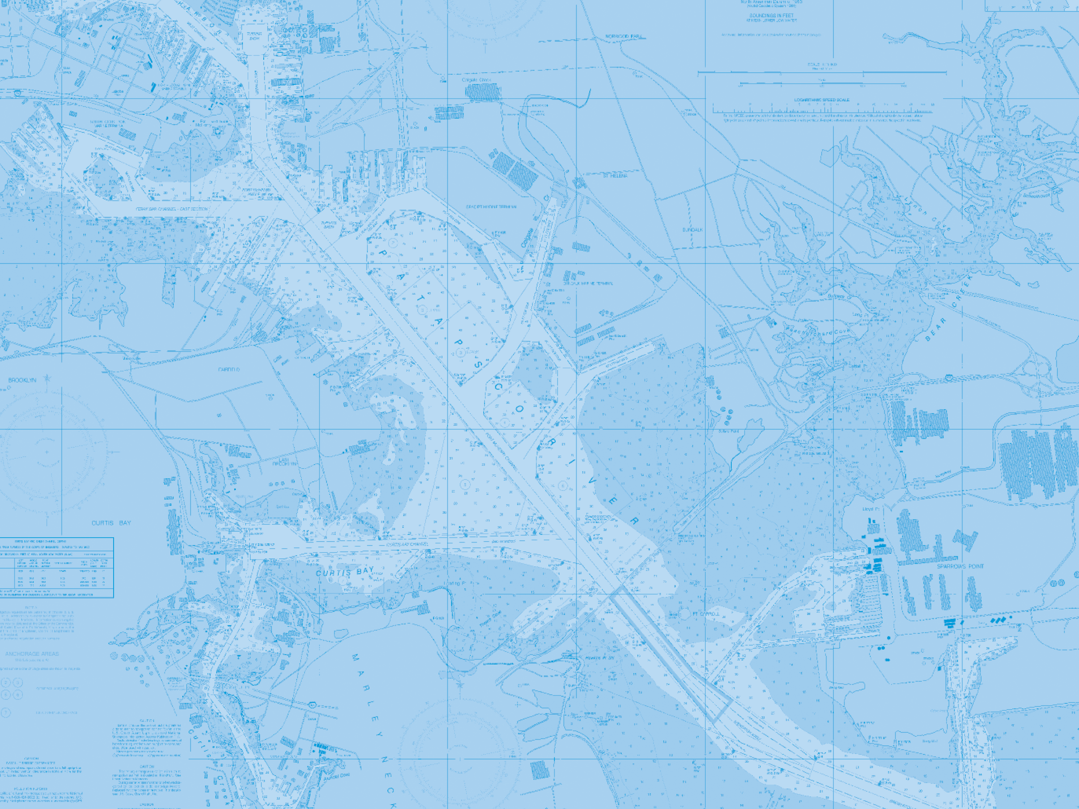
Office of Coast Survey update to the Hydrographic Services Review Panel
Captain John Lowell
October 13, 2010

Slide 2
Coast Survey FY10 metrics
May Status | October Status
Acquired 2,200 SNM of hydro data | Acquired 4,500 SNM of hydro data*
Added 44 ENCs, for total of 744 | Added 72 ENCs, for total of 772#
* acquired by NOAA and contractors
# goal is parity with suite of 1,000 paper charts

Slide 3
Hassler Update
NOAA is in possession
Contract with Halter Marine terminated for default
Anticipating April 2011 certification by ABS and approval by USCG
Additional shipyard work in late 2011
Hassler should be ready for the 2012 hydrographic field season

Slide 4
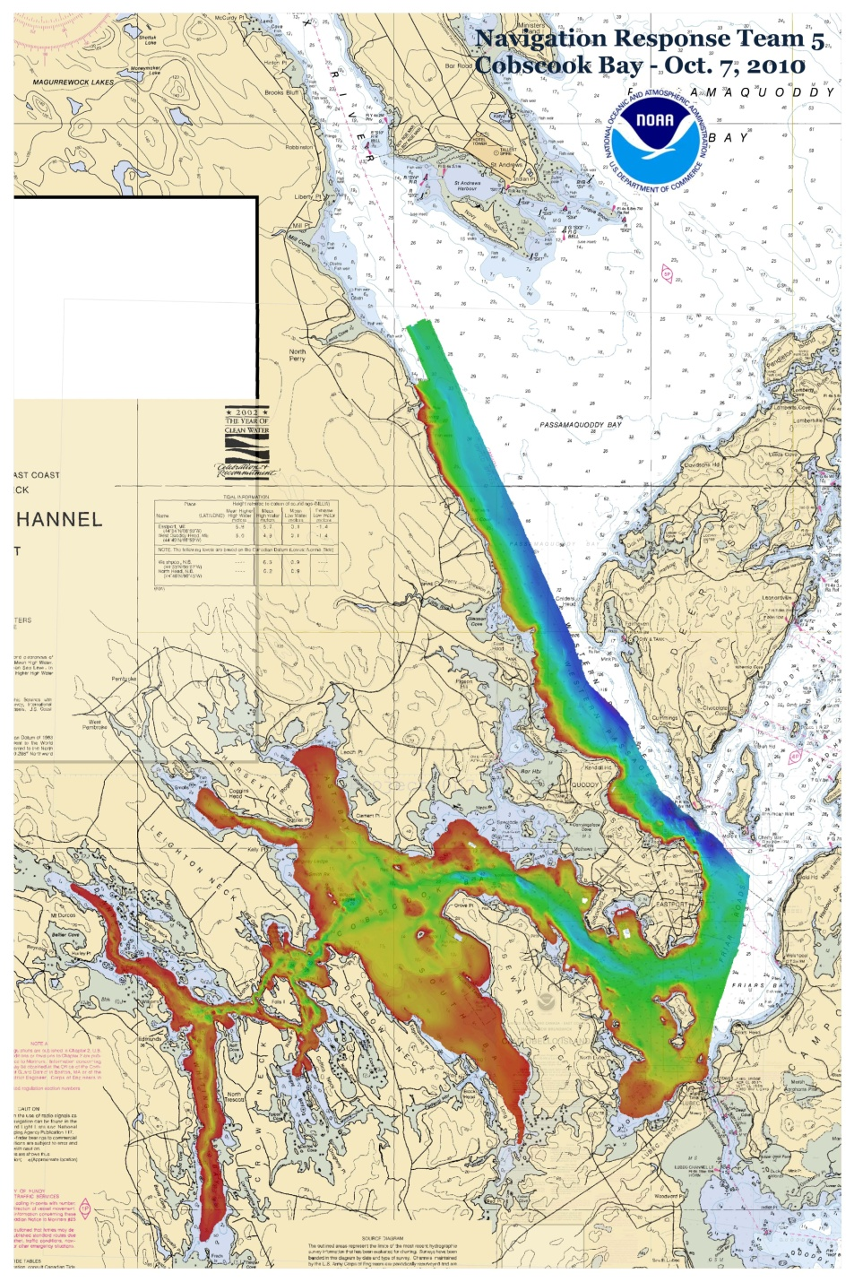
Assisting Maine fishing communities
16 men lost in vessel sinkings over 5 years
Coast Survey conducted sidescans last November, located wreck of All American
In April, Senators Collins and Snowe asked for “full bottom survey”
NRT 5 arrived in June, will complete multibeam survey by November

Slide 5
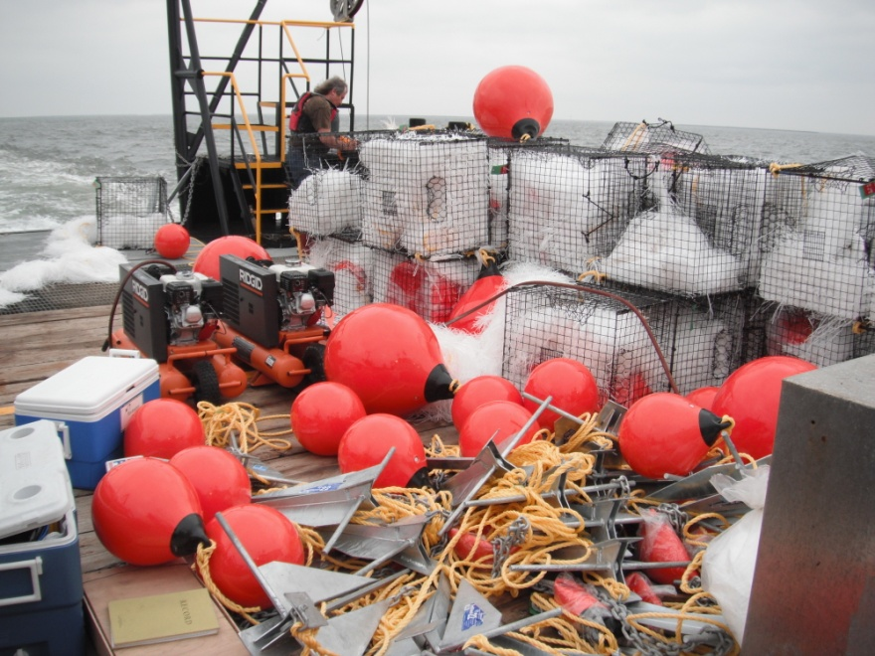
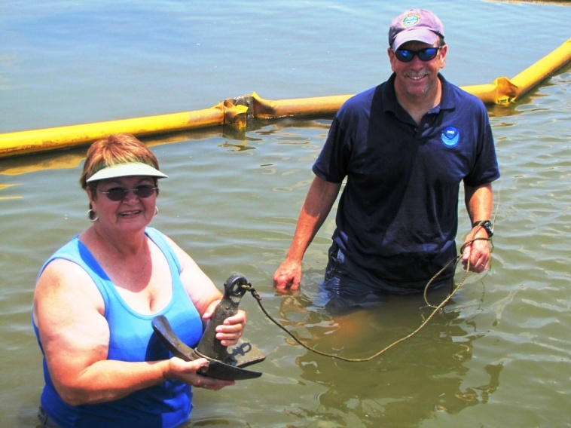
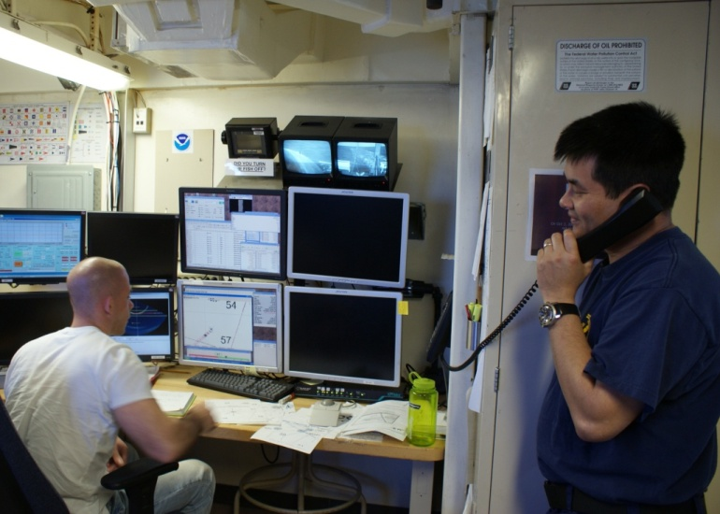
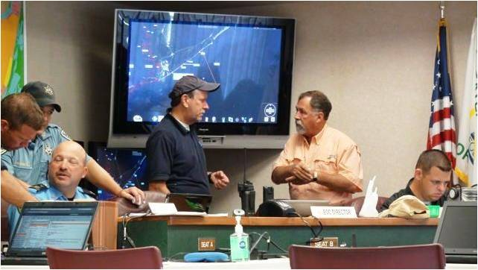
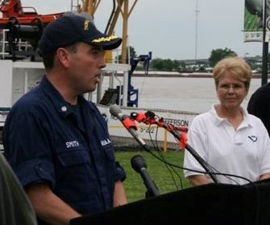
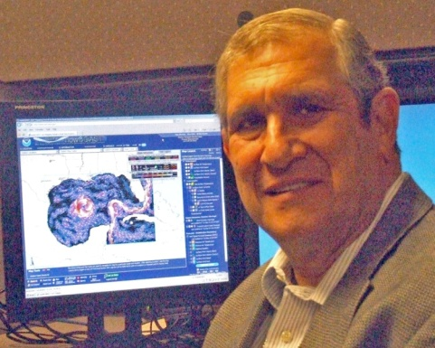
Hydrographic and cartographic experts contributed to BP spill response
Notes:
Alan Bunn retrieving water sample snares
Tim Osborn helping The Nature Conservancy lay boom
TJ staff collecting hydrography
Sean Legeer and Leland updating oil spill trajectory maps
Rich Patchen and the ERMA map that used Coast Survey models
Shep at a press conference with Dr. L prior to TJ deployment
Tim at Port Fourchon ICC Port Command

Slide 6
Sponsoring marine safety effort
Alliance members:
United States Power Squadron
C-MAP by Jeppesen
BoatU.S.
Sea Tow Foundation
OceanGrafix
In a poll:
Only 36% respondents “are concerned about the accuracy of the data used for navigation” enough that they “update navigational data regularly.
Keeping navigational aids up-to-date is not a priority to most recreational mariners.
Awareness and purchase of update data is low, as is the use of LNMs.
www.allianceforsafenavigation.org

Slide 7
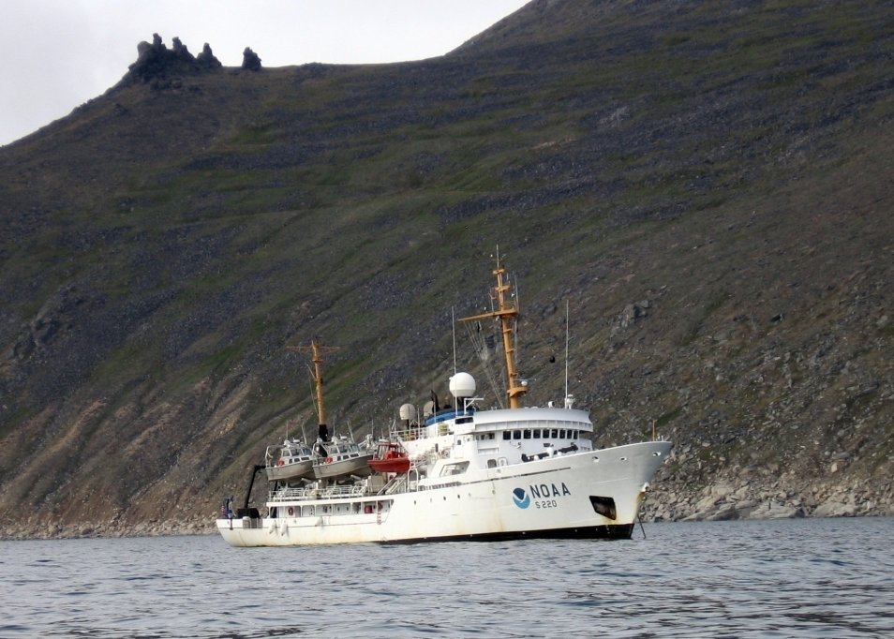
Making progress in the Arctic
Fairweather surveyed Bering Straits around Cape Prince of Wales
674 SNM of hydrographic data acquired in the Arctic in 2010
Marine Chart Division preparing an Arctic Nautical Charting Plan

Slide 8
Joining the new Arctic Regional Hydrographic Commission
U.S. delegation, October 6, 2010
Canada, Denmark, Norway, Russia, United States

