Slide 1
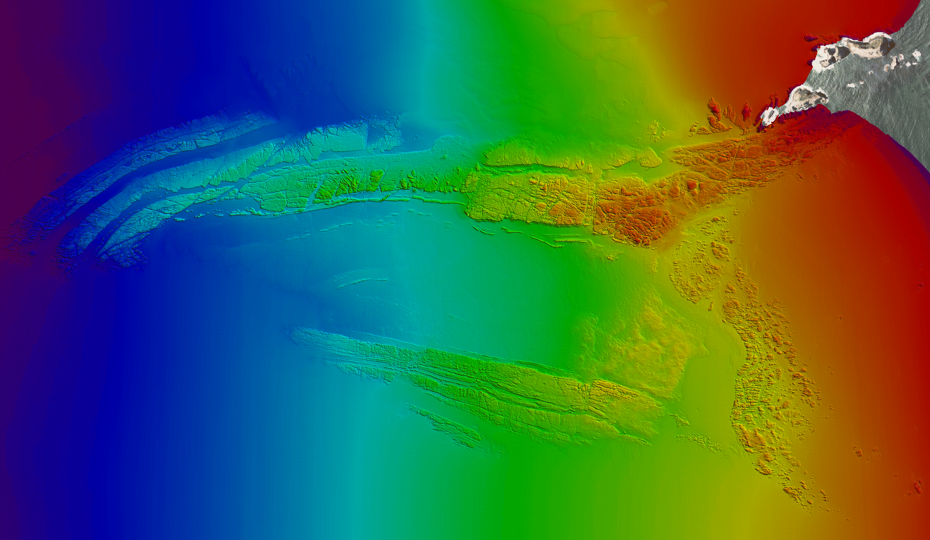
2010 HSRP Public Meeting
Oregon Coast Charting
James Coleman
David Evans and Associates, Inc.

Slide 2
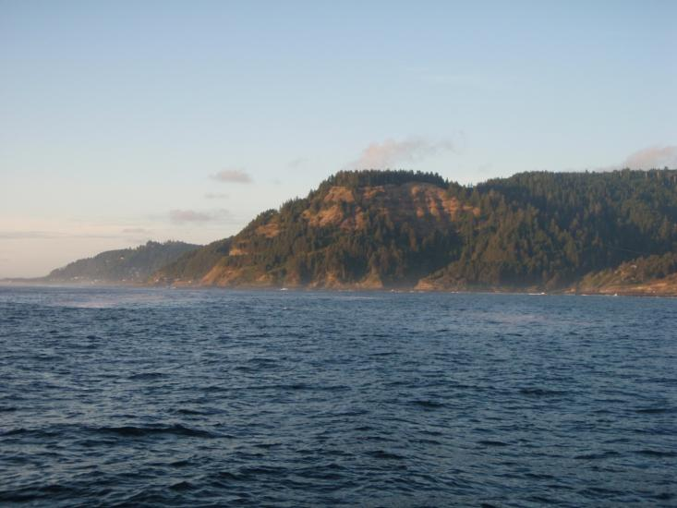
Neahkahnie Mountain

Slide 3
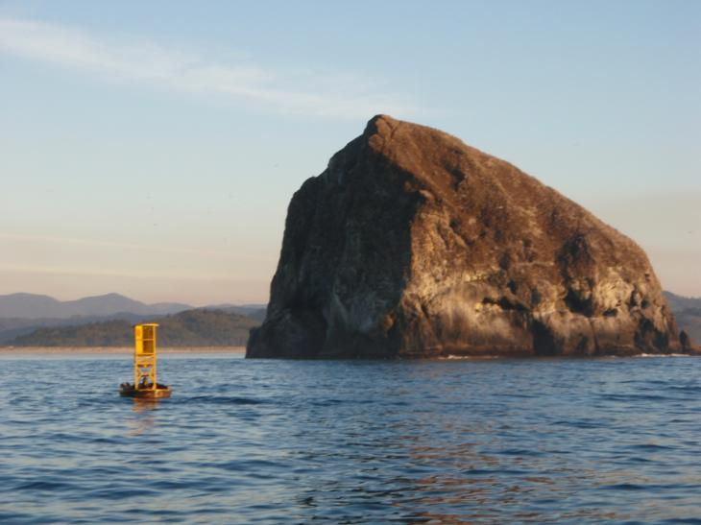
Haystack Rock near Pacific City

Slide 4
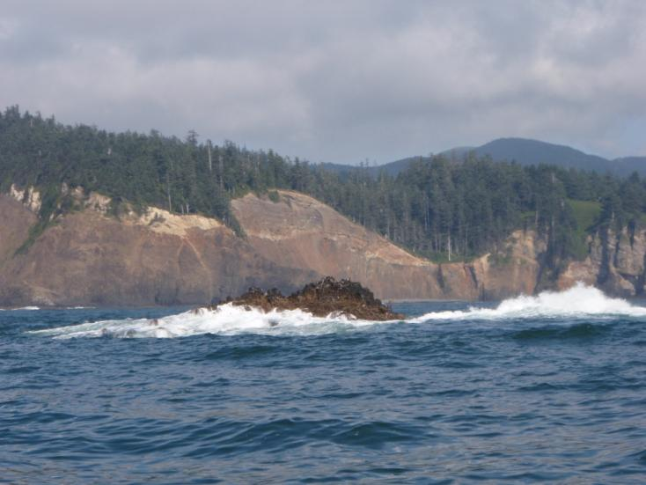
Falcon Rock

Slide 5
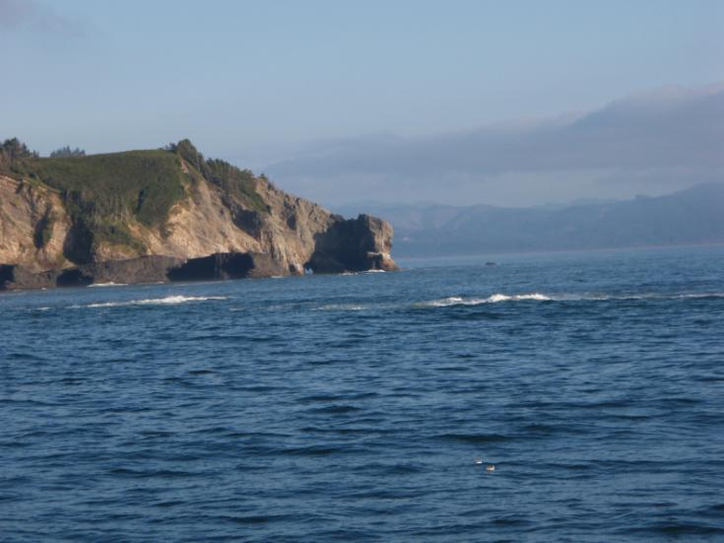
Awash rocks near Cape Falcon

Slide 6
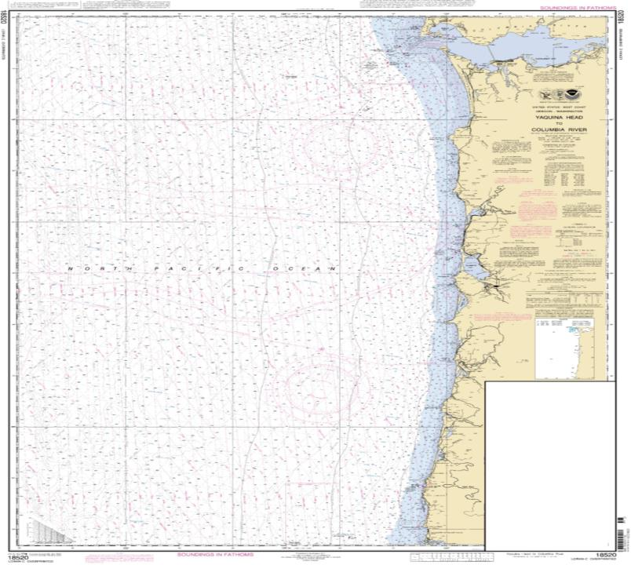
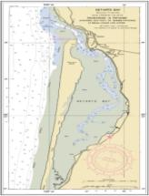
Notes:
Largest scale chart 80nmx100nm Newport to Cape Disappointment

Slide 7
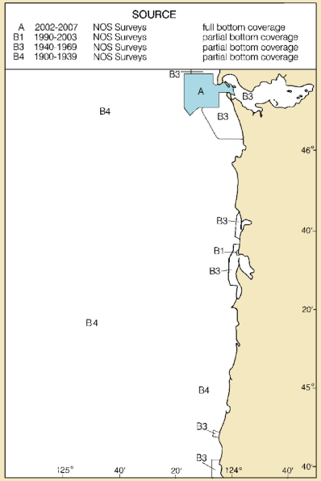
Notes:
Largest scale chart 80nmx100nm Newport to Cape Disappointment

Slide 8
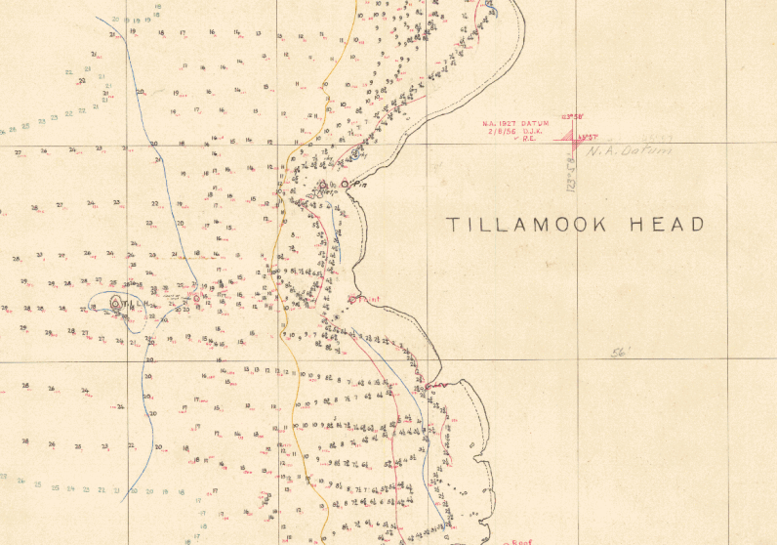
1927 Smooth Sheet

Slide 9
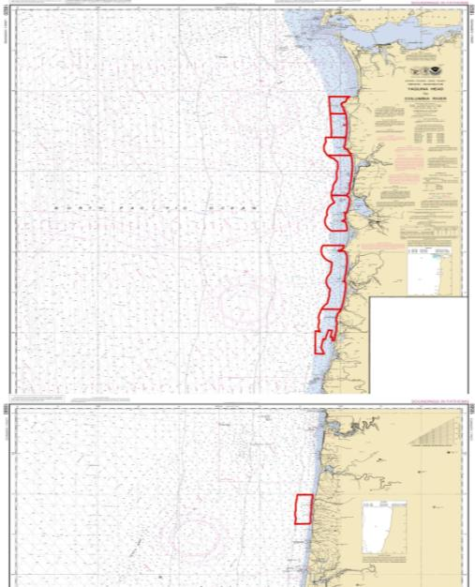
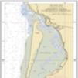
Oregon Coastal Mapping Project
West Coast Governor’s Agreement
8 Sheets
H12122 to H12129
8m to ~70m Depth
Multiple uses:
Nautical charting
Tsunami modeling
Marine Protected Areas
Commercial applications
Geologic mapping

Slide 10
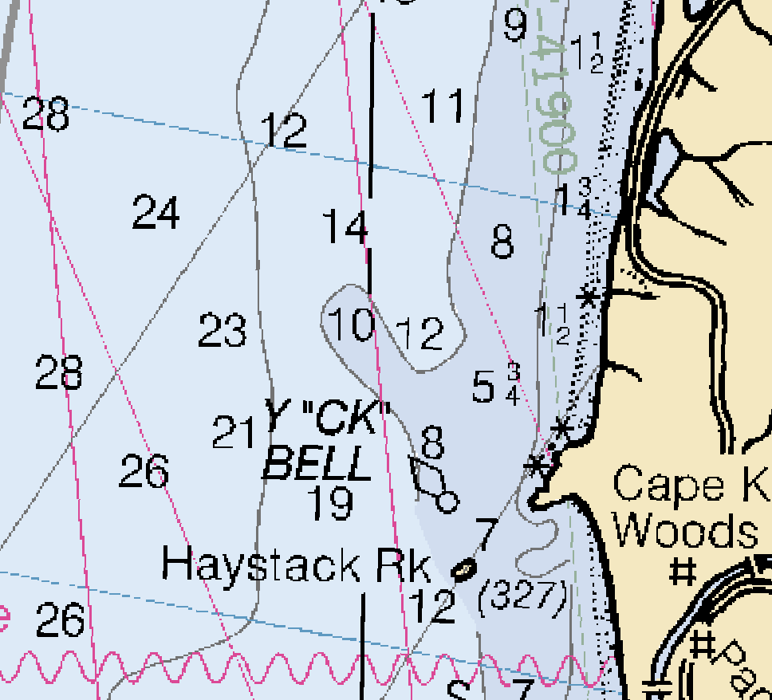
Nautical Chart 18520 near Pacific City

Slide 11
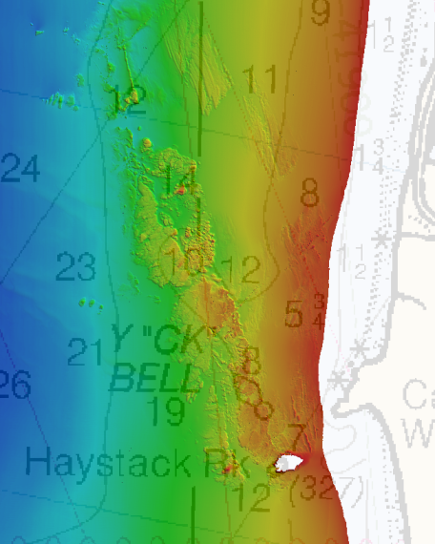
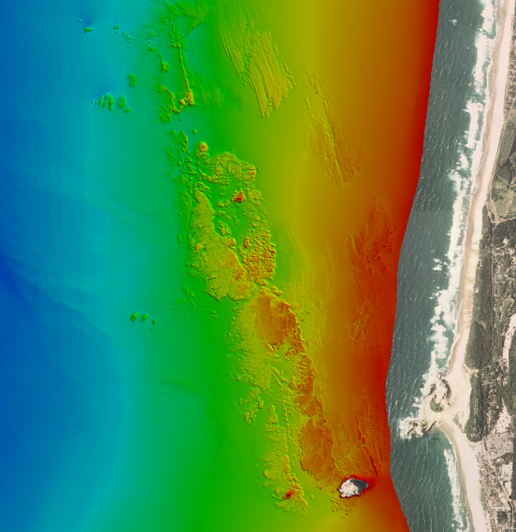
Seafloor near Pacific City

Slide 12
Seafloor near Pacific City

Slide 13
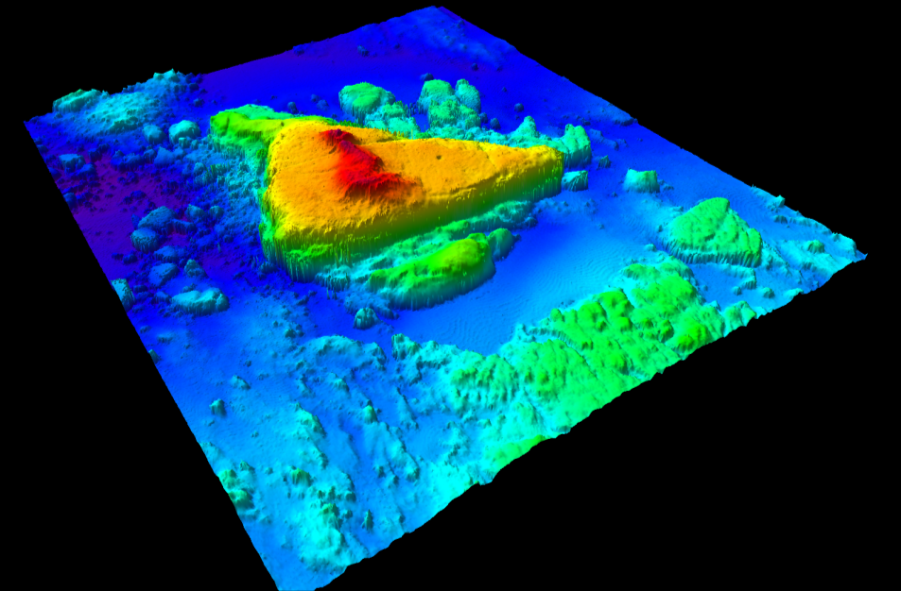
Uncharted Danger to Navigation

Slide 14
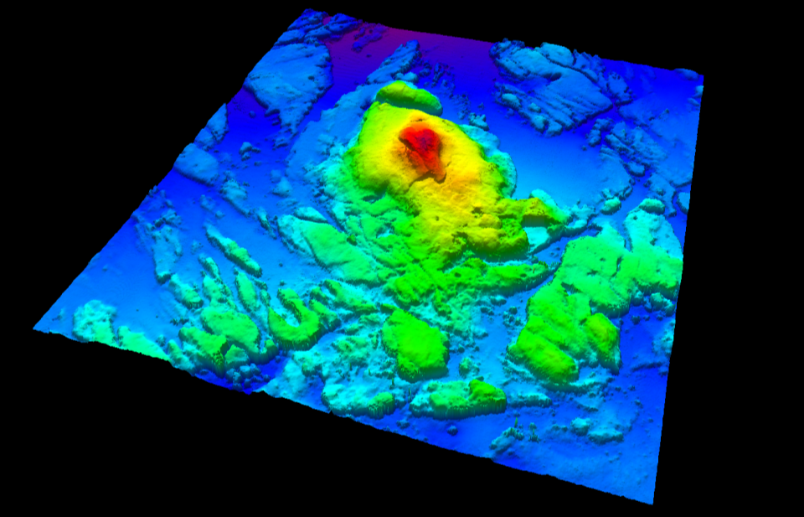
Uncharted Danger to Navigation

Slide 15
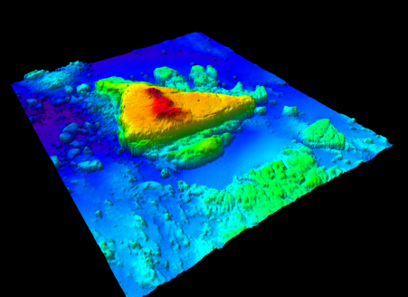
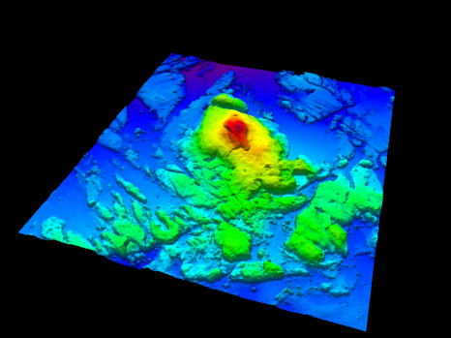
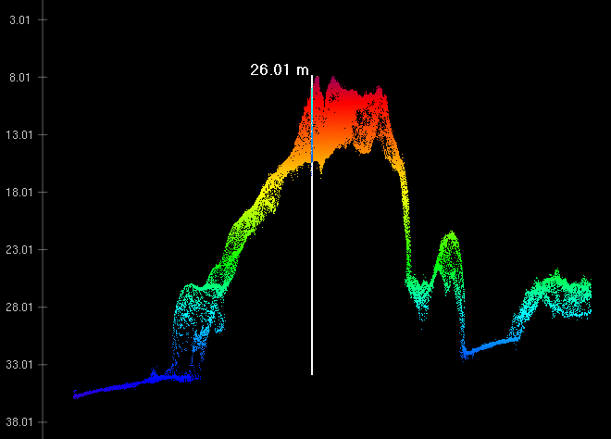
Uncharted Dangers to Navigation
Notes:
85-ft

Slide 16
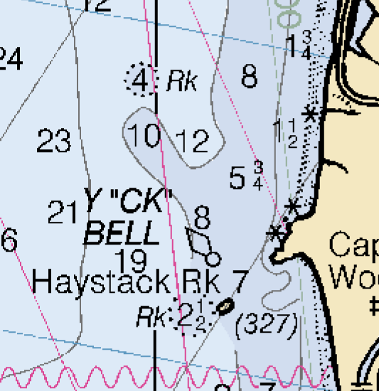
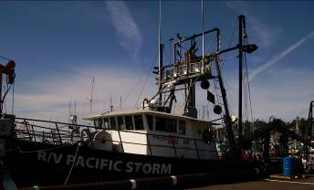
Updated Nautical Chart 18520
22 Dangers to Navigation identified
Over 8,000 nm of survey lines
100 days of survey

Slide 17
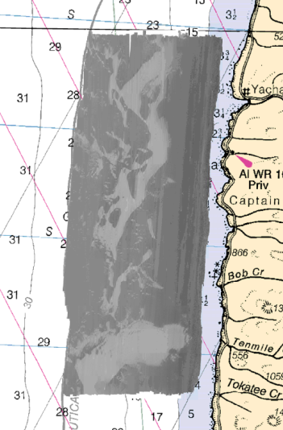
Integrated Ocean and Coastal Mapping
“Map Once… Use Many Times”
Inundation modeling
Habitat Mapping
Cable routes
Wave energy
Meeting this demand requires collecting to the highest accuracy and with the latest technology:
Multibeam sonar with backscatter
Moving vessel profiler
High accuracy horizontal and vertical positioning

Slide 18
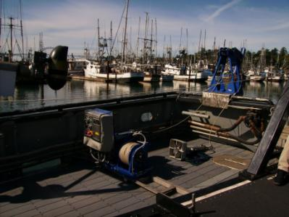
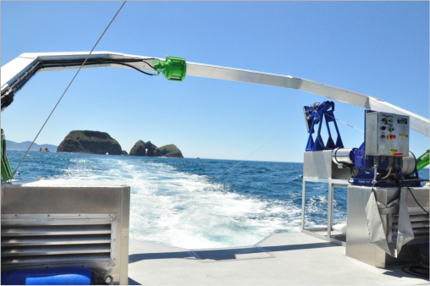
Addressing Sound Velocity Variability
Brooke Ocean Technology Moving Vessel Profiler (MVP)
AML Micro-SV Sensor
Seabird SBE-19 for comparison casts
Collected over 9400 individual sound velocity profiles

Slide 19
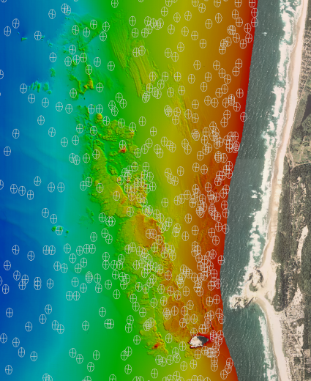
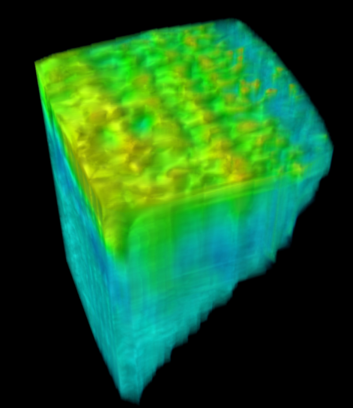
Addressing Sound Velocity Variability

Slide 20
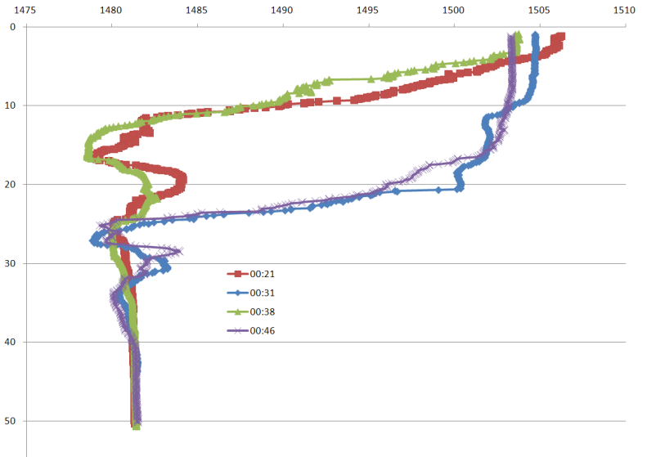
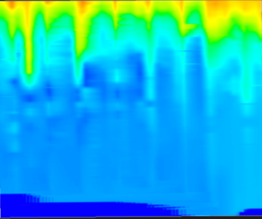
Addressing Sound Velocity Variability: Internal Waves?
Notes:
Aug16

Slide 21
Surveying on the Ellipsoid: ERS
Integrated Ocean and Coastal Mapping:
Reduce soundings to Mean Lower Low Water for Charting
Tie soundings to the national spatial reference system for other applications
Collect soundings relative to the ellipsoid, and use the VDatum model to reduce soundings to MLLW.
Requires high accuracy vertical positioning
Utilized inertial-coupled post-processed kinematic GPS positioning.
Applanix SmartBASE solution from a network of existing NGS CORS and UNAVCO GPS reference stations.

Slide 22
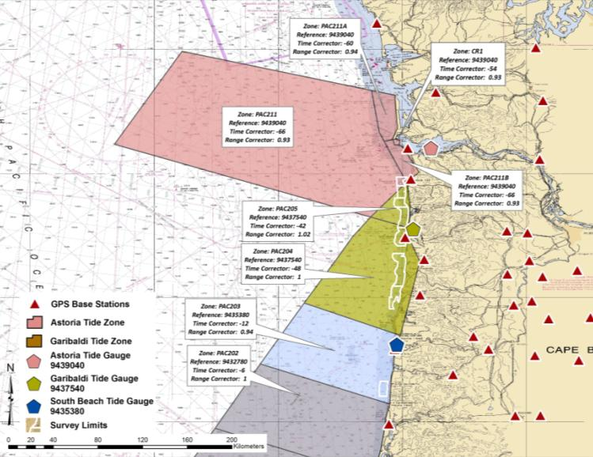
Traditional Tide Zones & Gauges
Astoria Measured Water Level
Garibaldi Measured Water Level
Notes:
This is zoned…. Not related to measurements at the boat…

Slide 23
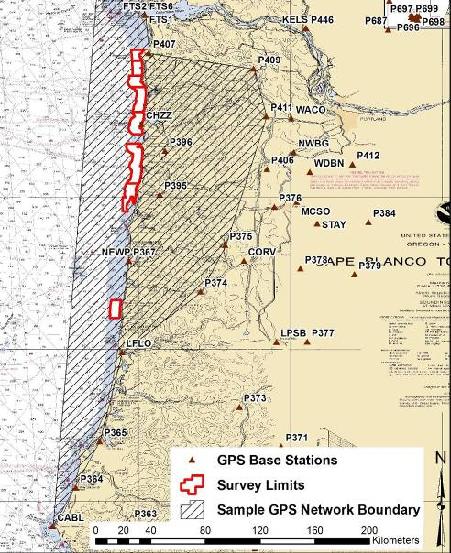
GPS Stations & Network Boundary
Continuously Operating Reference Stations
NGS CORS
UNAVCO
Precise Ephemeris
Applanix SmartBASE
Average of 10 Base Stations per Sheet
Applied separation model derived from VDATUM
NAD83 to MLLW
GEOID 03

Slide 24
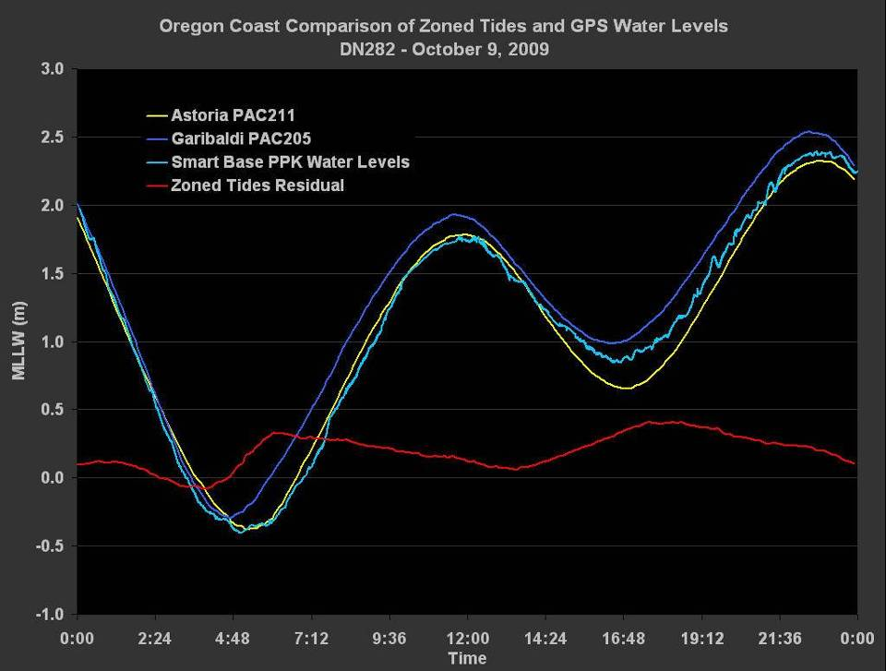

Slide 25
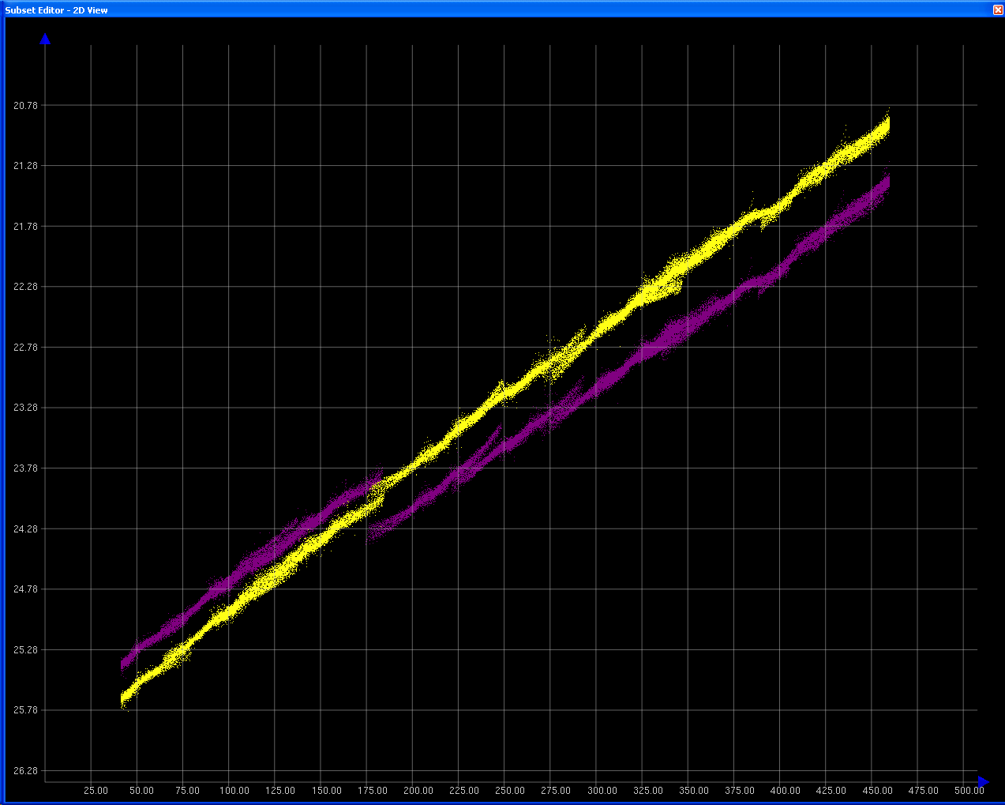
ERS Tides and Zoned Tides: Subset View
ERS Tides
50cm Bust
Zoned Tides

Slide 26
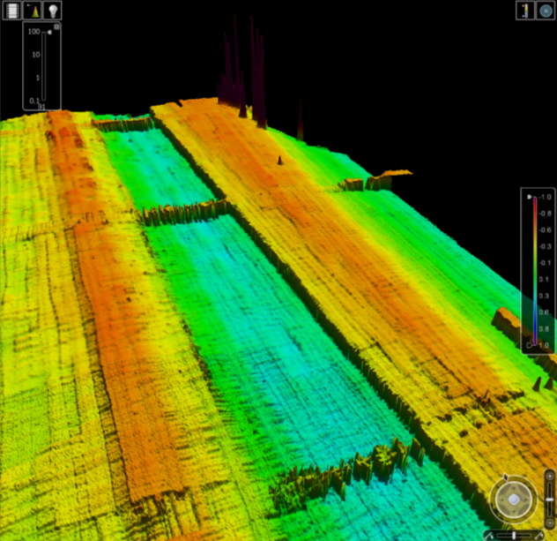
ERS Tides and Zoned Tides
Location 1

Slide 27
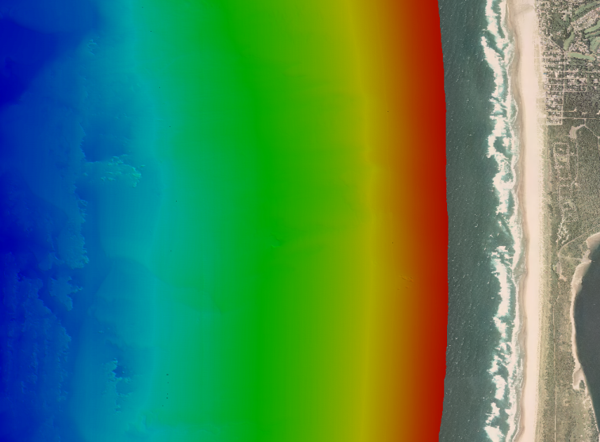
Surveying close to shore…

Slide 28
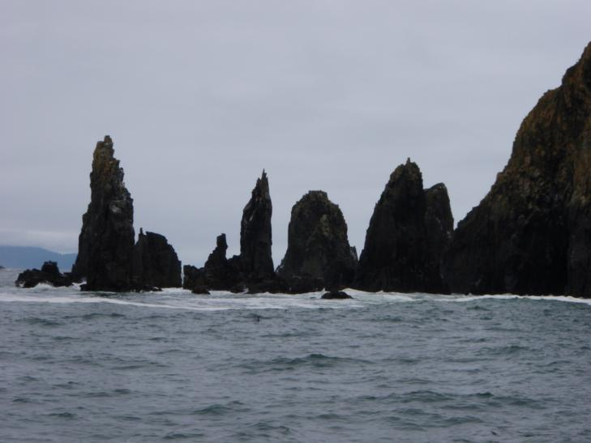
Surveying close to shore…

Slide 29
R/V Jab

Slide 30
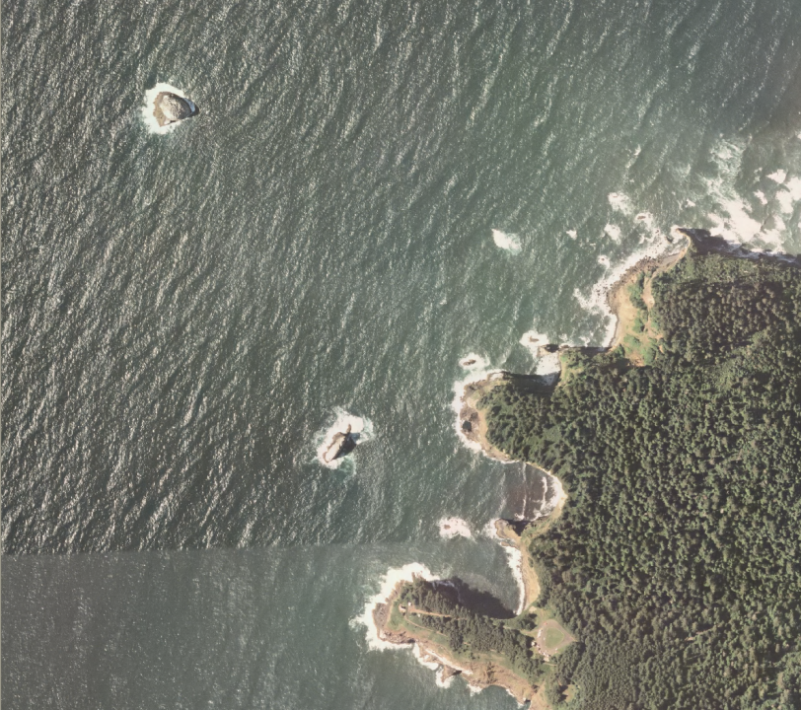

Slide 31
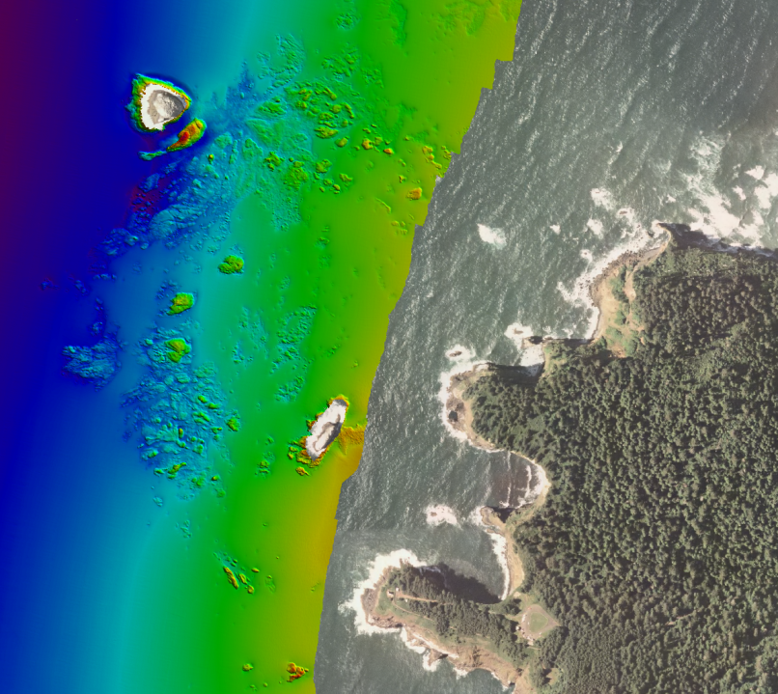

Slide 32
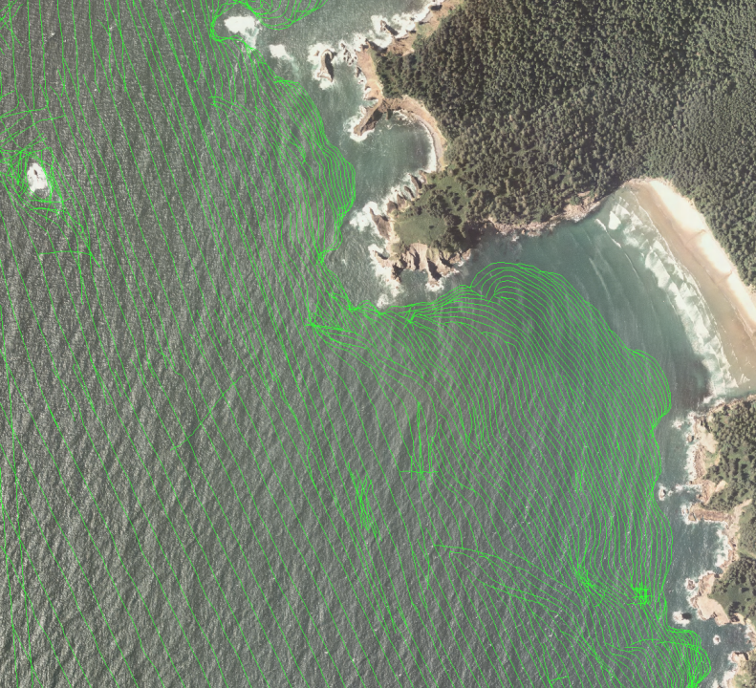

Slide 33
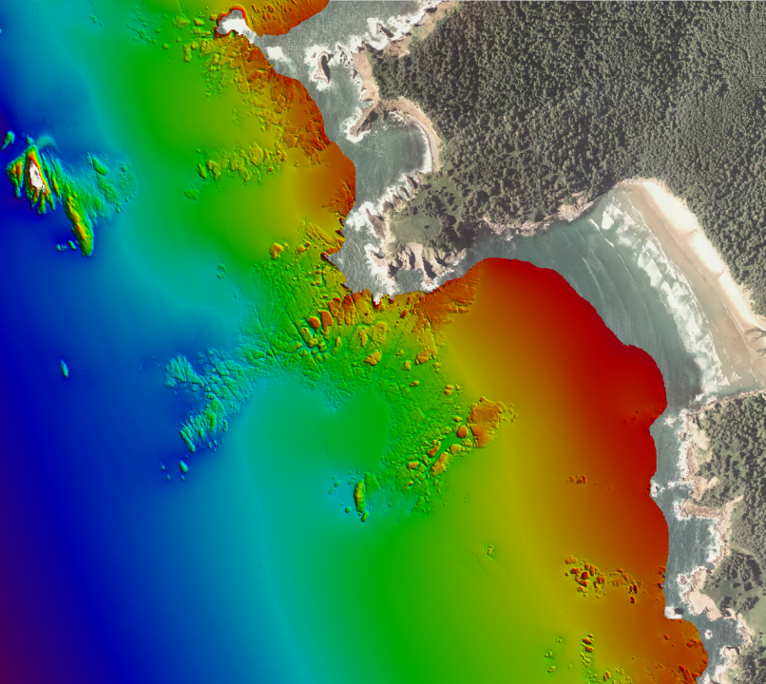

Slide 34
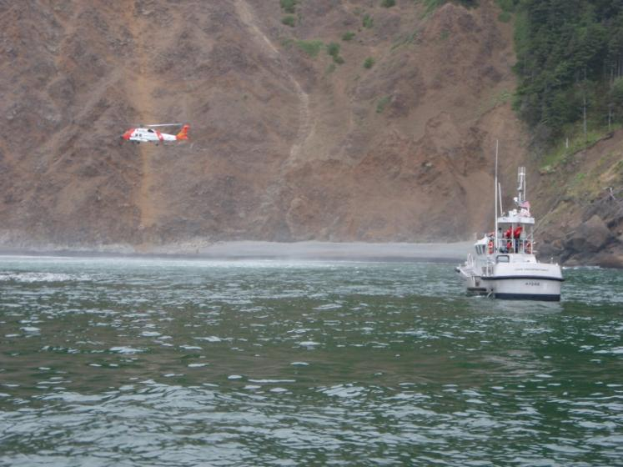
A Little Lagniappe…

Slide 35
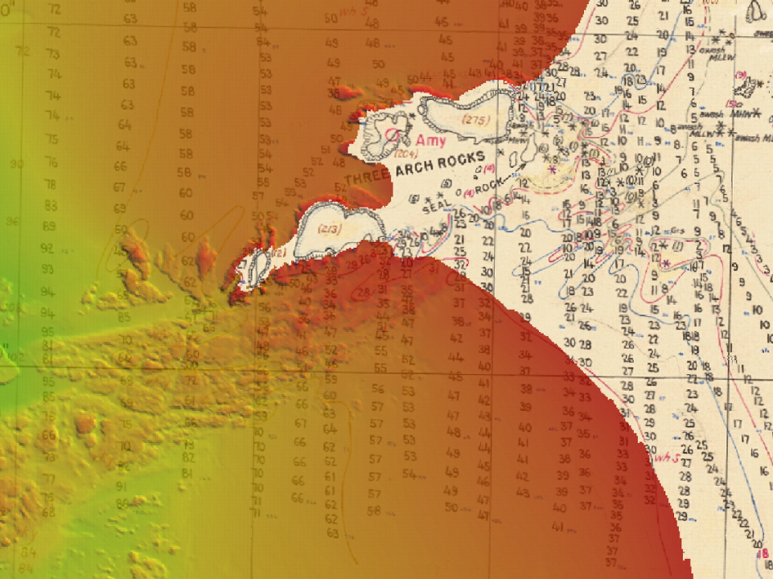
Thank You

Slide 36
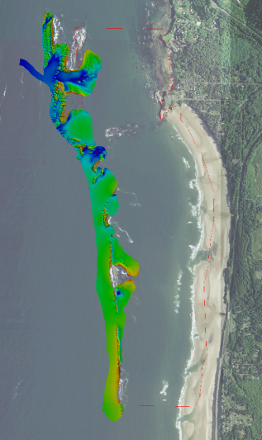
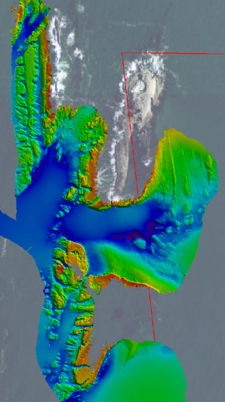
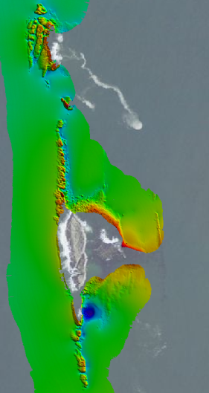
Otter Rock

Slide 37
