Slide 1
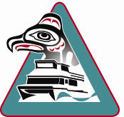
Allen Marine Tours
Angie Thrower, Staff Captain
Hydrographic Services Review Panel
Stakeholder Perspectives
August 28, 2018

Slide 2
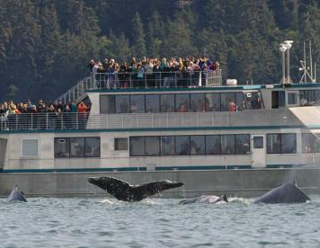
Local, family owned
Allen Marine Tours, Alaskan Dream Cruises, Allen Marine Industries
Day tours, overnight cruises, charters, transportation
450 seasonal employees, 150 year round
Operate over 35 USCG Certified passenger vessels
Current tour range of 300 nautical miles, including remote access to
Tracy Arm
Glacier Bay
Misty Fjords

Slide 3
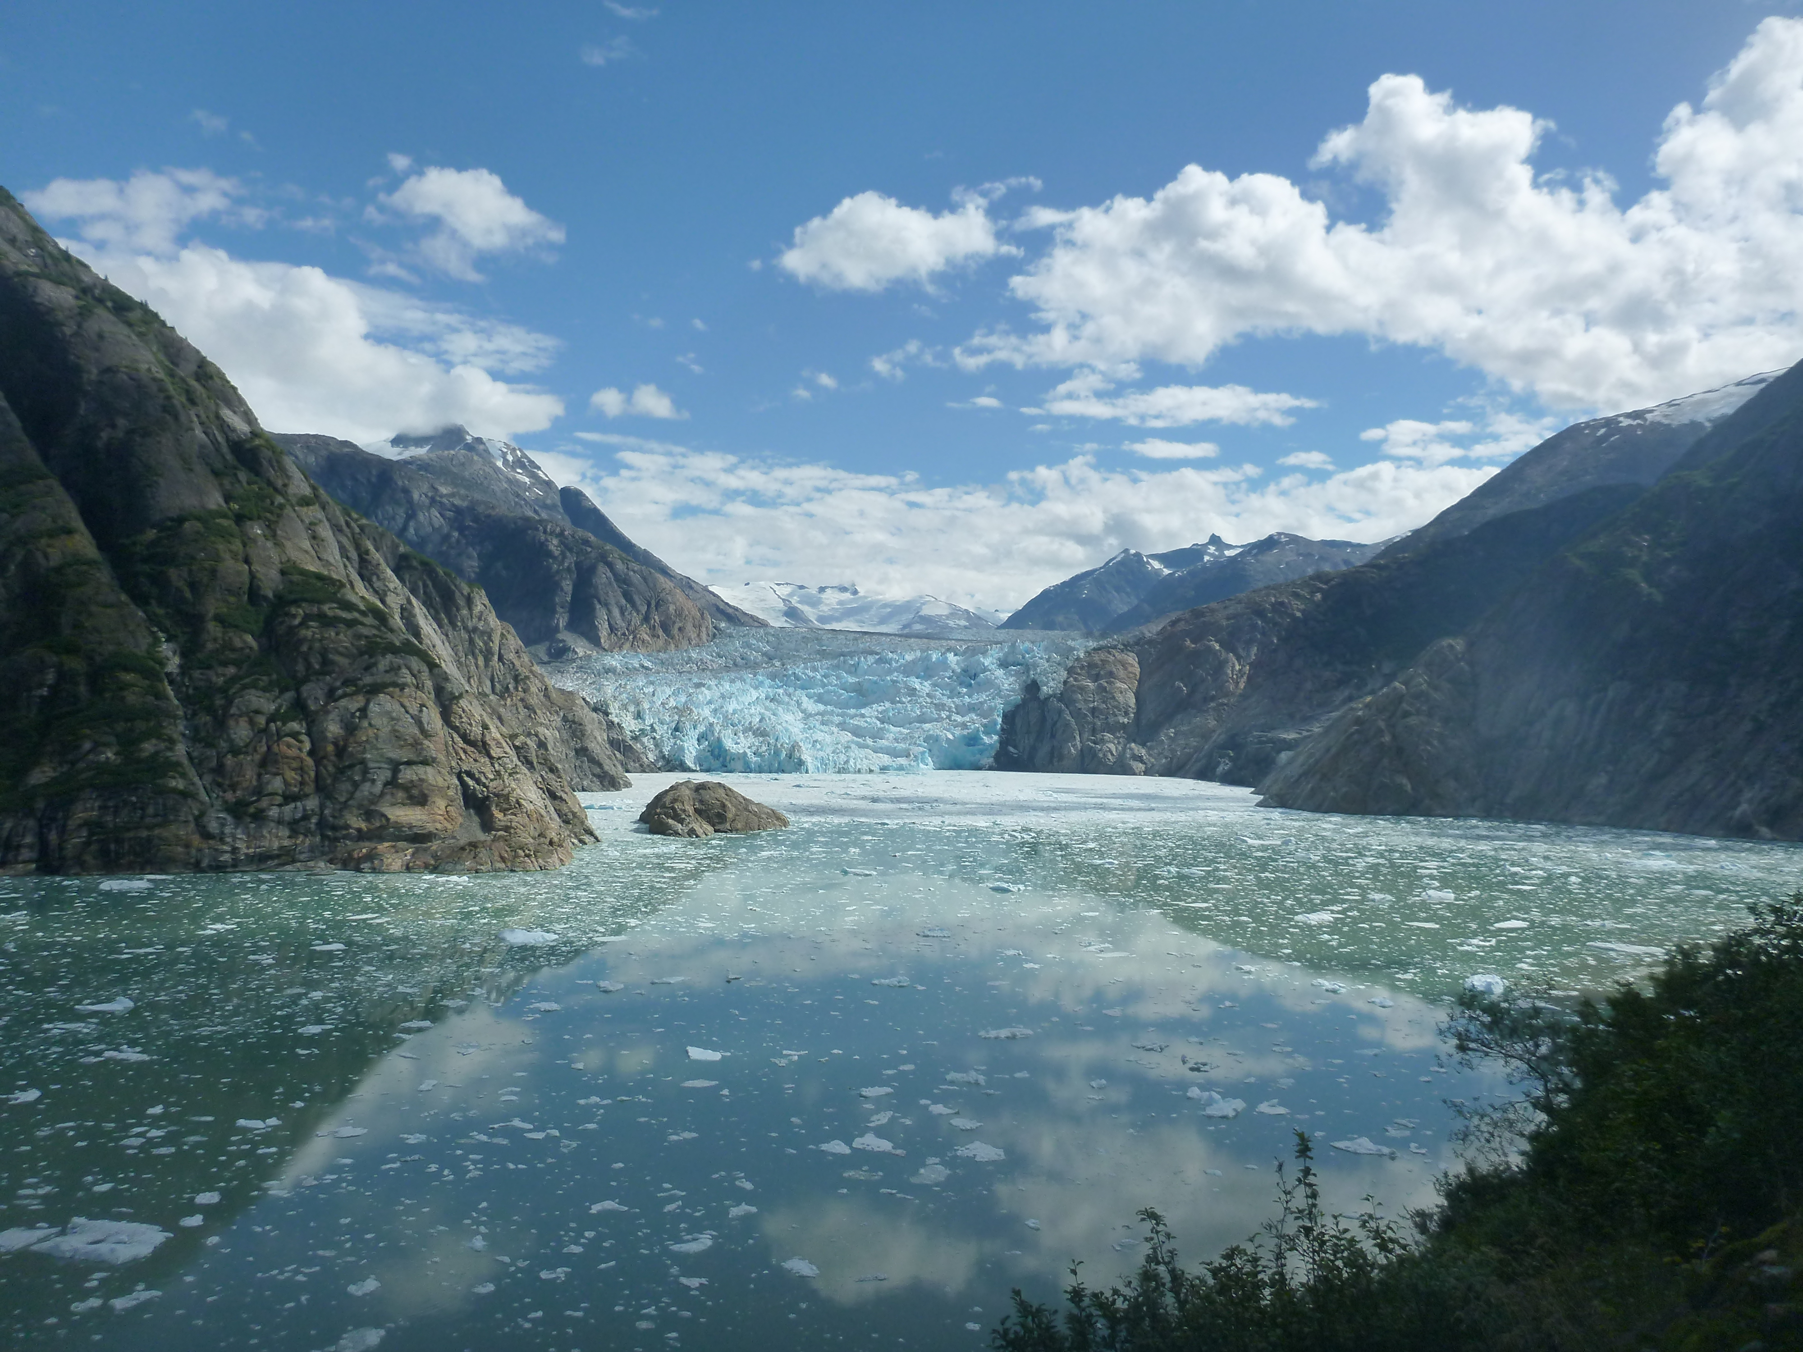
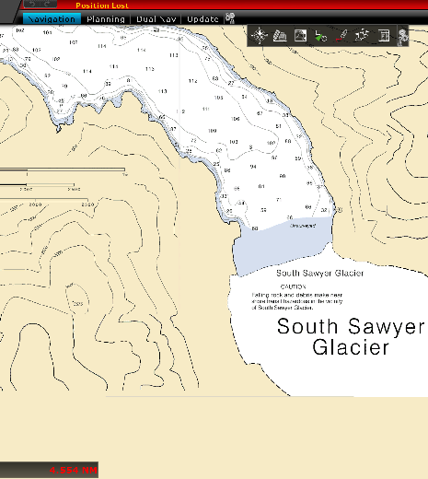
Daily Use of NOAA Services
Southeast Alaska Marine Observations
Used daily by all fleet Captains, management and remote-site staff
Used to make weather-based safety decisions
Marine Forecast
Used daily by all fleet Captains and management
Informs vessel movements between ports
Assists in decision-making for tour expansion
Nautical Charts
Actively used at all times by all Captains in all ports
Determines site-specific safety protocols
Assists in decision-making for tour expansion

Slide 4
Requests for NOAA Navigation Services & AOOS Data
Midway Islands (Stephens Passage) weather observation station
Up-to-date surveys of glacial fjords, sandbars, areas of interest

Slide 5
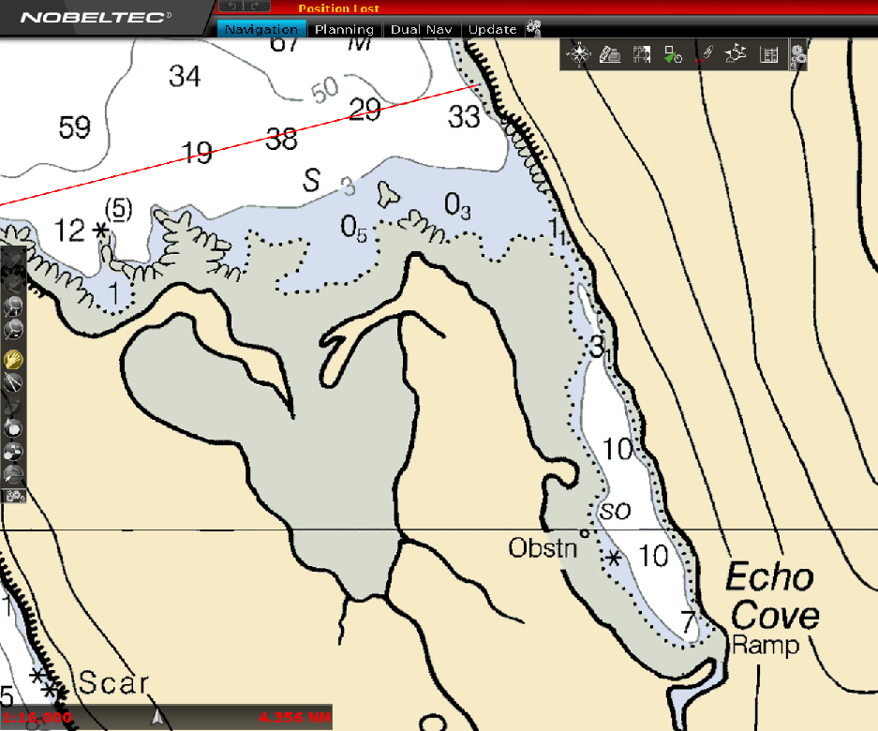
Responsive to a State of Change
Accuracy increases safety, reliability - increases consumer confidence
Opens areas of interest and opportunity – tourism futures

Slide 6
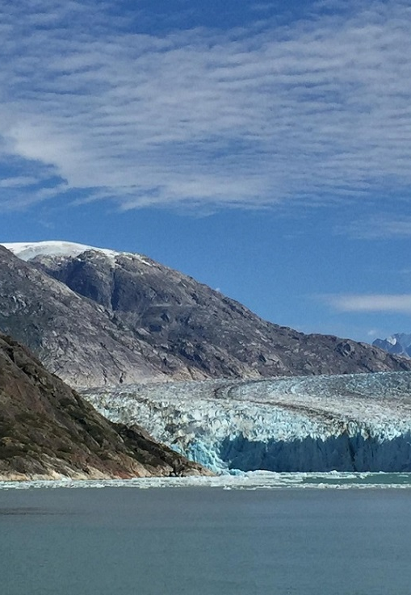
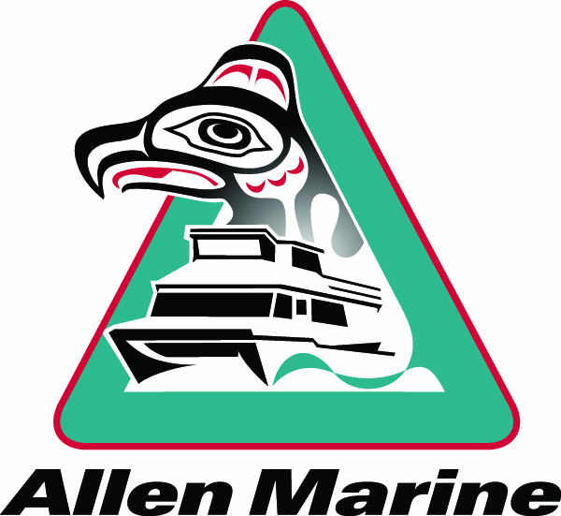
Contact Information:
Capt. Angie Thrower
Allen Marine Tours
athrower@allenmarine.com

