Slide 1
COORDINATION OF INTEGRATED AND INTER-AGENCY COASTAL WATER LEVEL OBSERVATIONS FOR ALASKA
Jacquelyn Overbeck
State of Alaska Department of Natural Resources
Division of Geological & Geophysical Surveys
Lewis Amik III Native Village of Kwigillingok

Slide 2
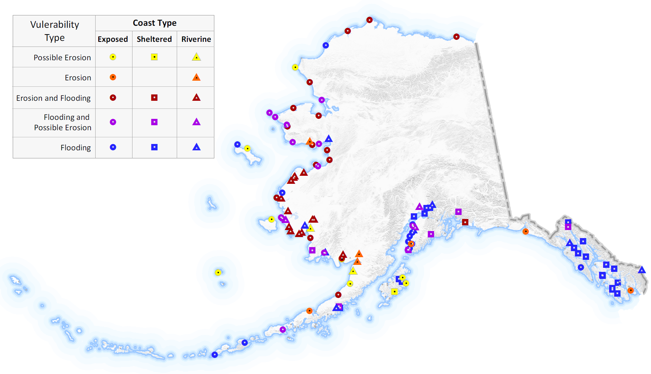
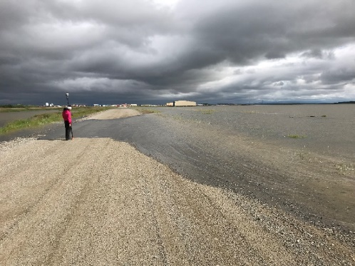
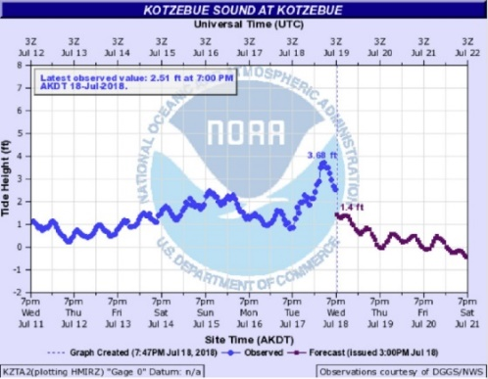
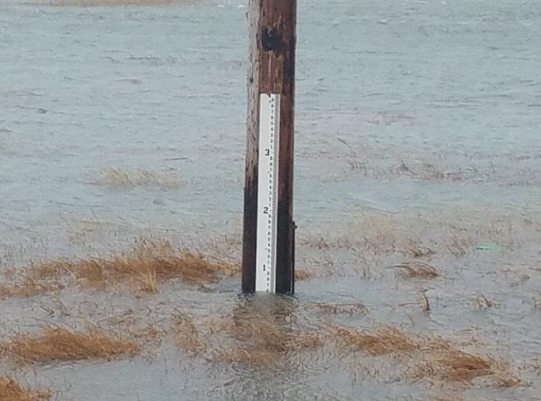
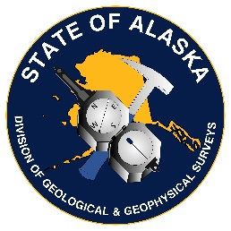
STATE OF ALASKA COASTAL HAZARDS PROGRAM
Alaska Coastal Hazards Program
Mapping, Monitoring, and Modeling Coastal Flooding and Erosion throughout Alaska
ALASKA WATER LEVEL WATCH

Slide 3
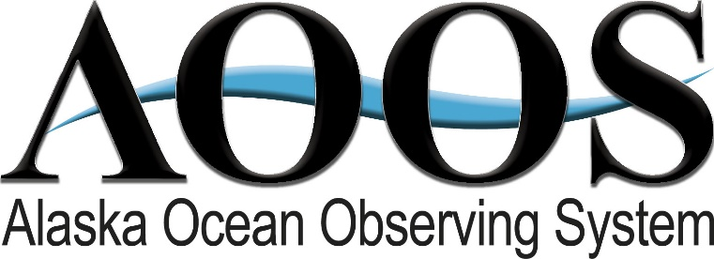
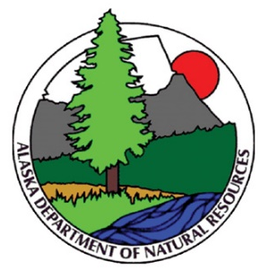
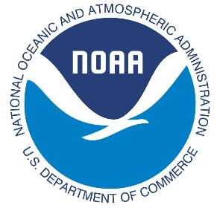
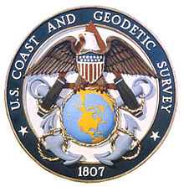
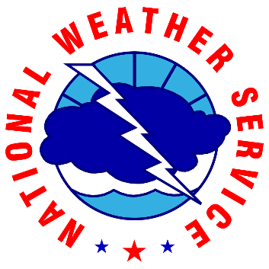
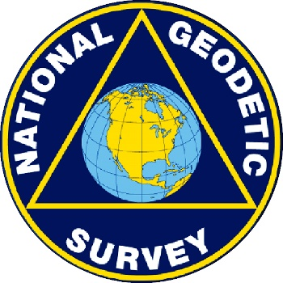
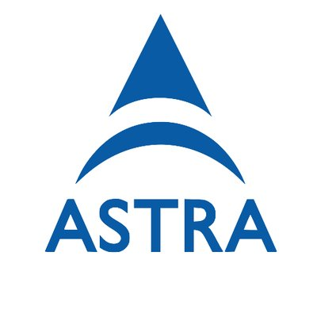
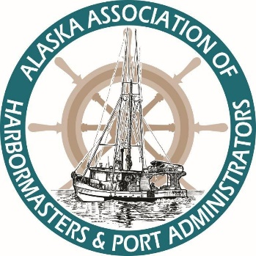
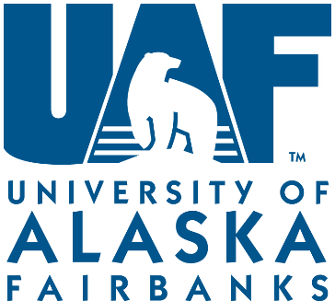
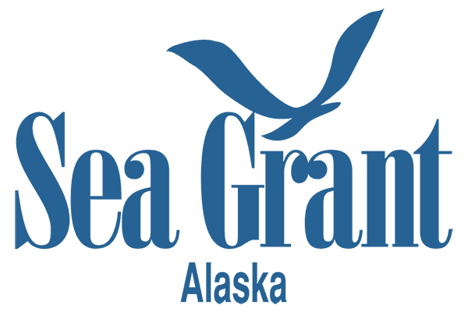
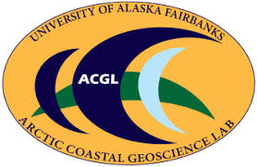
Alaska Water Level Watch is a collaborative group working to improve the quality, coverage, and accessibility to water level observations in Alaska’s coastal zone.
https://www.aoos.org/alaska-water-level-watch/
ALASKA WATER LEVEL WATCH

Slide 4
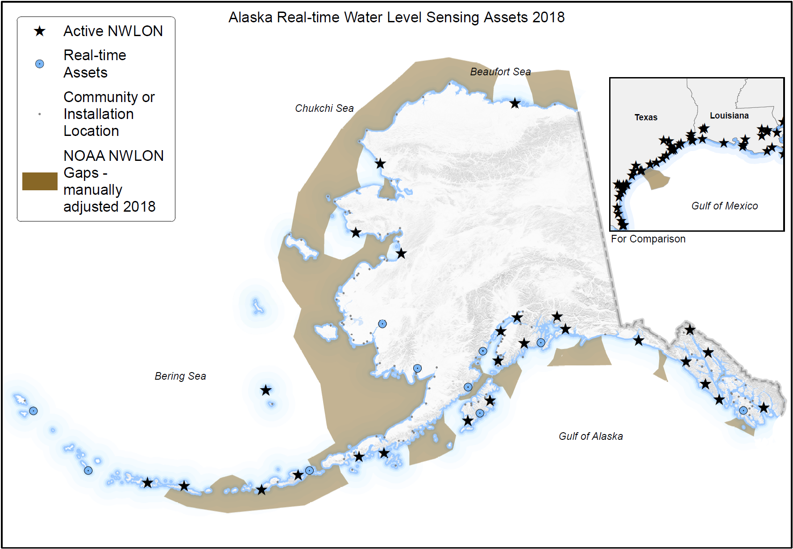
INTER-AGENCY MEETINGS TO DISCUSS COASTAL WATER LEVEL PRIORITIES
Meetings held May 2015 (initiation) and 2018 (follow up and progress to-date)
Technology and User Needs Gaps for coastal water level data and products.
Participants including state and federal agencies, private sector, non-profits, Native organizations.
Strategies moving forward including the development of summary documents and a build-out plan.
ALASKA WATER LEVEL WATCH

Slide 5
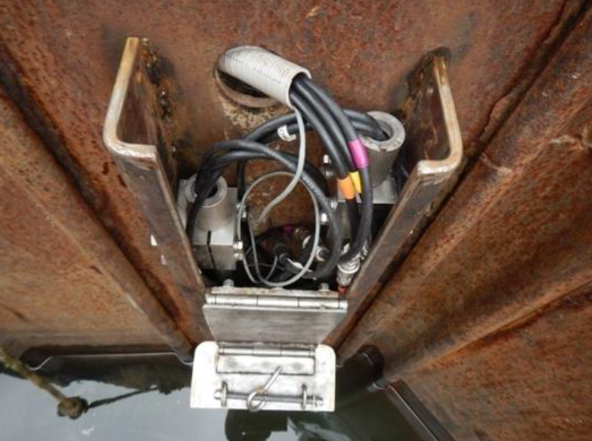
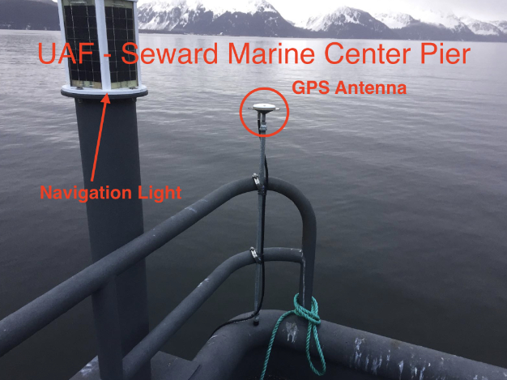
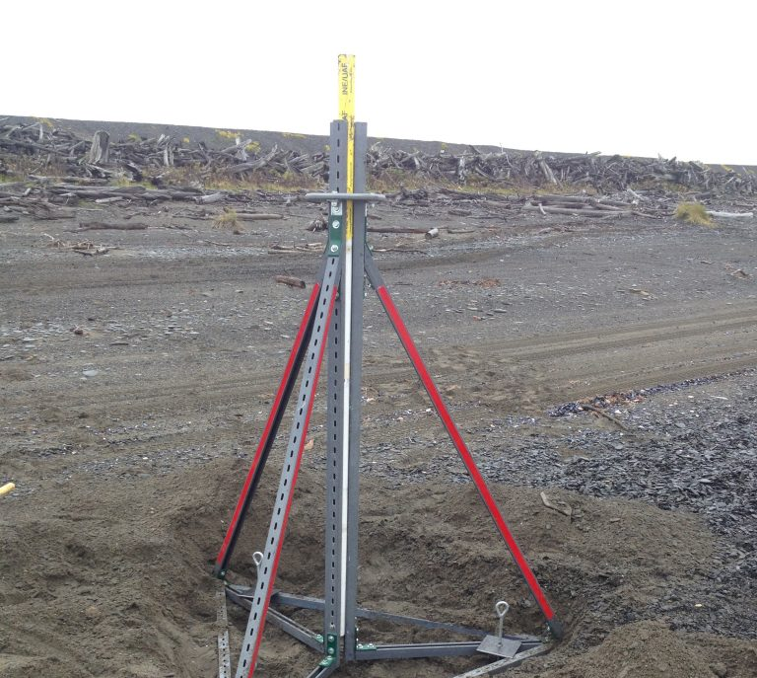
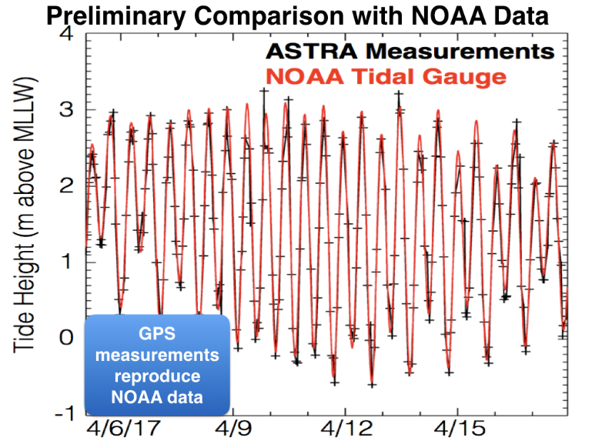
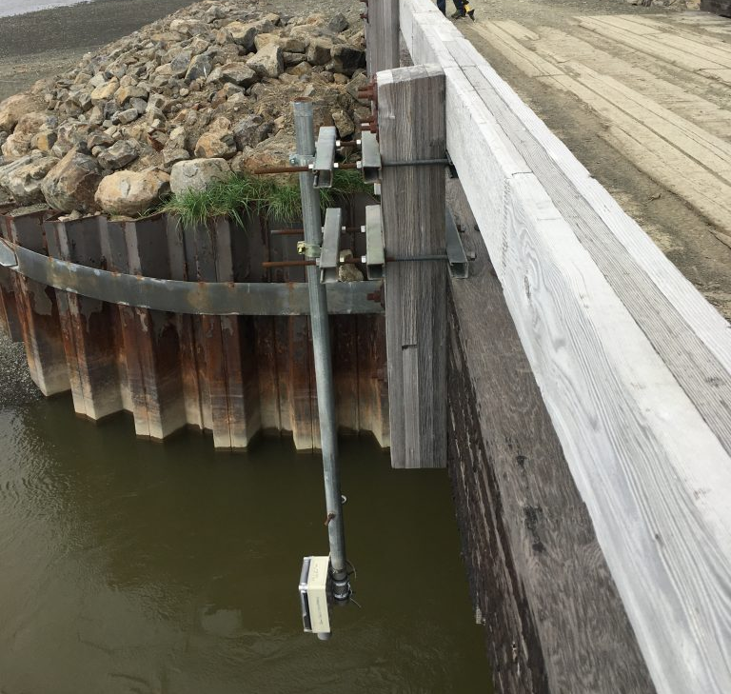
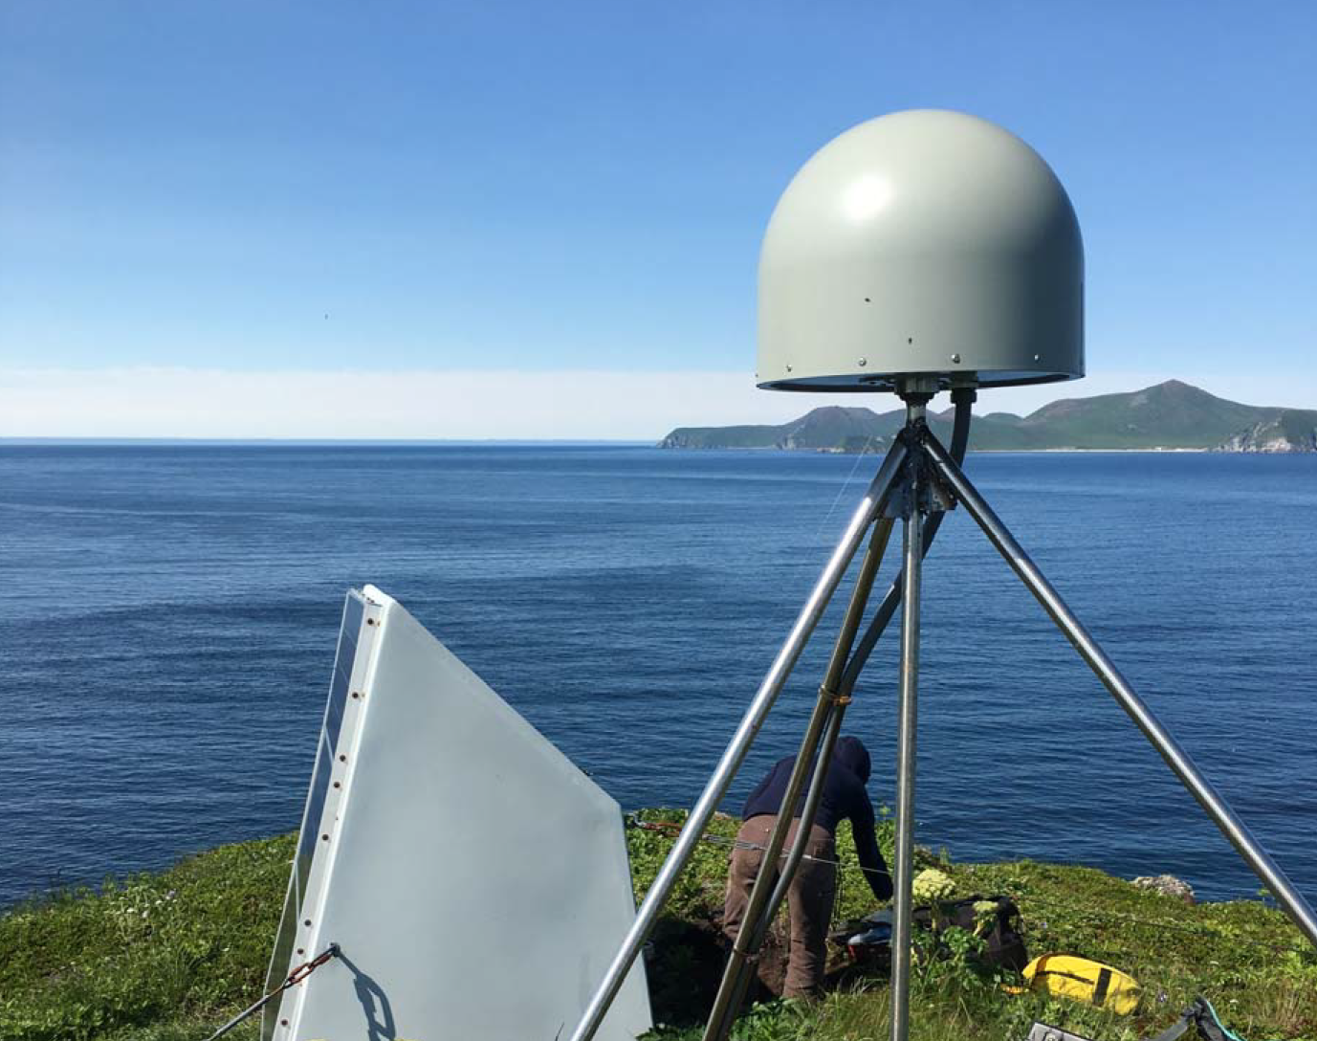
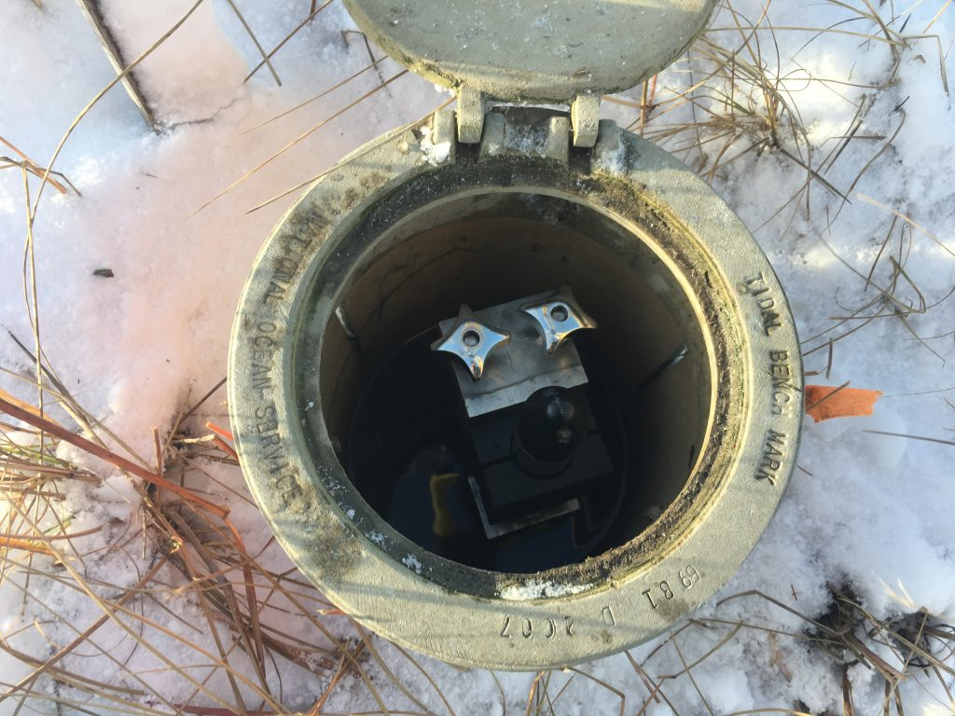
WATER LEVEL TECHNOLOGIES DEVELOPMENT
REAL-TIME
RAPID RESPONSE
NOAA Unalakleet NWLON
ASTRA GNSS Antenna
UAF pressure transducer tripod
APRFC Ultrasonic iGage
JOA pressure transducer mount
UNAVCO GNSS Antenna (CORS)
ALASKA WATER LEVEL WATCH

Slide 6
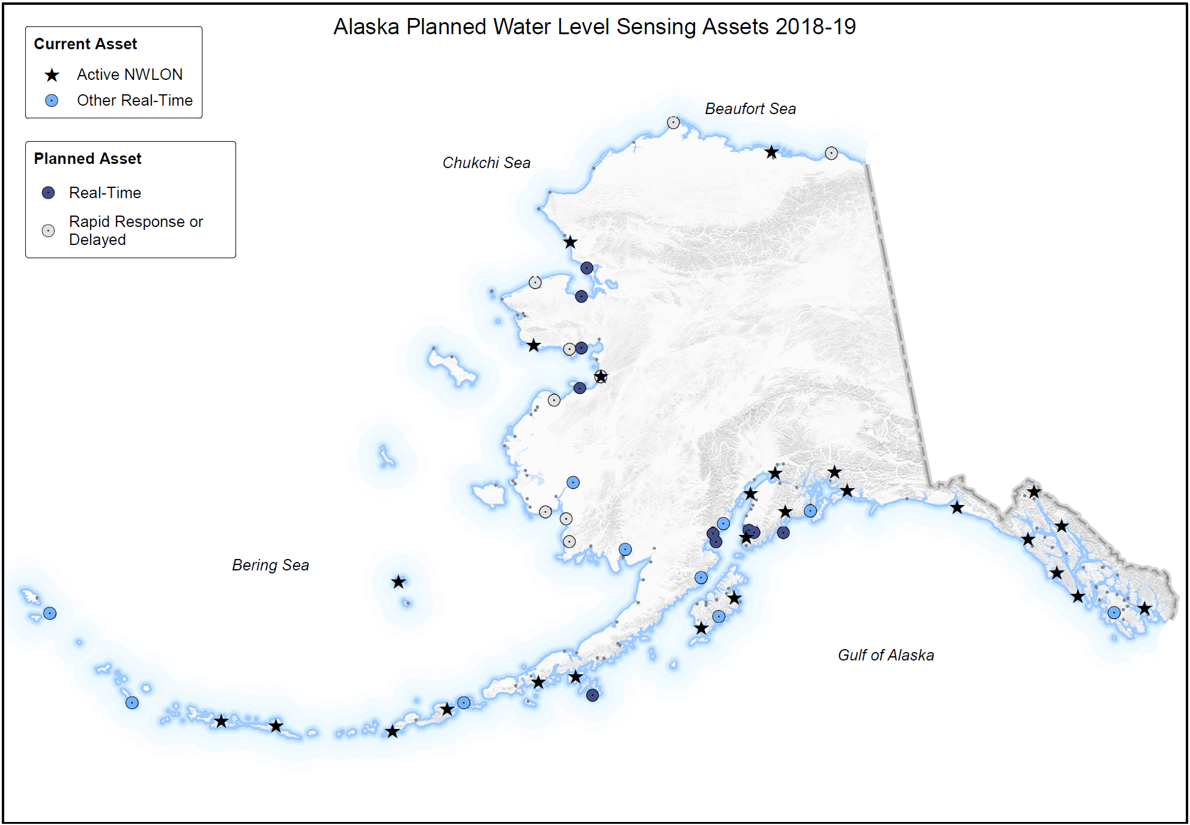
ALASKA WATER LEVEL WATCH

Slide 7
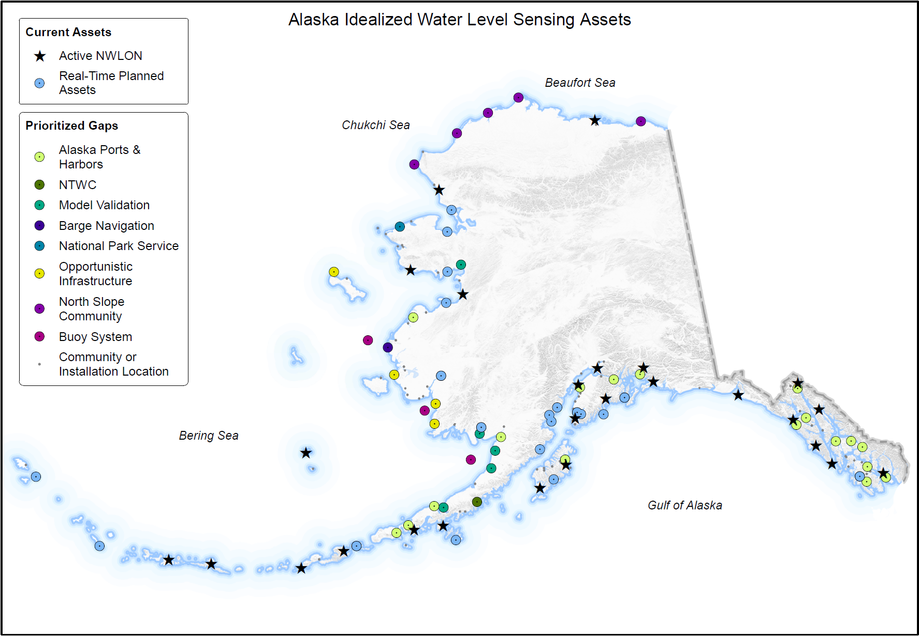
ALASKA WATER LEVEL WATCH

Slide 8
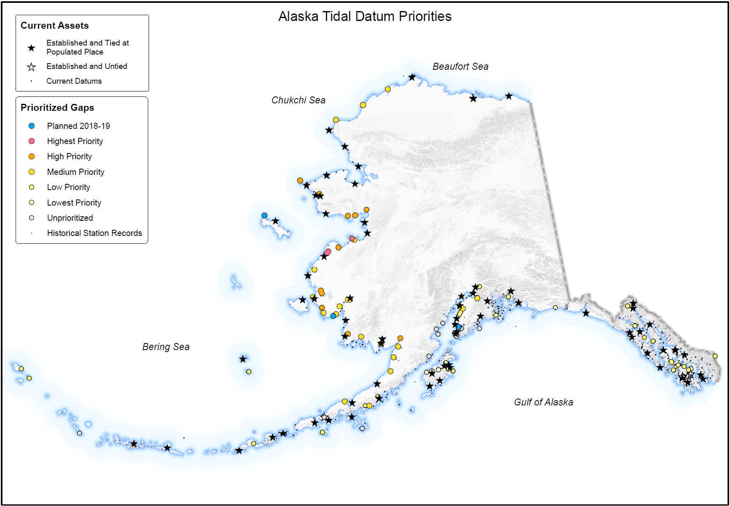
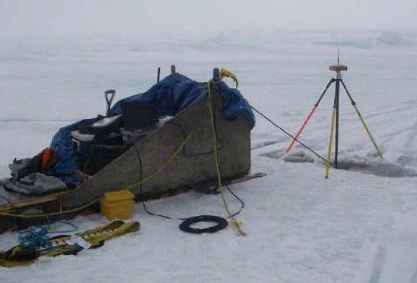
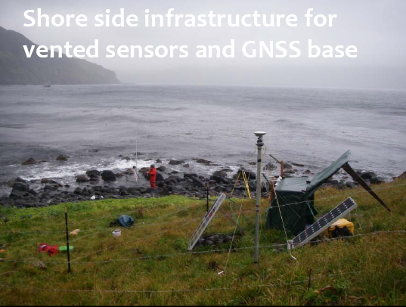
ALASKA WATER LEVEL WATCH

Slide 9
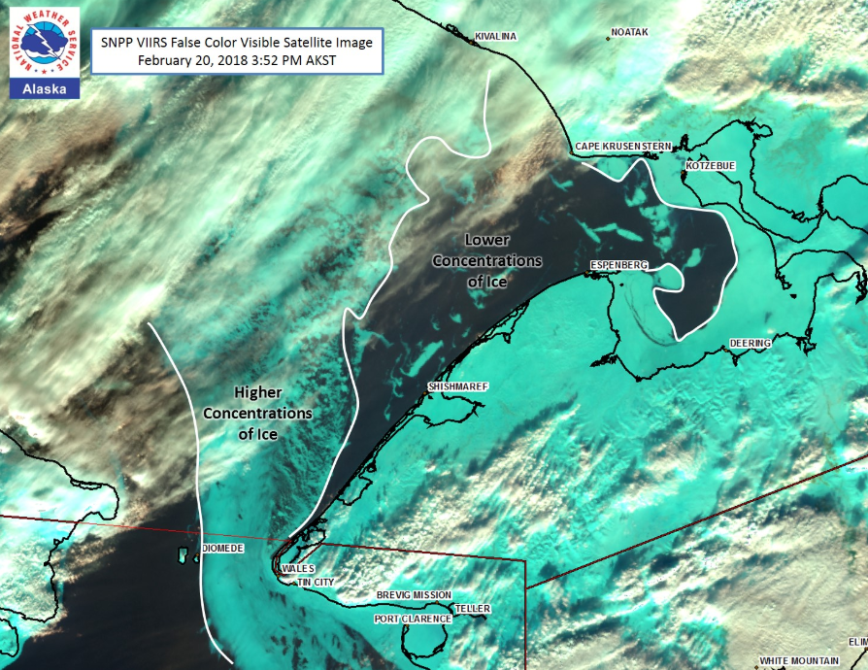
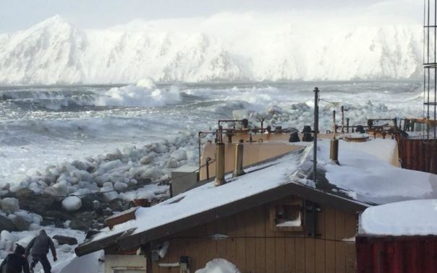
In Summary
Users need water level data in a consistent format and served from one location for:
Safe navigation
Geodetically tied tide datums
Tracking and documenting coastal storms
Flood mapping
Relative sea level projections
Tsunami warnings, watches, and advisories
Incident response planning
Search and rescue
Coastal management and planning
Habitat mapping
Data gaps in Alaska are so vast that cooperative measures and new technologies must be used to fill them.
Data needs are emerging as sea ice concentration diminishes during fall and winter.
National Weather Service—Alaska Sea Ice Program
Diomede February 20, 2018
Jacquelyn Overbeck
State of Alaska
Department of Natural Resources
Jacquelyn.overbeck@Alaska.gov
907-451-5026
ALASKA WATER LEVEL WATCH

