Slide 1

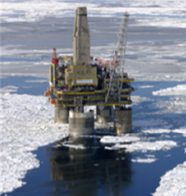
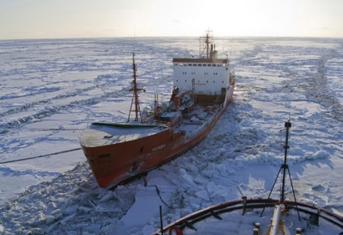
HSRP
Arctic Policy Document

Slide 2
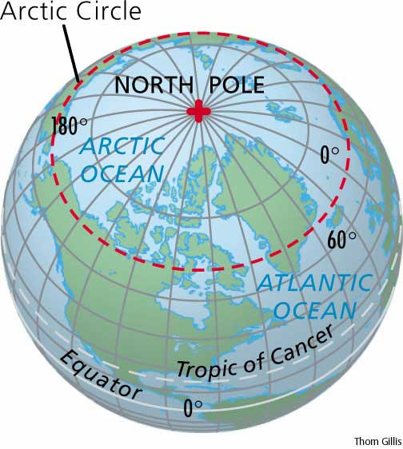
Only vessels that intend to operate within the Arctic and Antarctic areas as defined in the Polar Code need to comply with the code. The areas are as follows;
Arctic: In general north of 60° N but limited by a line from Greenland; south at 58° - north of Iceland, southern shore of Jan Mayen - Bjørnøya – Cap Kanin Nos.

Slide 3
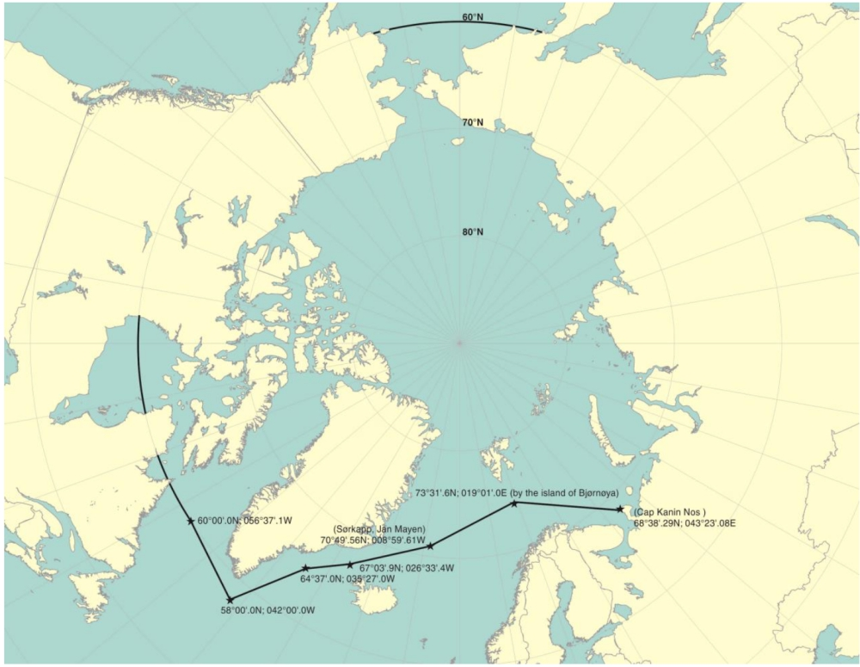

Slide 4
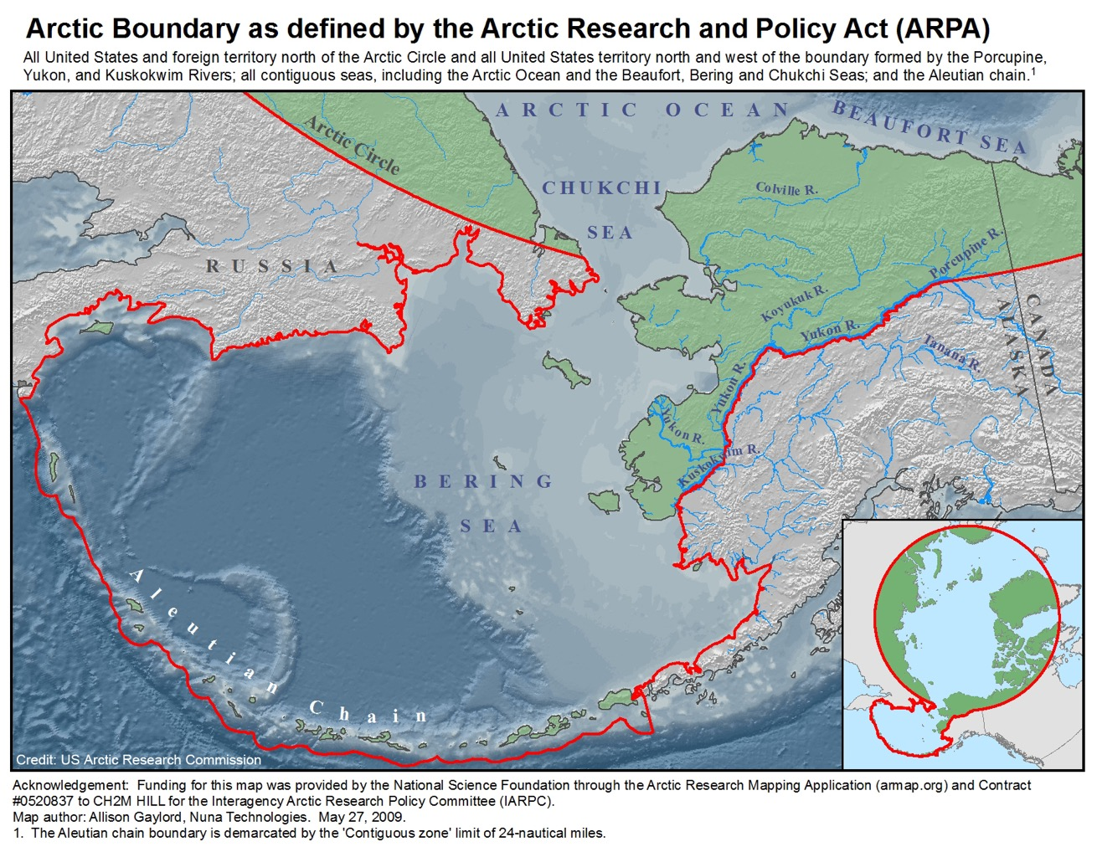

Slide 5
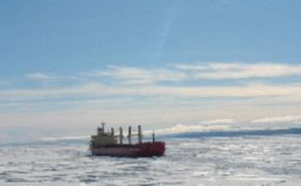
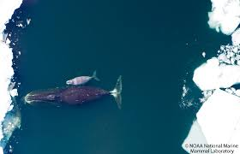
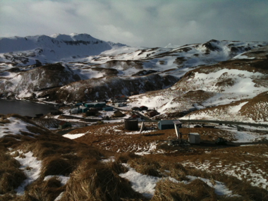
Extreme Weather,
Environmental Safety and Limited Infrastructure

Slide 6
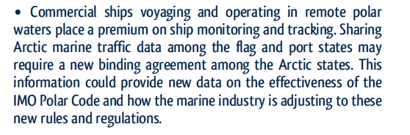
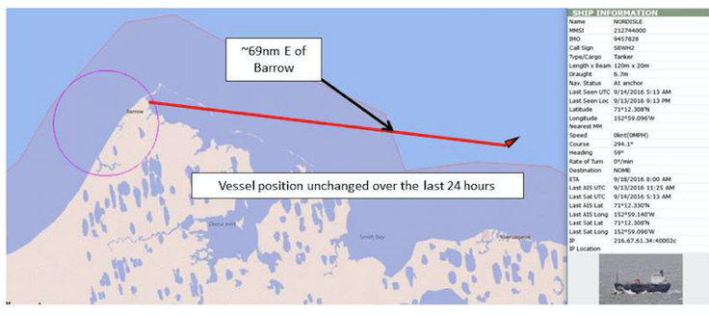

Slide 7
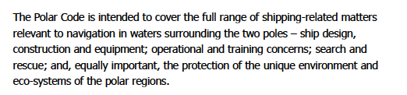
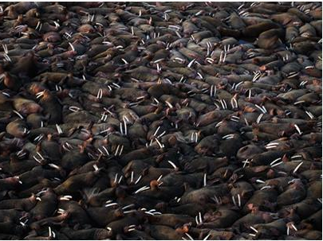

Slide 8

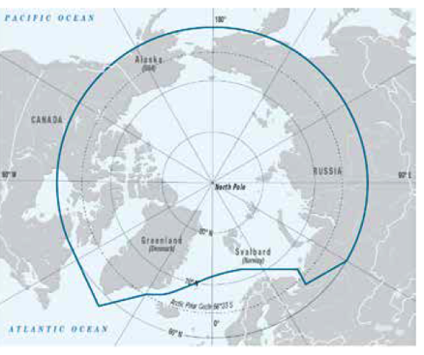
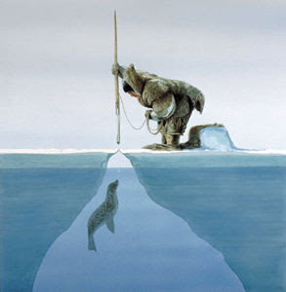

Slide 9
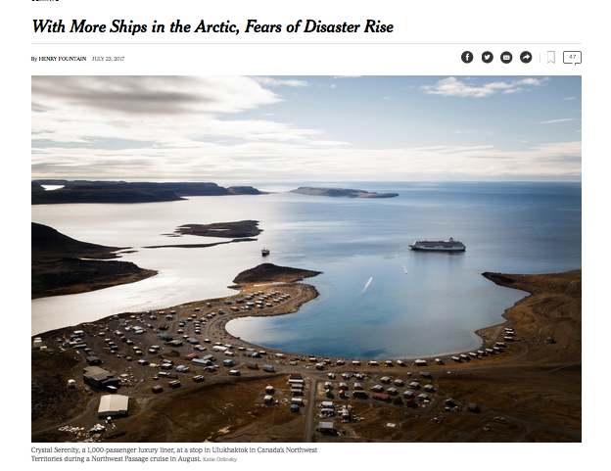

Slide 10
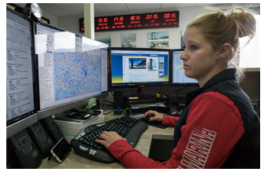
At the Marine Exchange of Alaska in Juneau, Shelby Martin monitors ship traffic through the state’s waters. Credit Michael Penn for The New York Times
Even relatively simple monitoring of ships can reduce the potential for disaster. Ed Page, a former Coast Guard captain, runs a private-public partnership, the Marine Exchange of Alaska, that uses a network of radio receivers to watch over ships around Alaska. Exchange operators can contact vessels that are getting too close to shore — a ship should usually be far from land, so that in the event of a mechanical problem, it has time for repairs without running aground — and have them change course.
Captain Page acknowledged that if something went disastrously wrong with a ship within the 1.5 million square miles of ocean his network covers, “it would be ugly.”
“But we should stop worrying about what we’re going to do when things go wrong,” he said. “We should prevent things from going wrong.”

Slide 11
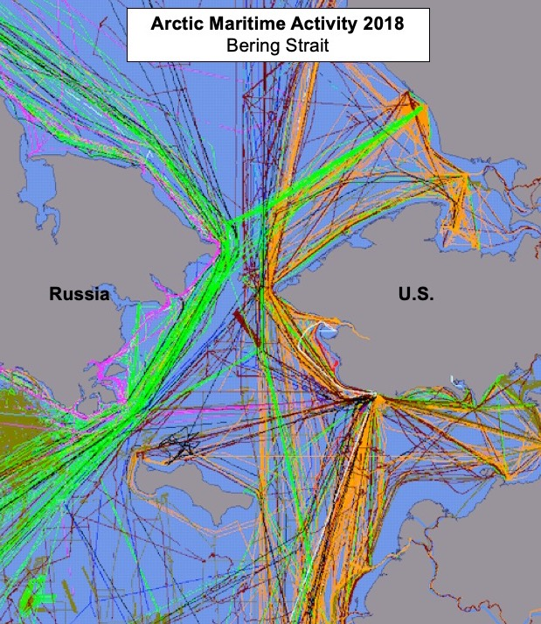
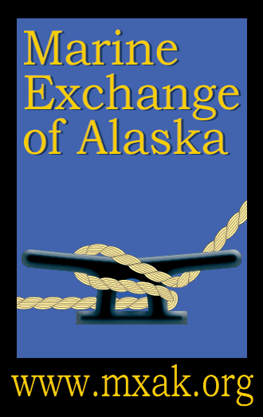
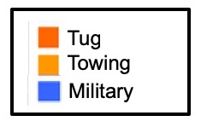
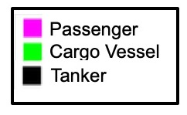

Slide 12
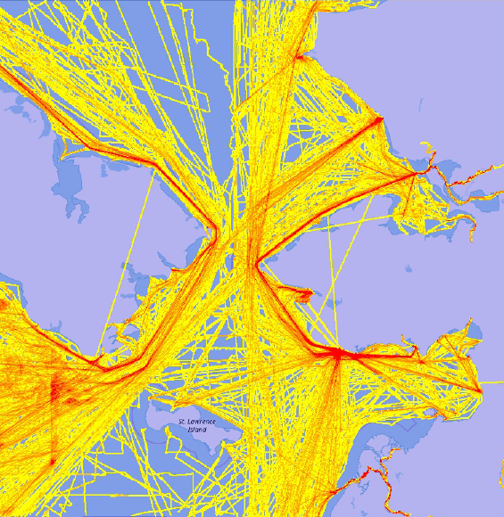
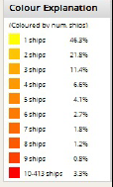

Slide 13
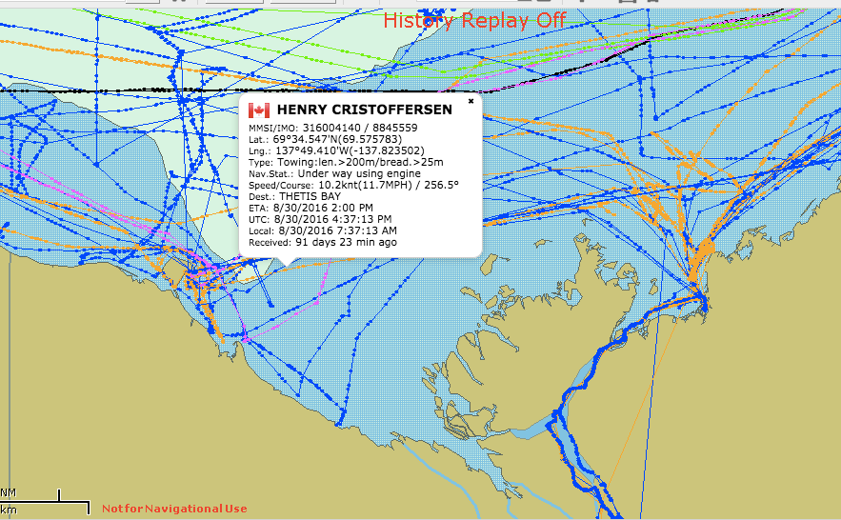
Vessel Monitoring and Tracking

Slide 14
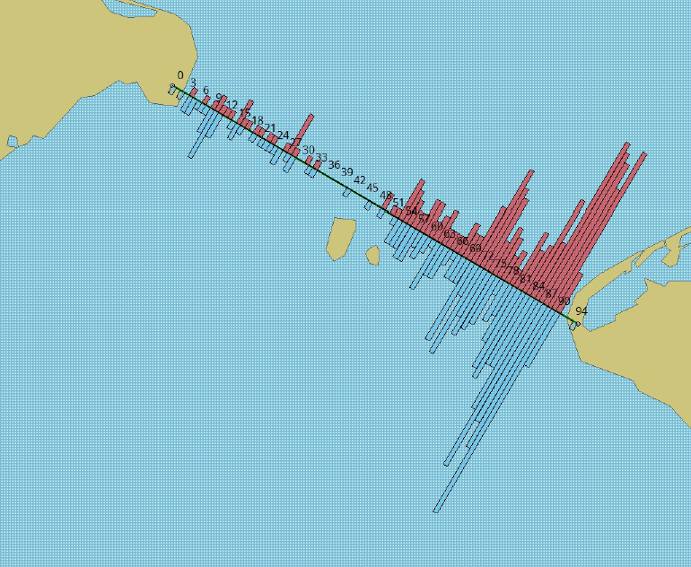
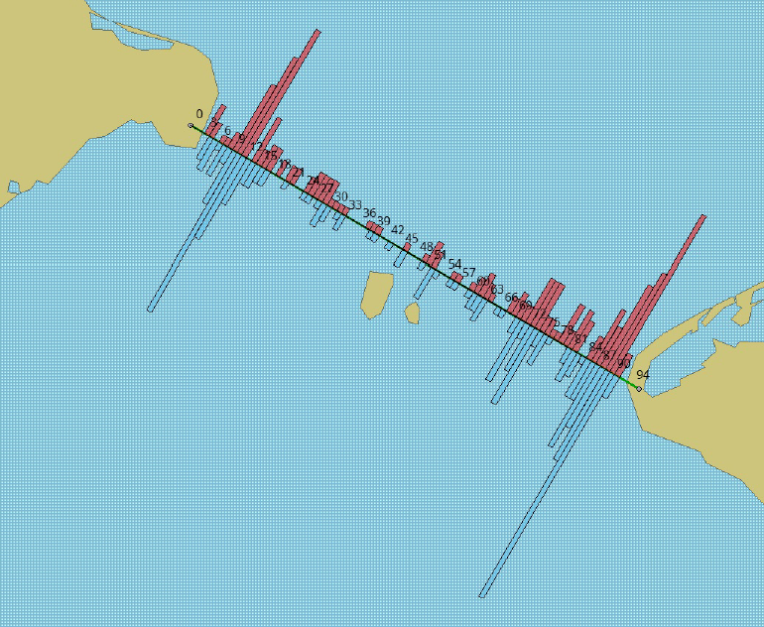
Bering Strait 2010
Bering Strait 2017

Slide 15


Slide 16
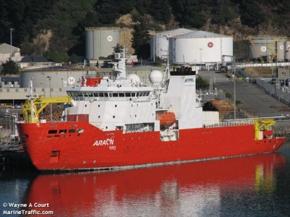
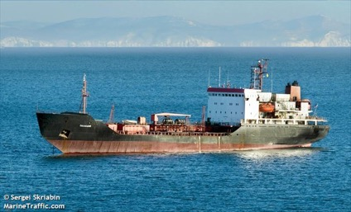
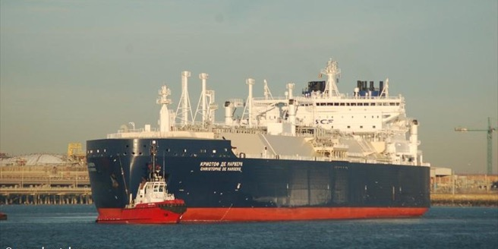
113 meters, 5k DWT
111 meters, 3k DWT
299 meters, 96k DWT

Slide 17
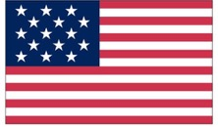
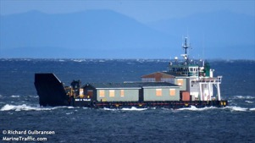
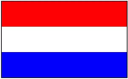
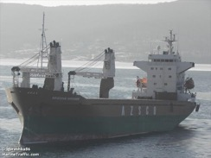

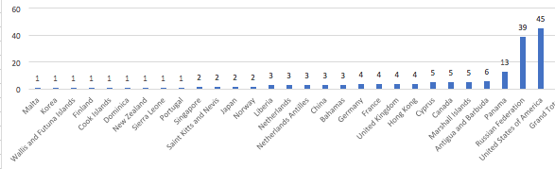
45 USA
39 Russian
13 Panamian
FLAGS OF VESSELS

Slide 18
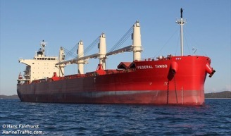
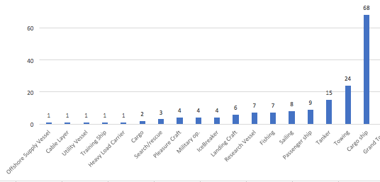
68 Cargo Vessels
24 Towing
15 Tankers

Slide 20
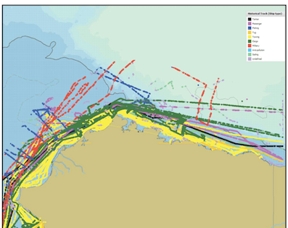
Beaufort Sea Maritime Activity 2017
90 Vessels
41 Towing Vessels
35 Cargo Vessels
8 Fishing Vessels
6 Passenger Vessels
3 Tankers
5 Sailing
2 Military

Slide 21
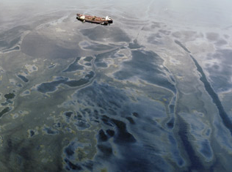
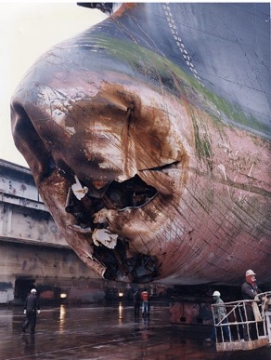
Maritime Domain Awareness &
Maritime Domain Management
Addressing marine safety and environmental protection issues with benefit of good information.
Exxon Valdez Oil Spill
Overseas Ohio

Slide 22
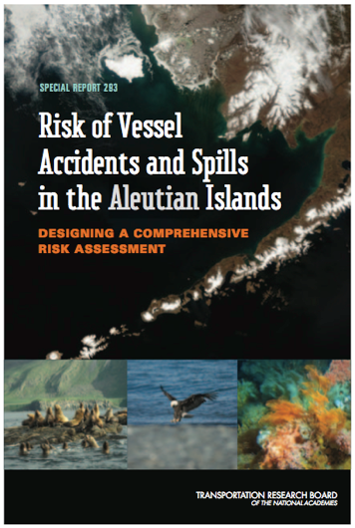
“… take appropriate action to expand the AIS tracking network …”
“Completion of an AIS receiver network in the Arctic is high priority; linkages between AIS and marine mammal awareness need to be developed.”

Slide 23
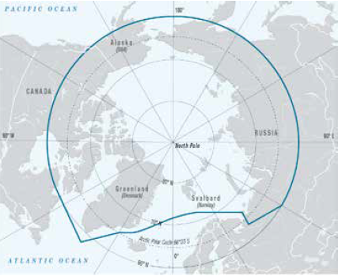

Polar Code

Slide 24
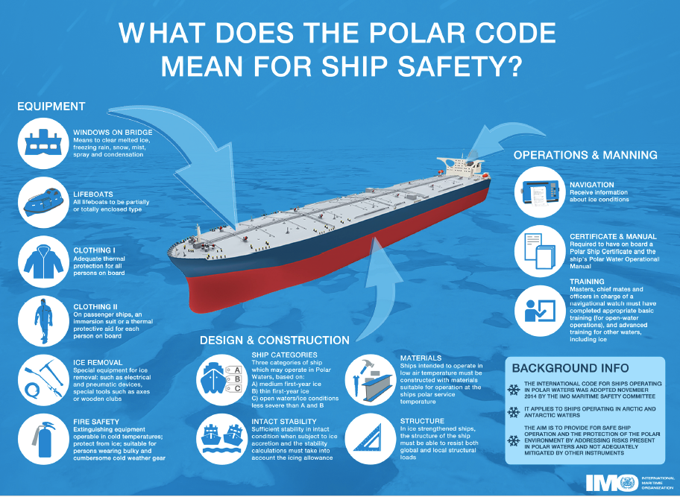

Slide 25
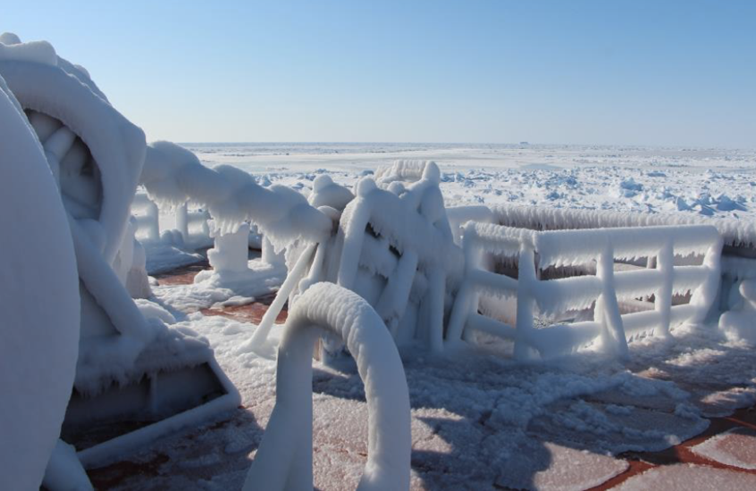

Slide 26
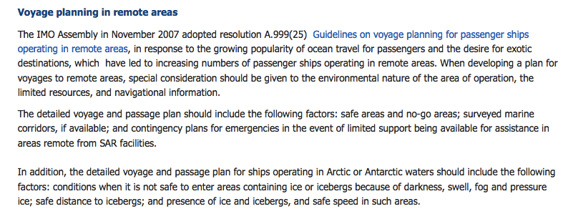
IMO Polar Code
Dynamic Marine Protected Areas and Navigational Hazards

Slide 27
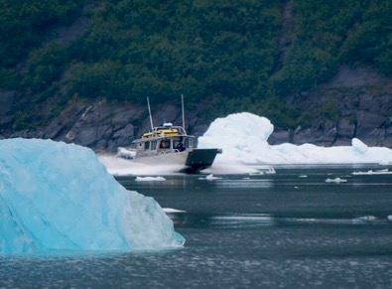
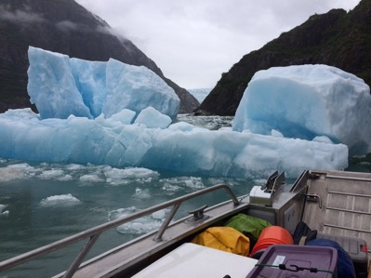
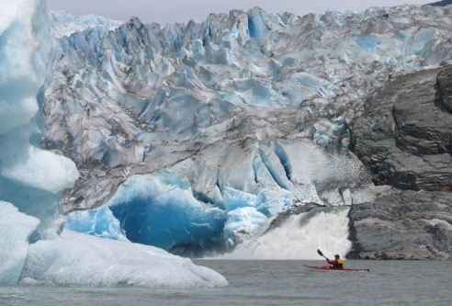

Slide 28
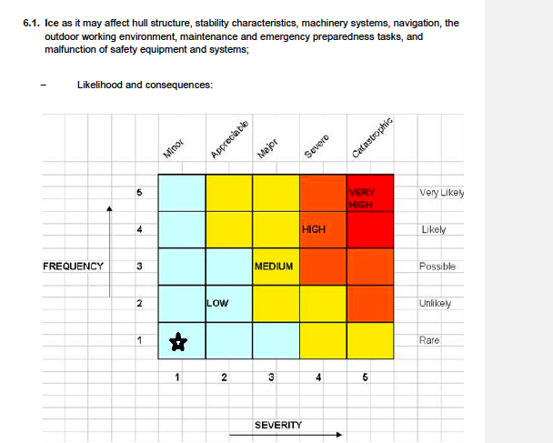
Polar Waters Operations Manual

Slide 29
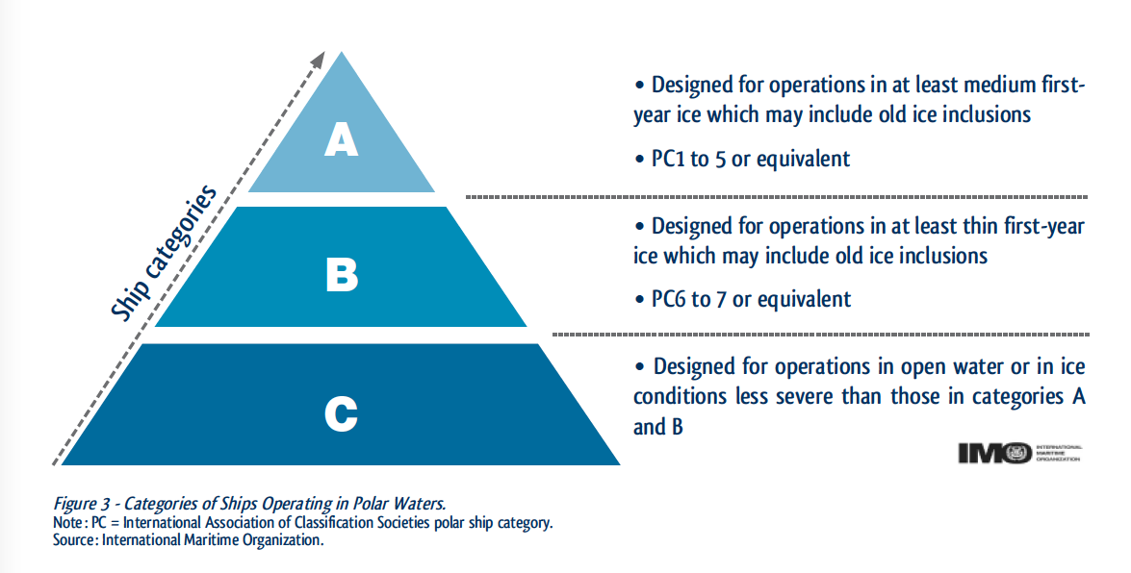
Ice Classed Vessels

Slide 30
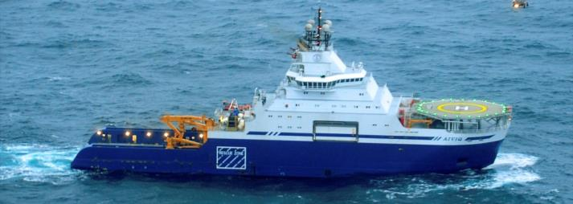
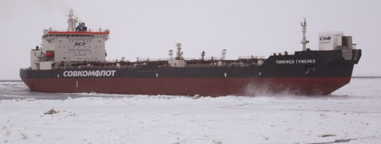

Polar Code
Ship Categories
Category A
Notes:
Top Row: Aiviq (Ice Class A3), Timofey Guzhenko (Ice Class Arc6)
Middle Row: Nanuq (Ice Class A0), Nathaniel B. Palmer (Ice Class A2)
Bottom Row: Miss Marilene Tide (Ice Class PC7), Costa Deliziosa (no ice class)

Slide 31


Polar Code
Ship Categories
Category B
Notes:
Top Row: Aiviq (Ice Class A3), Timofey Guzhenko (Ice Class Arc6)
Middle Row: Nanuq (Ice Class A0), Nathaniel B. Palmer (Ice Class A2)
Bottom Row: Miss Marilene Tide (Ice Class PC7), Costa Deliziosa (no ice class)

Slide 32
Polar Code
Ship Categories
Category C
Notes:
Top Row: Aiviq (Ice Class A3), Timofey Guzhenko (Ice Class Arc6)
Middle Row: Nanuq (Ice Class A0), Nathaniel B. Palmer (Ice Class A2)
Bottom Row: Miss Marilene Tide (Ice Class PC7), Costa Deliziosa (no ice class)

Slide 33



USCG-MXAK CRADA
(Cooperative Research and Development Agreement)
“Arctic Next Generation Navigational Safety Information System”
AIS transmission tests conducted with Coast Guard cutter Healy

Slide 34


Arctic Next Generation
Navigational Safety
Information System
Builds upon AOOS AIS/WX project to communicate information to vessels via AIS;
Virtual aids to Navigation (i.e. buoys)
Locations of whalers
Environmental Data (i.e. weather and ice)
Locations of whales
Vessels in distress, etc.
Notify vessels in “Areas to be Avoided” or exceeding speed restrictions

Slide 35



AIS Atons in Alaska

Slide 36

Virtual Buoys – AIS ATONS

Slide 37



Slide 38
Arctic Maritime Safety Net Project

Slide 39



Slide 40


Slide 41


Subsistence harvesting of Beluga whales occurs at Point Lay during the months of June and July and vessels should contact the Point Lay telecommunications center on VHF-FM channel 68 if transiting in the area during this time.
(116) Point Hope 22 miles NW of Cape Thompson and 102 miles from Cape Krusenstern, is the seaward extremity of a low tongue of land that projects 16 miles W from the general line of the coastal mountains. Subsistence whaling at Point Hope occurs in the spring (April-May) and fall (September-October) as far as 30 miles offshore. Vessels transiting in the vicinity of Point Hope during these times are requested to contact the Alaska Eskimo Whaling Commission and the Point Hope communications center on VHF-FM channel 68.
(187) Mariners should be aware that Alaskan Natives engage in subsistence whaling in the Beaufort Sea near Point Barrow in the spring from March through June and in the fall from September through November. Vessel operators are requested to contact the Alaska Eskimo Whaling Commission at 907-852-2392 or 800-478-2392 or aewcdir@barrow.com prior to entering this area for information about the location and avoidance of traditional Native hunting parties.

Slide 42



Slide 43



Slide 44


Slide 45



Slide 46



Slide 47


Slide 48


Slide 49

Vessel Monitoring and Tracking

Slide 50


Tanker Transits 2017
Tanker Transits 2018

Slide 51

M/V Selendang Ayu
No Information
No Maritime Domain Awareness and
No Maritime Domain Management
Loss of Life, Loss of Property, Major Oil Spill

Slide 52

INFORMATION - NO TIME
Maritime Domain Awareness
No Offshore Routing Measures
No Maritime Domain Management

Slide 53


Slide 54


Slide 55

Providing Information and Validating Compliance

Slide 56

From January 1, 2018 to December 31, 2018 there were 2,482 cargo vessel transits within 100 miles of shore made by 777 individual vessels.
1,543 of these transits were made less than 25 miles offshore.
  62.17% of transits made outside Monterey Bay, CA in 2018 were less than 25 miles offshore, a majority were 16-21 miles off shore.

Slide 57

Weather Stations – Data Transmitted via AIS

Slide 58

Cruise ships Transiting Whale Waters
Automatic generation of e-mail and text msg alerts

Slide 59

NOME Environmental Data – Buoy
Current and Waves

Slide 60


Slide 61



Reduced Speed: 1600, Jan 23, 2019
Not Under Command: 0550, Jan 24, 2019
Taken Under Tow by Denise Foss: 0710, Jan 28, 2019

Slide 62

Vessel Adherence to Routing Measures

Slide 63

130 AIS Receivers
28 AIS Transmitters
49 WX Stations

Slide 65

Risk Mitigation
Offshore Routing and Use of Safe Passes

Slide 66


Slide 67


Slide 68


Slide 69


Slide 70


Slide 71
HSRP Arctic Paper
Information to Mariners
Dynamic Coast Pilot
Ice and Weather Information
Updated Charts
Voyage Planning – Polar Operations Manual
Information to Agencies – USCG
Validation of Adherence with Polar Code
Emergency Response – Environmental Conditions

Slide 72



Slide 73


