Slide 1
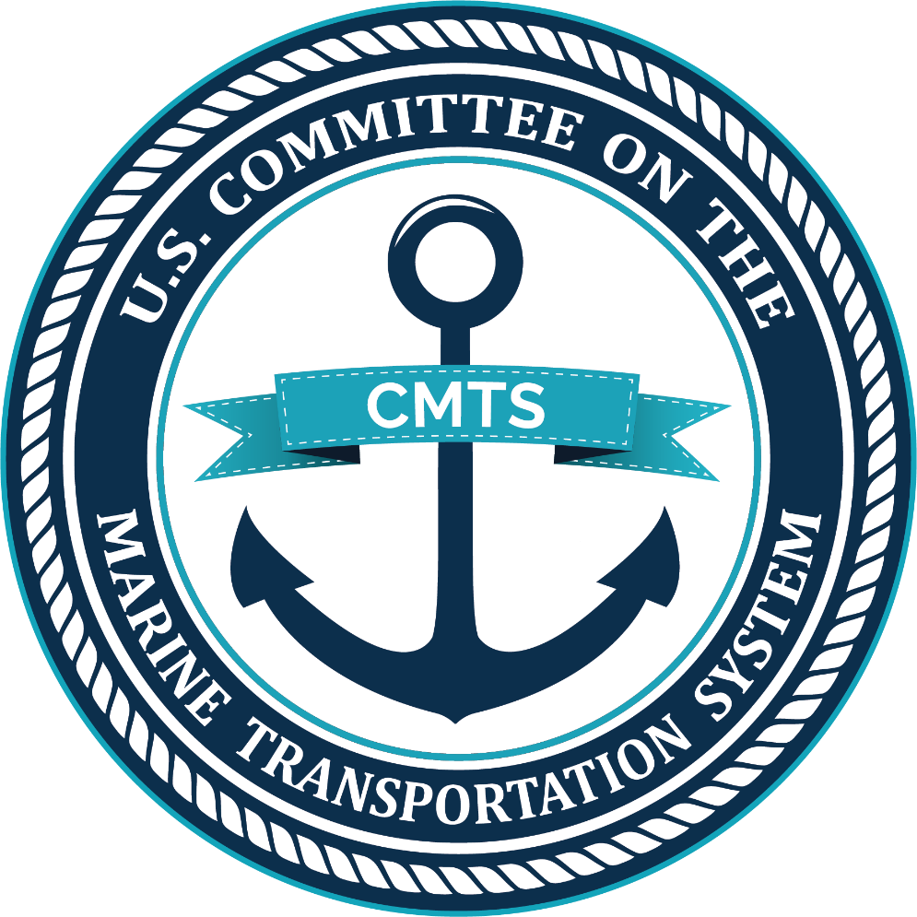
Federal Partnership for the MTS
March 7, 2019

Slide 2
Management of Transportation at the Federal Level
Air: Federal Aviation Administration (DOT)
Highways: Federal Highway Administration (DOT)
Rail: Federal Railroad Administration (DOT)
Marine: 30+ Federal Agencies & Offices
Organization

Slide 3
Federal Matrix of Roles in the MTS
FEDERAL INTEREST | MAJOR CATEGORIES | USDA | DOC | DOD | DOE | DOI | DOJ | DOL | DHS | DOS | DOT | Treasury | FMC | NTSB | EPA
Enhance Safety | Safety |  | X | X |  | X | X | x | X |  | X |  |  | X | X
Facilitate Commerce | Environmental Protection | X | X | X | X | X | X |  | X | X | X |  |  |  | X
 | Trade Facilitation | X | X |  |  | X | X |  | X | X | X | X | X |  | X
 | Trade Promotion | X | X |  |  |  |  |  |  |  | X | X | X |  | X
 | Vessel Construction |  |  |  |  |  |  |  | X |  | X | X
 | Vessel Operation |  | X |  |  | X | X |  | X |  | X |  |  |  | X
 | Federal Channels, Waterways, and Sea Lanes |  | X | X | X | X | X |  | X | X | X | X |  |  | X
 | Ports/Modal Transfer Infrastructure |  | X | X | X |  |  |  | X |  | X | X |  |  | X
Ensure National Security | Security |  | X | X | X | X | X |  | X | X | X
Cross-Cutting | Research & Development |  | X | X | X | X |  |  | X |  | X | X |  |  | X
 | Human Resources |  | X | X |  | X | X |  | X |  | X |  |  |  | X
Organization

Slide 4
Authorization of the CMTS
U.S. Ocean Action Plan (2004)
This Plan contained a Presidential Directive to establish a cabinet-level interagency committee on the marine transportation system (MTS).
Coast Guard and Maritime Transportation Act (2012), PL 112-213:
The CMTS shall serve as a federal interagency coordinating committee for the purpose of:
Assessing MTS adequacy
Promoting MTS integration with other modes of transportation and marine environment uses
Coordinating, improving the coordination of, and making recommendations related to MTS relevant federal policy
Organization

Slide 5
COMMITTEE
Chair: Secretary of Transportation by Charter (Secretary Elaine L. Chao)
Members: Secretaries of 14 Departments and Independent Agencies
COORDINATING BOARD
Chair: Rotates yearly between DOT, DHS, DOD, DOC (MG Scott Spellmon, USACE)**
Members: Leadership of Agencies and Offices of designated member Department and Independent Federal Agencies, White House Ex-Officio Members
EXECUTIVE SECRETARIAT
Executive Director and dedicated staff to facilitate meetings, support CMTS work plan and activities.
WORKING GROUP
Interagency staff of member agencies to provide liaison to Coordinating Board and expertise to Integrated Action Teams and Task Teams
INTEGRATED ACTION TEAMS
TASK TEAMS
Organization
Notes:
Active Engagement by: USCG
USACE
NOAA
MARAD
FMC
TSA
DOE
Treasury
BTS
15 others

Slide 6
2018-2019 Work Plan
Implementing the 2017 National Strategy for the MTS
Ocean Policy and the Maritime Nexus
Navigation Safety Services and Technologies Integration
Maritime Data Coordination/Enhancing Access to AIS
U.S. Arctic Marine Transportation System Assessments
Maritime Cyber Security Touchstone Project
MTS Infrastructure Investment Economic Benefit
MTS Resilience – Hurricane Response Analysis
Supporting Military to Mariner
Promoting the value of the MTS and the Federal Role
Organization

Slide 7
14 Recommendations under 5 Priority areas:
System Performance
Safety
Security
Energy Innovation
Infrastructure Investment
Organization

Slide 8
Ocean Policy
The MTS is a critical component of Ocean Policy, and the CMTS offers expertise and an established forum with a proven track record of facilitating inter-departmental cooperation and collaboration. The CMTS supports and enhances the role of maritime transportation within Executive Order 13840 on Ocean Policy and the Blue Economy.
Lead: Executive Secretariat
Activities:
Engage Federal and non- Federal stakeholders to more fully understand current roles within the ocean policy and blue economy.
Engage in Ocean Policy Committee initiatives, as appropriate.
Teams

Slide 9
Maritime Safety
The CMTS Future of Navigation IAT will facilitate the coordinated and integrated collection, processing, and dissemination of navigation data and information to provide services to stakeholders, eliminate duplication, and enhance the safety, reliability, and efficiency of our waterways and ports.
Leads: NOAA, USACE, USCG
Activities:
Waterways Harmonization
eMarine Safety Information
Expansion of the S100 architecture
Common Information Sharing Standards
Coordinating with NSC/DOD on the new “National Maritime Information Sharing Environment” MDA
Teams

Slide 10
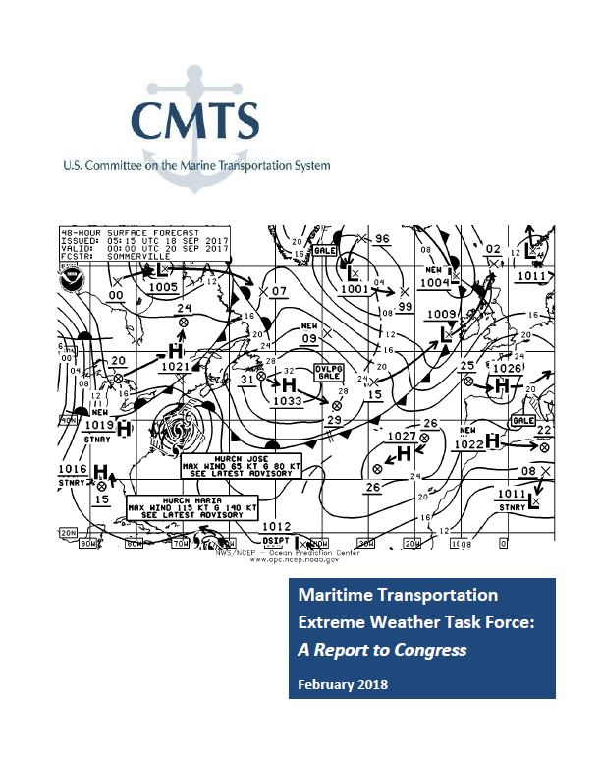
Maritime Safety
NOAA led the development of interagency report related to receipt and response to extreme weather information – delivered to Sec. Chao in early 2018.
Established an ongoing relationship between NWS and SOCP.
Eight recommendations related to NOAA’s outreach to industry; USCG review of weather-related questions on credentialing exams; enhanced training at MM training orgs.

Slide 11
Maritime Data
The Maritime Data IAT serves as the CMTS’s body of experts on the discovery, access, and sharing capacity of data related to the operation and governance of the MTS. The work of the Maritime Data IAT includes facilitating the identification, archiving, linking, and integration of authoritative data from agencies with equities in maritime data.
Leads: MARAD, USACE
Resources:
Enhancing access to and sharing of AIS data
Interagency report on Federal access, acquisition, analysis and sharing of AIS data.
Aligns with Ocean Policy E.O.
Expected publication: April 2019.
Harmonization of maritime terminologies and data bases
MTS Performance Measures Report and Website
Maritime Tab at DATA.gov
Teams

Slide 12
U.S. Arctic MTS
Through the Arctic Marine Shipping IAT recommendations and member agency actions, maritime transportation in the U.S. Arctic will be better managed and made more safe and secure, resulting in more efficient transits, greater protection of Arctic coastal and ocean resources, maintenance of subsistence uses by native communities, and less risk to loss of cargo and life.
Leads: USCG, NOAA, MARAD
Resources:
2013 “U.S. Arctic MTS: Overview and Priorities for Action.”
UPDATE: 2016 “A Ten-Year Prioritization of Infrastructure Needs in the U.S. Arctic.” Reviews 25 near-term recommendations.
2017 Recommendations and Criteria for Using P3 for Arctic Infrastructure.
In Process: Update of the 2015 report, “Ten-Year Projection of Vessel Activity in the U.S. Arctic.” Publication: Summer 2019.
Teams

Slide 13
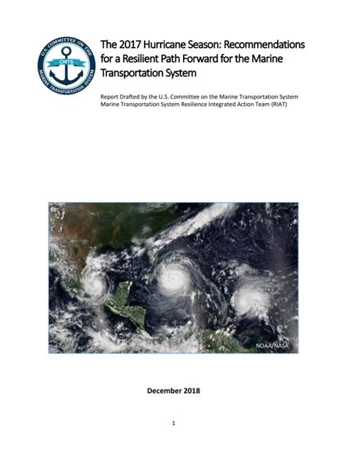
Marine Transportation System Resilience
The Resilience IAT fosters interagency exchange and co-production to incorporate the concepts of resilience into the operation and management of the U.S. MTS.
December 2018 Report: 2017 Hurricane Season: Recommendations for a Resilient Path Forward for the Marine Transportation System.
Leads: USACE, NOAA
Teams

Slide 14
Maritime Security
The CMTS supports interagency and stakeholder collaboration for maritime security, including maritime cybersecurity, to provide foundational information with which to enhance the Federal engagement and response.
Leads:
CMTS Executive Secretariat
National Maritime Intelligence Integration Office
Global MOTR Coordination Center
Tasker: Assess the maritime industry cyber incident threshold for federal engagement and confirm the central point of contact.
Teams

Slide 15
Infrastructure Investment
Resources:
Federal Funding Handbook for MTS-Related Infrastructure Investments (2017)
P3 Resource Library
Department of Treasury P3 White Papers
Compendium of Federal P3 Authorities for Infrastructure Investment
Modeling Maritime Infrastructure Investment
MTS infrastructure outreach during National Infrastructure Week 2019
The Infrastructure Investment Integrated Action Team (IAT) was established to facilitate the development of broad evaluation and decision criteria that can be used across Government programs for informing Federal infrastructure investment. The team also focuses on developing tools that are value-added for practitioners at the local and non-Federal level as well as the Federal stakeholders.
Leads: Treasury, USACE, DOT
Teams

Slide 16
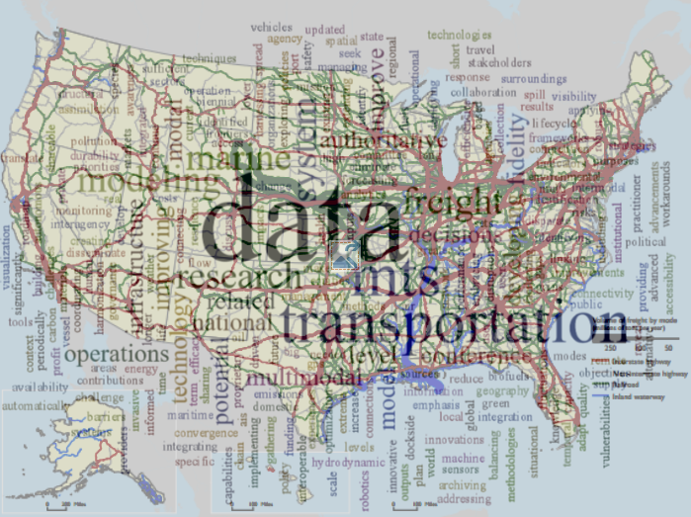
Maritime Innovative Science and Technology IAT
2018 R&D Conference at the
National Academy of Sciences
Washington, DC [Proceedings at www.TRB.org]
Supporting DOT multi-modal freight modeling initiative directly and via the R&D conference on multimodal freight analytics with TRB.
Working with CMTS teams to assess and facilitate pilot studies on emerging R&D requirements.
Planning for a 2020 Conference
Lead: USACE; MARAD, EPA
Teams

Slide 17
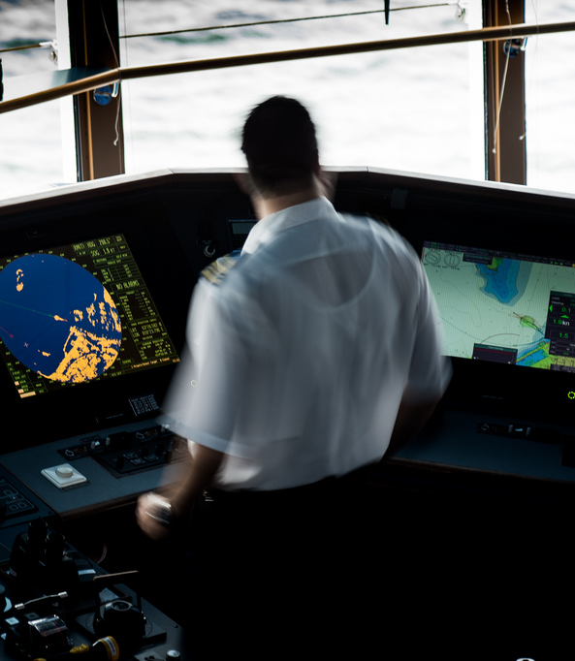
Military to Mariner
The Military to Mariner (M2M) Initiative helps coordinate Federal efforts to facilitate the transition from military service to civilian employment in the U.S. Merchant Marine and/or the Marine Transportation System.
Webinars to support mariner credentialing and mariner hiring.
Review of use of GI bill for mariner training.
Expanding USCG approval of sea service training for credentialing.
Leads: MARAD, Military Sealift Command
Teams

Slide 18
TAKEAWAYS:
The CMTS is a resource and source for MTS related reports, SME’s, and initiatives within the USG;
NOAA is an active member of the CMTS and has taken a leadership role in a number of interagency initiatives;
Secretary of Commerce becomes chair of the Coordinating Board August 1, 2019.

Slide 19
Contacts
1200 New Jersey Avenue SE
Washington, DC 20590
(202) 366-3612
Helen.Brohl@cmts.gov, Executive Director
Pat.Mutschler@cmts.gov, Senior Advisor/USACE
Heather.Gilbert@cmts.gov, Senior Advisor/NOAA
Nancy.Lang@cmts.gov, Executive Assistant
Jaya.Ghosh@cmts.gov, Data and Infrastructure Advisor
Sarah.Harrison@cmts.gov, Arctic Advisor
Kathryn.H.McIntosh@usace.army.mil, Resilience Advisor
www.cmts.gov
Facebook /USCMTS
Twitter @USCMTS
Conclusion

