Slide 1
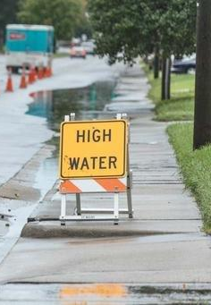
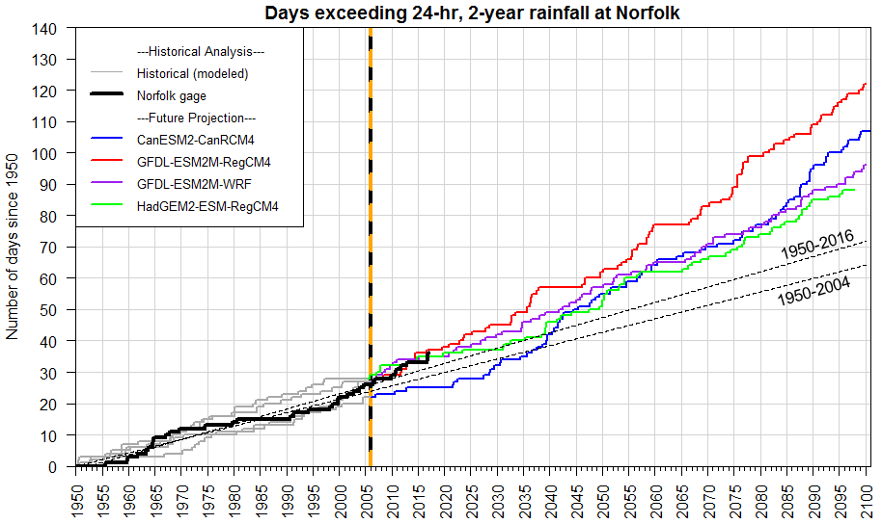
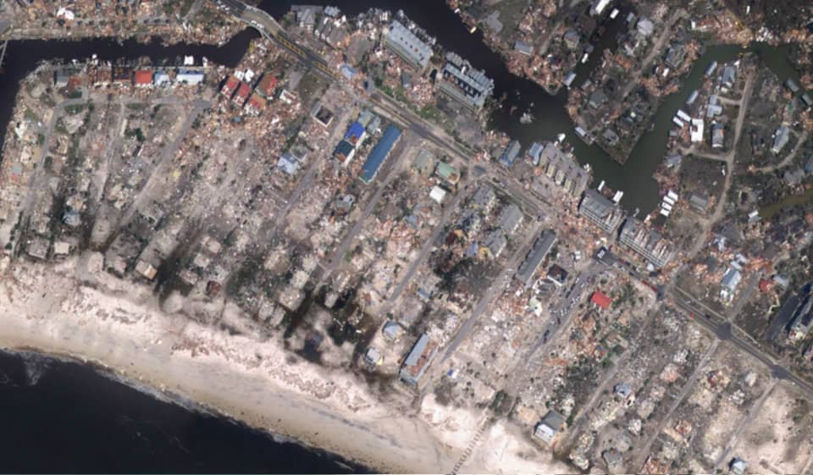
Benefits and Opportunities from NOAA’s Coastal Zone Products
Brian K. Batten, Ph.D., CFM

Slide 2

NOAA does so much for the coastal community!

Slide 3
Agenda
SLR Scenarios – supporting community use
Water Level Gages – improving accessibility and align products
Rainfall – the other flood hazard for coastal communities

Slide 4

Community Use of SLR Rise Scenarios

Slide 5
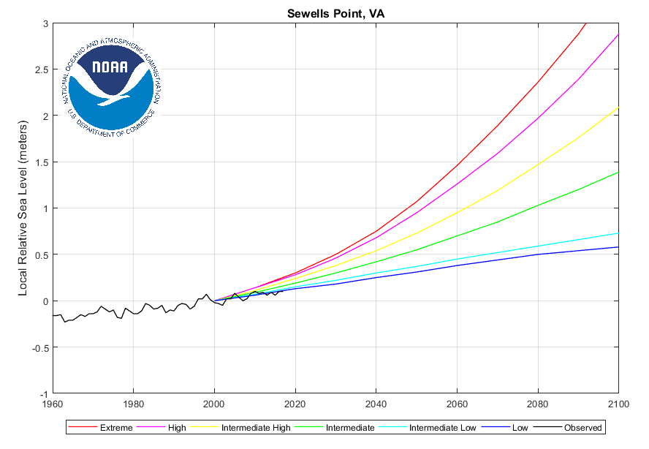
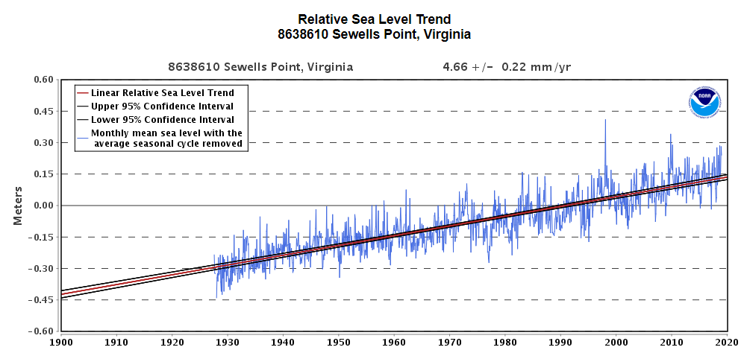
From the established past to an uncertain future

Slide 6
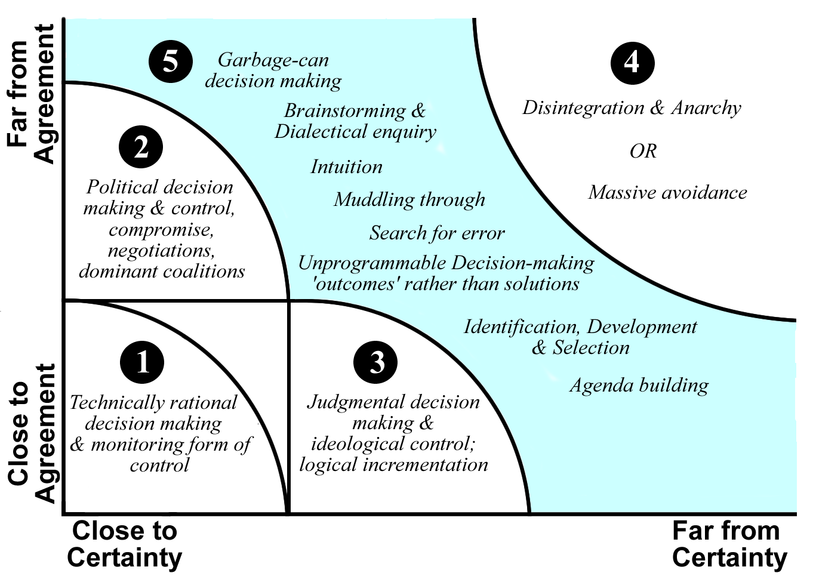
Outcomes of uncertainty
Ralph Stacey
Complexity Matrix

Slide 7
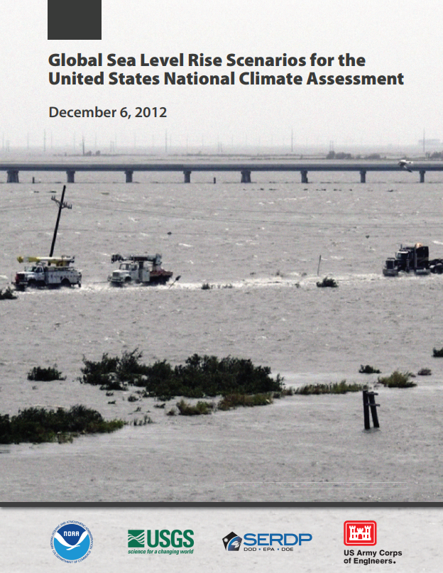
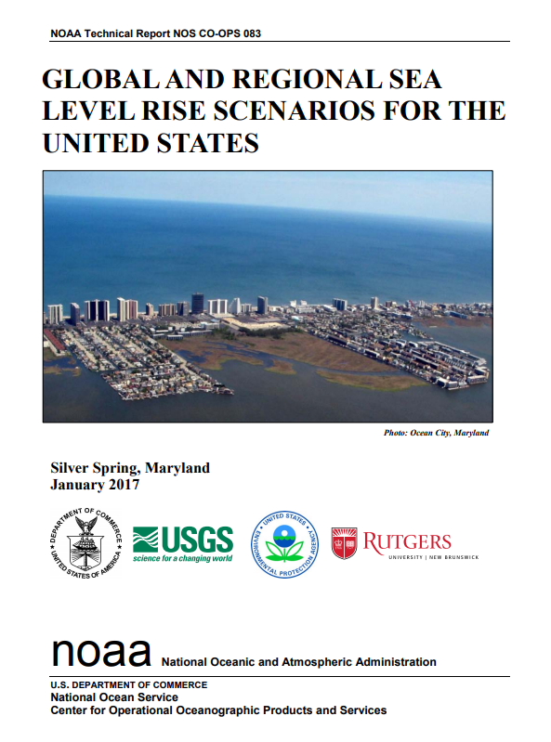
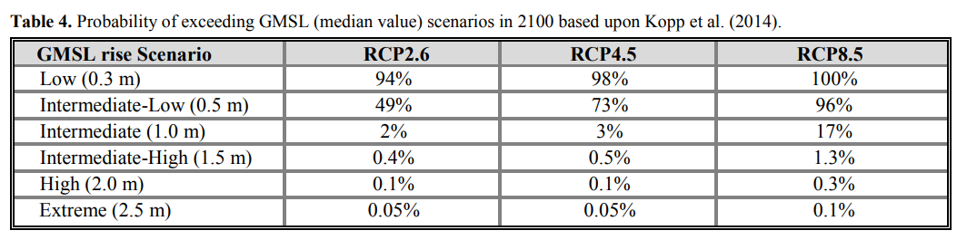
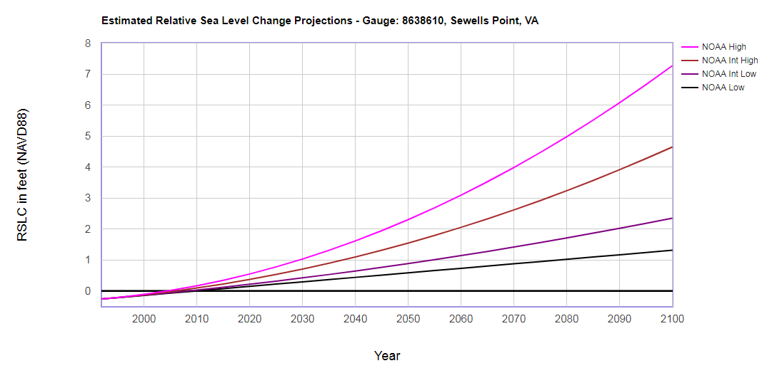
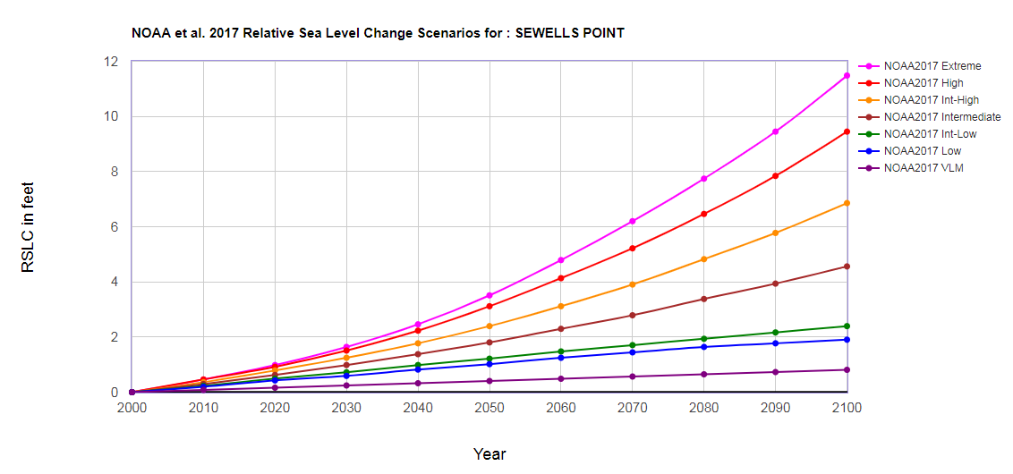
Federal Scenarios for the NCA
2012 Guidance
Risk tolerance guidance
2017 Update

Slide 8
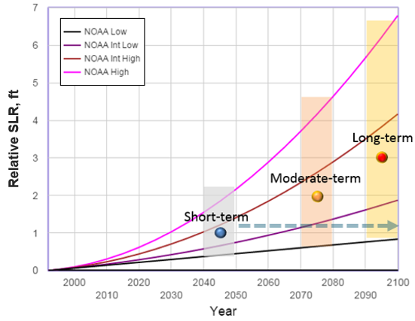
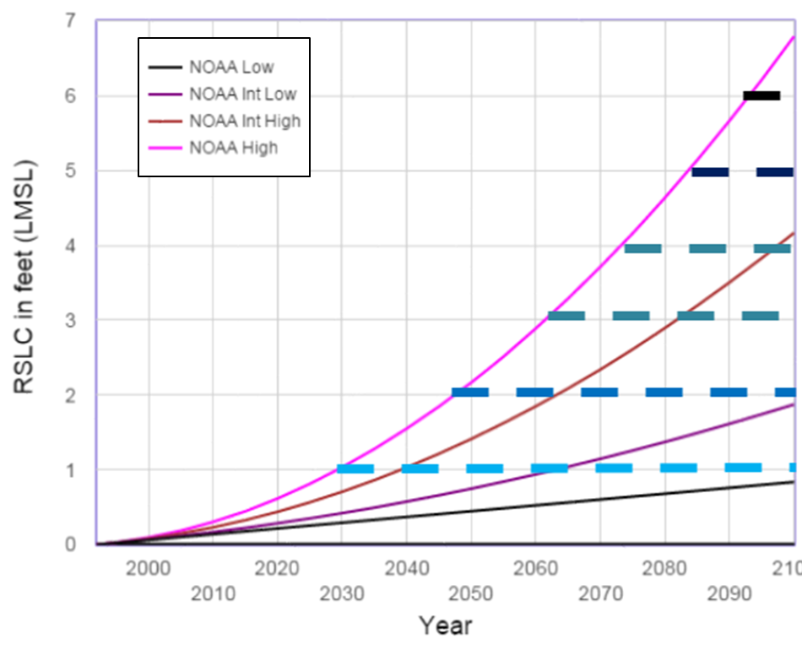
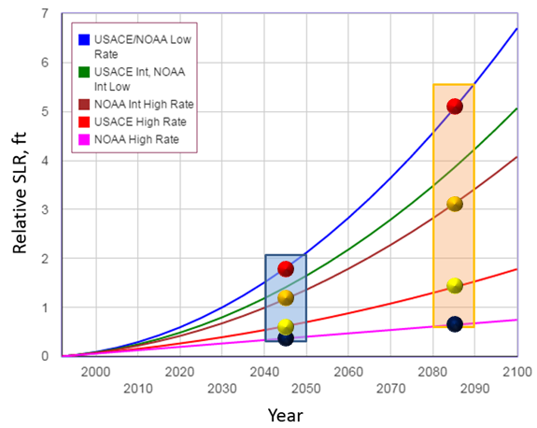
Scenario Approaches
Approach | Benefits | Drawbacks
Pick a curve - Choose curve, use values at time slices for planning | Simple | Justification for buy-in to specific curve
Representative Values – Single values per time horizon balancing curves | Simple Balances uncertainty | Limited look at vulnerability progression Misses extremes
Multiple Scenarios – Sample curves at each time | Discreet representation of full range Full representation of uncertainty | Can complicate follow-on application Many values, additional guidance needed to use
Incremental Values – Equal increment increases, assess vulnerability | Detailed look at vulnerability progression, back into timing of adaptation actions | Extensive analysis, interpretation

Slide 9
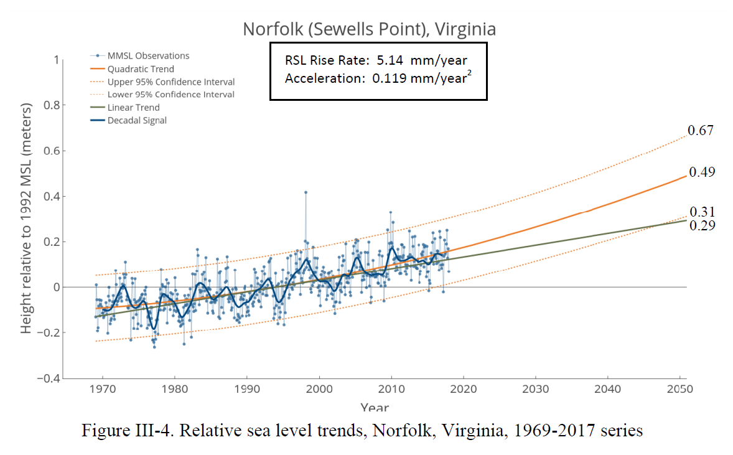
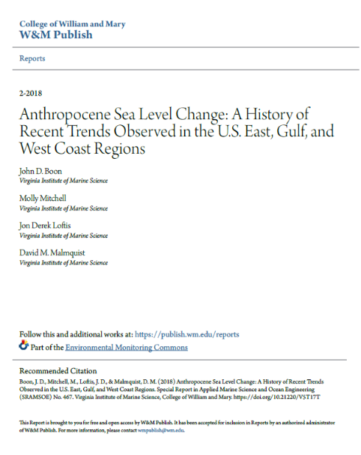
“Empirical” data…

Slide 10

The other flood hazard for coastal communities…

Slide 11
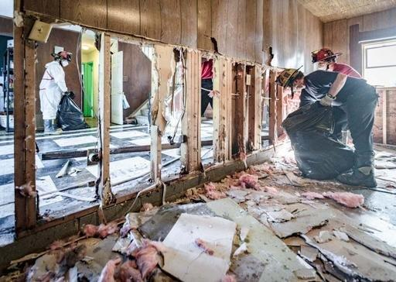
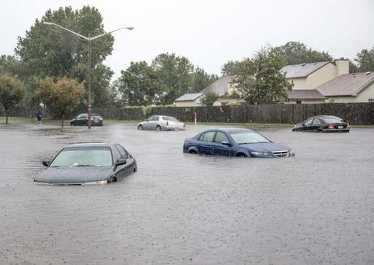
Virginia Beach –
2016 Heavy Rainfall – Opened Eyes
July 31 - heavy rainfall
  500 to 1000-yr recurrence interval at the 2-hr duration
September 19 – Julia
  100 to 200-yr event at the 24-, 48-hr durations
October 8-9 – Matthew
  500 to 1000-yr event at the 24-hr durations
Is the recent increase in heavy rainfall frequency short-term statistical
noise or part of a long-term historical trend?
What kind of future trend (if any) is being projected by long-range Global Climate Models?
Does the City need to take steps now by increasing its design rainfall guidance?

Slide 12
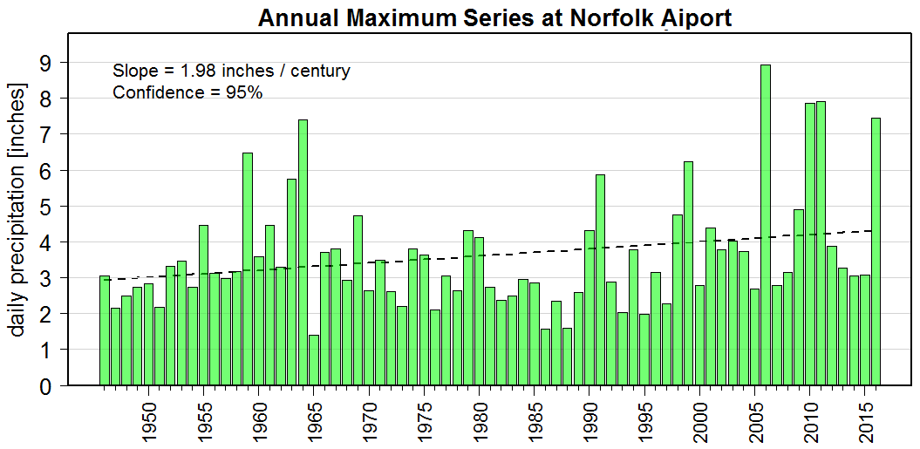
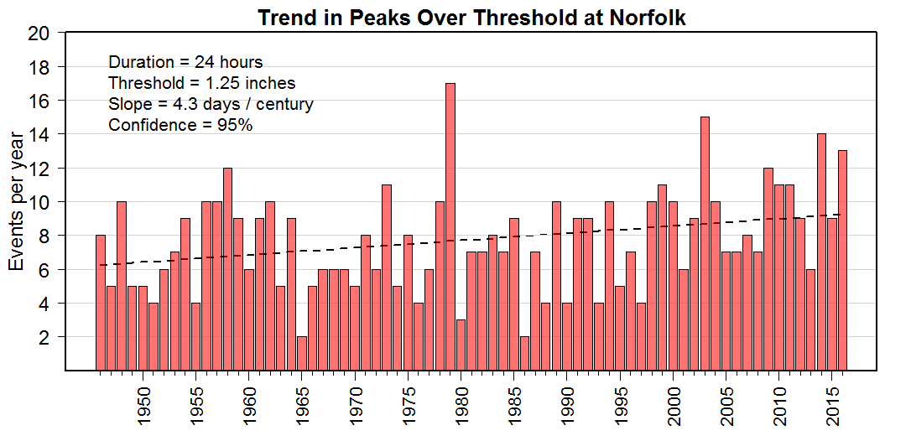
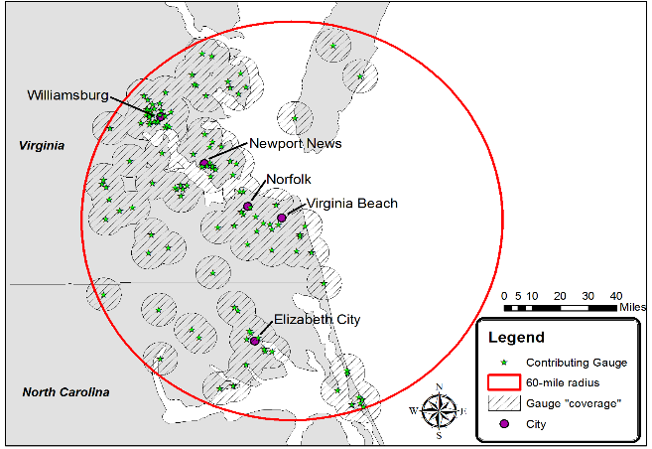
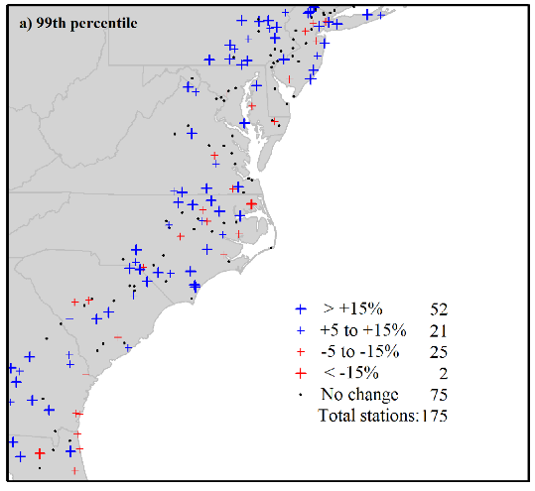
Historical Rainfall Analysis
Gage (Norfolk
Local (Hampton Roads)
Regional (Mid-Atlantic Seaboard)
Moderate/high confidence that frequency & intensity is increasing

Slide 13
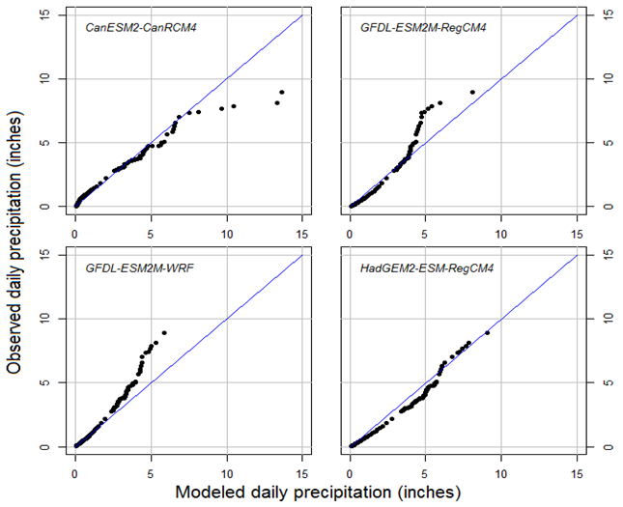
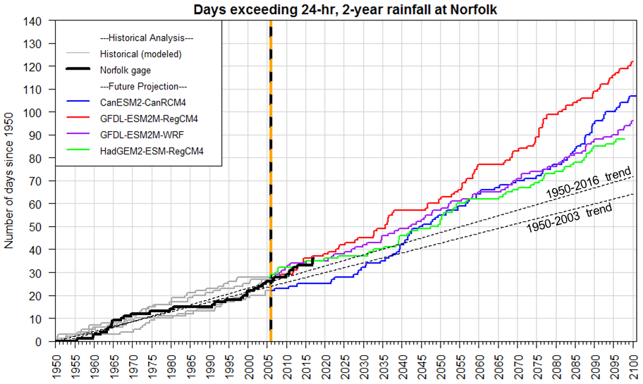
Future Rainfall Projections
Medium and High emission scenarios RCP 4.5 and 8.5
Bias correction
Variable resolution (11 & 44 km)
Peaks over Threshold
Probability Frequency Curves

Slide 14
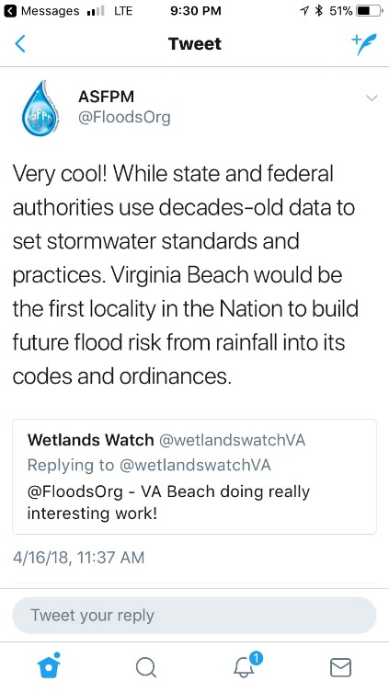
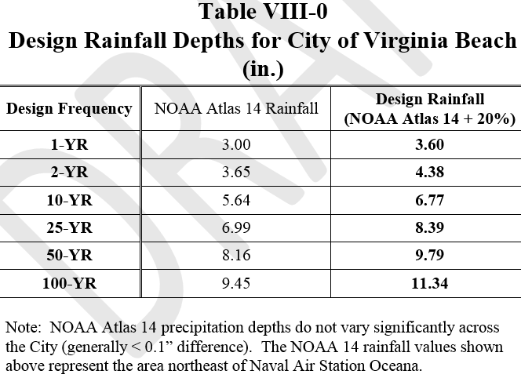
Increasing Rainfall Findings and Actions
Atlas 14 guidance may be underestimating the local design rainfall by 7-10%
Future projections support increases of 5% for the intermediate scenario to 24-27% in the high scenario by 2060
Historical trends suggest a 20% increase in standard given a 40-year design horizon

Slide 15

Water Level Observation Data

Slide 16
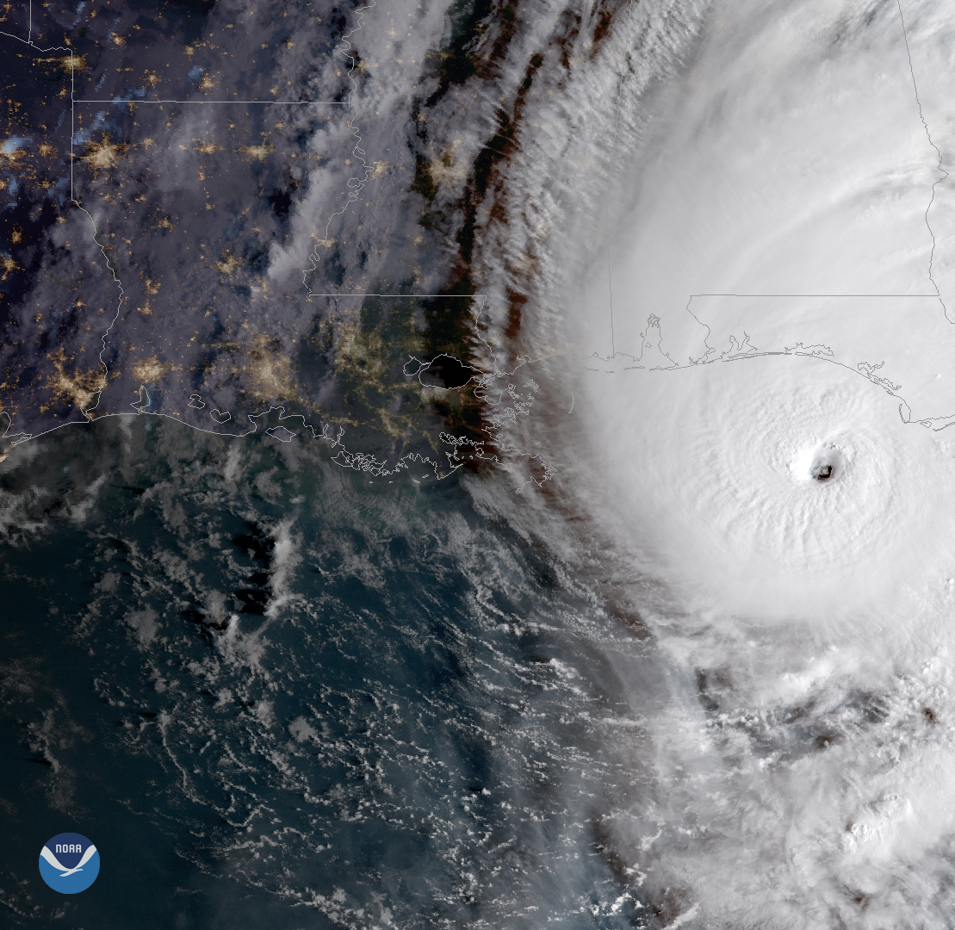
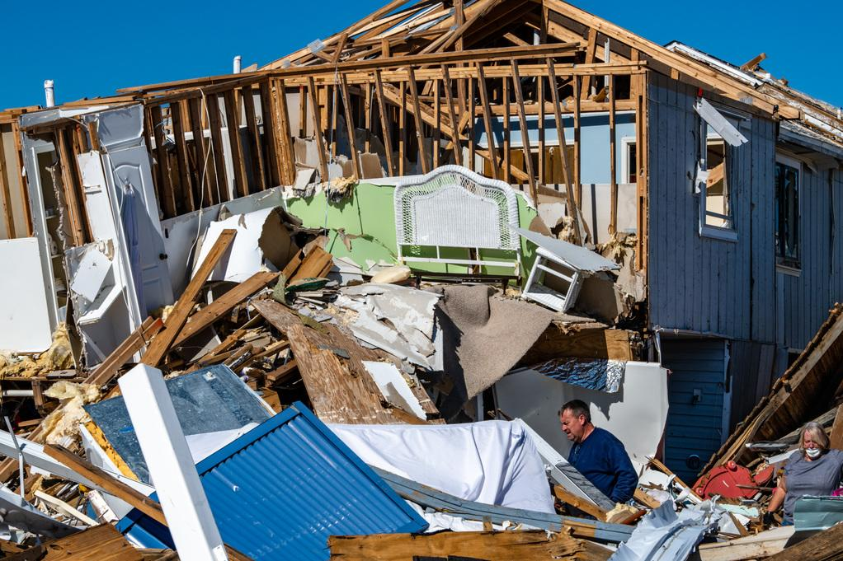
Water Level Data to Assess Inundation
Post-disaster
damage assessments
Informs recovery
resource allocation
  Primary Use:
  Storm Surge Model Validation

Slide 17
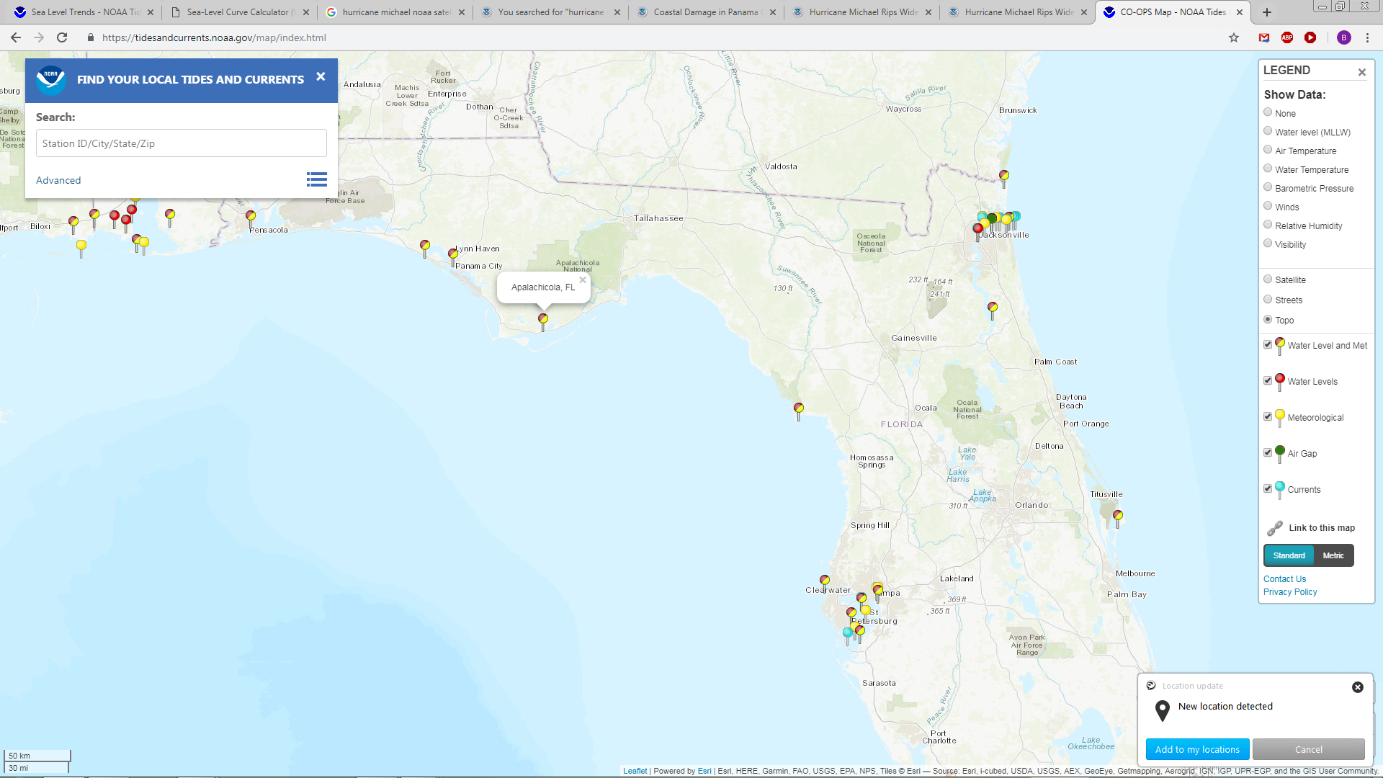
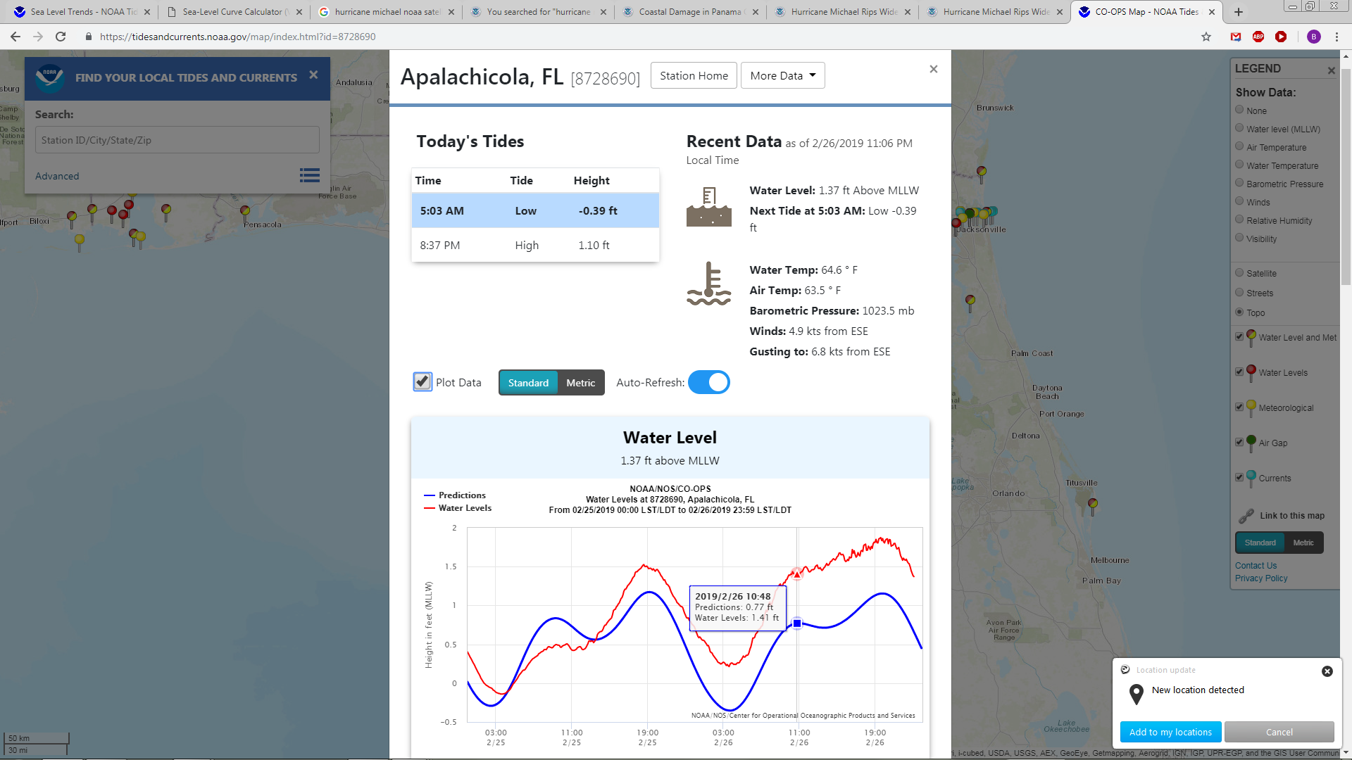
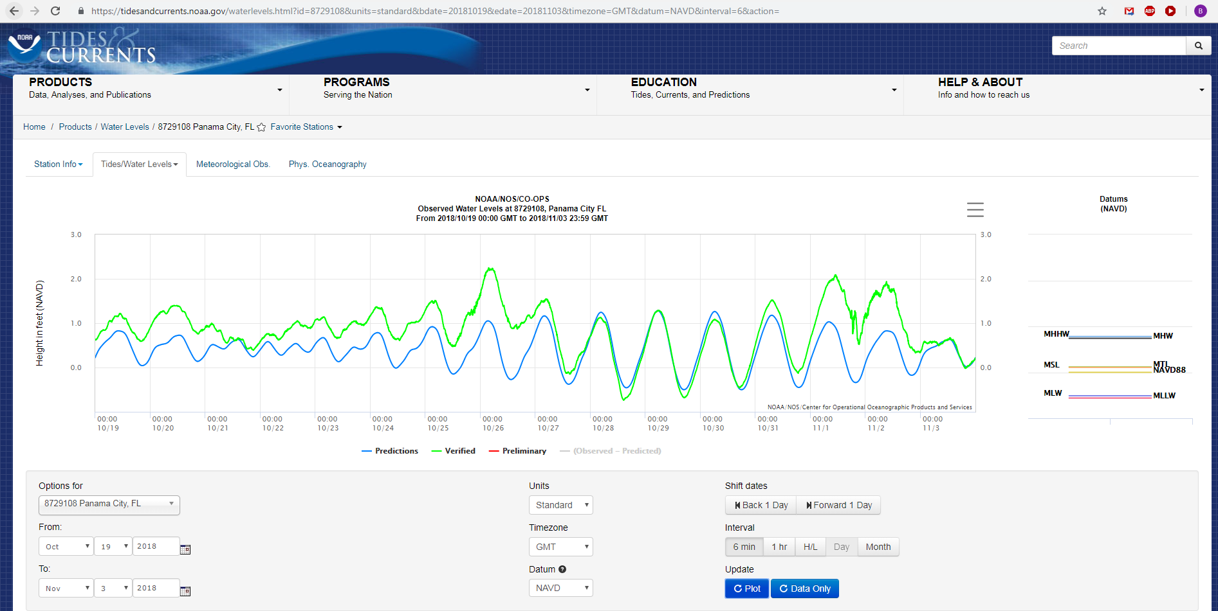
Accessing Water Level Data

Slide 18
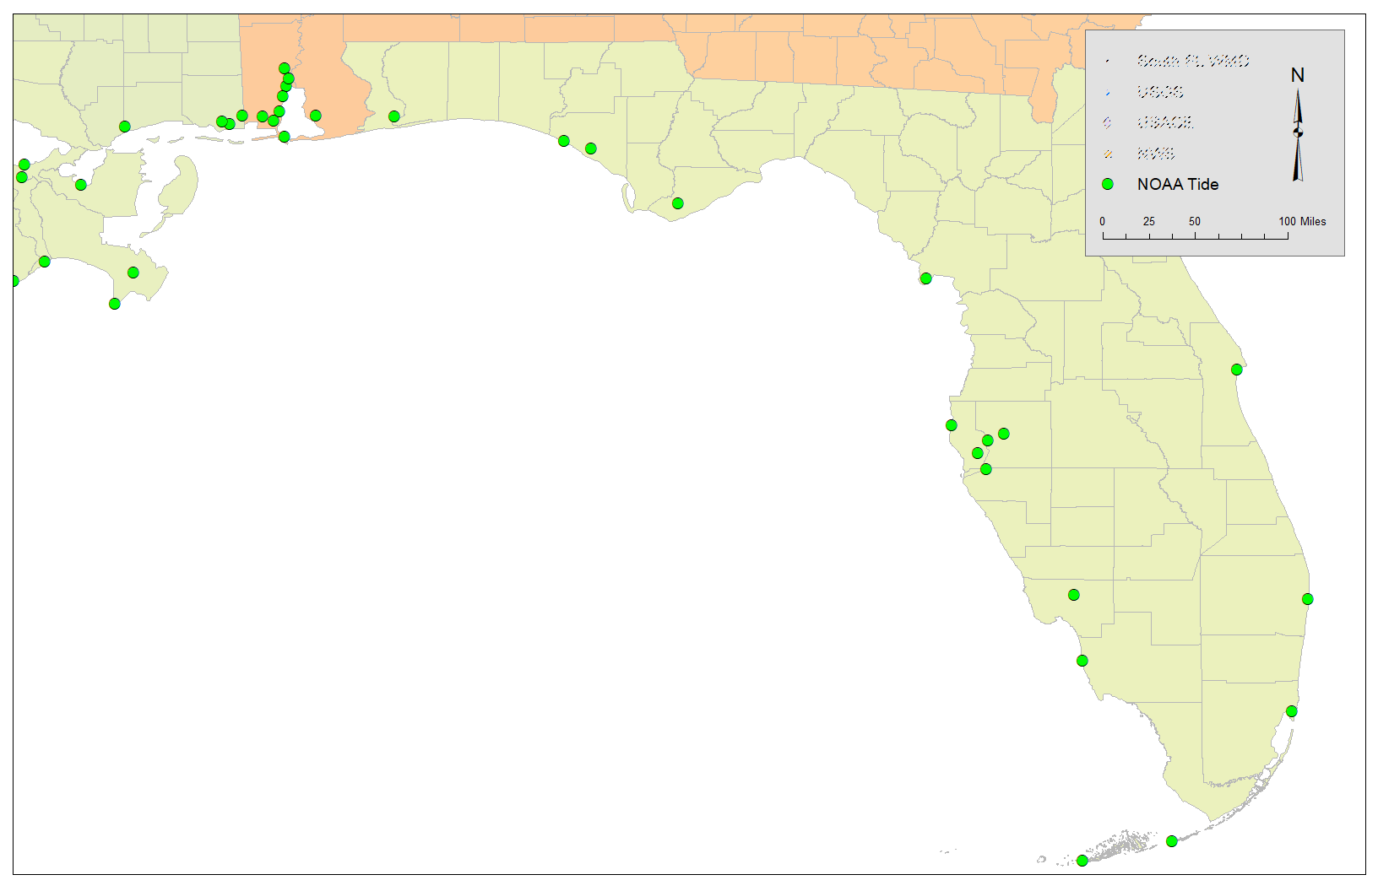

Slide 19
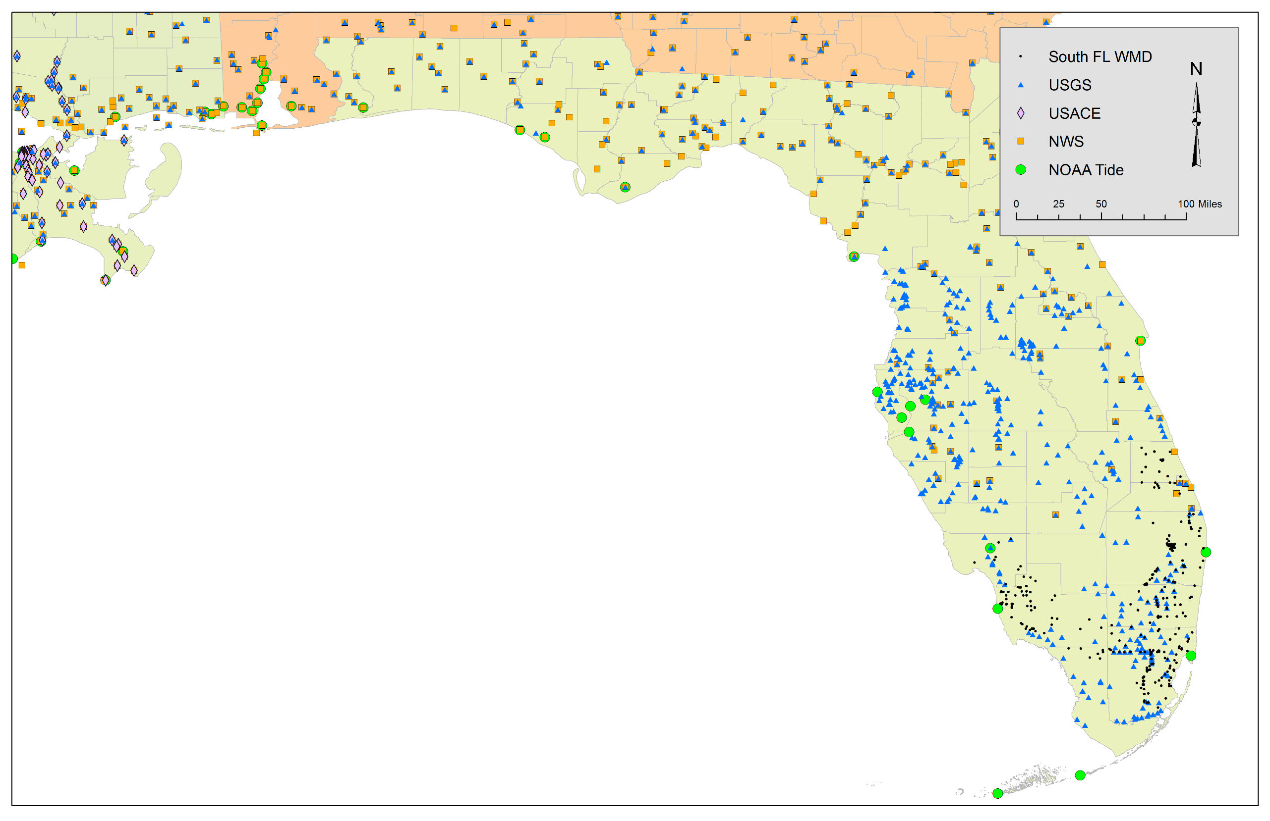
Challenges
Currently need 4+ custom methods that
access the federal agency APIs or gage tables
to collect metadata and data.
  USGS, NOAA, NWS (aggregator), USACE, State/Local
Different standards for
  Horizontal and vertical datum
  Date & time
  Reporting intervals and historical time periods

Slide 20
Gage Sourcing Complicates the Process
FOR EACH Agency:
  Acquire and plot gage positions
  Investigate duplicates (cross/intra-agency gages)
  Find metadata (gage datum)
  Query data
  Convert elevations to NAVD88, if possible
  Remove gages with no data and no datum
Merge

Slide 21



Recommendations
Sea Level Rise
Quantify and publish acceleration
Improve guidance to help communities
Rainfall
Non-stationarity analysis
Update Atlas 14, and in context of non-stationarity
Water Level Data
Enable download of multiple station records
One federal data standard and access portal

