Slide 1
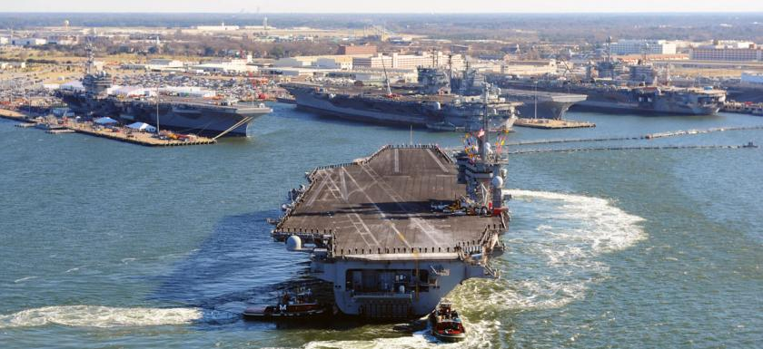
Perspectives on use of NOAA’s Coastal Data, products and services
US Navy file photo
Hydrographic Services Review Panel
March 7th, 2019
Rear Admiral Ann Phillips, US Navy (Retired)
Special Assistant to the Governor of Virginia for Coastal Adaptation and Protection
ODU File Photo

Slide 2
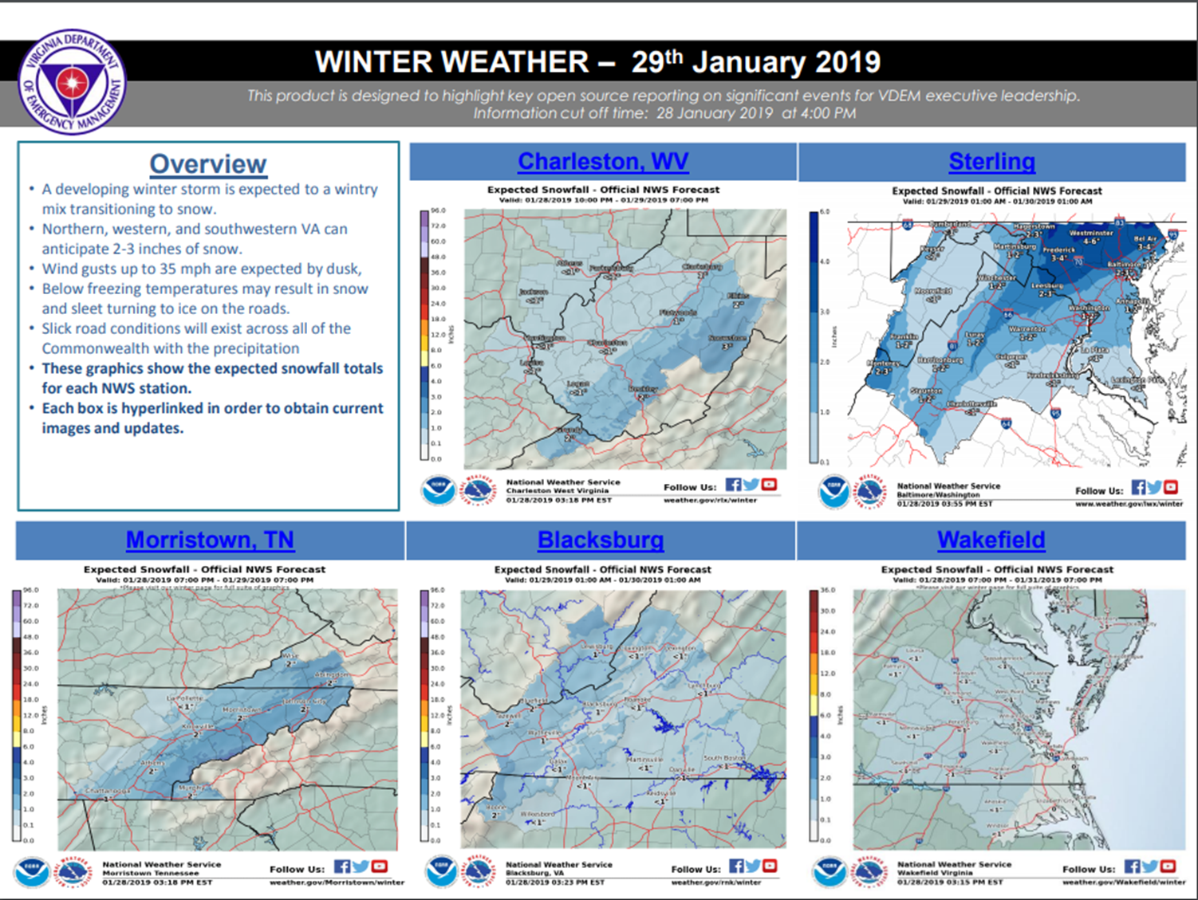
Issue: Hydrographic Modeling with Statewide and
Regional Focus and Integrated Forecast Capability
Example shows Winter Weather
Forecast for 29 Jan
Integrated Water projections
are also needed.

Slide 3
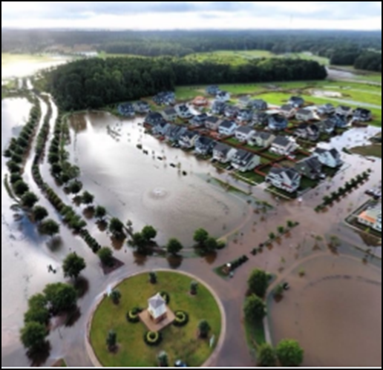
Issue: Continued improvement rainfall, streamflow,
and storm surge models
Enhance forecasting of storm impacts in coastal communities
Flooding because of precipitation, runoff and storm surge.
Combine with constant update NWS rainfall frequency analysis
Enable improved risk analysis and risk communication
Local, Regional, State managers.
Update Atlas 14
Asheville Park Neighborhood, October 2016
Photo Courtesy of City of Virginia Beach

Slide 4
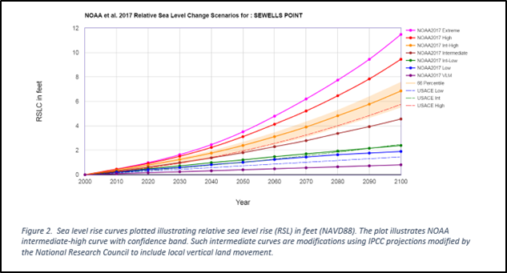
Issue: Aligned Sea Level Rise Scenario data presentation,
Facilitate planning process use by cities, regions.
Planners challenged to understand NOAA's Six 2017 SLR scenario curves
What do they mean by region, and what does NOAA recommend?
Are they coordinated with SERDP recommendations regarding risk?
Why are USACE and NOAA curves different?
Source: Transportation Research Record: http://journals.sagepub.com/doi/figure/10.1177/03611981774234

Slide 5
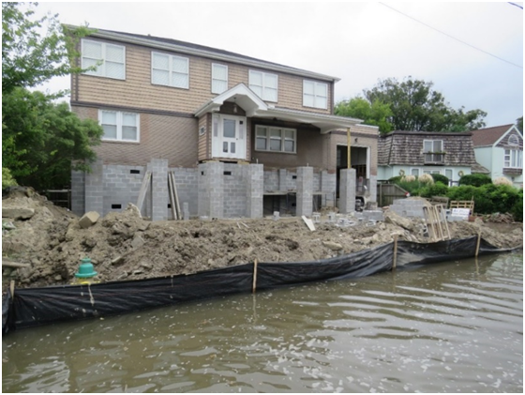
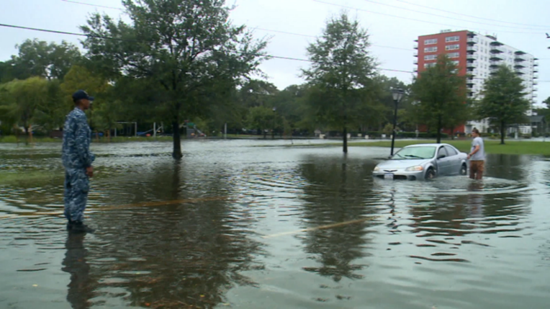
Summary:
Issue: Hydrographic Modeling with Statewide and Regional Focus and Integrated Forecast Capability
Issue: Continued improvement of the national water model - Integration with estuarine and Coastal System Models
Issue: Aligned Sea Level Rise Scenario data presentation to facilitate planning process use by cities, municipalities, regions.
Photo Courtesy of Dr. Larry Atkinson, ODU
Courtesy of WAVY 10 News/ Still Photo, American Resilience Project

