Slide 1
Critical Information in a timely manner
Capt. Jorge J. Viso
American Pilots’ Association
March 5, 2019
Washington, D.C.

Slide 2
Current Services
NOAA P.O.R.T.S.
AIR GAP
FORECAST

Slide 3
P.O.R.T.S.
TIDAL HEIGHTS
CURRENTS
METEOROLOGICAL
Wind
Barometric Pressure
Water Temperature
Air Temperature
Salinity

Slide 6
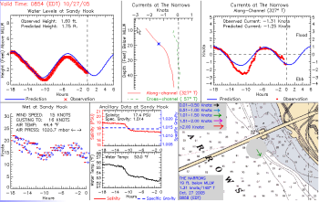

Slide 7
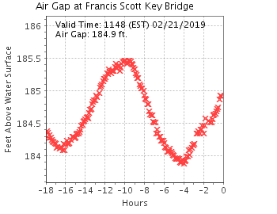
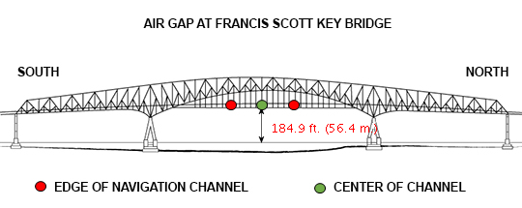

Slide 8
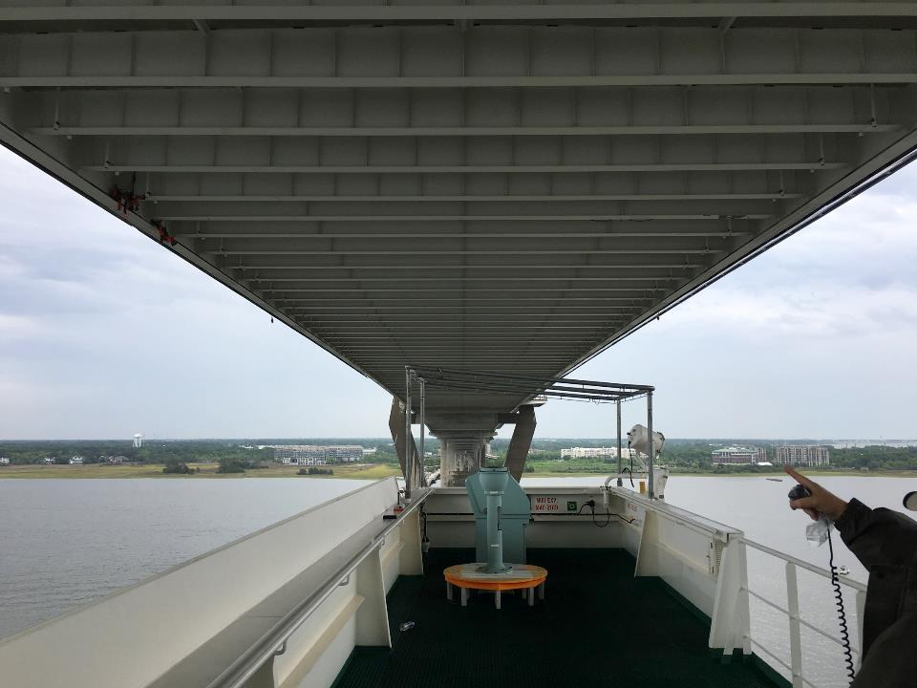
Notes:
COSCO DEVELOPMENT Highway 17 Charleston, SC

Slide 9
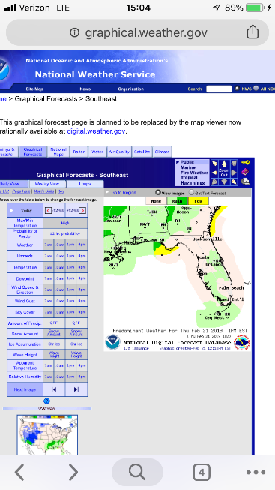
Forecasts
Graphical Forecasts
Marine Channel
Forecasts

Slide 10
Improvements
Delivery
Cooperation between agencies
Consistency

Slide 11
“Like to haves…”
Nationwide AIS delivery
bENC expansion
Visibility sensors

Slide 14
Ships get bigger…

