Slide 1
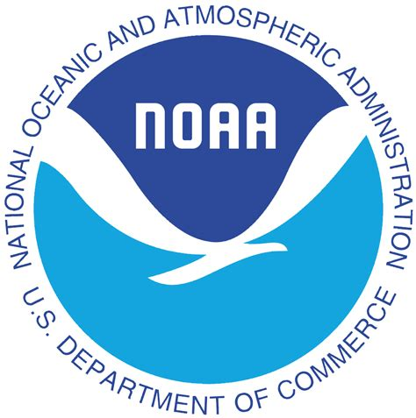
The Role of NOAA Services in Our Success: The Geospatial Community Perspective and the State of Practice
Dr. Qassim Abdullah
Chief Scientist and Senior Associate
Woolpert
NOAA Hydrographic Services Review Panel - Public Meeting, Washington, D.C., March 5-7, 2019

Slide 2
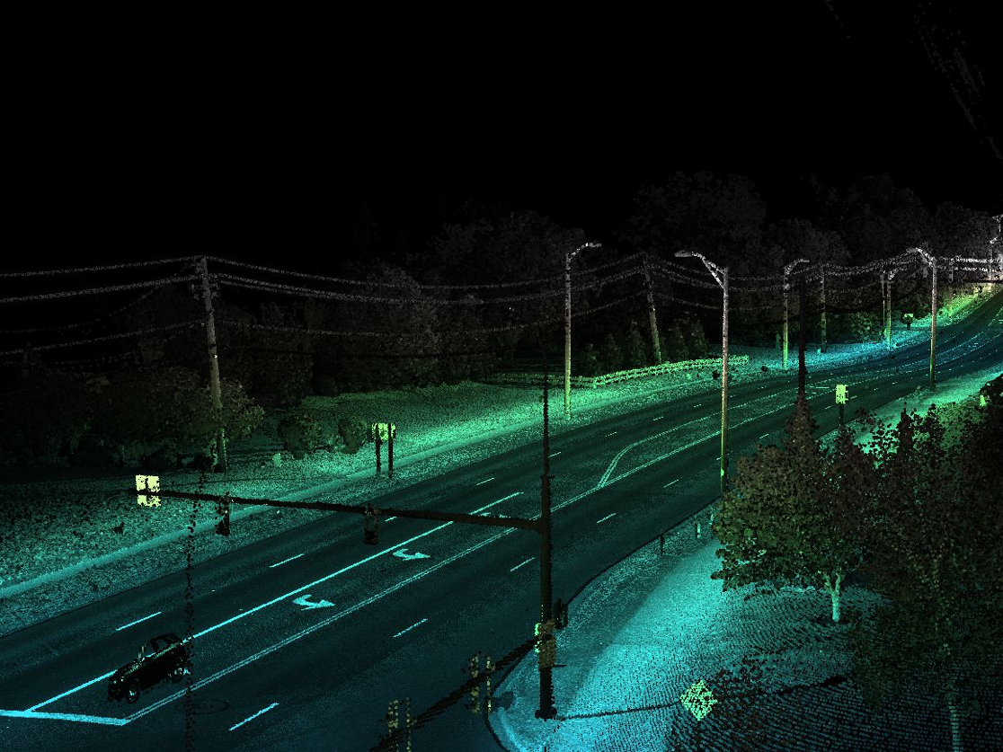
This presentation unofficially reflects the opinions of:
Geospatial data providers
ASPRS members
MAPPS members
Penn State and University of Maryland faculty
Special thanks to the industry partners and collogues who helped me prepare this presentation:
Jon Dasler and Jason Creech, David Evans and Associates, Inc.
Nathan Wardwell, JOA Surveys, LLC
David Kuxhausen, Woolpert

Slide 3
Our geospatial industry reached new heights in data acquisition capabilities

Slide 4
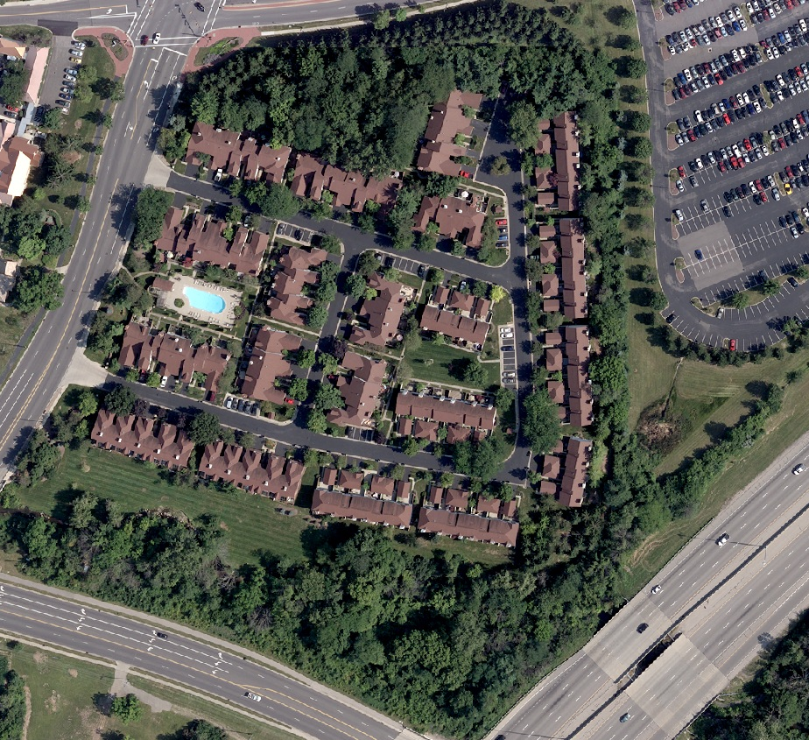
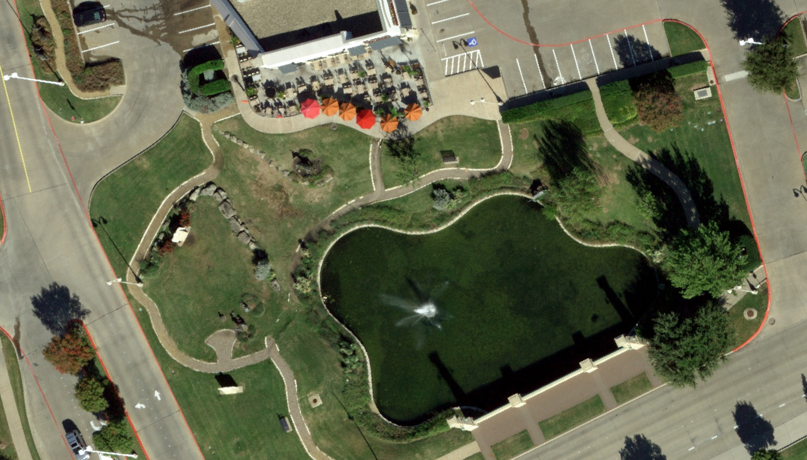
whether... Digital Imaging

Slide 5
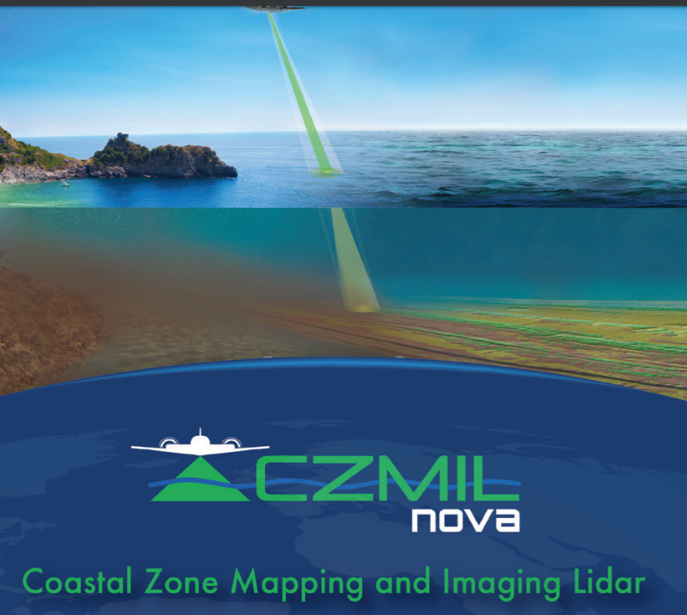
or… Bathymetric Lidar

Slide 6
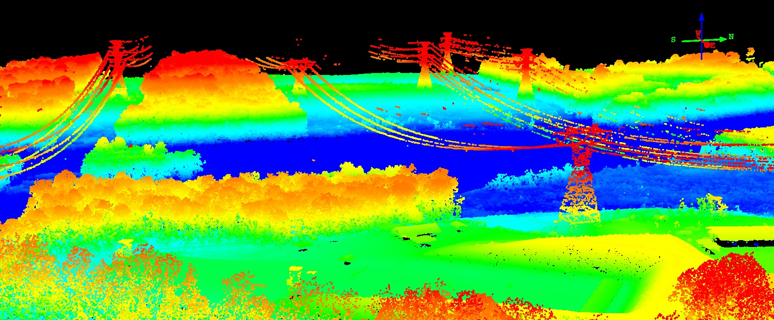
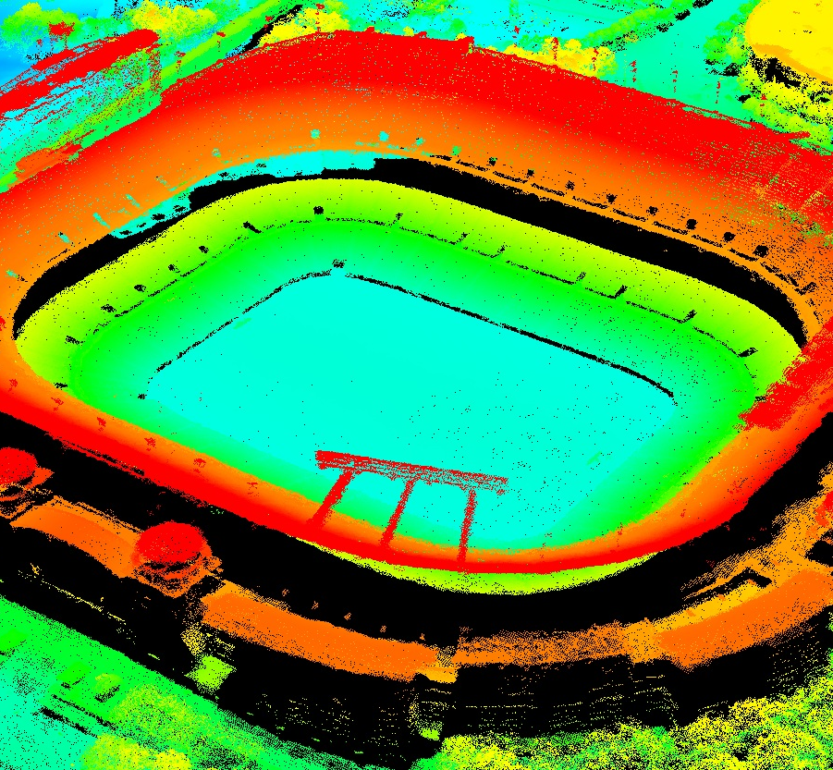
or…
Aerial Lidar
We can collect lidar from 26,000 ft. AGL with 10-cm accuracy

Slide 7
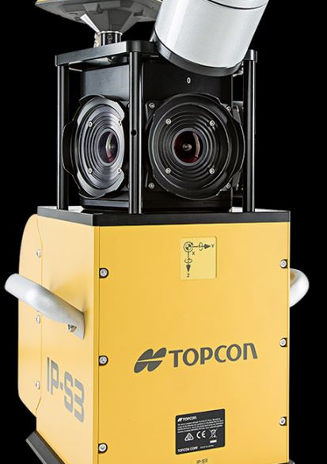
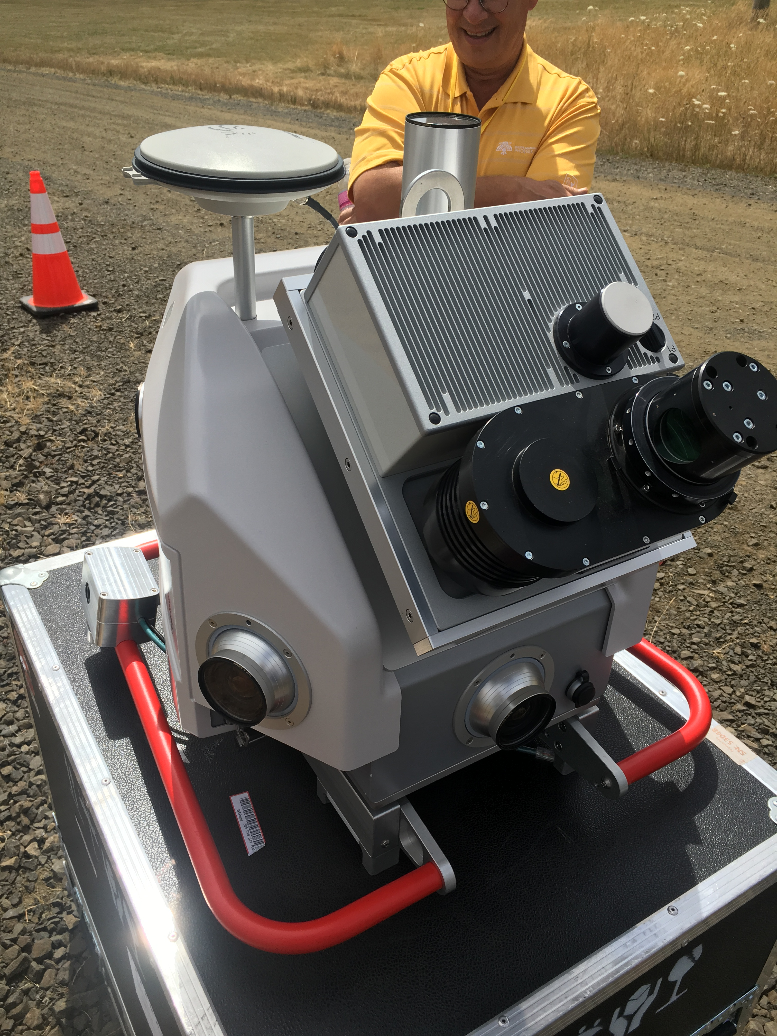
or… Mobile Lidar

Slide 8
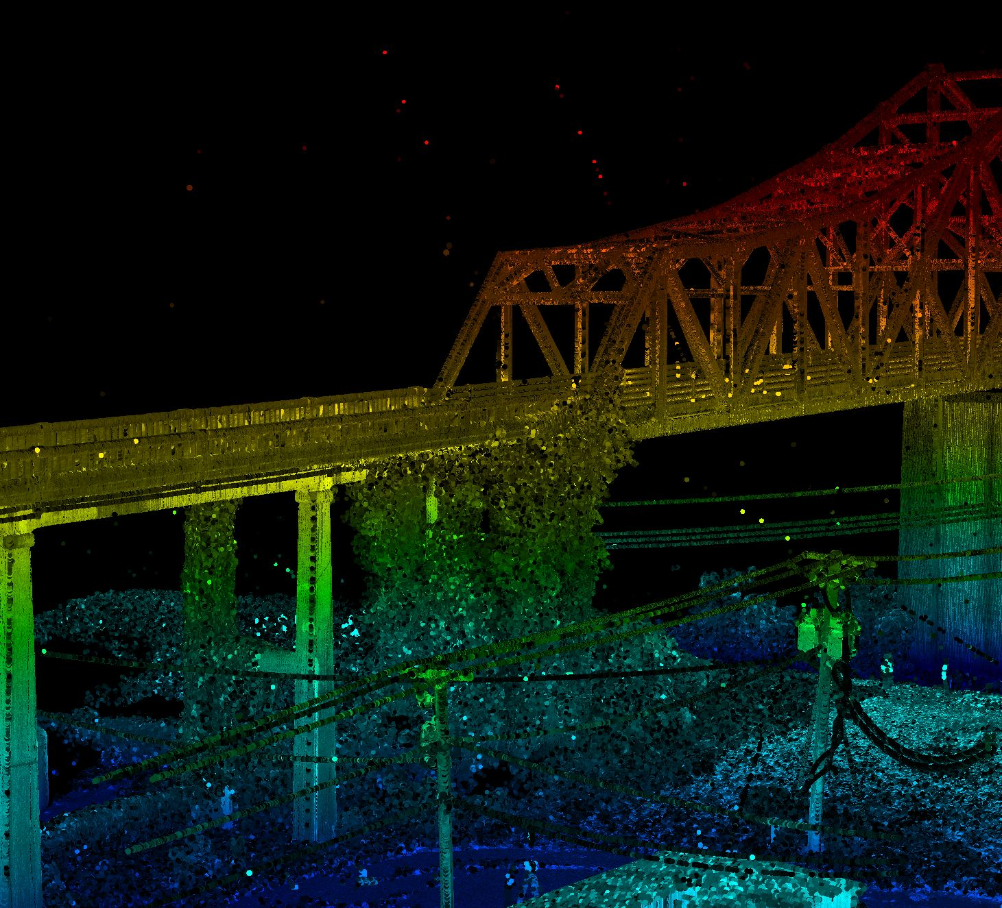
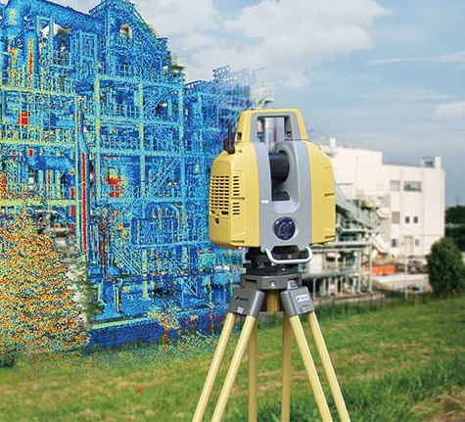
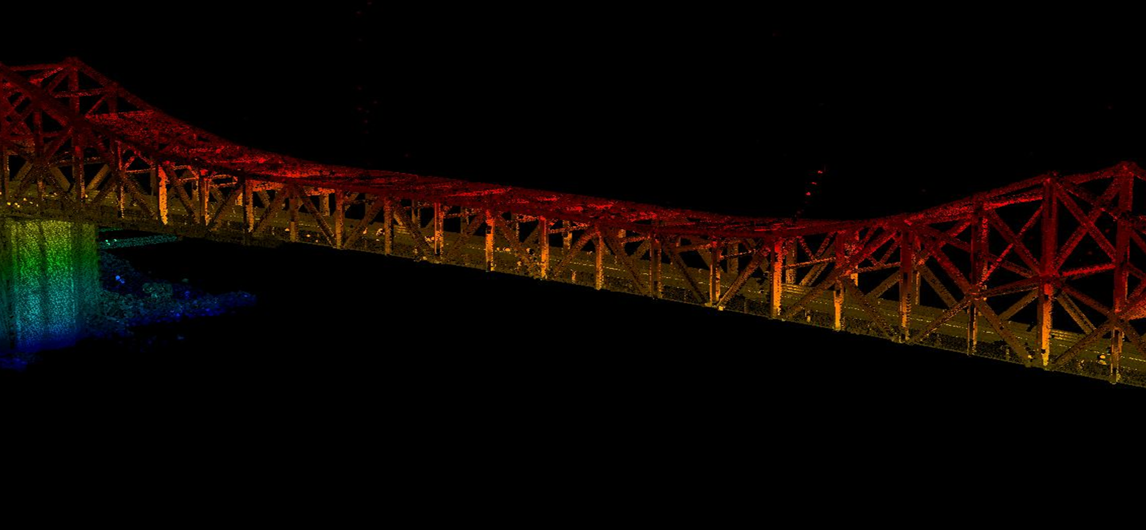
or… Stationary Lidar

Slide 9
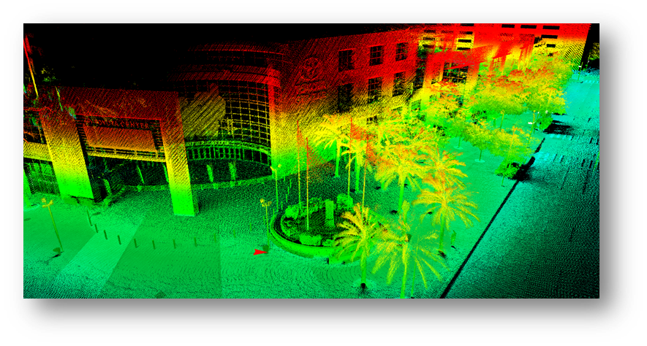
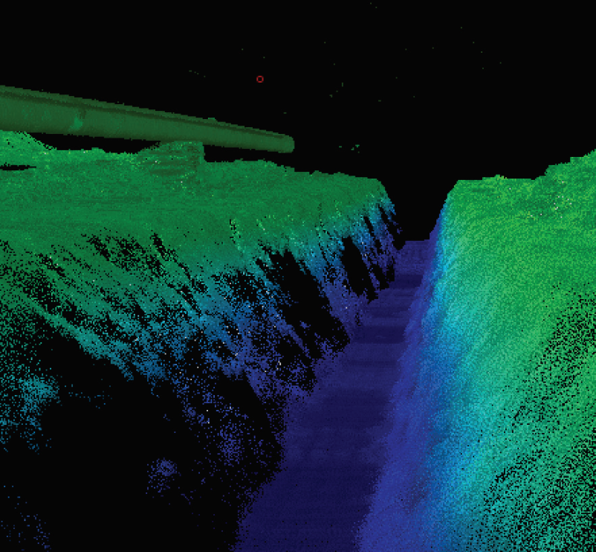
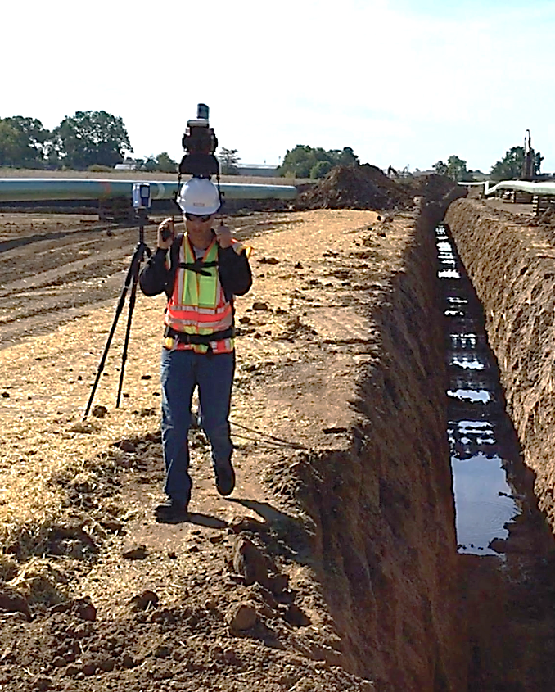
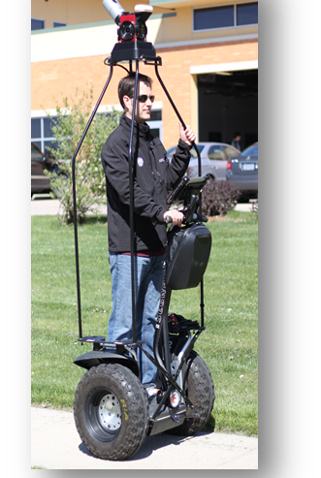
or... Carry-on Lidar

Slide 10
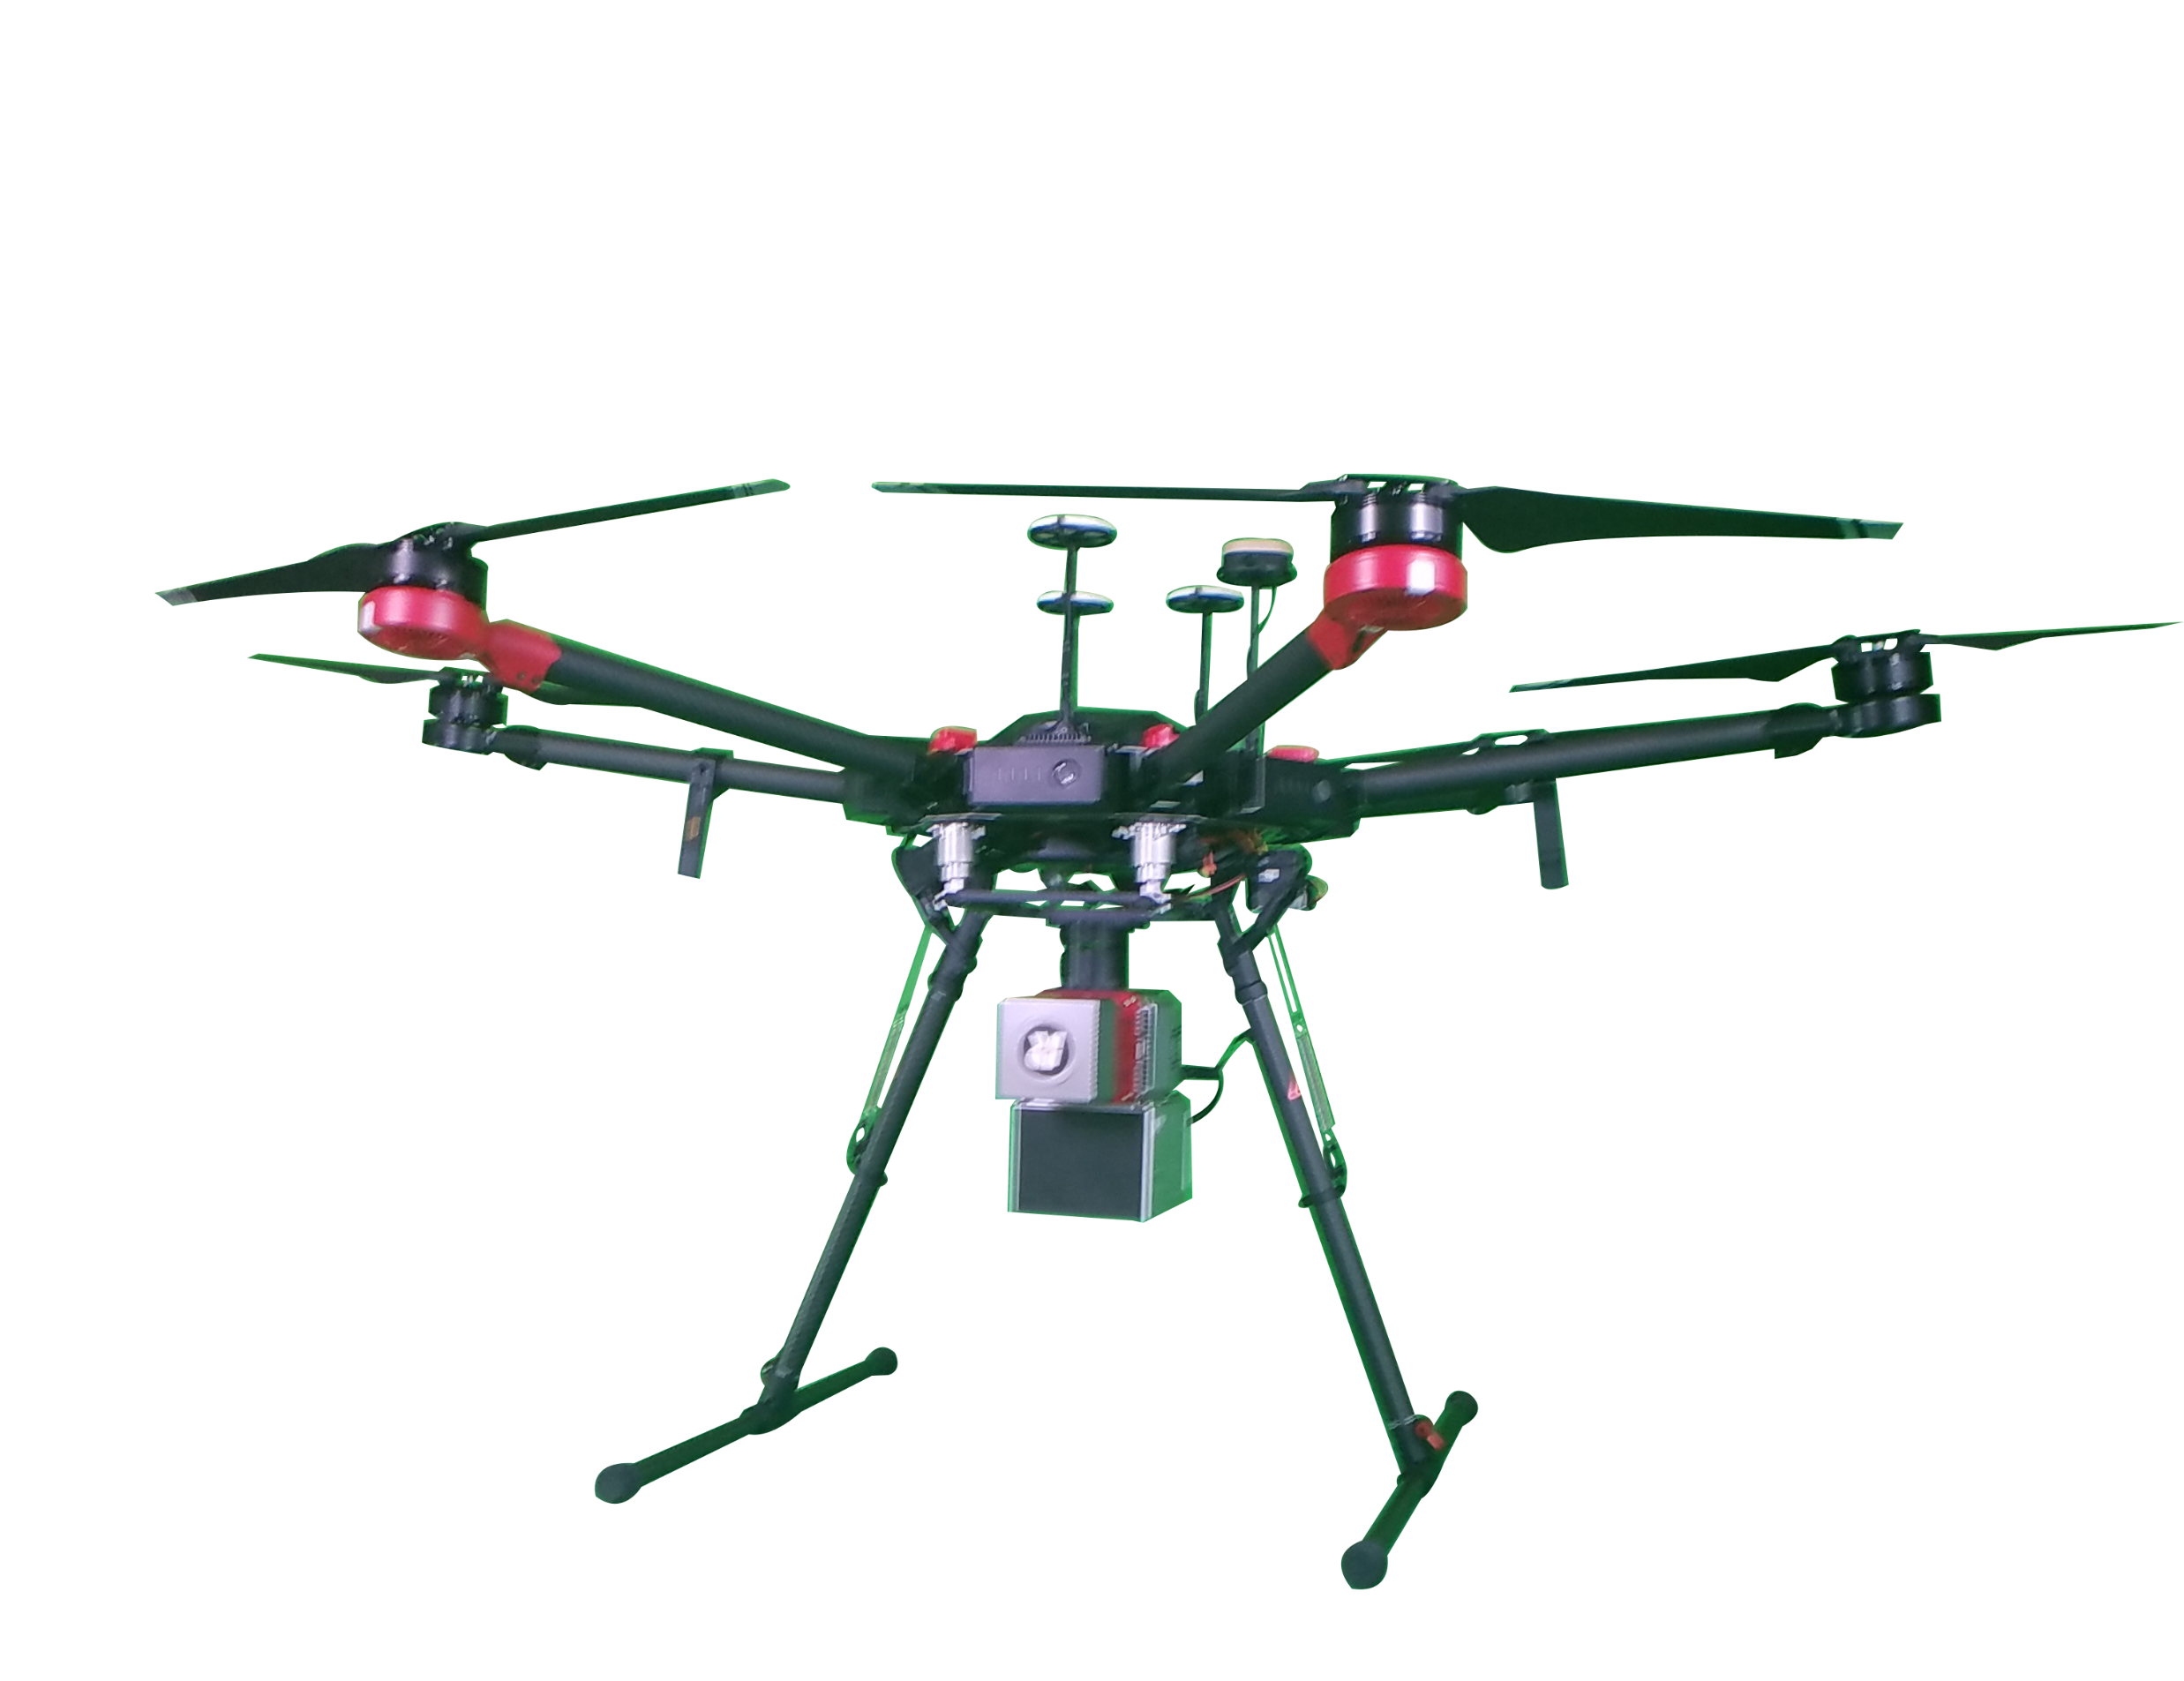
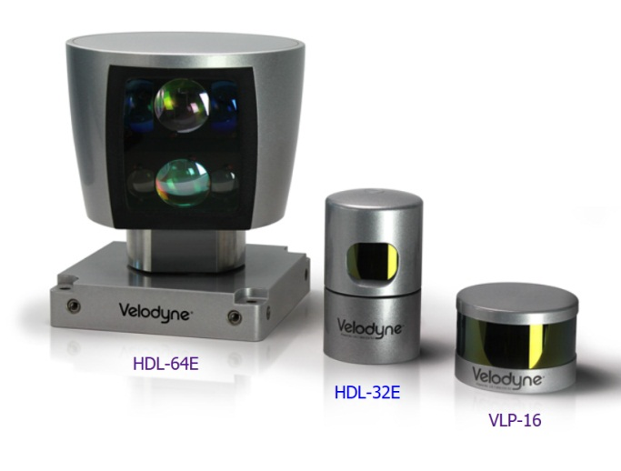
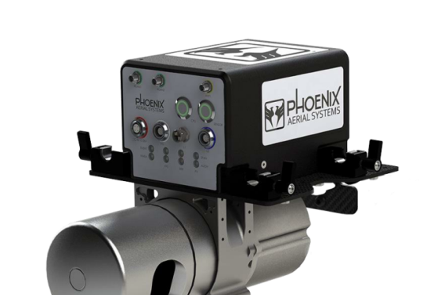
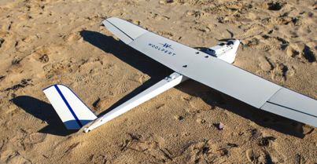
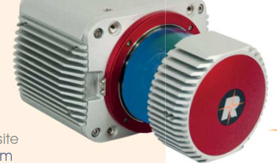
or... UAV-based Lidar

Slide 11
Shallow and deep-water bathymetric surveys
Lidar gives us everything we need for
sea floor mapping.

Slide 12
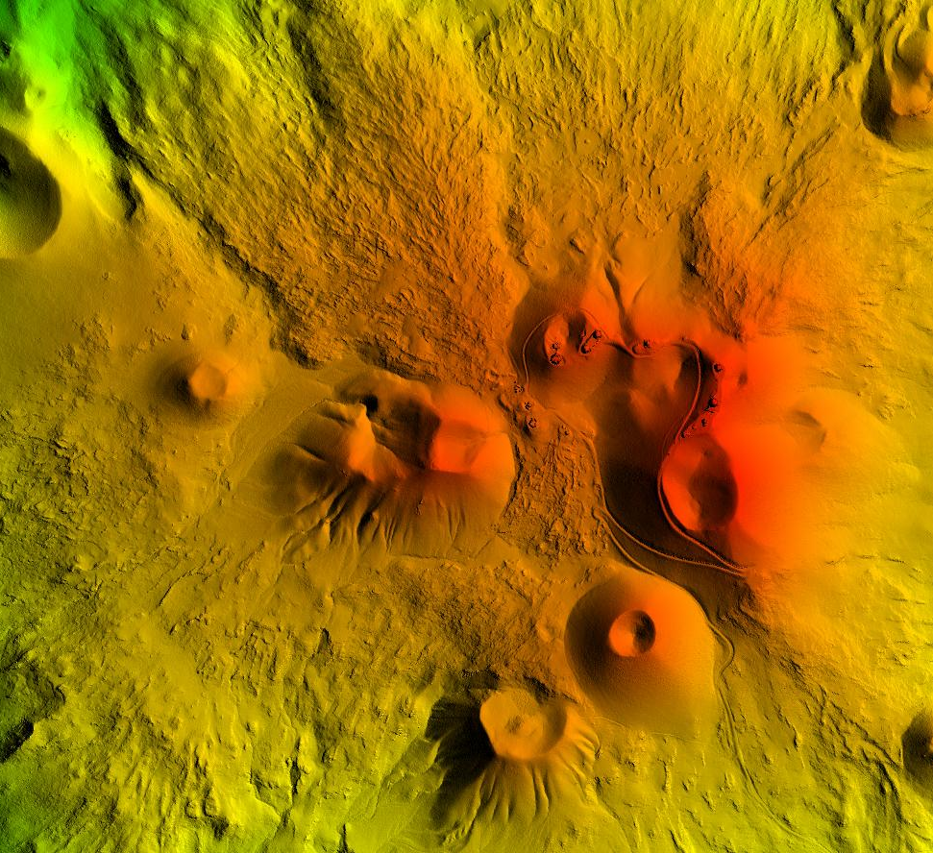
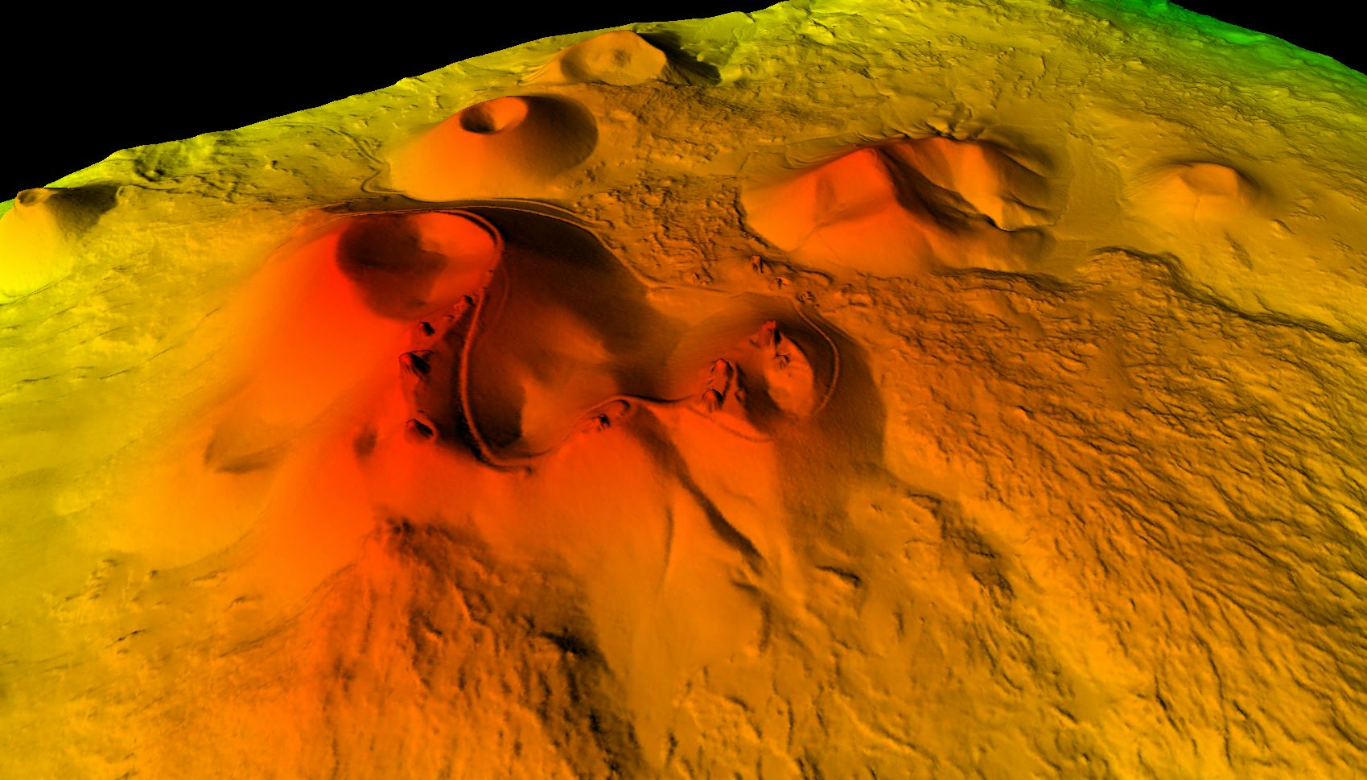
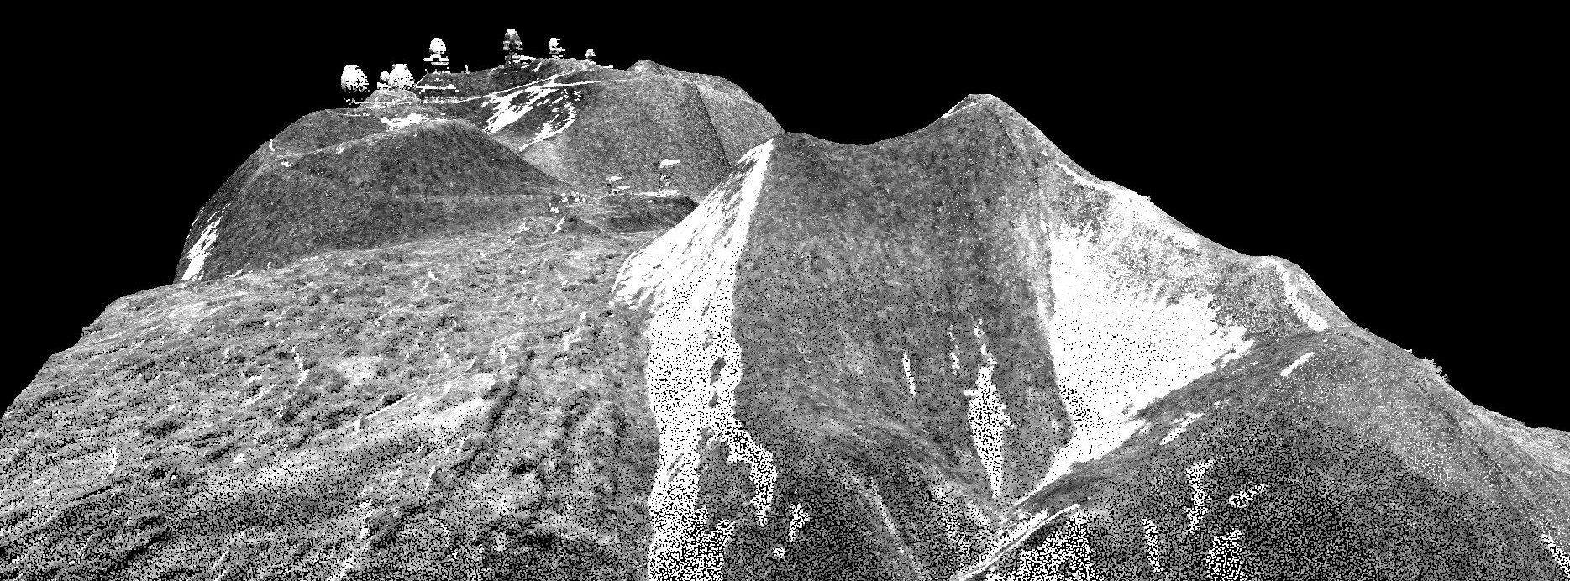
Lidar gives us everything we need for topographic mapping.

Slide 13
Lidar gives us everything we need for engineering design.

Slide 14
Factors Contributing to Our Success
Advanced sensor technologies
Geolocation capabilities
GPS, CORS stations, OPUS
IMU
Ground surveying techniques and survey monuments
Enabled processing software
With the help of NOAA services
With the help of NOAA services

Slide 15
Useful NOS Services
CORS and OPUS projects
Horizontal time-dependent positioning (HTDP)
Access to aeronautical data
NGS coordinate conversion and transformation tool (NCAT)
VERTCON
Weather forecasting for mission planning
Snow coverage maps
Tidal records
Historical weather
Vertical Datum Transformation (VDatum)
National Reference System Modernization of 2022 – Looking forward for it!

Slide 16
NOS Service Acknowledgment and Suggestions

Slide 17
VDatum
Great program heavily used by geospatial industry
More funding to support more frequent updates
Extend coverage shoreward (500 meters?) to account for changing shoreline, eliminate existing coverage gaps, and convert airborne and vessel lidar shoreline coverage
Incorporate river gradient datums such as Mississippi Low Water Reference Plane and Columbia River Datum
Geospatial community concern over new National Tidal Datum Epoch (NTDE) impact on VDatum; adequate funding for simultaneous update of all models on rollout
Geospatial community concern about whether NOAA will update the NTDE and VDatum simultaneously with 2022 NSRS rollout

Slide 18
VDatum
Extend coverage to Alaska, especially major ports and coastal communities
Current NTDE is 1983 to 2001; will be updated to new 19-year period soon. Some tidal datums reference modified five-year epoch
Perform more robust GNSS ties at temporary tide stations. Current SOW is a single four-hour observation of a single tidal benchmark; two simultaneous observations of two marks would improve ties between tidal datums and global reference frame
Tidal datum and ellipsoid height information for many tidal benchmarks used in development of VDatum grids reference different epochs. The reference epoch for the current NSRS is 2011 and the center of the current NTDE is 1992. Combining tidal datum and ellipsoid heights referencing different epochs introduces errors, especially in regions with significant vertical land motion.
Notes:
Incorporating transformations between different tidal datum epochs would be useful.

Slide 19
CORS
Great program by National Geodetic Survey and heavily used by geospatial industry
Enhance funding to support and expand
Consider adding CORS stations collocated with CO-OPS** tide stations where practical
Extend CORS network to offshore platforms, islands, etc., to support ellipsoid reference surveying
For new installations, select coastal sites suitable for both positioning and measuring water levels via GNSS reflectometry
** Center for Operational Oceanographic Products and Services (CO-OPS)

Slide 20
Precision Navigation
Kudos to Office of Coast Survey Visionary Program for improving safety of maritime commerce in key harbors (Long Beach, Lower Mississippi River, New York)
Kudos to CO-OPS for ports support of dynamic under-keel clearance. Need to expand, obtain federal funding and foster industry partners similar to CORS
Visionary use of mobile mapping systems (vessel lidar and imagery) for harbor asset management and charting (bridge and overhead wire clearance, precision positioning of features, etc.)
Obtain funding to expand precision navigation products to all deep-draft ports to support increasing demands of maritime commerce on ports, harbors and approaches
Improve water level forecasts and near-shore bathy around arctic communities

Slide 21
National Water Level Observation Network
Great program by NOAA Center for Operational Oceanographic Products and Services (CO-OPS) and widely used by geospatial industry
Enhance funding to support and expand
Publish relationship of NAVD88 on tidal datums page for all published stations
Extend offshore observations (buoys, platforms, bottom mount gauges, etc.)
Consider expanding network through GNSS reflectometry, especially in challenging coastal environments such as Alaska
Improve GNSS ties at NWLON stations by leveling ties between NWLON stations and nearby CORS, and through more robust GNSS observations
Consider using modified five-year epoch for all tide stations to provide more consistency between tidal datums and ensure currency of tidal datums

Slide 22
Thank you!
Qassim Abdullah
qassim.abdullah@woolpert.com
Mapping_matters@asprs.org

