Slide 1
Hydrographic Services Review Panel FAC
Chris Edmonston
BoatU.S.
Hydrographic Services Review Panel
NOAA and Recreational Boaters
March 5, 2019, Washington, DC

Slide 2
About BoatU.S.
Boat Owner’s Association of the United States
The Largest association of recreational boaters in the country, with over 600,000 dues-paying members.
Over 500 employees in 4 offices across the country, over 300 on-water service providers (TowBoatU.S.) and over 20,000 on-the-road towers.
Largest boat-only insurance company in the country.
Largest circulating boating magazine in the country.
Largest provider of online and on-water boating education.
We are the boaters’ voice!
We have provided government affairs and consumer advocacy for over 50 years.
Full-time government affairs staff lobbies on state/federal laws that impact boating.
Consumer affairs help is available to all boaters, not just members.

Slide 3
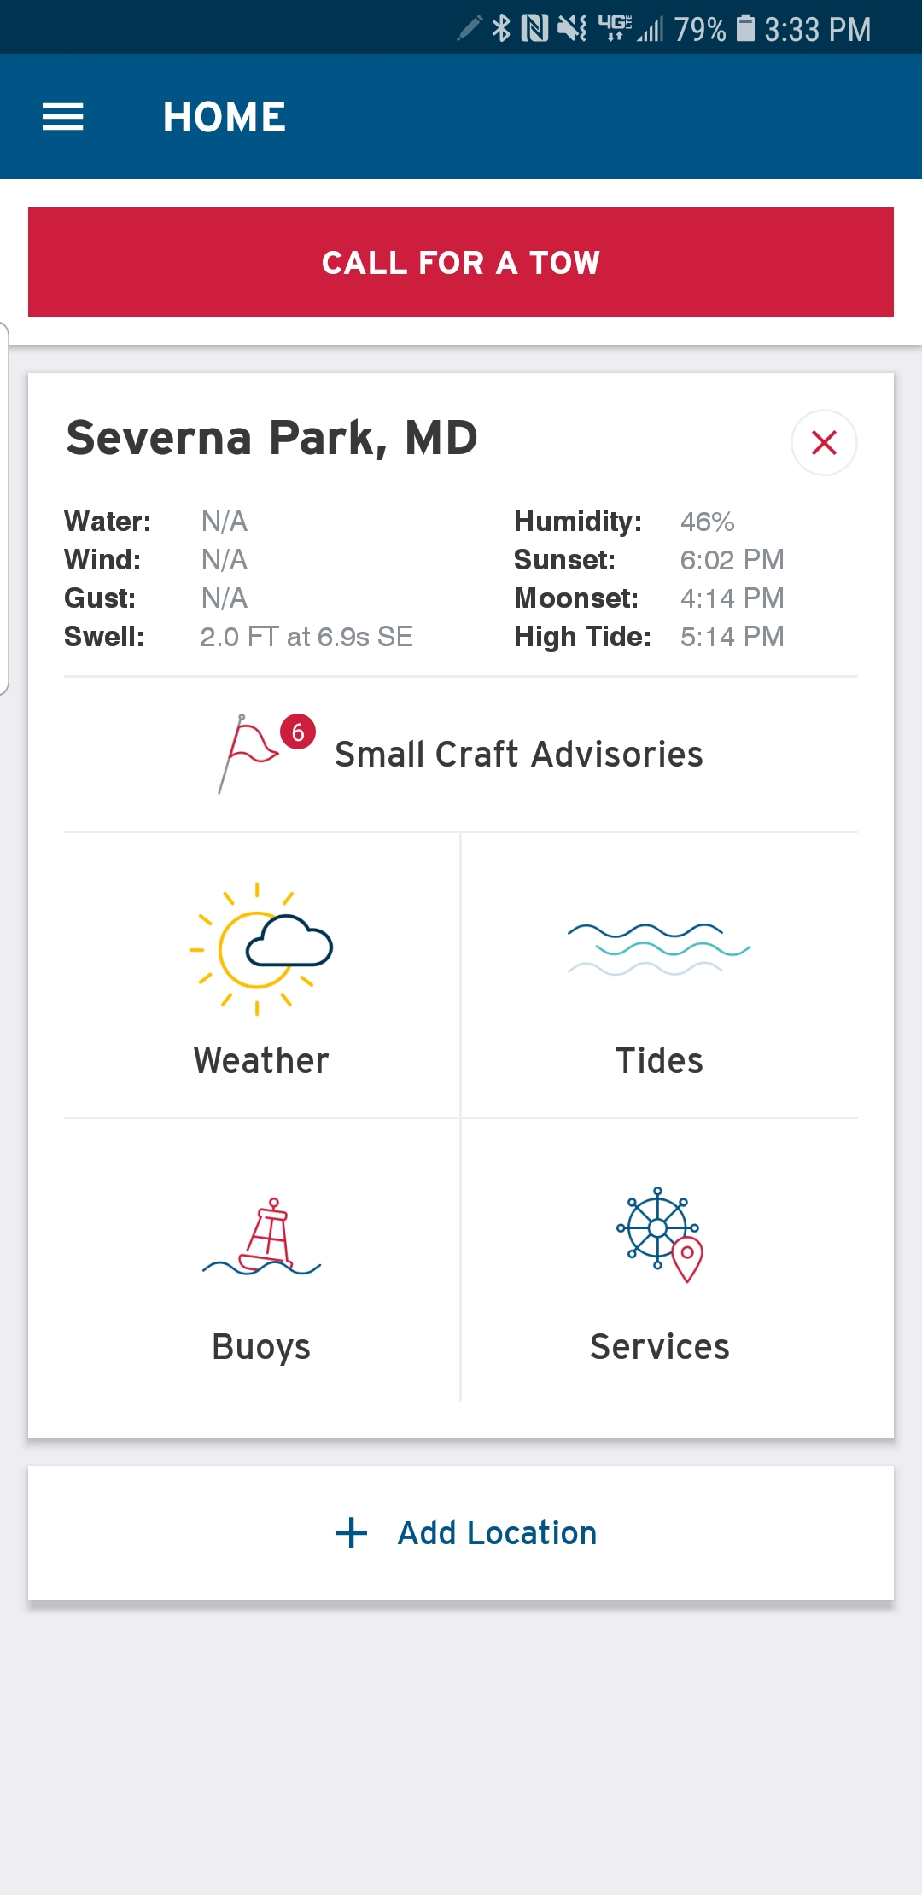
Usage of NOAA Navigation Services, products & services by BoatU.S.
Recreational boaters depend on NOAA data!
Tides
Charting
Buoy data
BoatU.S. App
Over 300,000 boaters use this
10,000 new users each month
Relies heavily on NOAA!
Towing dispatch

Slide 4
Requests for NOAA Navigation Services data, products, and services from boaters
What products or services do you wish you had?
API library for your products.
Buoy data as an API rather than a text file.
Have nowCOAST available in other formats such as tablet/smartphone versions (downloadable/an APP)
River stages
Lake water levels
Data, Data, Data…
Right now we have to convert buoy data from flat text file to a database, then into an API—for a fee. If the data came from NOAA in an API, it would be easier to use and more cost effective.
There are currently API’s for river stages and water levels, but they refer you to locations of stations—not the data itself…

Slide 5
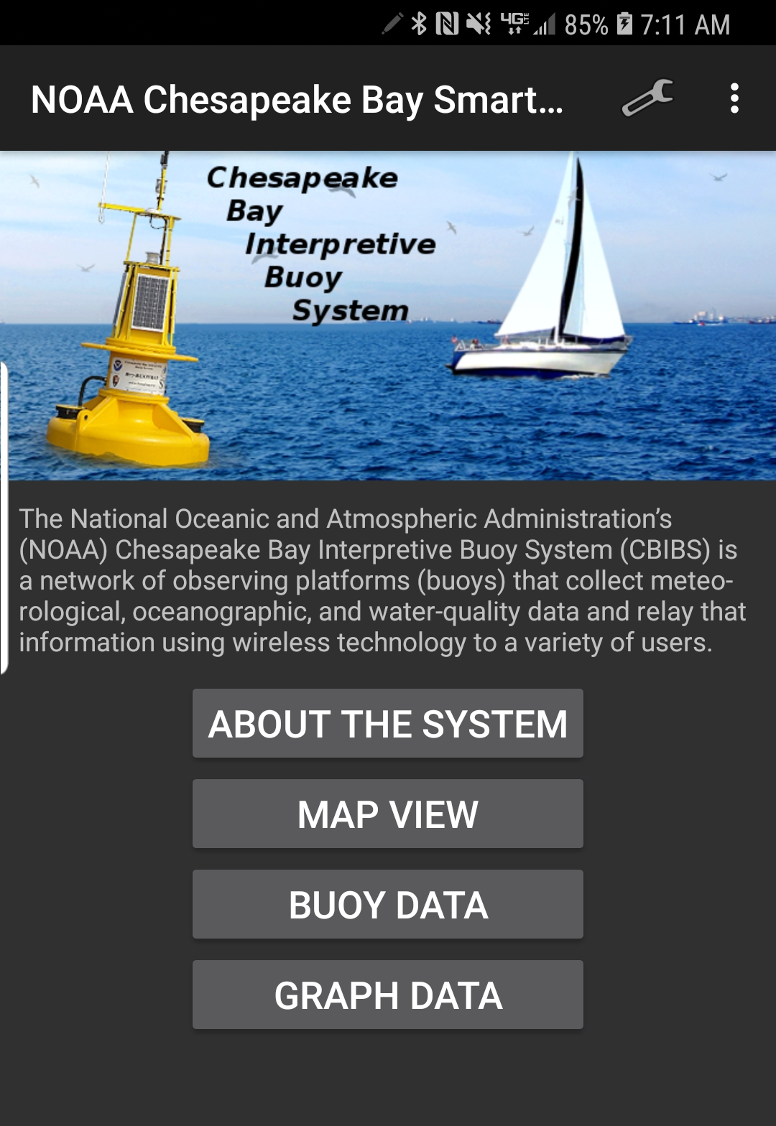
Real impacts of NOAA Navigation Services data, products & services
For me, I live in Annapolis Maryland and I use the Smart Buoy APP all the time…
Dissolved oxygen
Salinity
Seanettle probability
Water temp
Wind speed

Slide 6
Contact Information:
Chris Edmonston
BoatU.S.
cedmonston@boatus.com
703.461.2878 X8356

