Slide 1
Hydrographic Services Review Panel FAC
Will Fediw
Virginia Maritime Association
Hydrographic Services Review Panel
Stakeholder Perspectives
March 5, 2019, Washington, DC

Slide 2
About the Virginia Maritime Association
“The Voice of Port Industries”
Promoting, Protecting, and Encouraging Commerce through Virginia’s ports since 1920
Representing 450+ member companies
Full spectrum of maritime logistics-related firms
Economic Impact of Virginia’s Ports
$88.4 Billion in spending
$27.4 Billion in wages; 530,800 port-related jobs
10.1% of state GDP; $2.7 Billion in state/local taxes
79 Million tons of cargo moved
Poised for Growth
$3.7 Billion invested
14,676 jobs created; 9.8 million square-feet developed

Slide 3
Usage of NOAA Navigation Services, products & services
Virginia’s Maritime Industry relies on accurate, real-time data
PORTS
Digital charts
Heavy weather planning & recovery
Widening & Deepening of our Channel
Changing hydrodynamics
Facilitating Ultra-Large Container Vessels (ULCV’s)
Increase in vessel size (14,000 TEU; 160 in CY 2018)
Potential size increase in coal ships
Capesize bulk carriers

Slide 4
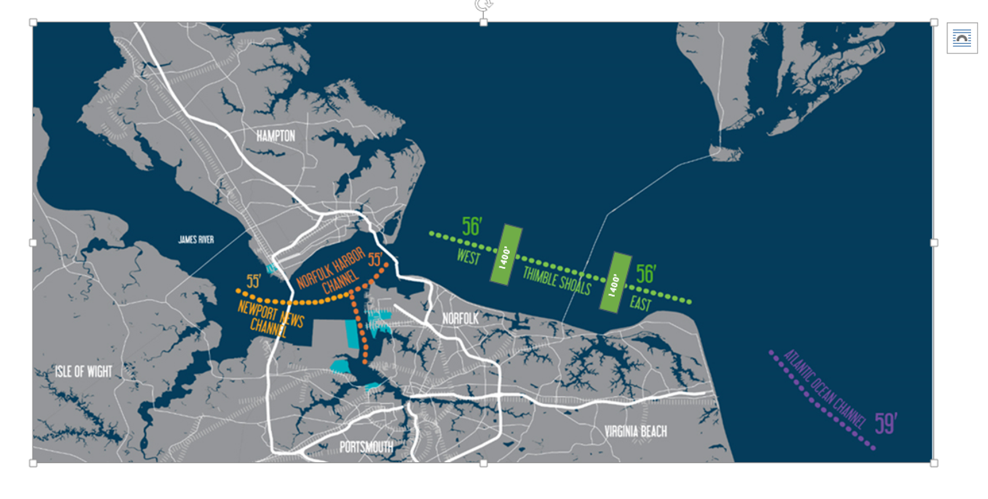
Usage of NOAA Navigation Services, products & services
1300’

Slide 5
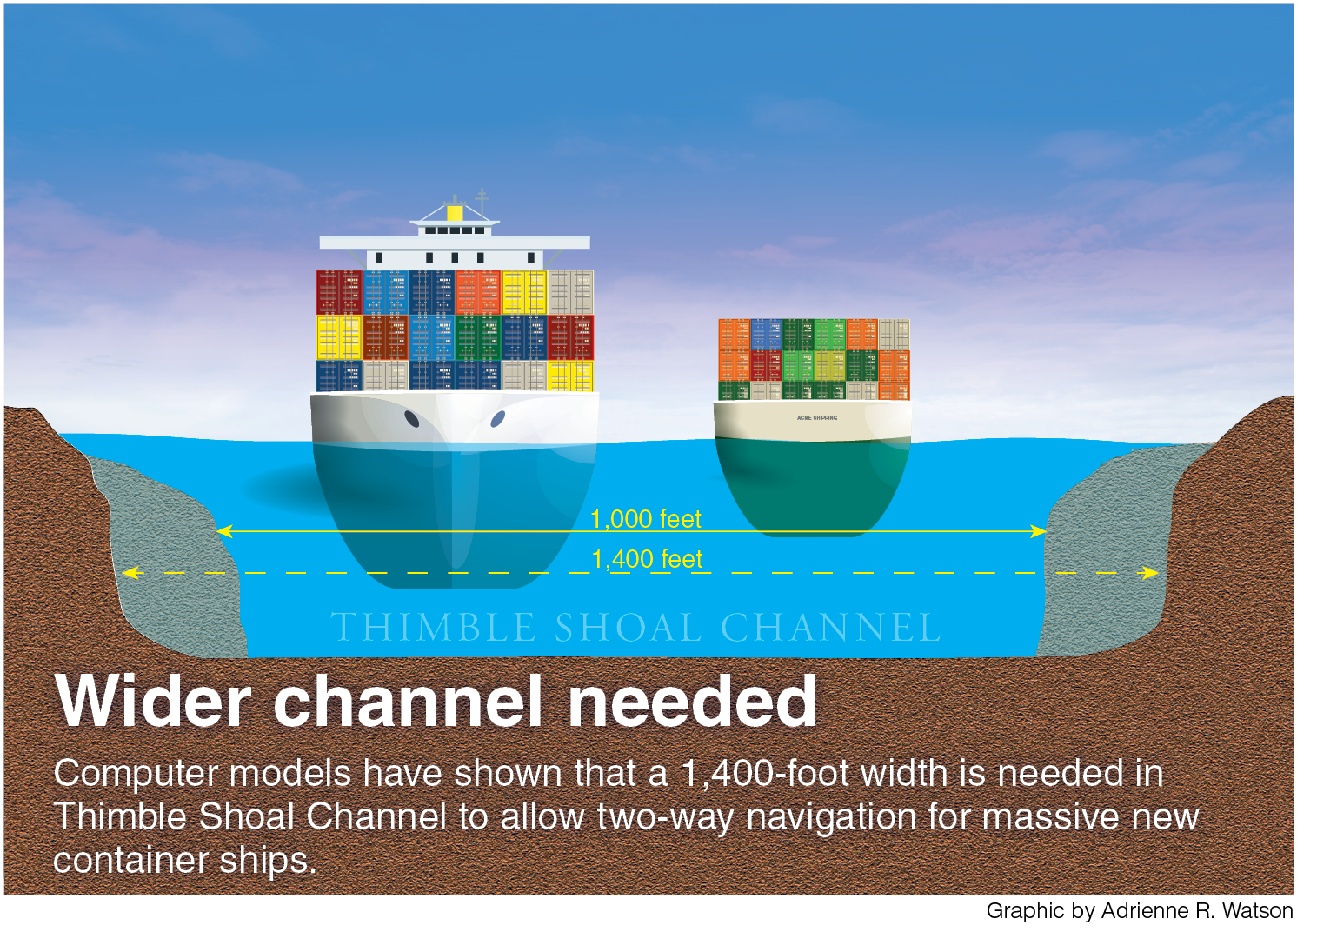
Usage of NOAA Navigation Services, products & services

Slide 6
Requests for NOAA Navigation Services data, products, and services
Facilitating Larger Vessels Requires:
Fully-funded Federal PORTS system
Existing infrastructure properly serviced & maintained
Improved Cape Henry wave buoy
Trustworthy PORTS data (CORMS)
Consolidated bathymetric data (NOAA & USACE)
Consolidated “dashboard” for PORTS data

Slide 7
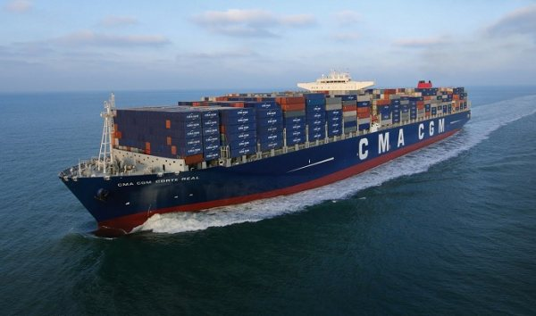
Real impacts of NOAA Navigation Services data, products & services
Pilotage decision-making
Real-time, CORMS-vetted data
CBIBS errors
“Tidal wave”
Post-storm recovery
2nd largest port on East Coast
Largest Navy base in the world
Chesapeake Bay Gateway
Economic Development Decisions
Modeling of larger ships
Project development
“We would be lost without our PORTS page”
Capt. Bill Cofer
President, Virginia Pilots Association

Slide 8
Contact Information:
Will Fediw
Vice President, Industry & Government Affairs
will@vamaritime.com

