Slide 1
AAPA Perspectives
Hydrographic Services Review Panel
Washington, D.C.
Susan Monteverde
AAPA Government Relations
March 5, 2018
American Association of Port Authorities
703.684.5700 • www.aapa-ports.org

Slide 2
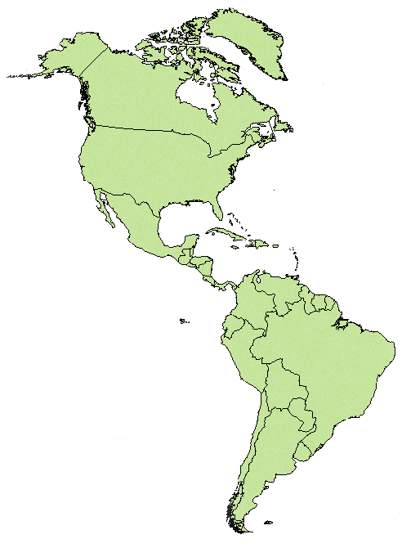
American Association of Port Authorities
Representing Seaports of the Western
Hemisphere for over 100 years!
  AAPA was established in 1912
  Since that time AAPA has been providing a space for collaboration and exchange of best practices
  Fostering collaboration among members and allied groups. We do this through:
    Education and Training, PPM
    Networking and one-on-one interaction
    Legislative and policy support
    Outreach

Slide 3
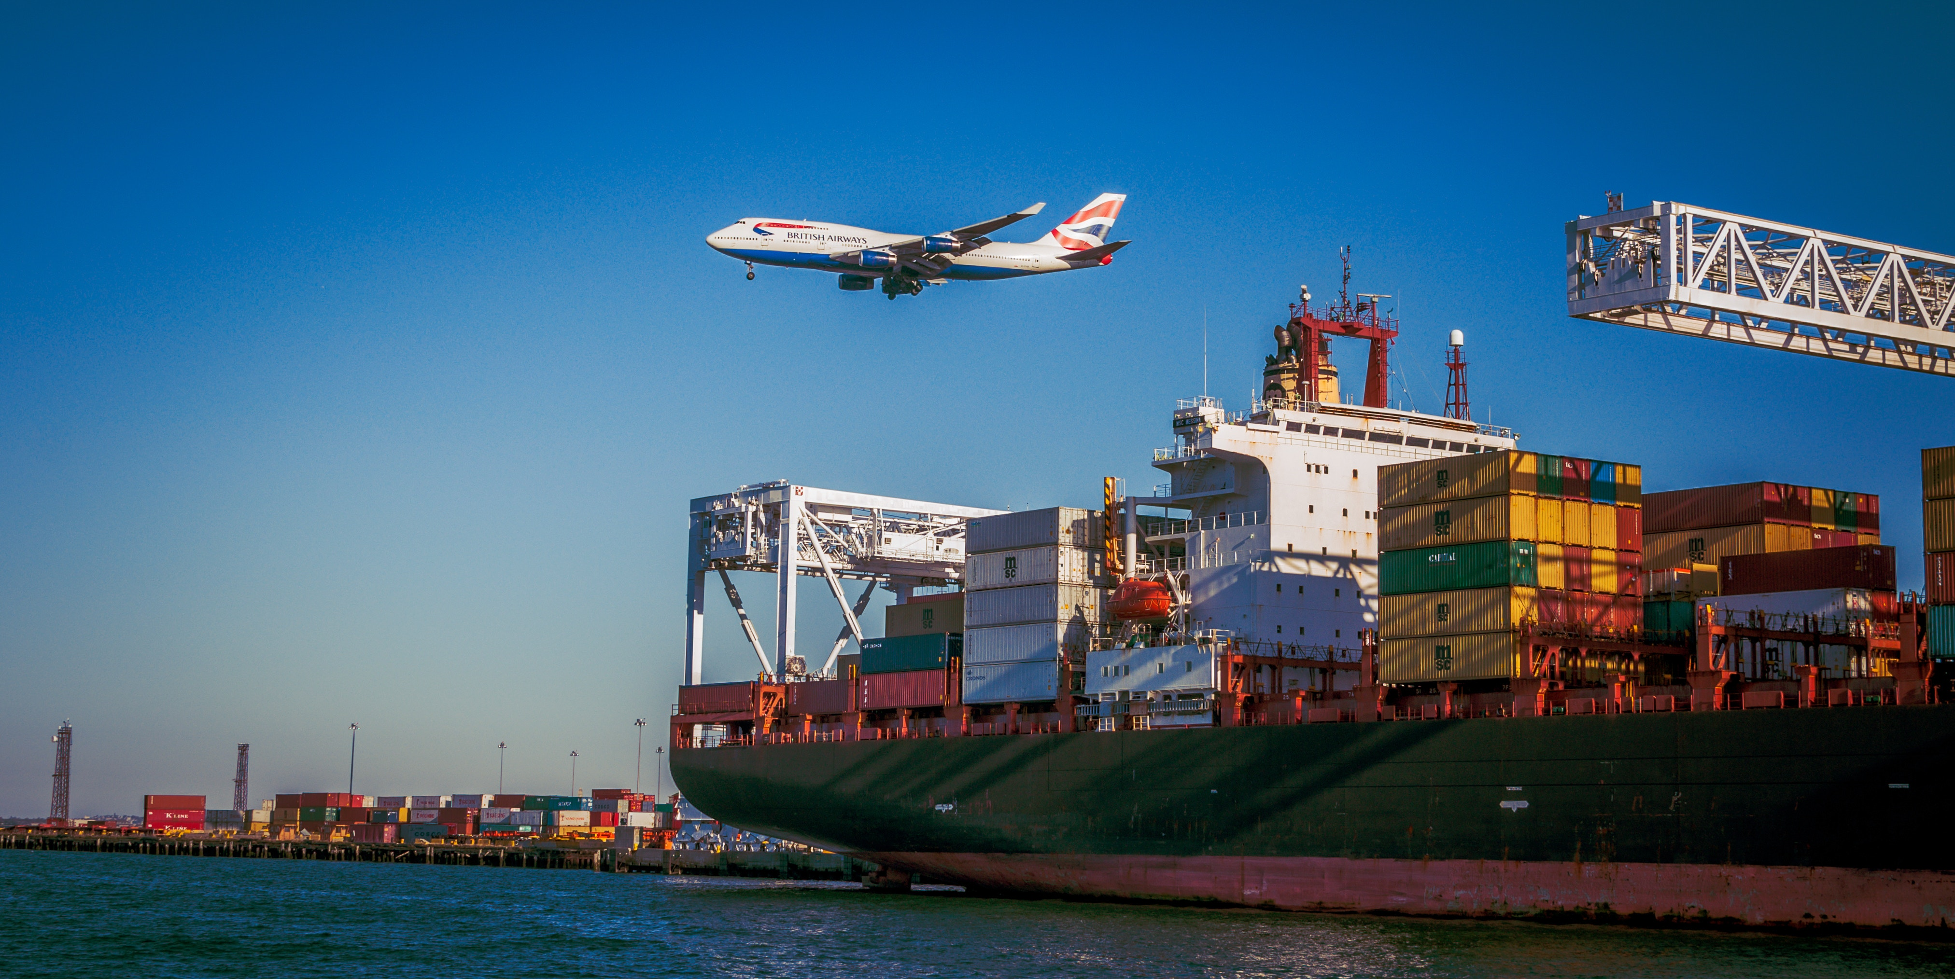
Shared Goal of AAPA and NOAA:
Facilitate International Commerce
We are a Maritime Nation (Constitution)
Federal navigation channels are the conduit
for almost all U.S. global freight movement
Water transportation savings are critical to America’s global competitiveness in trade
We must educate Congress and the public on the importance of investing in the nation’s maritime infrastructure

Slide 4
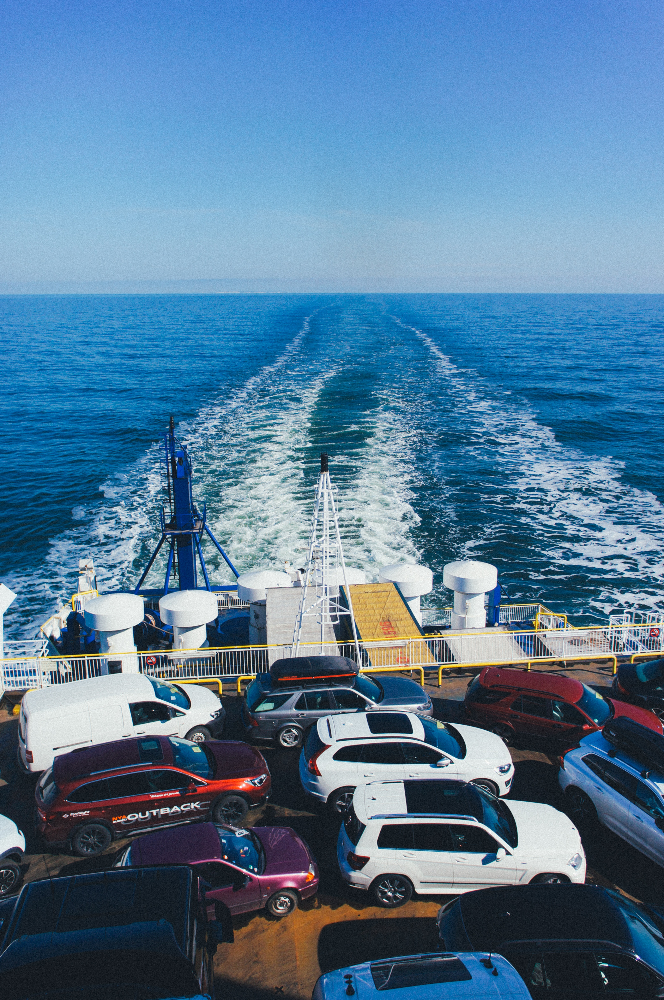
Maritime Role in U.S. Economy
21st century U.S. economic growth is directly linked to global trade
95% of world population and 80% of consumption is outside of the United States
26% of GDP
Maritime infrastructure – ports, ships, navigation channels and navigation support systems are essential to global trade and economic growth!
Notes:
These are key points when AAPA is advocating for funding for various Federal programs associated with maritime infrastructure.
Seaports are a vital part of our U.S. economy, supporting 26 percent of the U.S. economy, handling 6 billion dollars of imports and exports a day. That is a lot of cargo that has to come in or leave the port to get to its final destination.

Slide 5
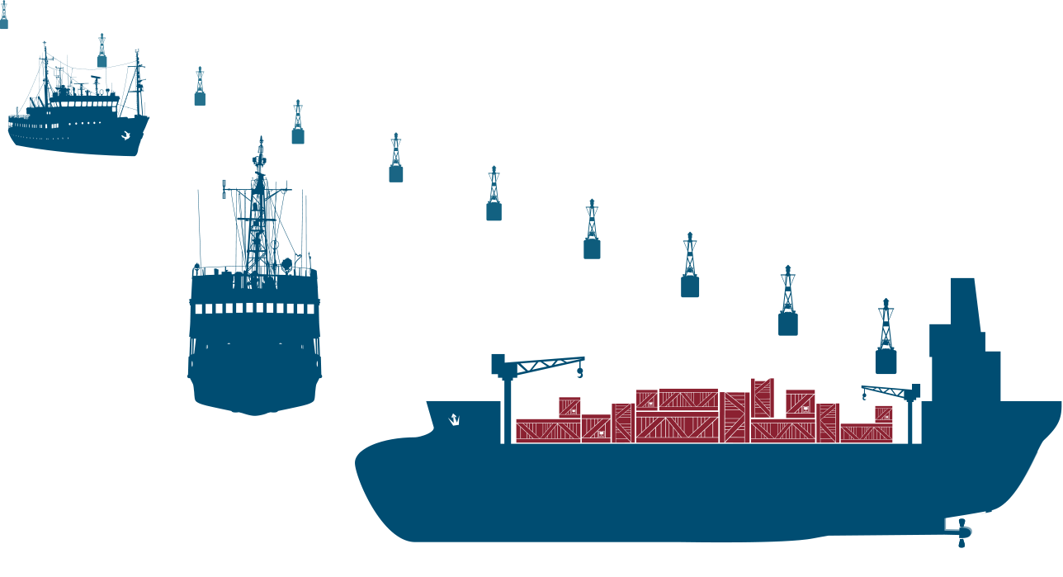
Infrastructure Vital for America’s
Trade Future
Landside and Waterside Connections Critical
Ports and partners investing billions a year in infrastructure improvements
Federal investment in seaport-related infrastructure is lagging far behind
Notes:
Ports are transportation hubs. They are connections for ships, roads and rails brining cargo into and out of the U.S. And ports are making a lot of investments in infrastructure, including providing funds to address environmental issues. This slide shows one of the challenges for seaports…many ports are part of a heavily congested urban area. They are dependent on rail and road connections to get freight to and from the market place. We partner with the U.S. Army Corps of Engineers who is responsible for the federal navigation channels, the water highways, and the U.S. DOT for the landside support through the state and federal highway programs as well as support from the DOT TIGER program. EPA has also been very helpful through its DERA program and we also would like to see more Congestion Mitigation and Air Quality (CMAQ) funds go to address air issues at ports, as well as the VW settlement funds.

Slide 6
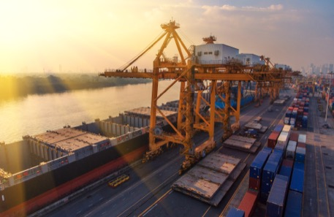
Port Views
Goal: Safe and efficient
freight movement
Primary focus:
Timely arrival/departure of ship at dock
Key Components:
  Nautical charts – NOAA
  Hydrographic surveys of federal navigation channels – identify any restrictions
  Safe and efficient transit – NOAA PORTS
  Weather service for storm response
  Dredging for depth and width
Notes:
There is a strong partnership between public ports and the federal government to enable safe and efficient freight movement.

Slide 7
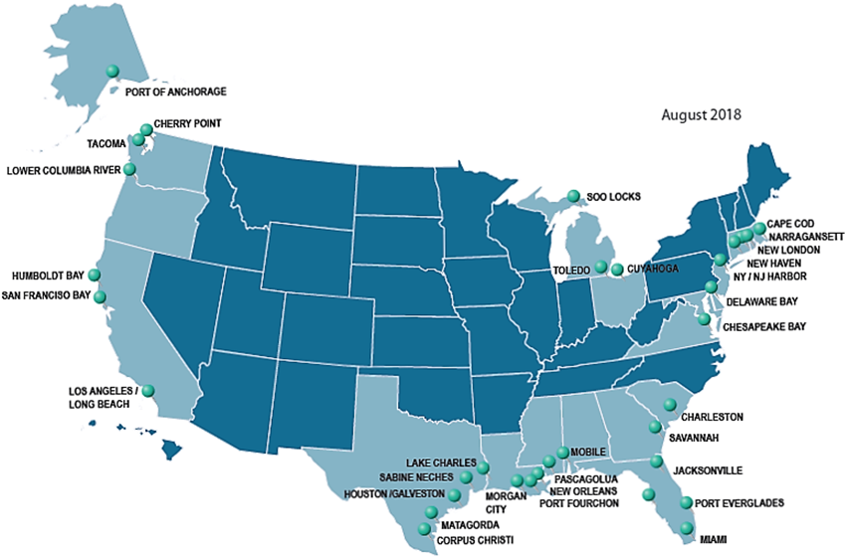
NOAA PORTS Locations
33 PORTS serving 76 seaports
Notes:
PORTS stands for Physical Oceanographic Real Time System. Ports around the country have learned the value of getting real time information on waves, wind, currents and other information. NOAA subsequent development of additional applications such as air gaps and visibility sensors are well received.

Slide 8
Ports’ Views of NOAA Programs
PORTS system – high value to ports
Challenges:
  Maintenance of aging systems
  Updates and upgrades
  New services
  Funding – flat budget restricts all the above
Post-hurricane navigation channel surveys
Nautical charts – essential to global navigation, but ports focus more on federal navigation channel
Notes:
In preparing for this presentation I contacted our port members and they shared the request for input with others. The key group were the Bar Pilots, which guide ships from the open ocean to the port dock and back out. Here’s a quote I wanted to share: “These products are as important to marine transportation as air traffic controllers are to air travel.” PORTS support personnel should be considered ‘essential’ government workers during events like the recent shutdown.

Slide 9
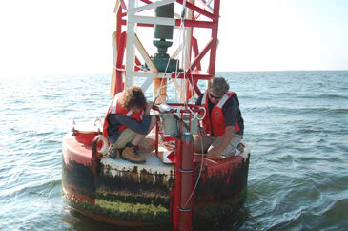
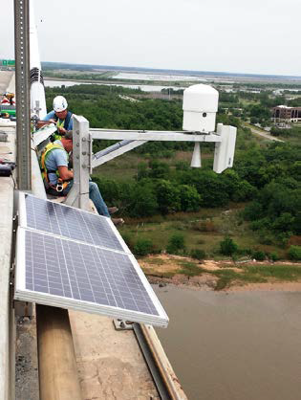
PORTS Feedback
Lots of kudos
Some suggestions:
  Reliability
  Ability to accept and share
  data from non-PORTS
  sensors (update rates)
  Expedite switch from tower
  to satellite signals
  PORTS support staff need
  to be ‘Essential’ government
  workers
Notes:
Upper photo is installation of automated data sensor and transmitter to a buoy
Lower photo is an ‘air gap’ sensor which determines clearance from water surface to bridge structure. Shippers can determine if they have sufficient vertical clearance. This is becoming a greater issue, especially with larger containerized cargo ships.

Slide 10
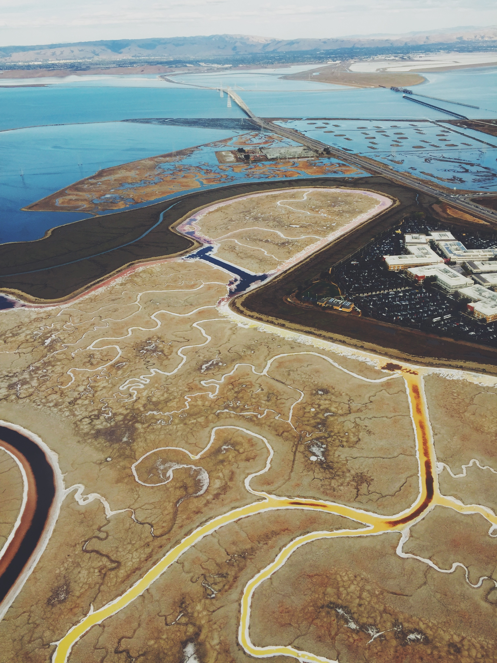
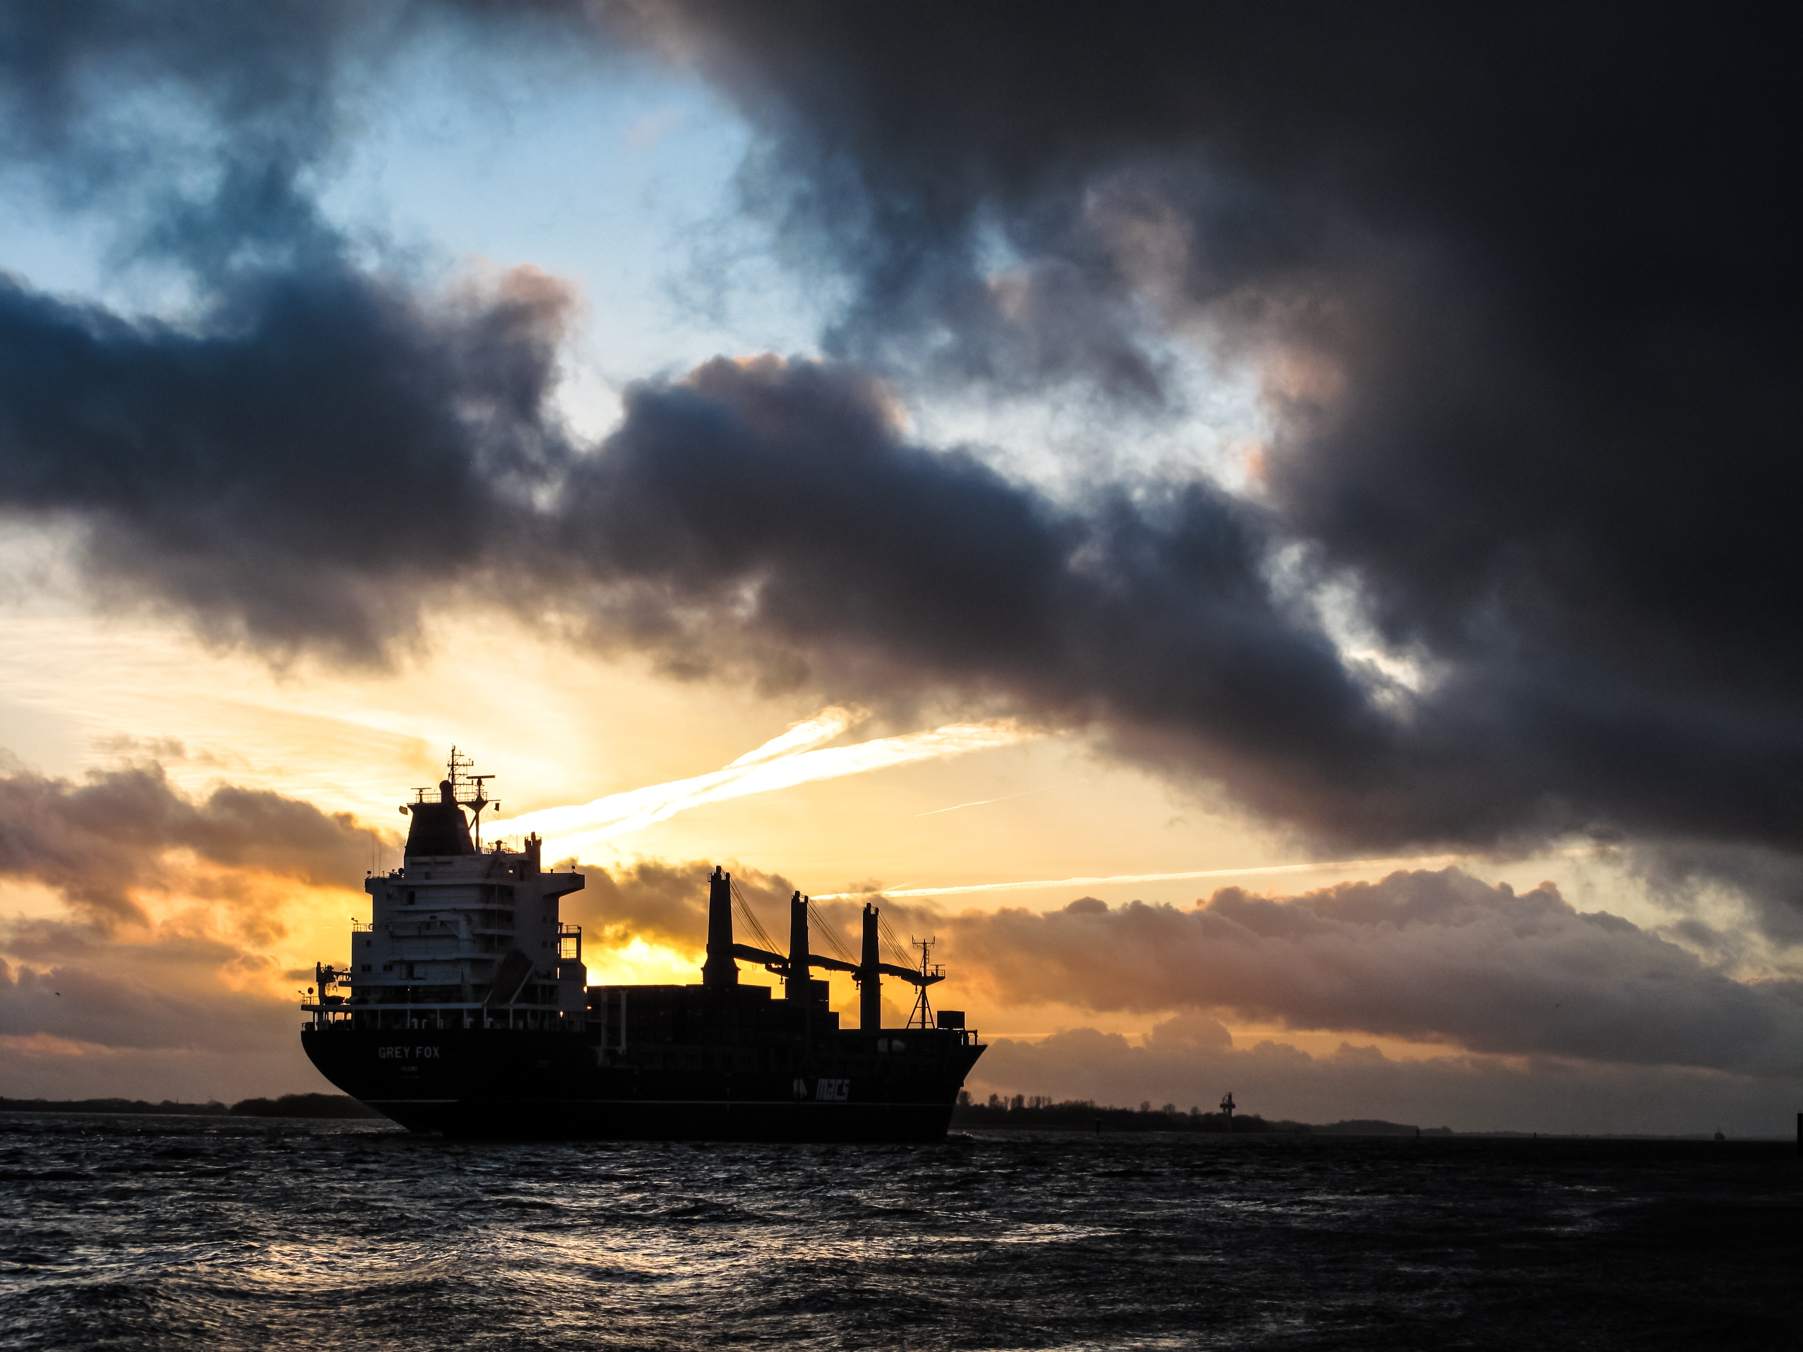
Summary
Continue the excellent work to facilitate safe and efficient freight movement
Identify the future vision of Nav Services and its cost
Keep educating Congress and the public on federal programs’ role in freight movement and economic growth
America is a Maritime Nation!
Thanks for all you do!
Susan Monteverde smonteverde@aapa-ports.org 703-684-5700

