Slide 1
What’s Next for NWS Marine Weather Services?
National Weather Service
Allison Allen
Chief, Marine, Tropical, and Tsunami Services Branch

Slide 2
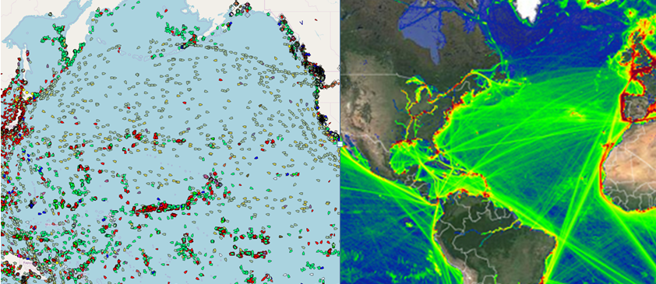
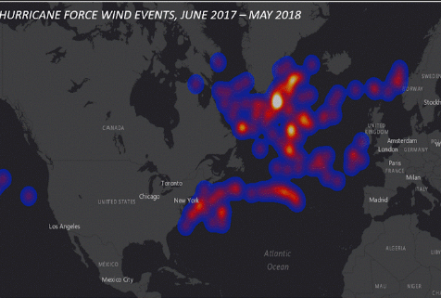
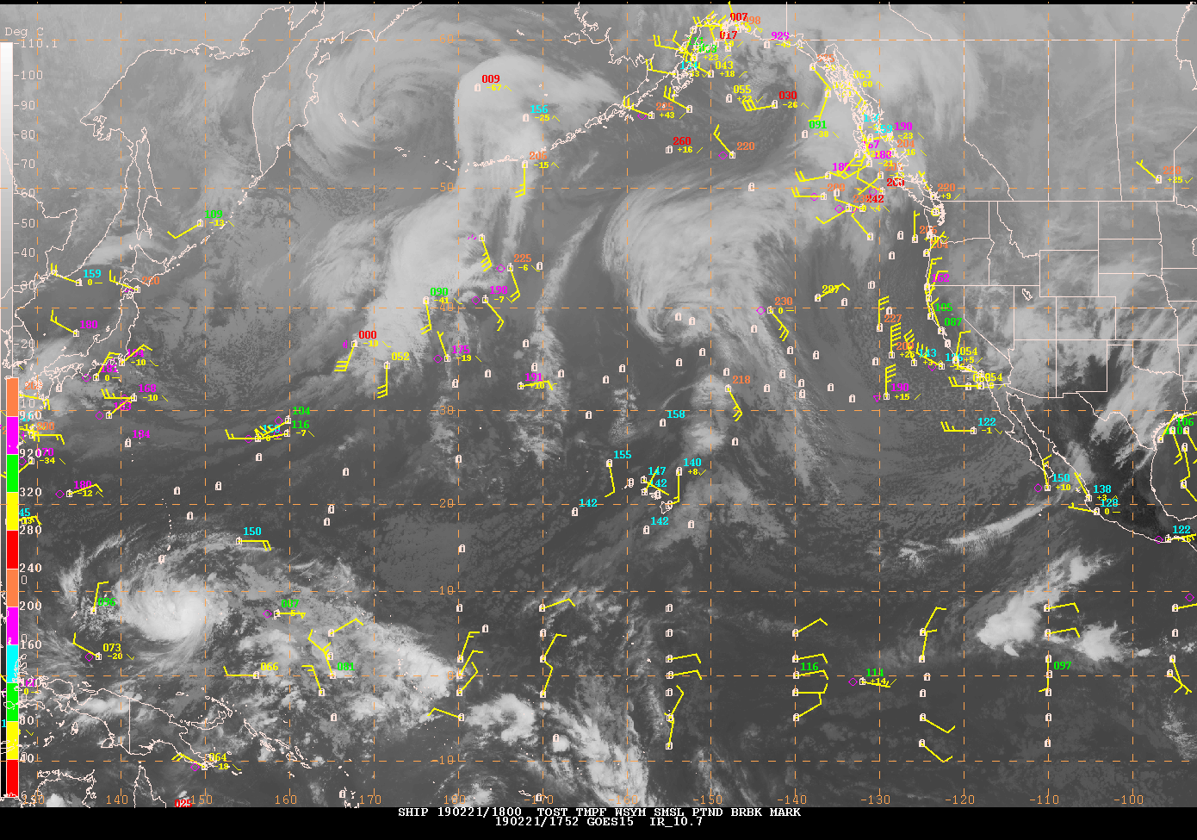
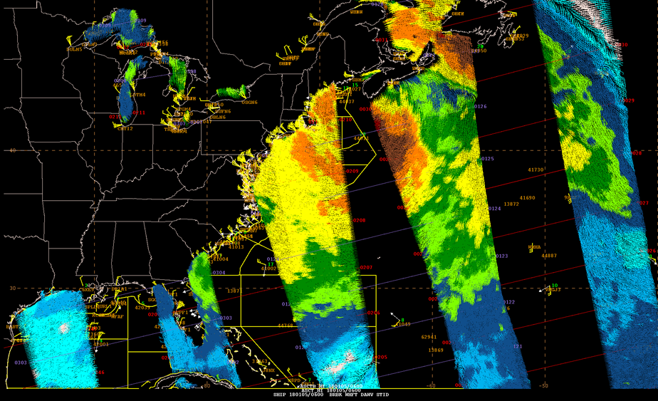
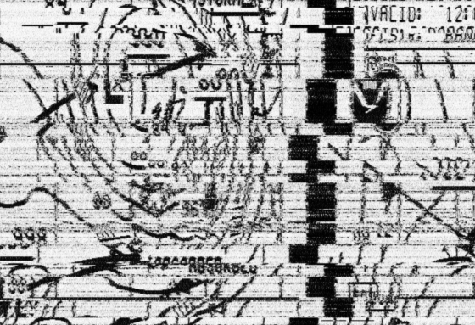
Challenges at Sea

Slide 3
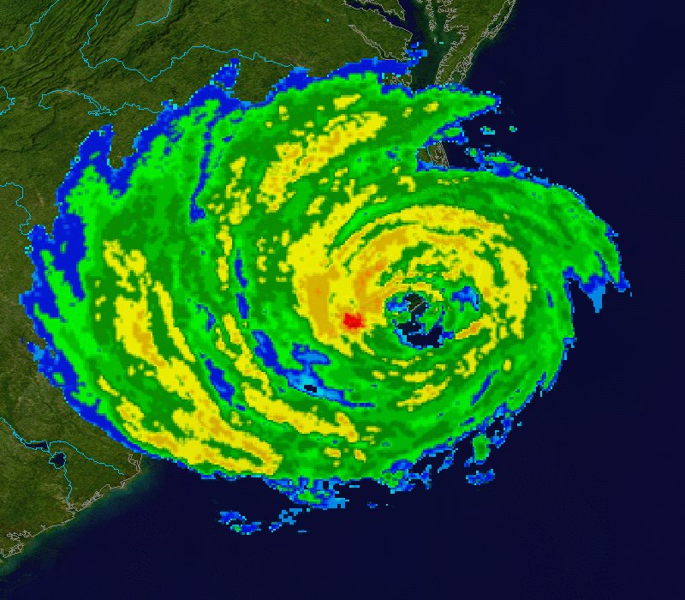
A Year in Weather
A Typical Year Brings:
6 Atlantic Hurricanes
1,270 Tornadoes
5,000 Floods
10,000 Violent Thunderstorms
Severe Winter Storms
Drought and Large Wildfires
Excessive Heat Episodes
600 Deaths; 5,000 Injuries; $14 Billion in Losses
Provide climate, water, weather forecasts and warnings to protect life and property and enhance the economy
76 billion observations
1.5 million forecasts
50,000 warnings

Slide 4
NWS National Service Programs

Slide 5
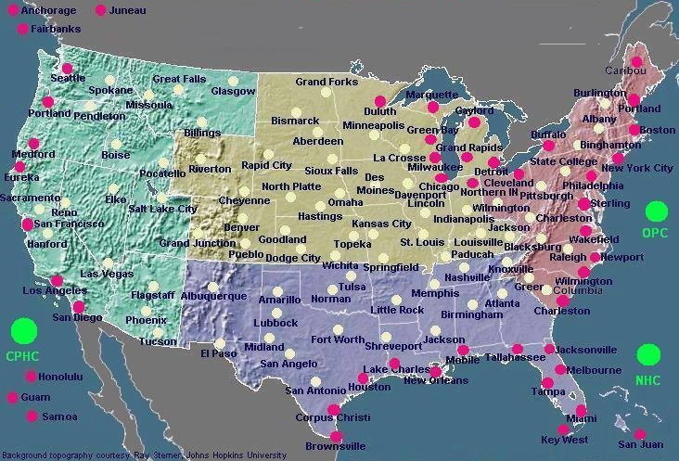
NWS Weather Forecast Offices
Provides Marine & Land Forecasts
Provides Land Forecasts

Slide 6
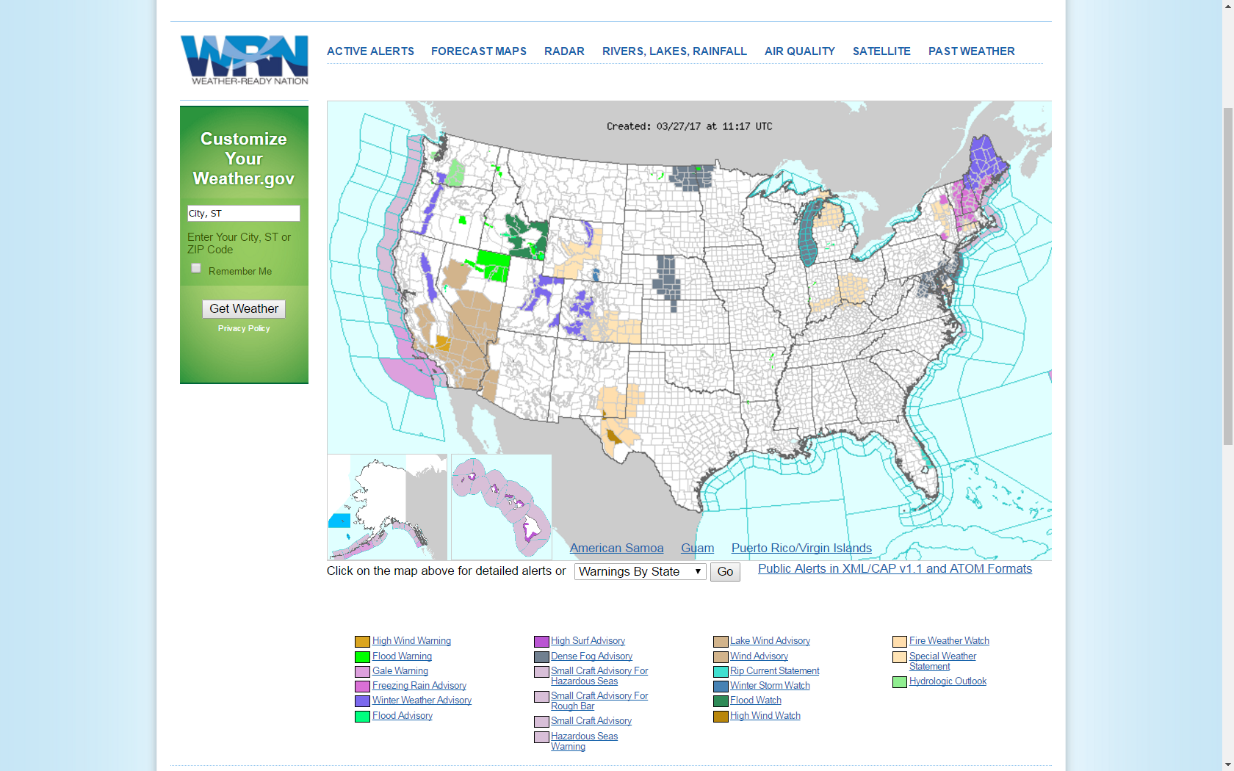
Coastal and Offshore areas

Slide 7
2016 Global Ship Tracks (NWS High Seas Marine Zones)
Shipping lanes in green:
OPC
OPC
NHC TAFB
WFO Honolulu
NHC TAFB
Source of 2013 total ship tracks and background: marinetraffic.com

Slide 8
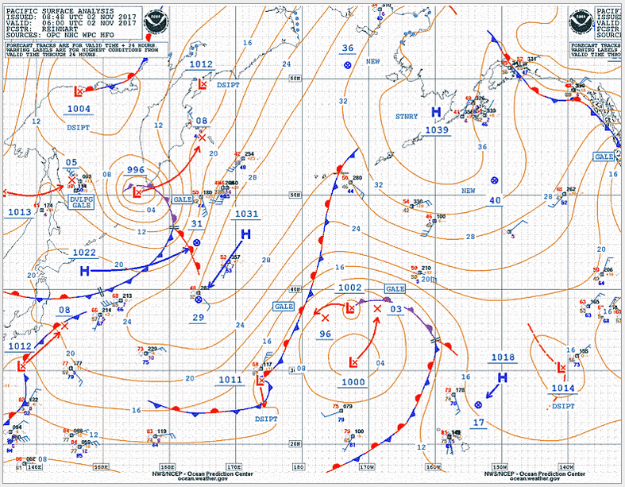
NWS Marine Products
Marine Text Forecasts and Products
Marine Graphic Forecasts and Products
Satellite and RADAR Imagery
Ice Analysis, Forecasts and Iceberg Reports
Computer Generated Model Guidance
Foreign Marine Forecasts
Marine Climatological Information
NWS Products Available Via E-MAIL (FTPMAIL)
Watches, Warnings and Advisories Using RSS and XML/CAP Based Formats
NOAA Weather Radio
USCG HF RADIOFAX
NAVTEX

Slide 9
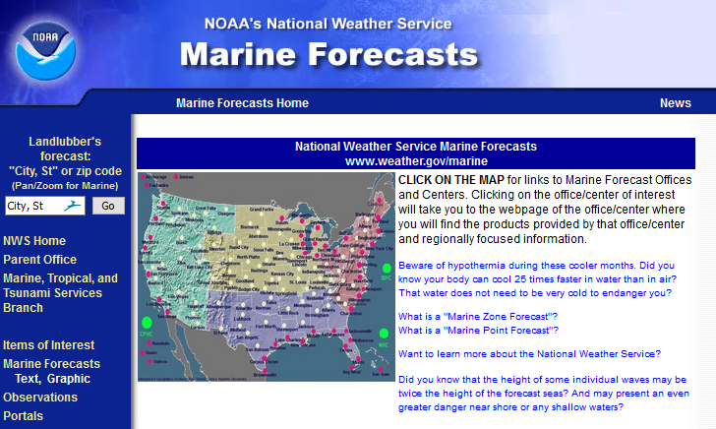
NWS Marine Website
http://weather.gov/marine

Slide 10
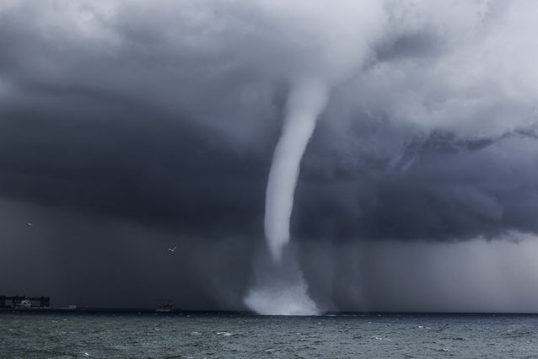
NWS Marine Service Program Team
Goal of NWS Marine Services: All marine users meet their safety and economic needs through ready access to accurate, timely, easily understood and technologically advanced coastal and marine forecasts, warnings and other products.
Comprised Of:
NWS HQ (Policy Branch/National
Marine Program Lead)
2 National Centers (OPC, NHC)
All NWS Regions
National Data Buoy Center
Port Meteorological Officer/VOS

Slide 11
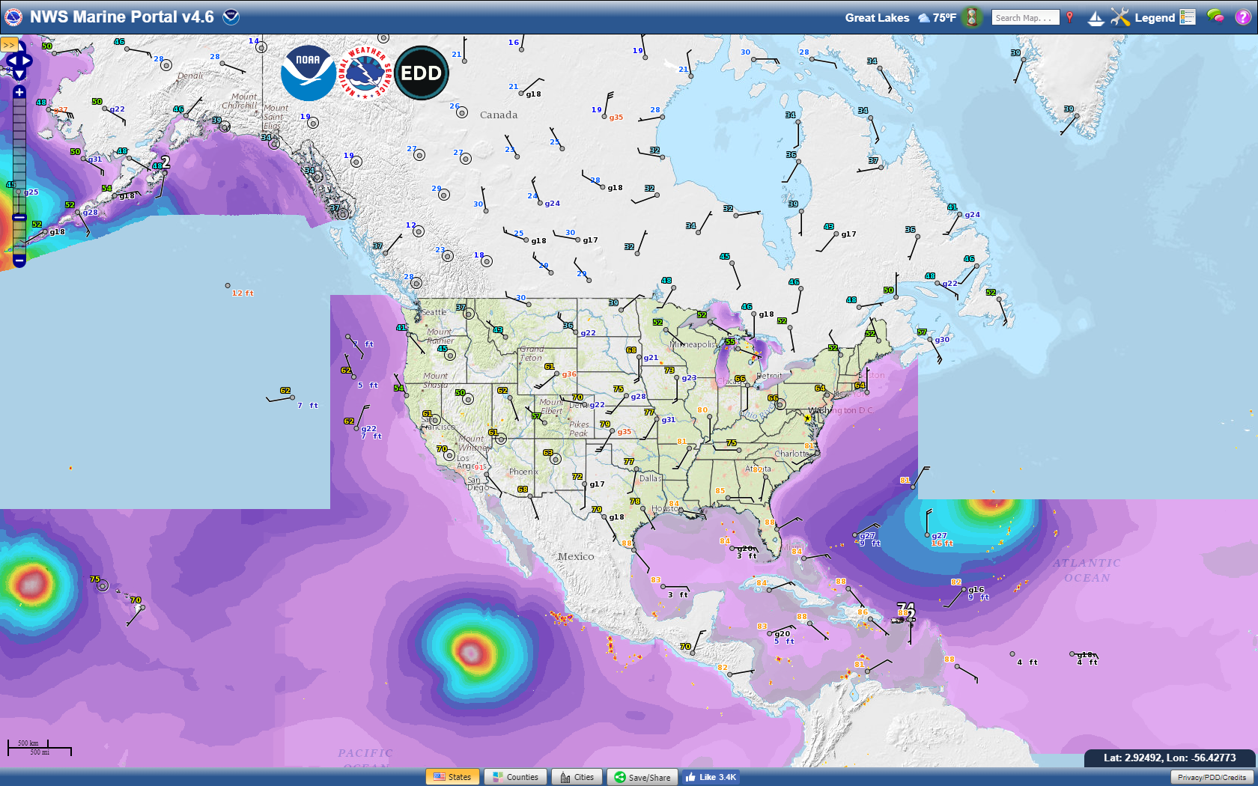
The National Digital Forecast Database is expanding over the Ocean area

Slide 12
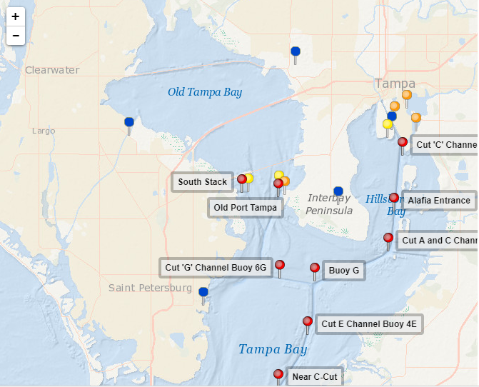
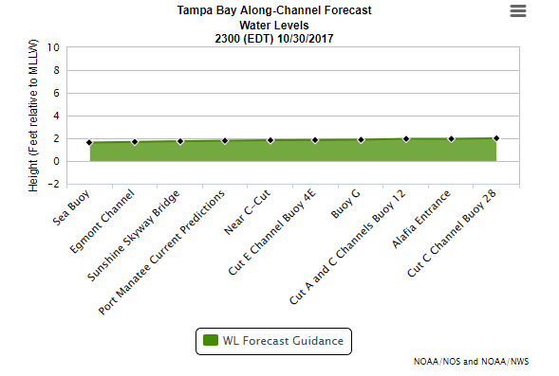
NWS Role In Precision Navigation
Development and dissemination of marine weather forecasts and warnings
Coordination on real-time risk assessment and decision support

Slide 13
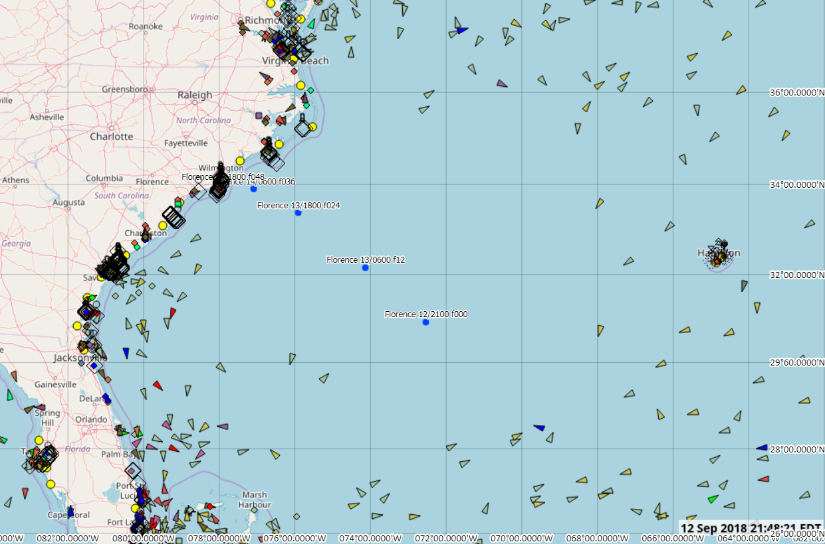
Hurricane Florence – Extreme Weather Avoidance
0145 UTC - 13 Sep 2018
Avoidance
~300 nm of coastal waters void of shipping
Area ~ 165,000 nm² ships heeding warnings
Vessels anchored or underway at very slow speed
Sortied ships off central FL coast
2100 NHC 09/12 Advisory

Slide 14
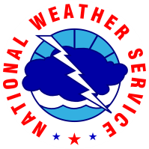
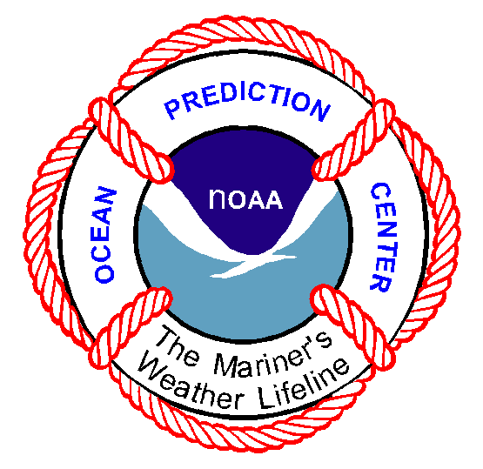
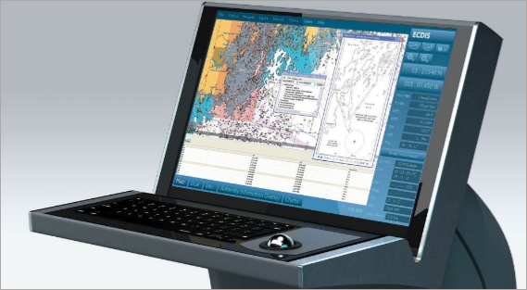
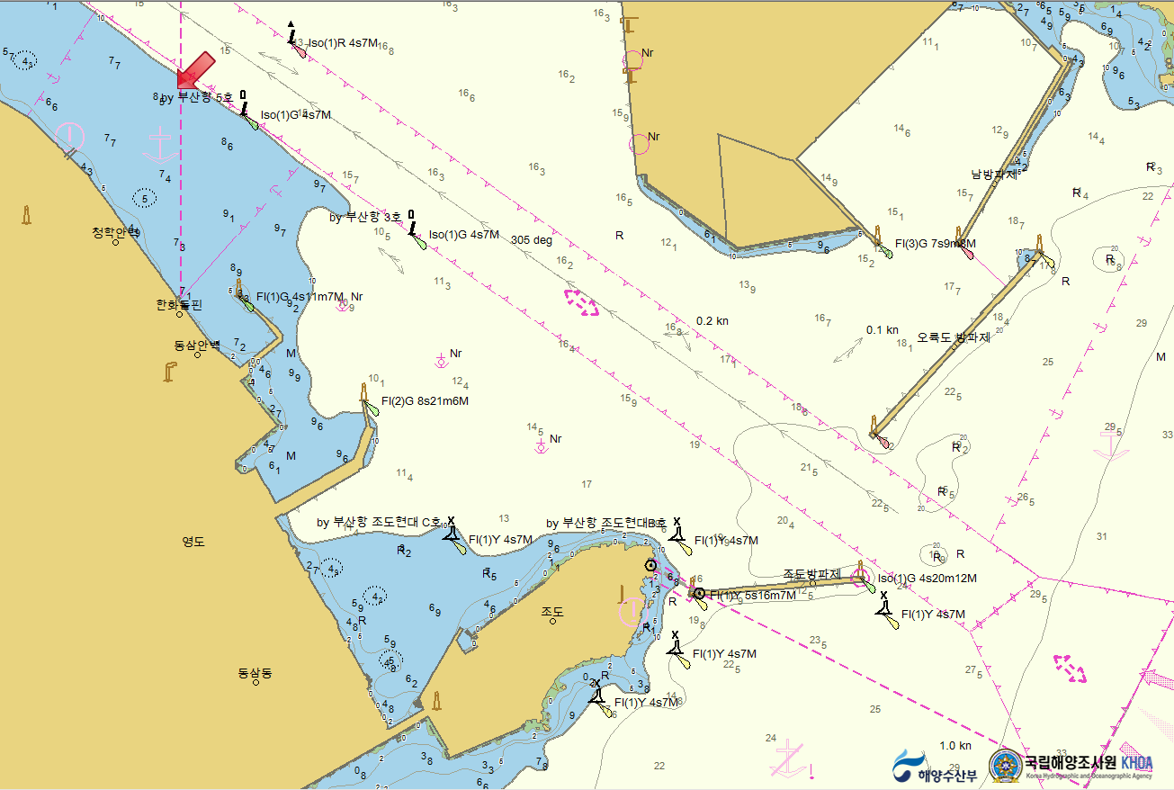
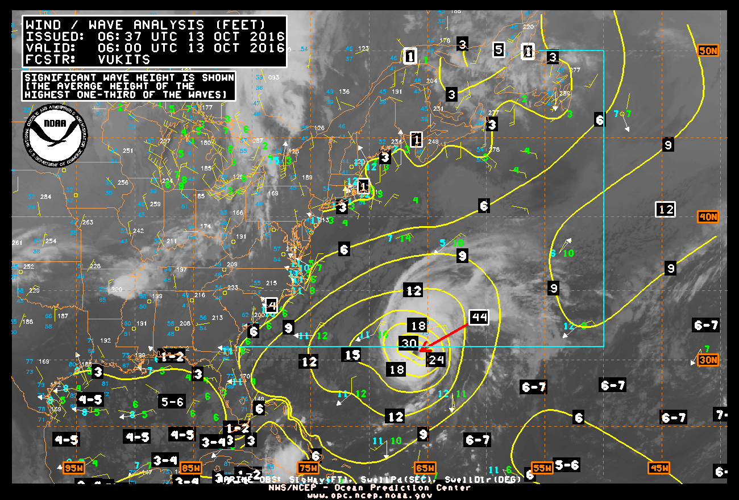
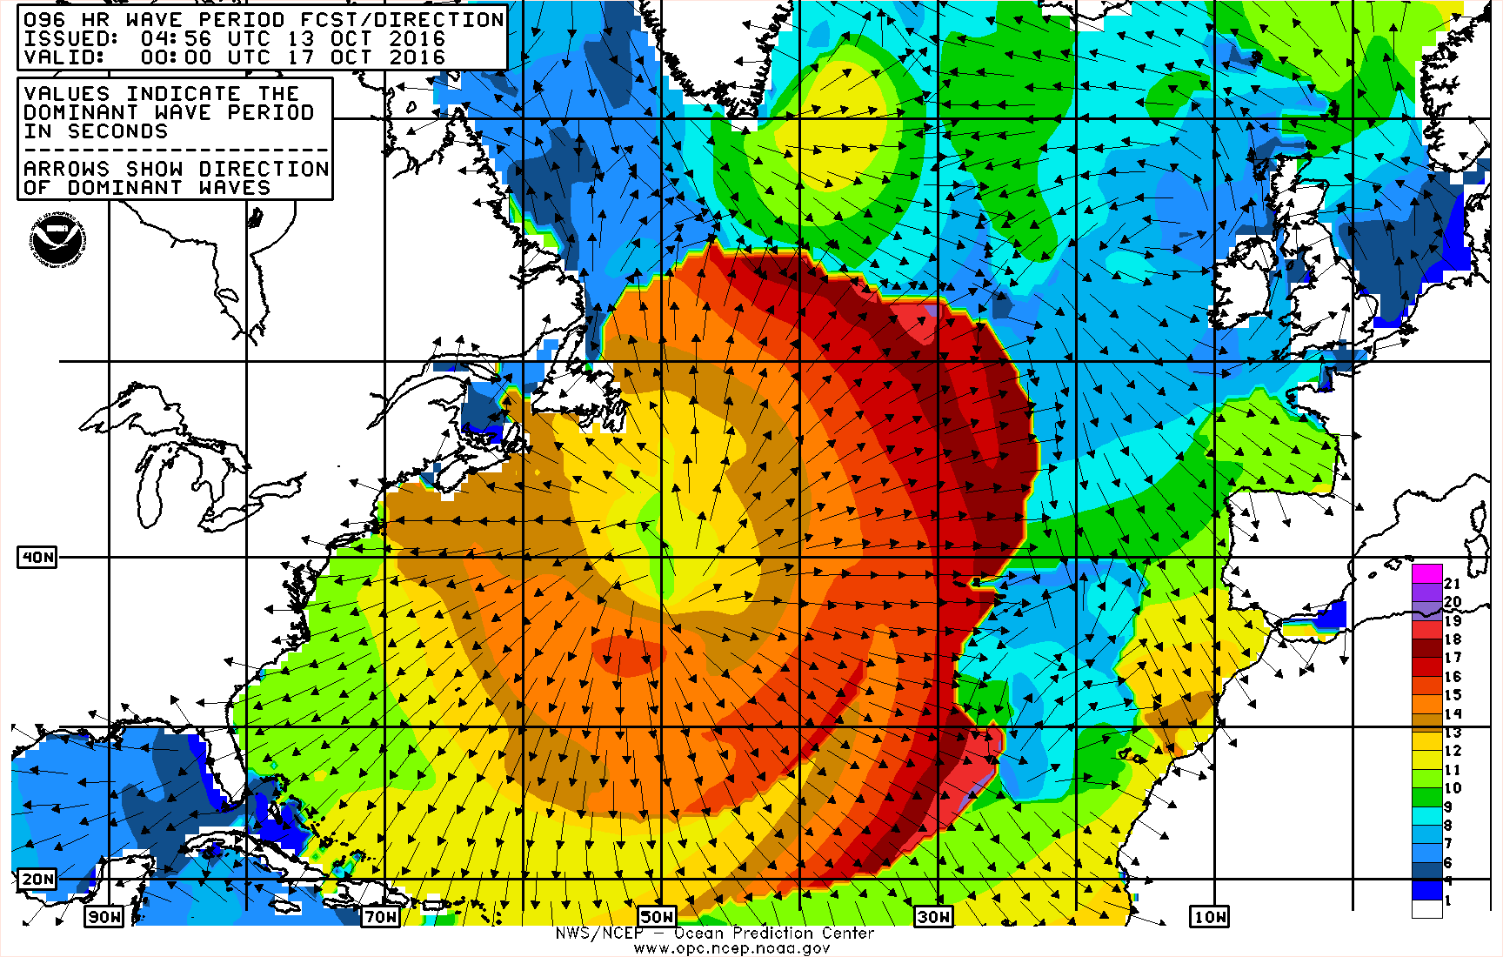
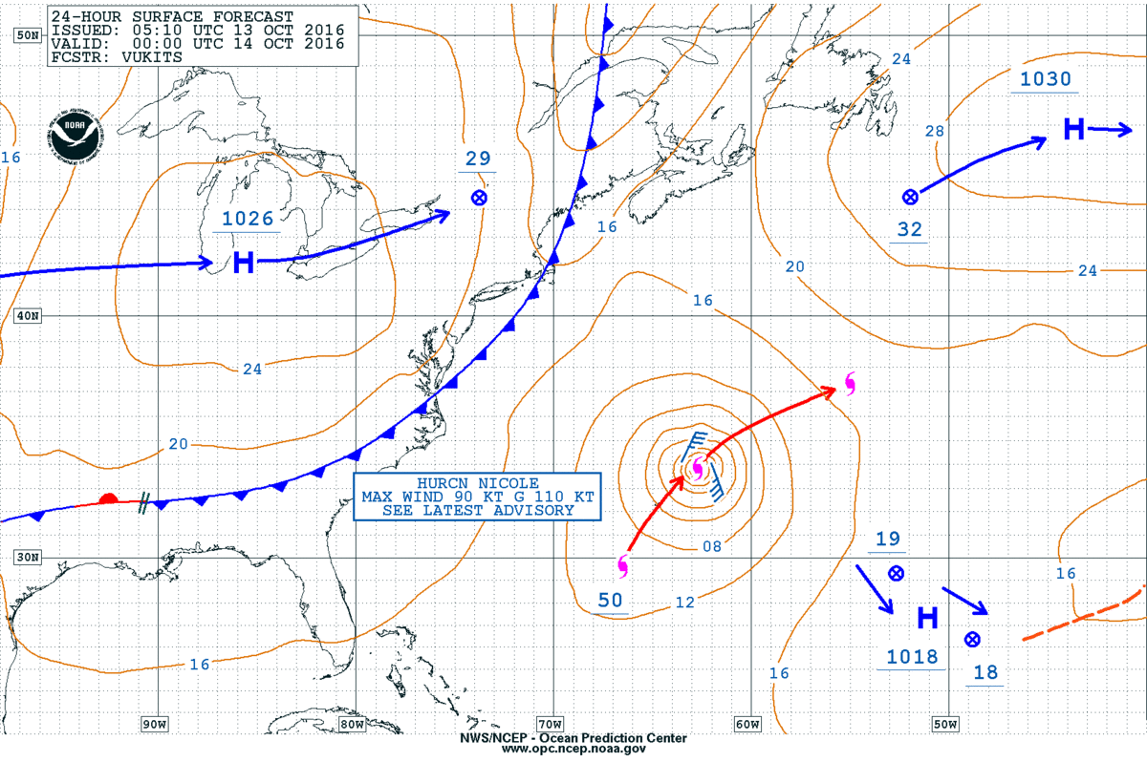
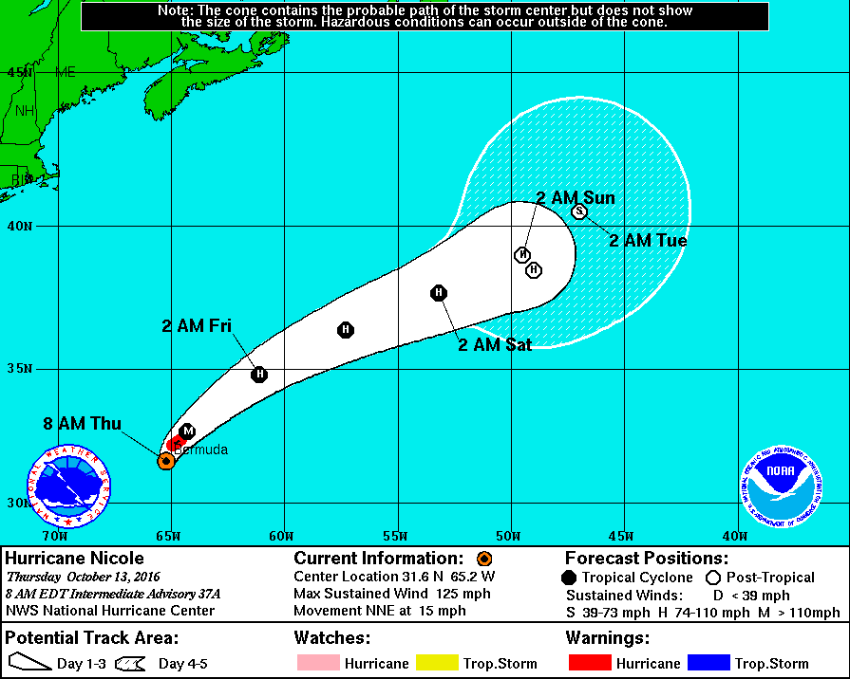
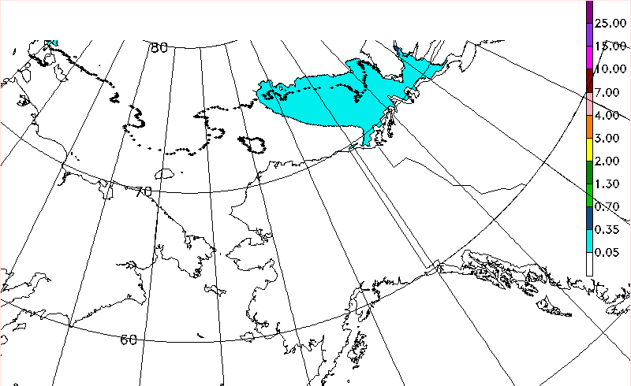
S-412 Weather Overlay Goal
Develop a navigation safety product specification for weather information for use in Electronic Chart and Navigation Display System (ECDIS)

Slide 15
S-412 Weather Overlay: Motivation and Approach
ECDIS does not currently include weather products
Weather products in ECDIS can improve situational awareness, safety, prevention of damaged goods, etc.
Mandatory carriage requirements of ECDIS approved by IMO
Separate Product Specifications
S-412
-Weather Hazards (includes Messages and Systems
S-413
-Weather Conditions
S-414
-Weather Observations
www.ecdis-info.com/ecdis_regulations.html

Slide 16
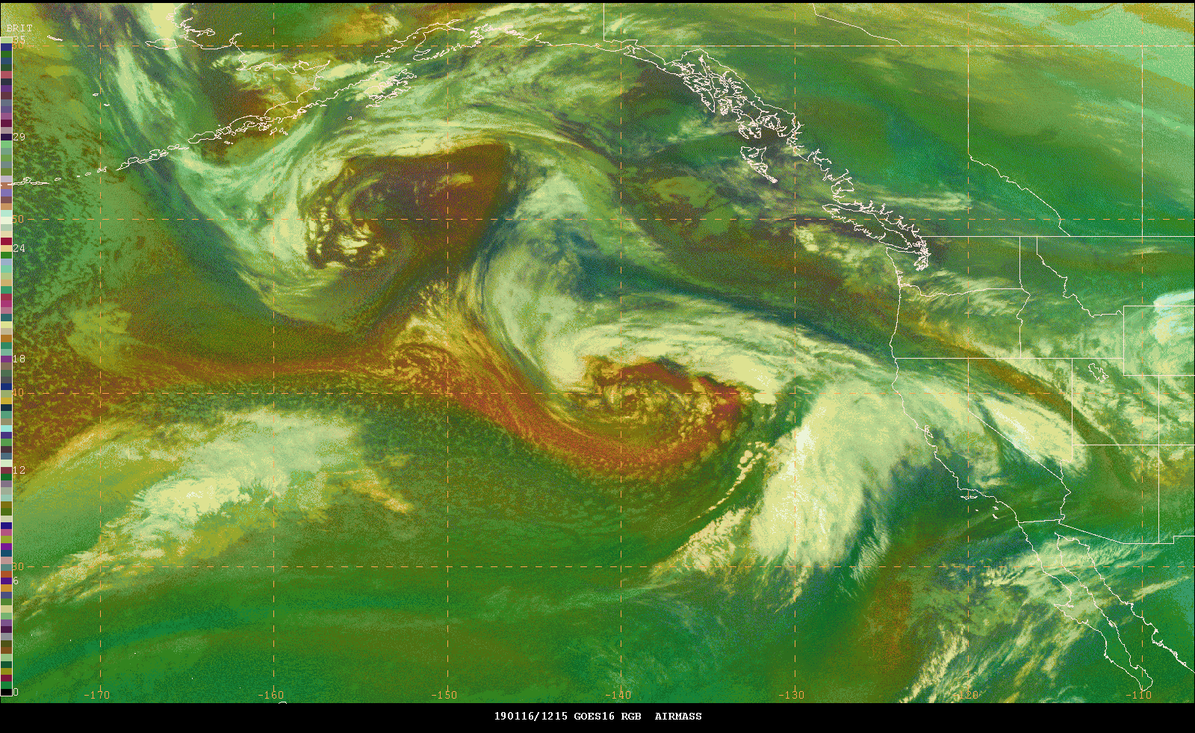
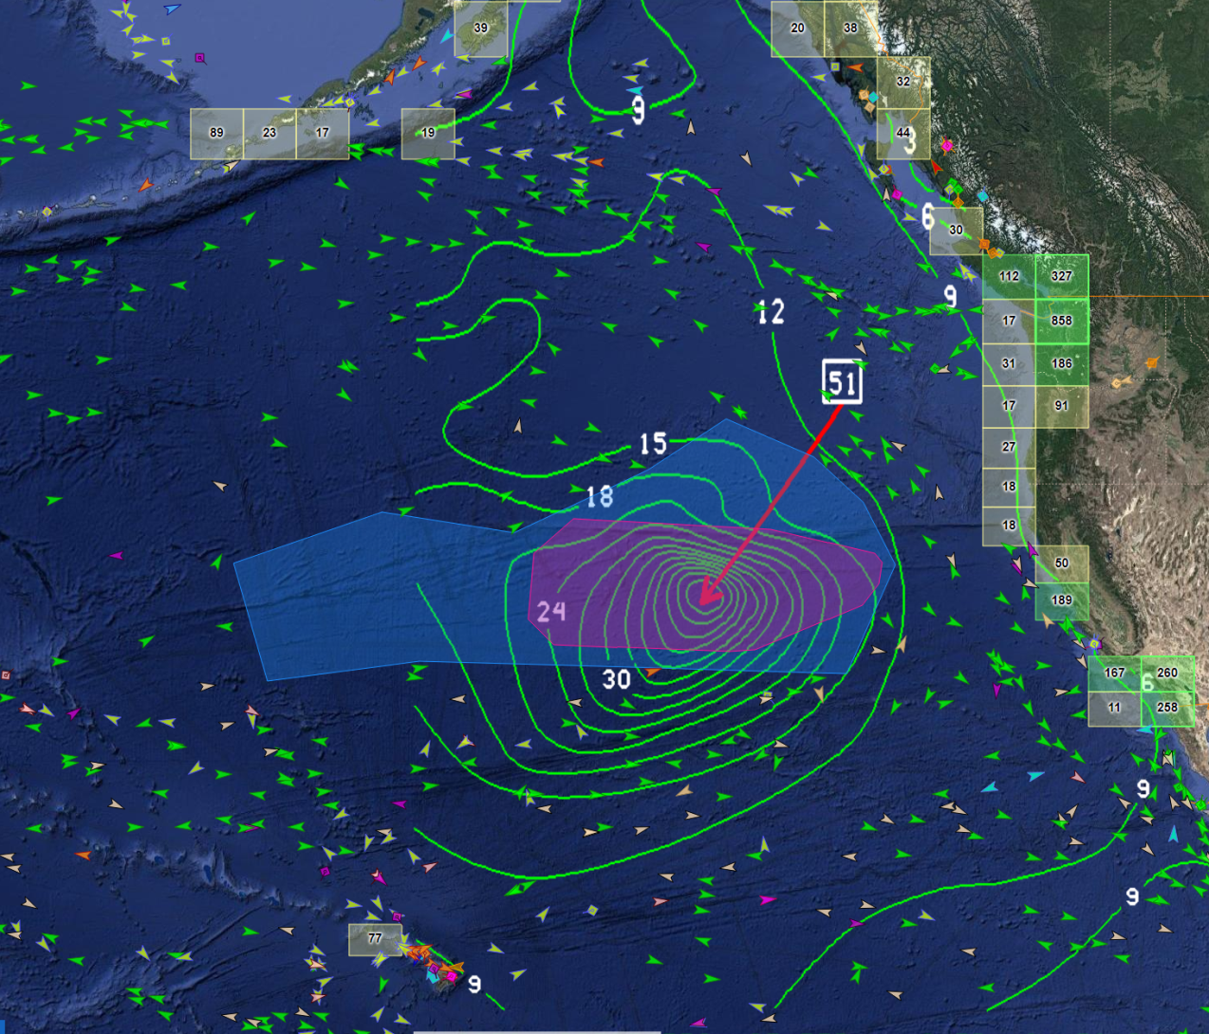
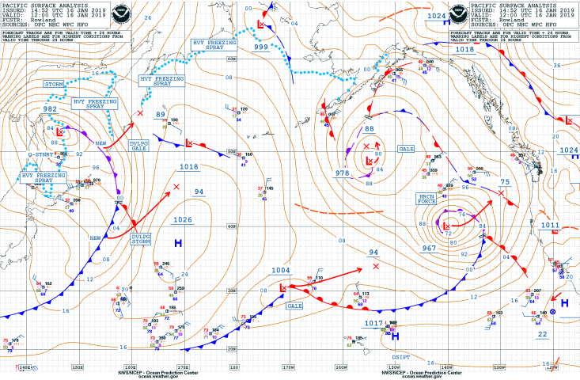
Extreme Weather Avoidance - Pacific
1200 UTC 16 Jan
Hurricane Force Wind Warning
Winds to 65 kt, Seas to 51 ft
E bound ships diverting south or
well north to avoid winds and seas
Ships N of low slowed significantly
Westbound ships - Great Circle
Vessels avoiding most extreme
winds and seas
Storm Warning – 240,000 sq n mi
Area void of vessels ~ 650,000 sq.
n mi (~ combined areas TX, CA,
MT, NM, SD)
48-hr LT to HF conditions and
waves 44’+
D
HURCN
FORCE
L
970
A
B
C

Slide 17
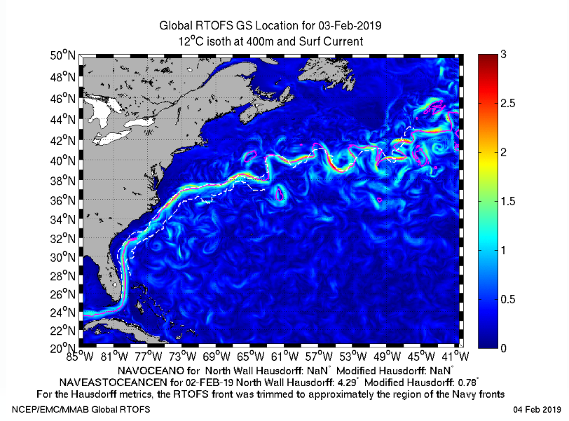
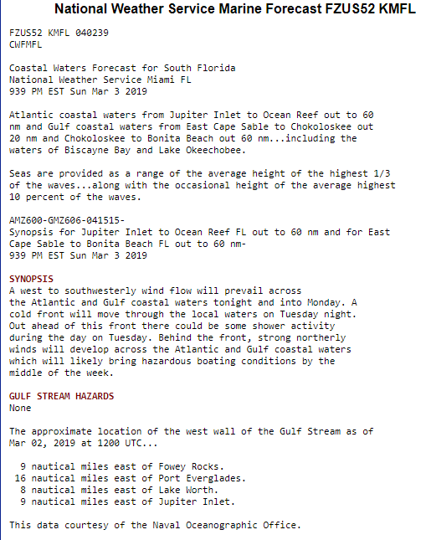
Wave Model Improvements: Gulf Stream
Wind and current interactions
“West Wall” hazards

Slide 18
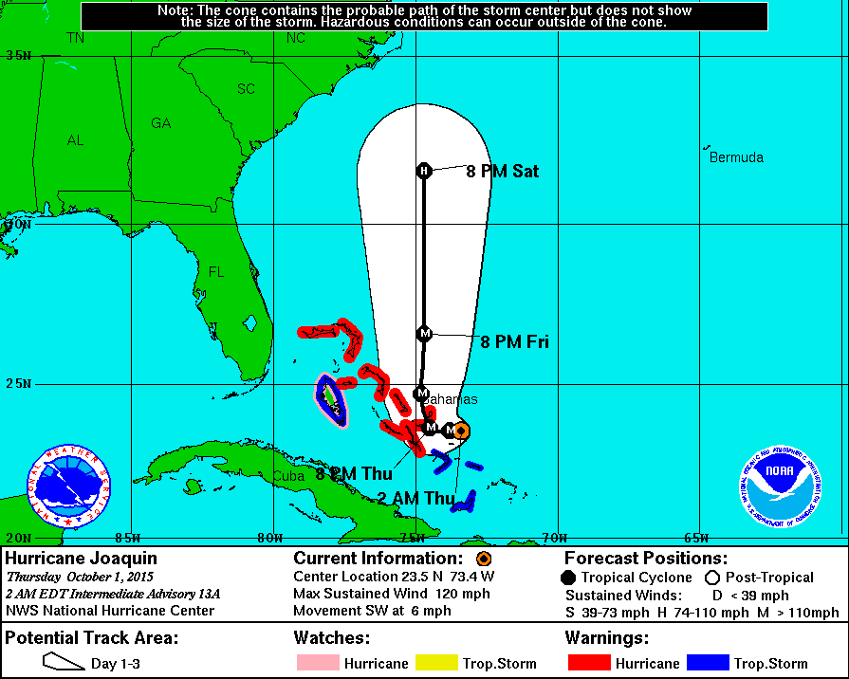
Cargo Ship El Faro
Ship location,
12’ sea and
64 kt wind
radii
approximated
Marine
Hurricane
Warning
Current
12-30’ seas and
64 kt winds at
Thu. Oct. 1, 2 am
Ship location
Thu. Oct 1, 356 am
(per Reuters)
El Faro location and NHC forecasts and warnings in place
at Thu. Oct. 1, 356 am, 3 hours before last communication

Slide 19
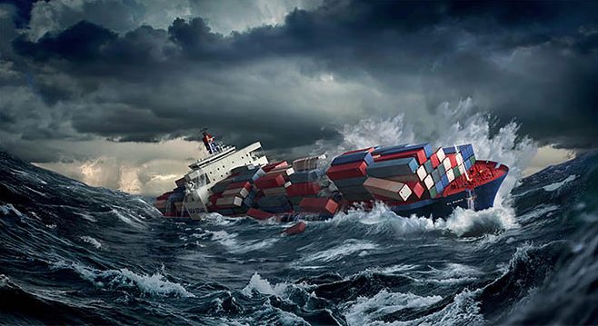
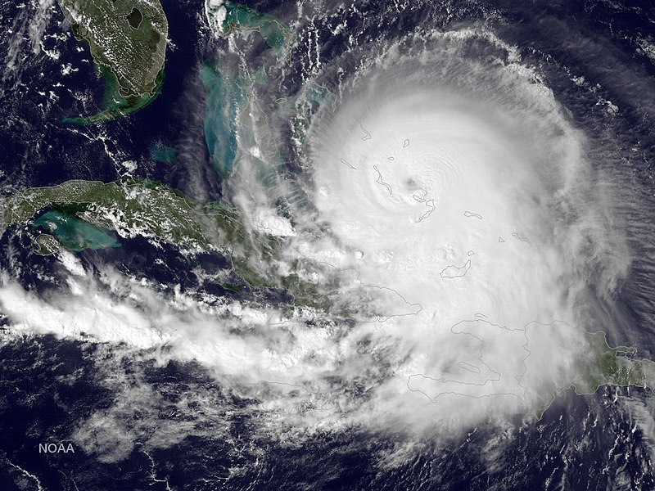
NWS Progress on NTSB Recommendations
NHC will modify the Forecast/Advisory product to indicate the time of the next intermediate public advisory (in addition to the next full advisory) when coastal watches/warnings are in effect
NHC has set quantitative criteria for intensity change that will trigger the issuance of a Special Advisory
NWS will work with NTSB and other marine organizations to identify any new low bandwidth products to add to the FTPmail Service

Slide 20
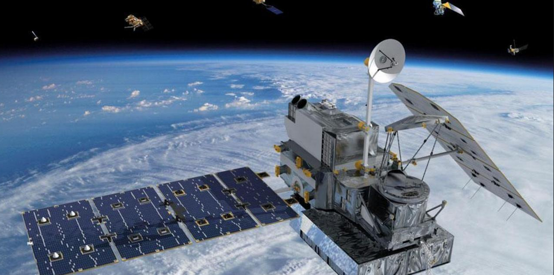
Receiving Weather Observations via AIS
NOAA, in partnership with US Army Corp and MARAD, are conducting a “proof-of-concept” project transmitting weather observations from ships using AIS
The potential increase in data would help improve weather forecasts in the open seas
NOAA hopes to complete this project in 2019

Slide 21
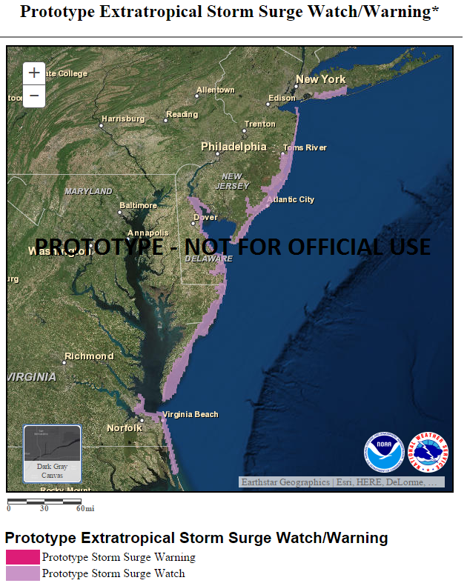
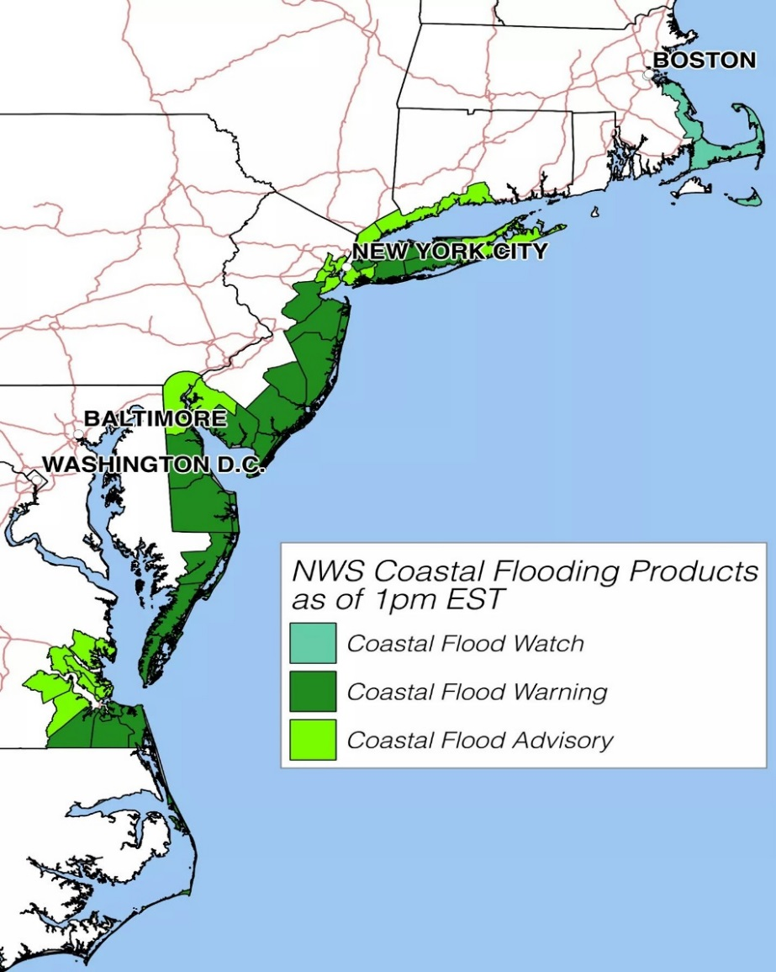
Prototype ET Watch/Warning Results versus Existing Coastal Flood Products

Slide 22
The NWS Watch, Warning, Advisory (WWA) System
Headline Term Definitions
Watch
We FORECAST THE POTENTIAL for a significant hazard. Timing and/or occurrence is still uncertain.
We WARN FOR A DANGEROUS hazard that is imminent or occurring. Significant threat to life and/or property.
Warning
We ADVISE CAUTION for less serious hazards that are also imminent or occurring - but could pose a threat to life and/or property if caution is not exercised.
Advisory

Slide 23
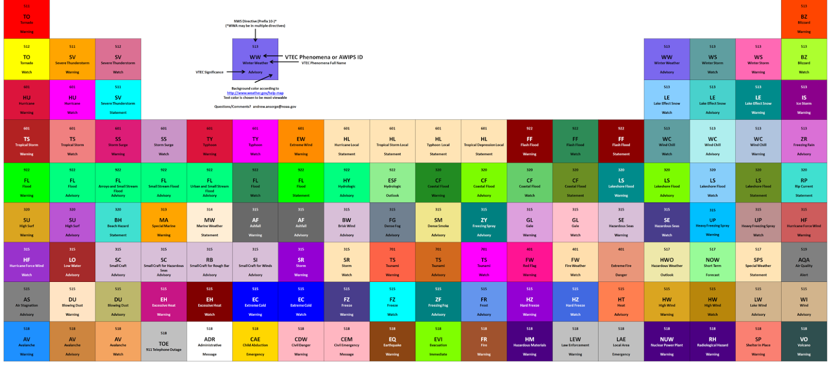
The NWS Watch, Warning, Advisory (WWA) System
Product Types

Slide 24
Reduce Number of Products
Marine Example
Current Products
Future Products
Small Craft Advisory
Small Craft Advisory for Hazardous Seas
Small Craft Advisory for Rough Bar
Small Craft Advisory for Winds
Consolidated to
Small Craft Advisory
Surf Zone Watch (created)
Beach Hazards Statement
High Surf Advisory
Consolidated to
Surf Zone Advisory
Rip Current Statement
High Surf Warning
Consolidated to
Surf Zone Warning

Slide 25
Simplified Product Text
“What, Where, When, Impacts” (3W)
...SMALL CRAFT ADVISORY IN EFFECT FROM 6 PM THIS EVENING TO 3 AM PDT THURSDAY…
* WHAT...Sustained winds or frequent gusts will be 15 to 25 knots.
* WHERE...Northern inland waters including the San Juan Islands
* WHEN...6 pm Wednesday to 3 pm Thursday
* IMPACTS...Wind and wave conditions are hazardous to small craft.
PRECAUTIONARY/PREPAREDNESS ACTIONS...
Inexperienced mariners, especially those operating smaller vessels, should avoid navigating in hazardous conditions.

Slide 26
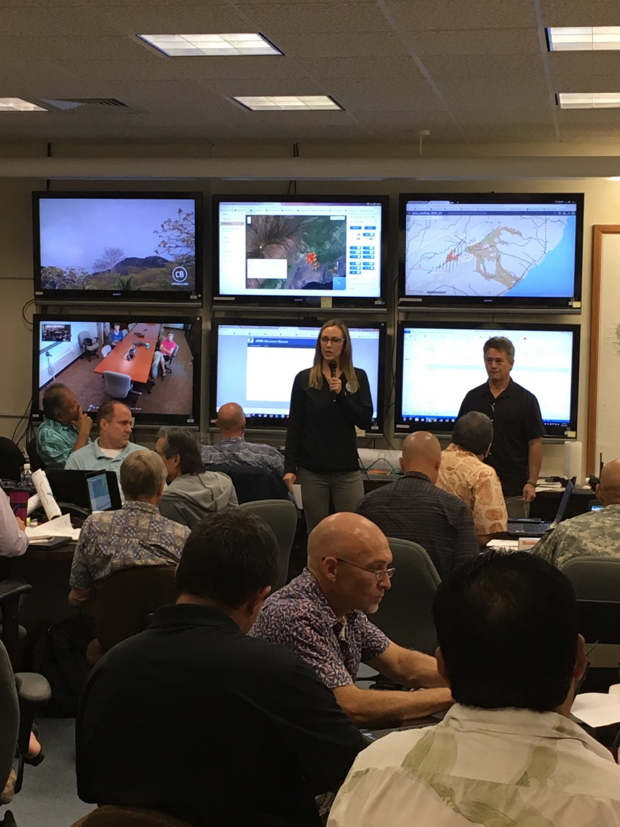
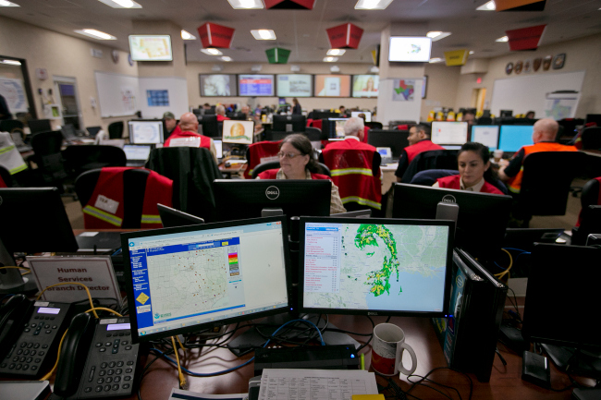
NWS Impact-Based Decision Support Services - Embracing Customer Service

Slide 27
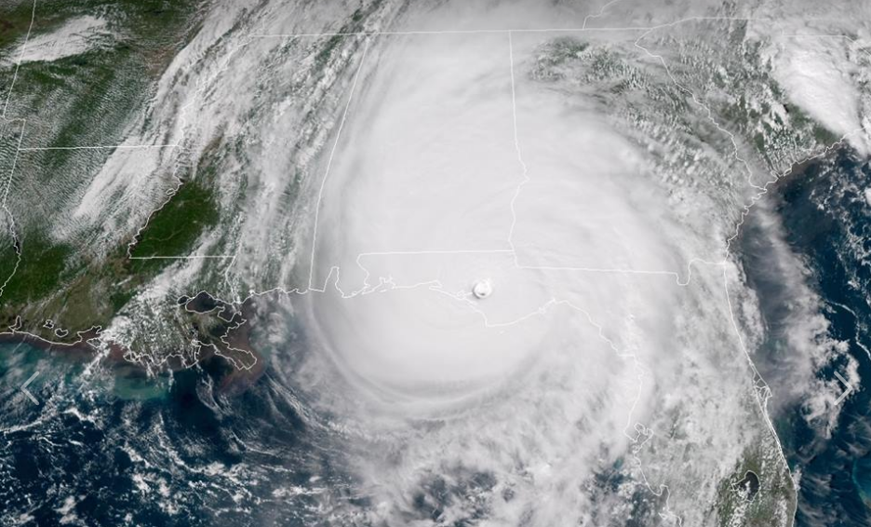
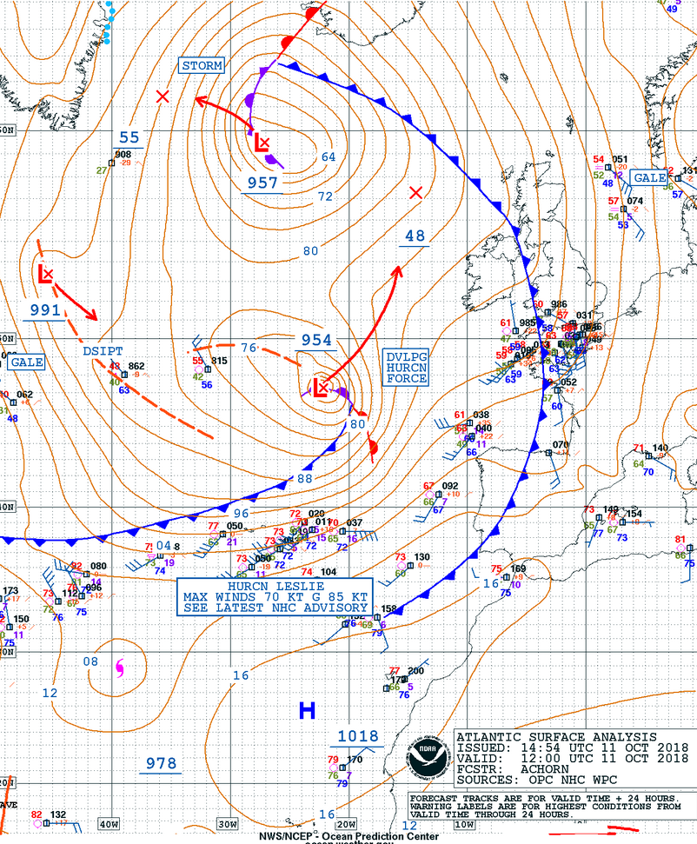
Questions? Allison.Allen@noaa.gov

