Slide 1
Office of Coast Survey
Rear Admiral Shepard Smith
March 5, 2018

Slide 2
Outline
Hurricane Supplemental Survey Projects
Nautical Charting Updates
Shutdown Impacts
Project Depths
ENC

Slide 3
Hurricane Supplemental Survey Projects
~$23 million
Three contracts awarded
Two contracts in negotiations
One program funded DAS
Notes:
Survey areas addressed areas of poor hydro health, a number of discrepancies, and were supported by the navigation managers.

Slide 4
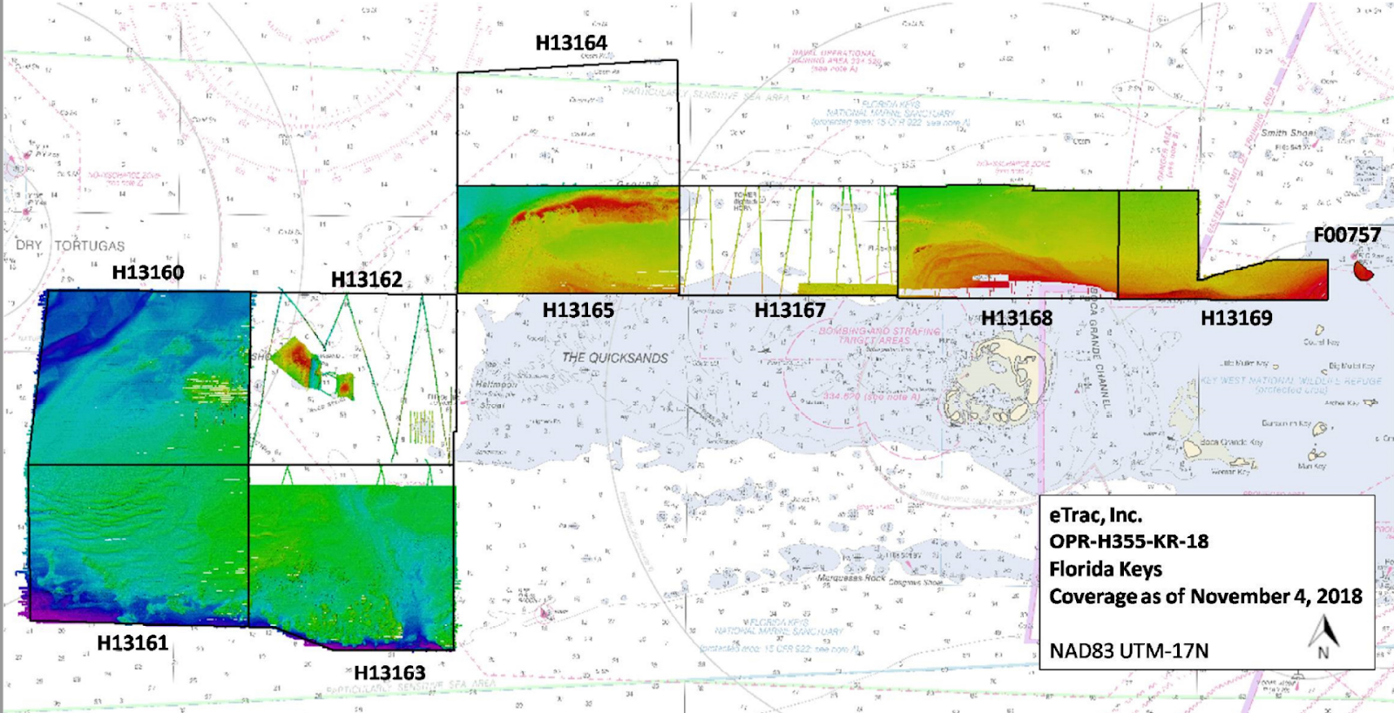
Hurricane Supplemental Survey Projects
Florida Keys National Marine Sanctuary
340 SNM
9 Sheets
Awarded to eTrac
Notes:
The data acquired will also support a wide range of marine habitat research projects through the National Centers for Coastal Ocean Science (NCCOS) and Office of National Marine Sanctuaries (NMS).
Most of the sanctuary has not been surveyed since although thousands of boaters visit the Florida Keys to fish and dive every year.
The first national marine sanctuary was established in 1975. Since then, the National Marine Sanctuary System has grown to include 13 sanctuaries and two marine national monuments. In 1990,
Florida Keys National Marine Sanctuary became the ninth sanctuary to join the system, in response to concerns about the decline of the reef ecosystem in the area.
Today, the sanctuary protects more than 2,900 square nautical miles of Florida Keys coastal and ocean waters.

Slide 5
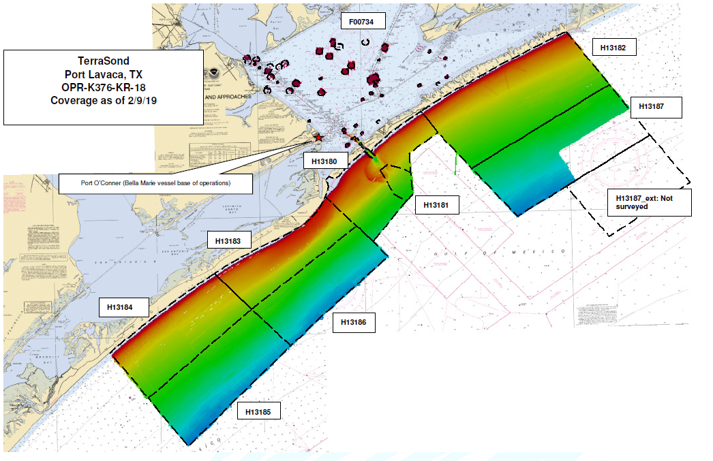
Hurricane Supplemental Survey Projects
Port Lavaca, TX
417 SNM
9 Sheets and PAs
Awarded to Terrasond
Notes:
This project is located in the vicinity of Port Lavaca, which includes the Matagorda Bay Shipping Channel. Port Lavaca is a major seaport that allows shipping to support the fishing, manufacturing, agriculture, tourism, as well as the fishing industries in the state of Texas.
As a leader in the shrimp processing industry, Port Lavaca allows million tons of seafood to be shipping through its port yearly.
Port Lavaca also supports shipping for Matagorda Bay, which houses several large manufacturing plants and a nuclear station.
The U.S. Army Corps of Engineers maintains the Matagorda Bay Shipping Channel which is dredged and there are future plans to expand this dredged channel to 44 ft. in depth and 400 ft. wide.
The survey area is 417 SNM that covers the approaches to the shipping channel in an effort to cover all shipping traffic into the Matagorda Shipping Channel. Recent hurricane activity in 2017 has made previous bathymetry in the area unreliable. This survey will allow shipping activities to continue into the Port of Lavaca.

Slide 6
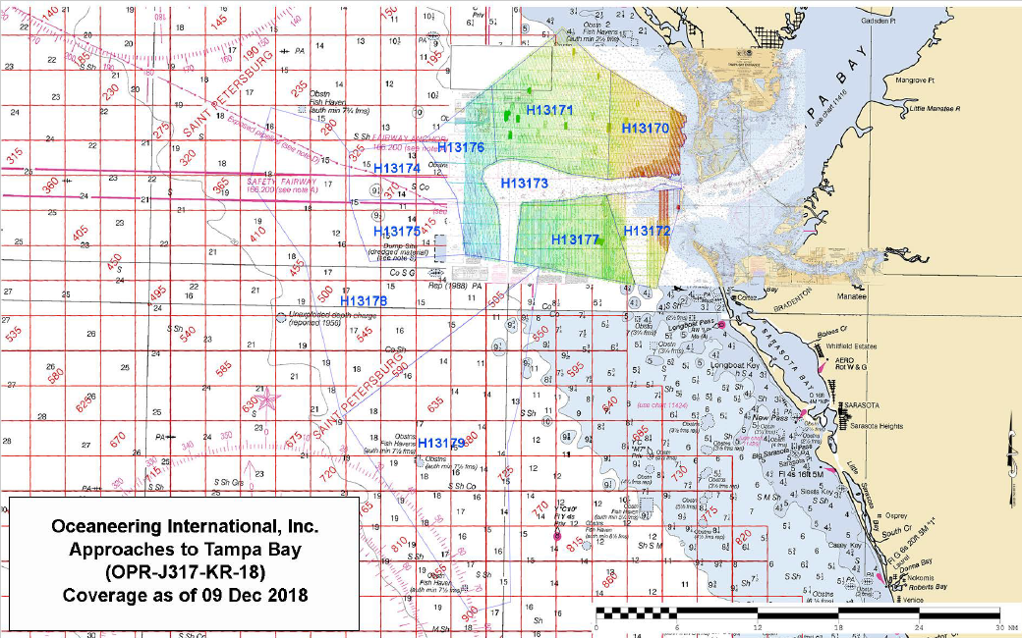
Hurricane Supplemental Survey Projects
Tampa Bay
660 SNM
8 Sheets
Awarded to Oceaneering
Notes:
The purpose of this project is to provide contemporary surveys to support an increase in vessel traffic into Tampa Bay.
With the exception of the main channel, survey vintage in the area is largely late nineteenth and early twentieth century, and is not full bottom coverage. This lack of modern data is of particular concern off the coast of the second fastest growing state (at a rate of about 1,000 people today) in the US.
With the drastic population rise has come a corresponding demand for fuels and other resources. About 26 million gallons of motor fuels are consumed every day in Florida by its residents.
The Ports of Tampa Bay are responsible for the supply of over 41% of fuel brought into the state each day and Port Tampa hosts giant fuel terminals that continuously receive shipments from large deep draft vessels.
In combination with the commercial traffic is a growing sport fishing and recreational boating contingent that serve to create a very complicated maritime traffic picture in the Approaches to Tampa Bay Survey area.
Tampa Bay is of crucial economic importance to the region, but is susceptible to strong storm events during hurricane season.
During the 2016-2017 alone, the region was impacted by four storm events that caused sand movement and shoaling in this heavily traveled area. It is of utmost importance to get accurate depths in such a dynamic area.
Finally, sand resources and movement in the area are of research importance to those doing habitat and conversation work, as well as managers engaged in beach nourishment activities. Bathymetric data is of high importance to those communities as well.

Slide 7
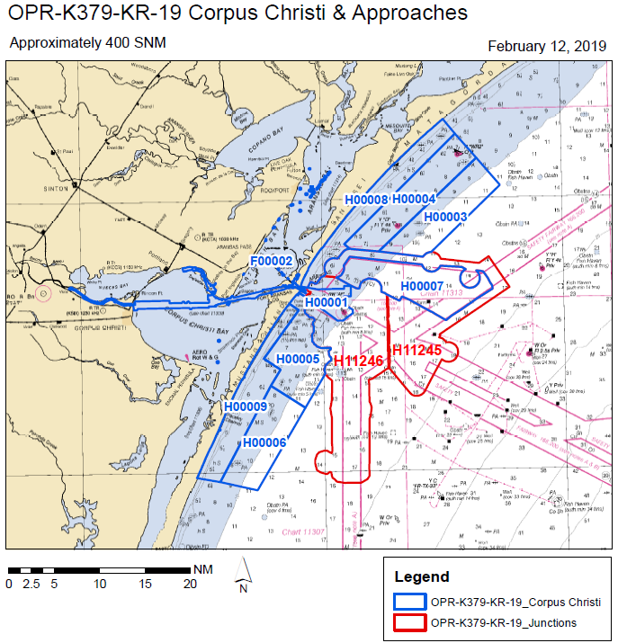
Hurricane Supplemental Survey Projects
Corpus Christi, TX
400 SNM
9 Sheets
In negotiations
Notes:
This project is located in Corpus Christi Bay, including the Corpus Christi Shipping Channel and offshore approaches.
The U.S. Army Corps of Engineers maintains the channel which is dredged through the bay to the jetties of Port Aransas.
The Corpus Christi Port primarily supports deep-draft vessels for export of petroleum and energy related products. In addition, the port supports seafood, industrial and agricultural industries in the state of Texas.
Metals, stone products, glass, chemicals, and gypsum products are produced near Corpus Christi Bay.
Six oil refineries and 1,500 wells are located near the bay as well as a large supply of natural gas.
The Channel also serves as a conduit for commercial ship traffic between Houston terminuses and the Gulf.
This survey will identify hazards and changes in bathymetry, providing contemporary data to update National Ocean Service (NOS) nautical charting products.

Slide 8
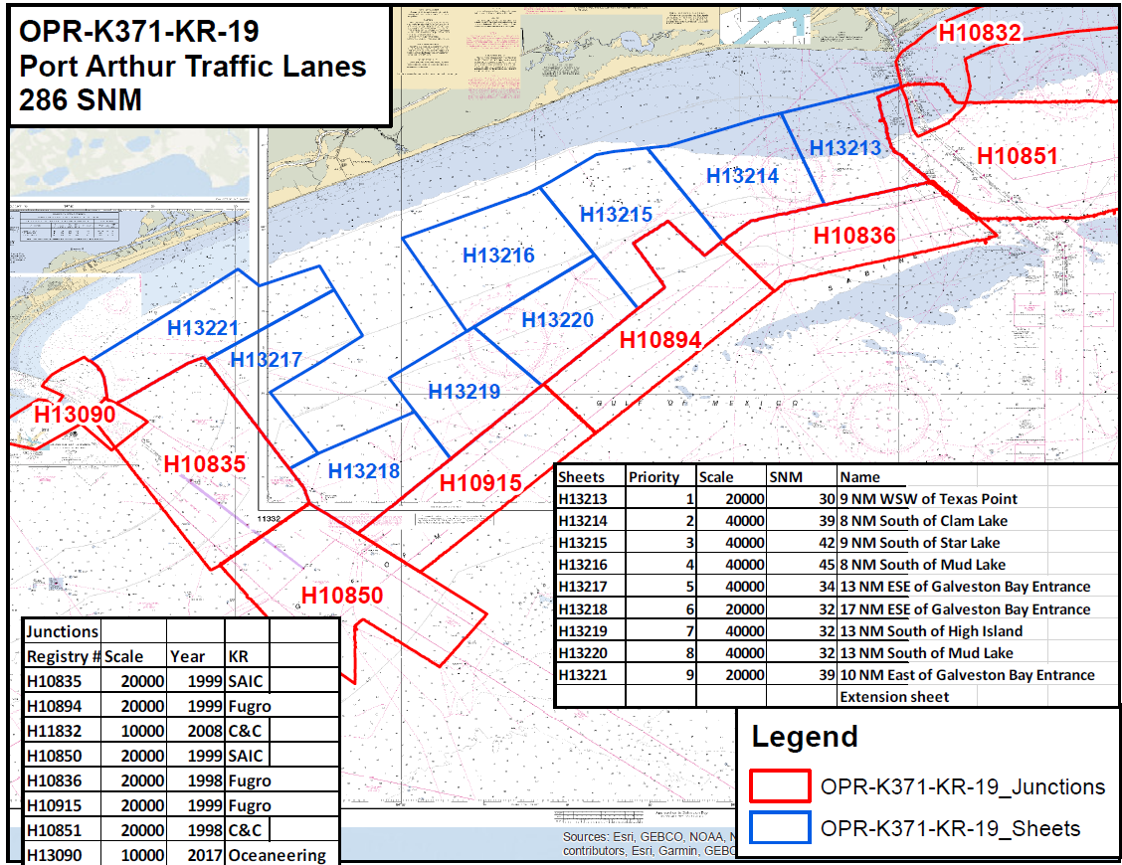
Hurricane Supplemental Survey Projects
Port Arthur Traffic Lanes, TX
286 SNM
9 Sheets
In negotiations
Notes:
Port Arthur, located on the Gulf Intra-coastal Waterway in Texas, is home a large refinery network.
The Port of Port Arthur hosts the Motiva refinery, the largest oil refinery in the United States.2 Traffic flow through the Port is heavy and in 2010, an oil spill occurred from an oil tanker and barge collision spilling 450,000 gallons of oil into the Sabine/Neches waterway.
This busy seaport has also been hit by several hurricanes. On August 29, 2017, Hurricane Harvey hit Port Arthur bringing upwards of 40 inches of rainfall and widespread flooding to the area.
This Hurricane had the potential to change the seafloor of the Port which sees over 35 million tons of vessel traffic.
To continue to promote safe passage of traffic through the Port, this project will survey 286 square nautical miles (SNM) of seafloor in Port Arthur.
The survey will address concerns of migrating shoals and exposed hazard by updating bathymetry and positions of hazards and reducing the risk to navigation.
Survey data from this project is intended to supersede all prior survey data in the common area and will provide contemporary data to update National Ocean Service (NOS) nautical charting products.

Slide 9
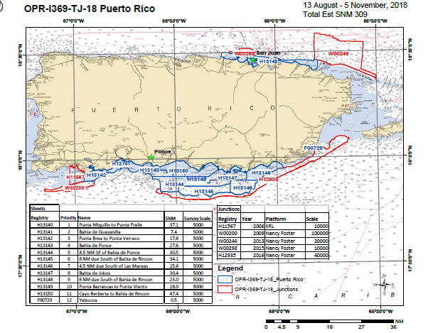
Hurricane Supplemental Survey Projects
Puerto Rico
309 SNM
12 Sheets
Program Funded DAS for $1,000,000
Notes:
The economy for the 3.3 million Americans in the territory of Puerto Rico is largely ocean dependent.
Approximately 7% of the jobs in Puerto Rico are directly involved in ocean related services accounting for over $920 million in wages.¹
The island also imports 85% of its foodstuffs and virtually all of its energy products.²
Currently, only a small percentage of its coasts and critical harbors have been surveyed with modern, high-resolution sounding or hydrographic LiDAR devices.
In 2017 the island was damaged by two major hurricanes; in response, the NOAA ship Thomas Jefferson conducted emergency sidescan and multibeam surveys of seven port facilities to locate storm related obstructions and damage to the channels.
A follow up to some of these ports and pilot areas, combined with a survey of the surrounding coastline, is necessary to verify that dangerous obstructions have been removed prior to updating nautical charts.

Slide 10
Shutdown Impacts
Coast Survey provided ENC danger to navigation updates during the shutdown
All raster updates were suspended
MCD applies approximately 20,000 changes to charts per year
As a result of the shutdown the chart application backlog has increased ~150%

Slide 11
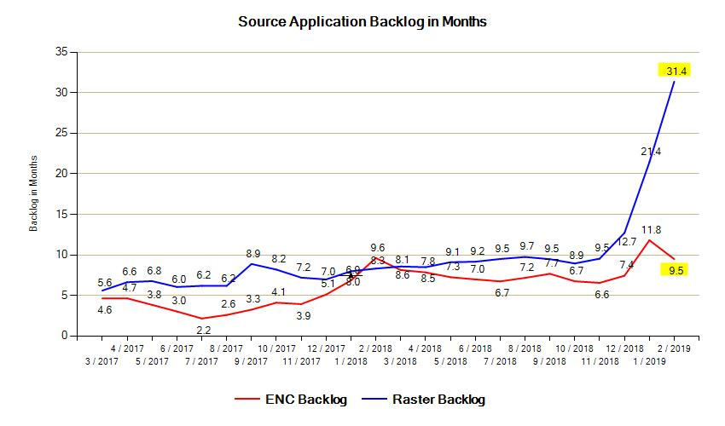

Slide 12
Project Depths

Slide 13
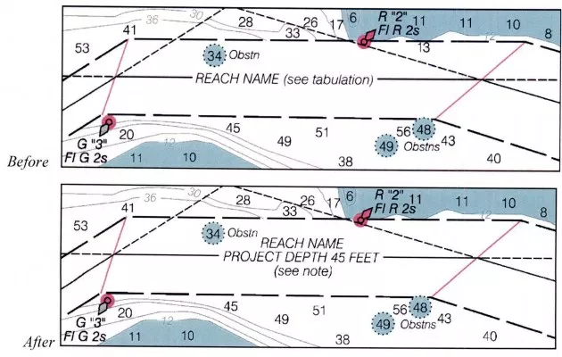
Project Depths
Notes:
We recently announced plans to change the U.S. Army Corps of Engineers (USACE) maintained channel depth values on raster nautical chart products, which include paper nautical charts and the corresponding digital raster navigational charts (NOAA RNC®).
Minimum depths (also called controlling depths) are collected during periodic USACE sonar surveys of channels.
In the past, these depths were provided on raster charts, but controlling depths will now be replaced with the original channel design dredging depths used by the USACE (called project depths).
Standardizing depth presentation on these products will improve data consistency and overall safety. Implementation begins in early 2019.
NOAA’s suite of electronic navigational charts (NOAA ENC®) are not affected by these changes. Mariners are encouraged to use NOAA ENCs for critical safety information as these products are typically updated up to one month ahead of raster products.
Blog: https://www.nauticalcharts.noaa.gov/updates/?p=171708

Slide 14
13 New ENCs Etolin Strait, AK ENCs released 11/16/18
ENC Updates – Etolin Strait
Notes:
Depths in meters:
Decimeters precision to 21m
Half-meter precision 21m to 31m
Whole-meter precision 31m and deeper
Whole-meter contours at 5m, 10m, 20m, and 30m
8 NOS Hydro Surveys – Aug 2016
Covered Approximately 570 Square Nautical Miles of seafloor
In this project area, deep-draft traffic is operating in relative shoals that have not been surveyed in over 100 years.
The 600' chemical tanker (Champion Ebony) grounded on an uncharted shoal in this survey area on June 24th, 2016, just days before survey operations were scheduled to commence.
Fortunately, no discharge occurred, but the incident emphasized the need for chart updates in the area.

Slide 15
Before Surveys – Best Scale 1:1,534,076 (Chart 16006 – Fathoms)

Slide 16
ENC Updates – Etolin Strait
8 NOS Hydro Surveys – Aug 2016
570 square nautical miles of seafloor
deep-draft traffic is operating in relative shoals that have not been surveyed in over 100 years.
Notes:
The 600' chemical tanker (Champion Ebony) grounded on an uncharted shoal in this survey area on June 24th, 2016, just days before survey operations were scheduled to commence.
Fortunately, no discharge occurred, but the incident emphasized the need for chart updates in the area.

Slide 17
ZOOM LEVEL = 1:288,895
Notes:
ENC viewer (aka ENC online). Safety contours/tints and even units can be customized by user. Soundings are only shown at the “compilation scale”, so not at zoom level greater than 1:80,000

Slide 18
ZOOM LEVEL = 1:72,229
Notes:
ENC Viewer. To see soundings, you must zoom in to 1:80,000 or larger

Slide 19
ZOOM LEVEL = 1:72,229

Slide 20
ENC Updates – New York

Slide 21
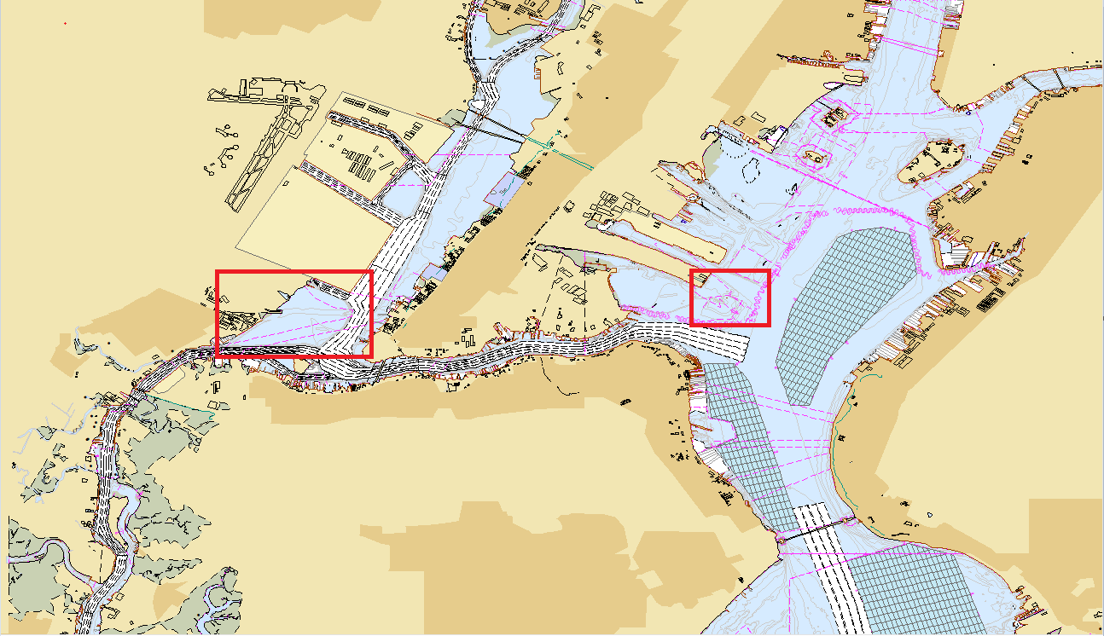
ENC Updates – New York
Example area 1
Example area 2
Notes:
Two example areas highlighted

Slide 22
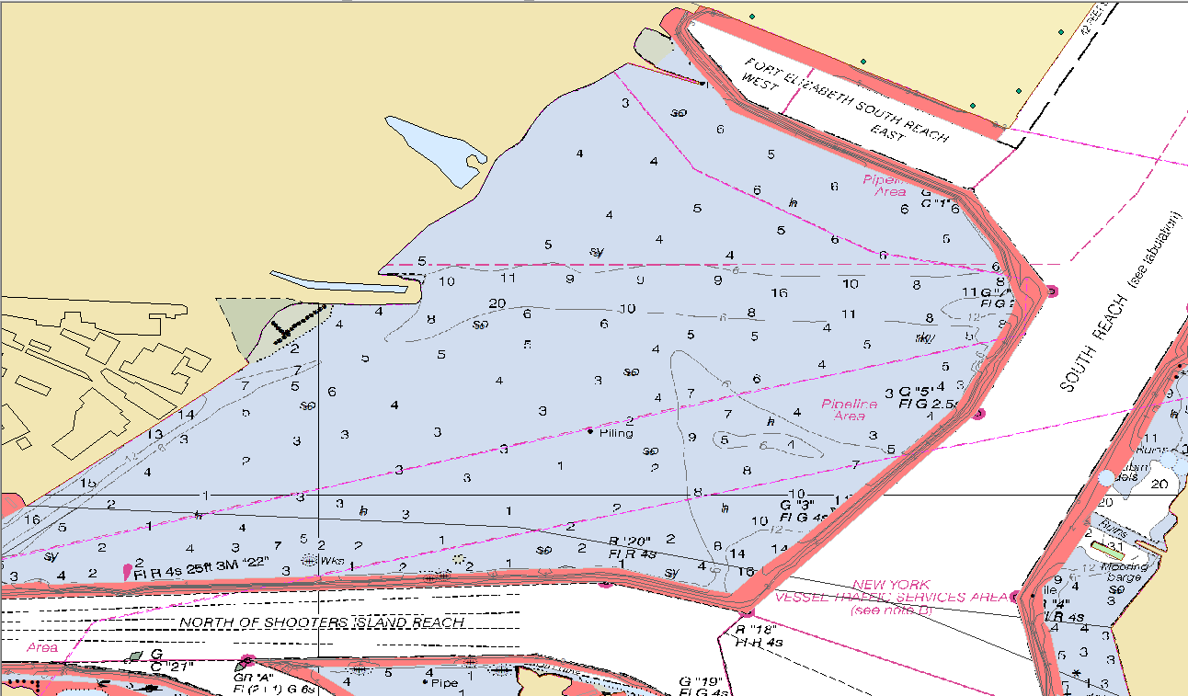
Example area 1
Notes:
Raster chart overlaid with extent of BAG data (red). Showing a large holiday in BAG data. Most holidays are near shore and in shallow/shoal areas.

Slide 23
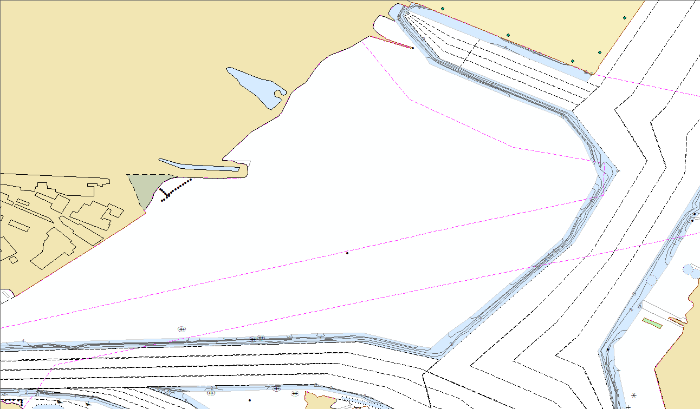
Notes:
Option 1: Only BAG data applied; leave data holidays as ‘unsurveyed’ (blank). This is the more time efficient option.

Slide 24
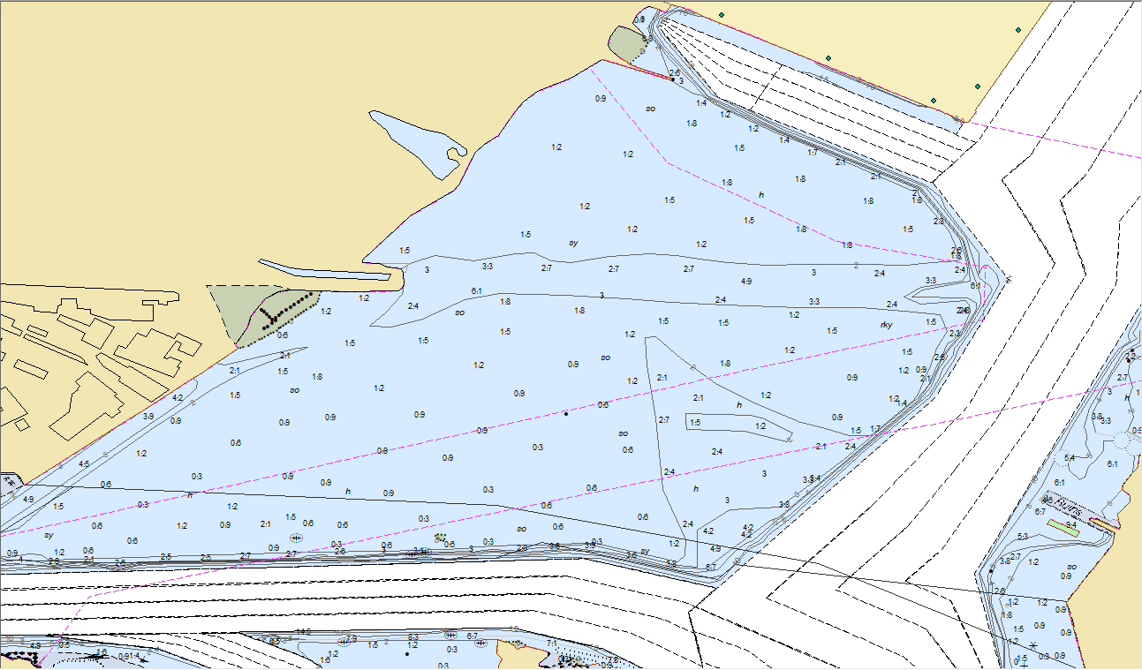
Notes:
Option 2: Populate data holidays with current chart data (time consuming and guesswork); combine BAG data and current chart data
-Convert soundings to meters (easy)
-Convert depth contours to new metric contour intervals (educated guesswork). Sometimes there are tracklines through the holidays to help confirm.

Slide 26
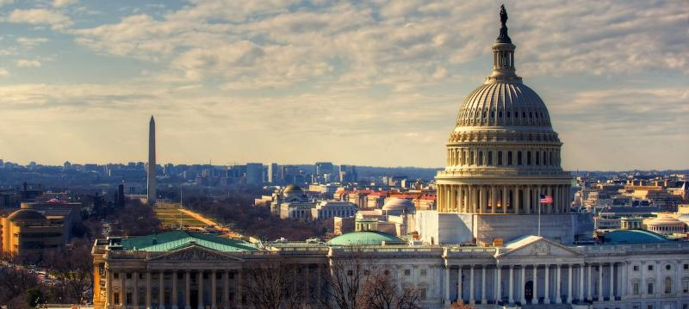
Questions?
nauticalcharts.noaa.gov
@NOAAcharts
NOAAcharts

