Slide 1
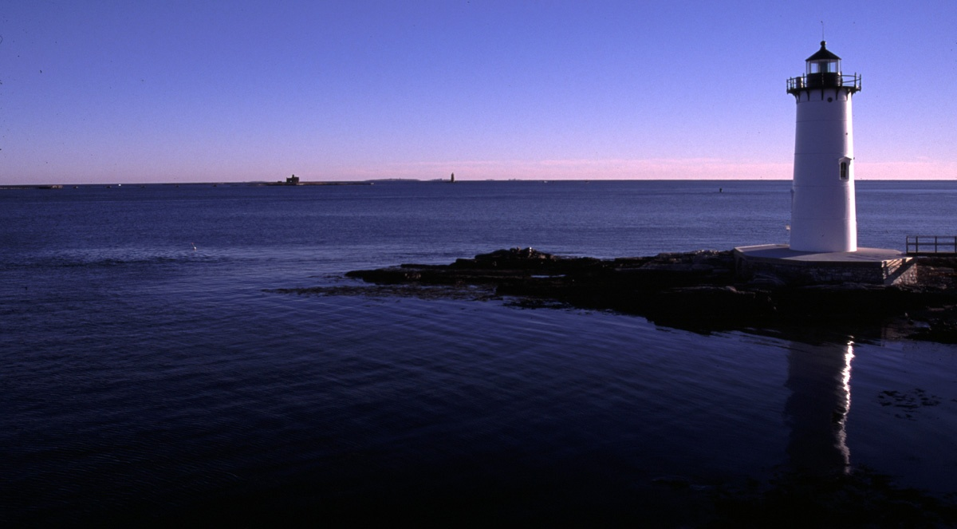

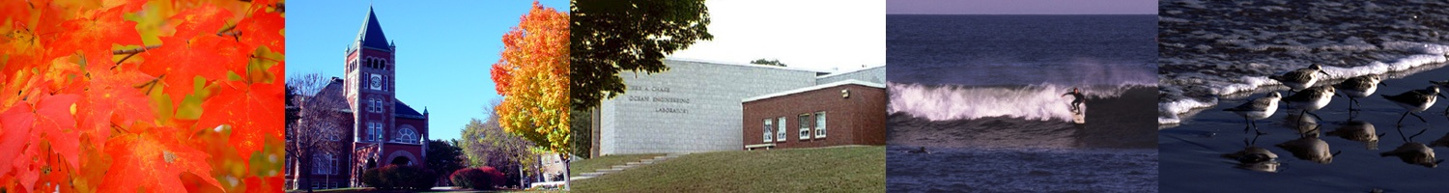
Center for Coastal and Ocean Mapping
NOAA/UNH Joint Hydrographic Center
FOCUS AREAS FOR NEXT YEAR
(some)

Slide 2
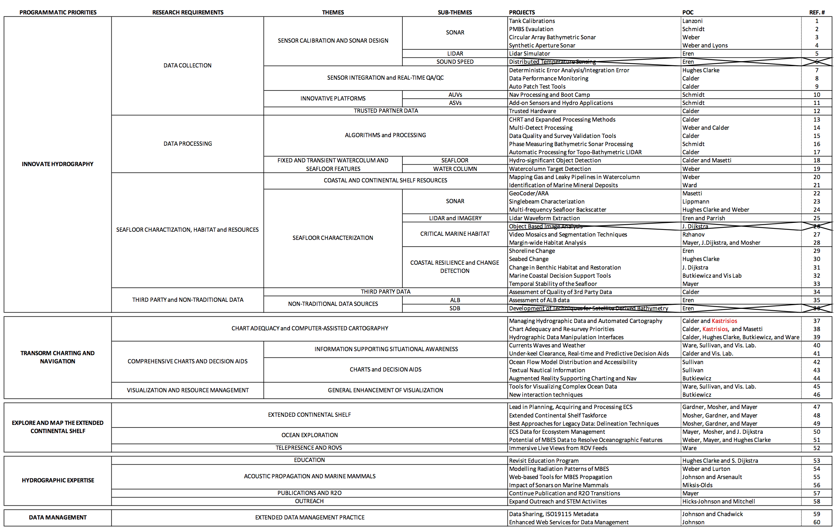
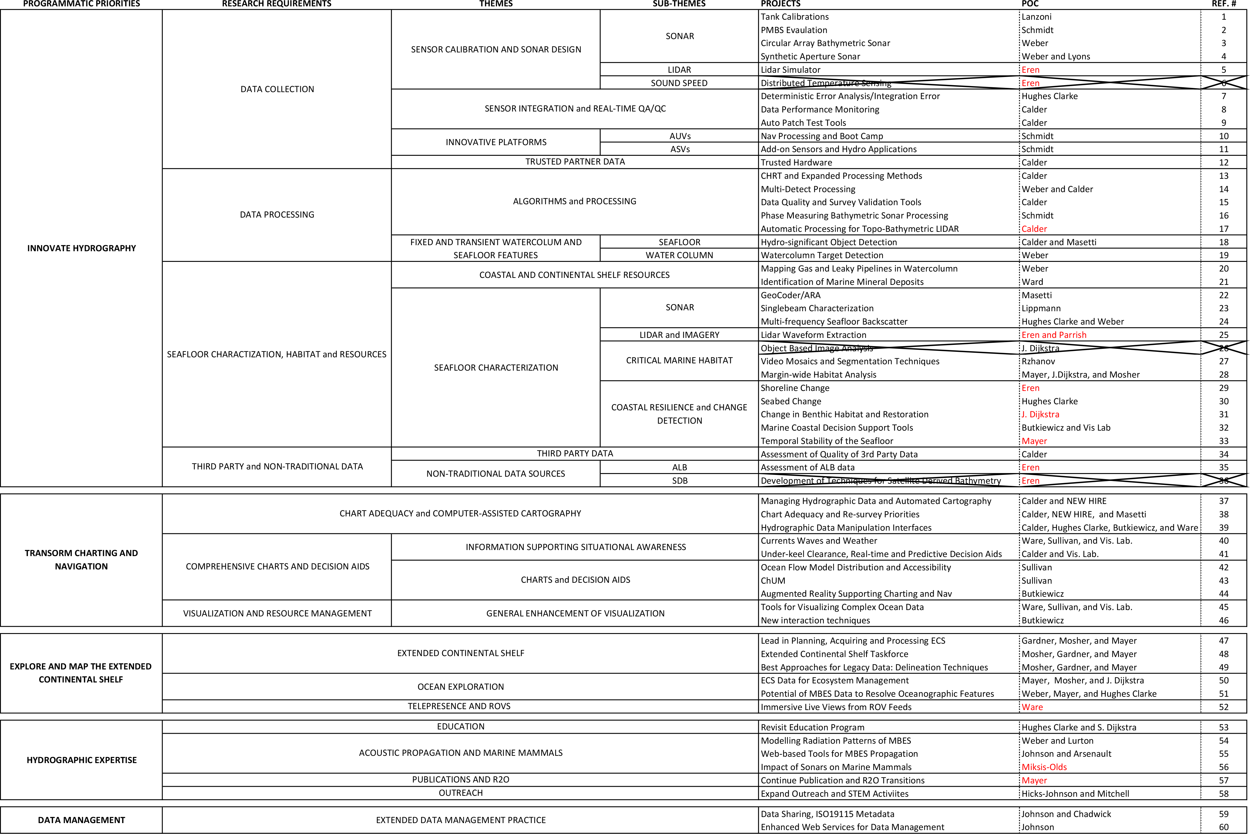
THE GRAND TABLE……..

Slide 3
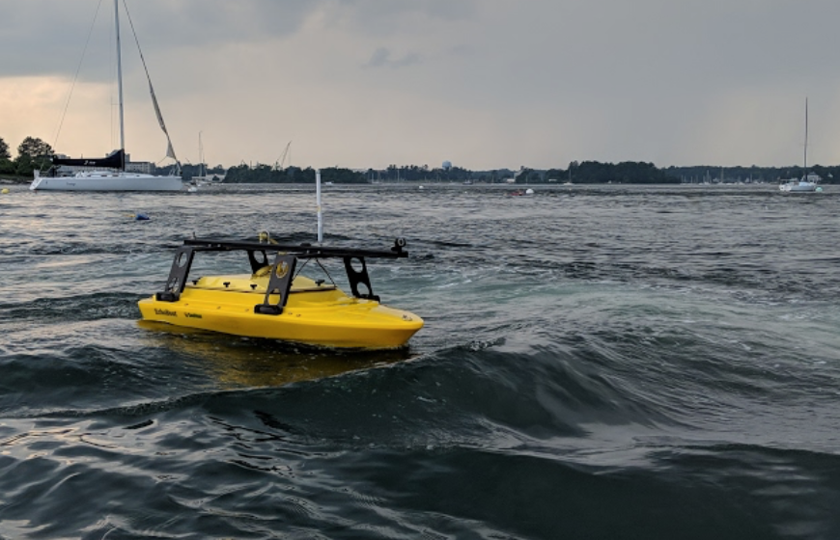
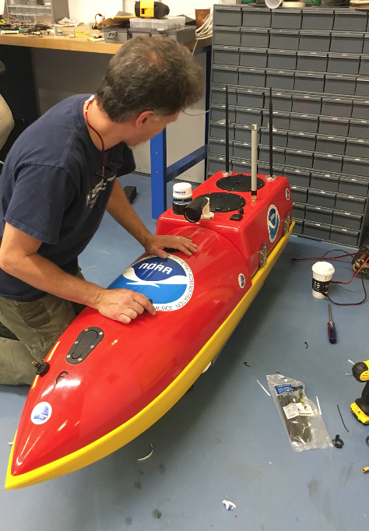
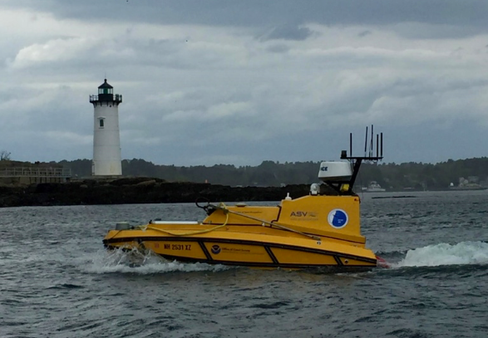
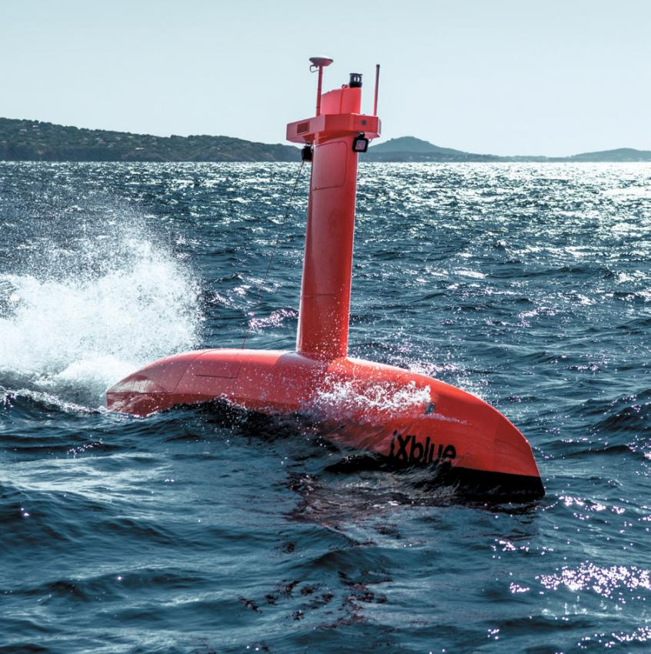
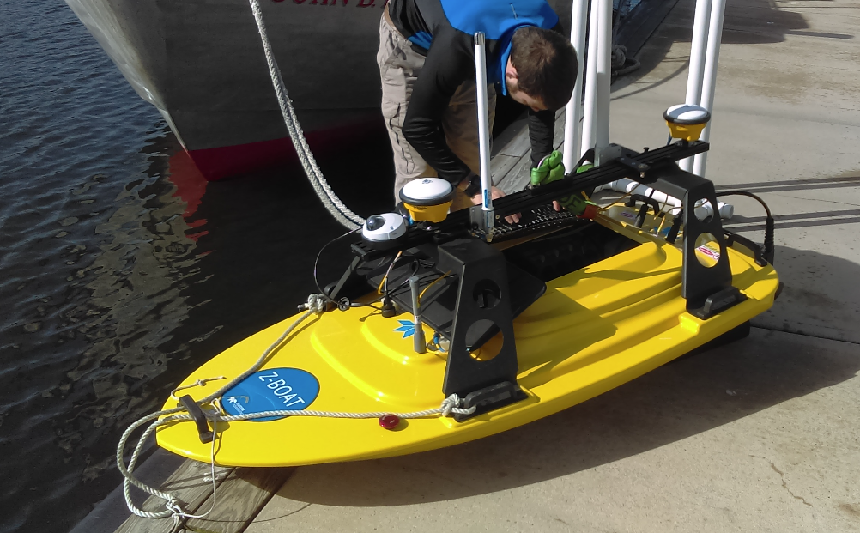
Autonomous
Surface Vehicles
Seafloor Systems Echoboat
ASV Global CW-4
Bathymetric Explorer and Navigator - BEN
Hydronalix EMILY Boat
iXBlue DriX
Teledyne Oceansciences Z-Boat

Slide 4
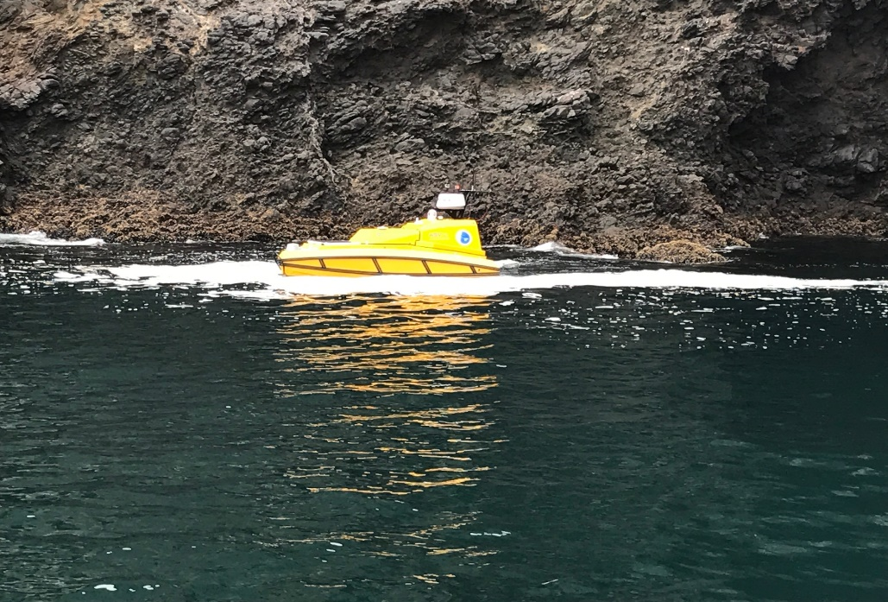
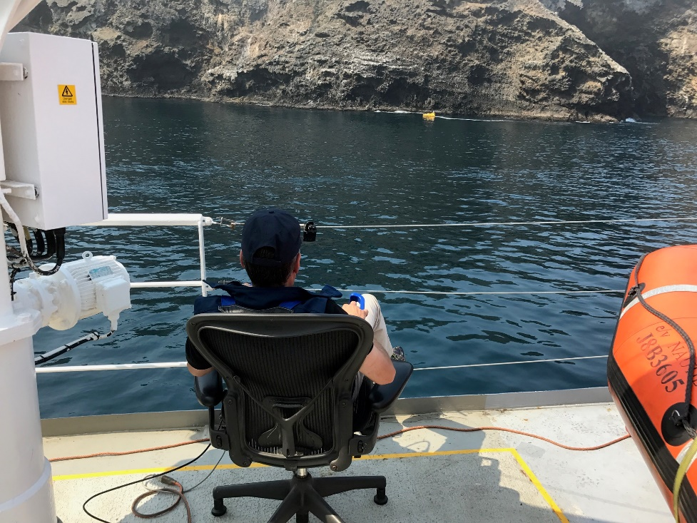
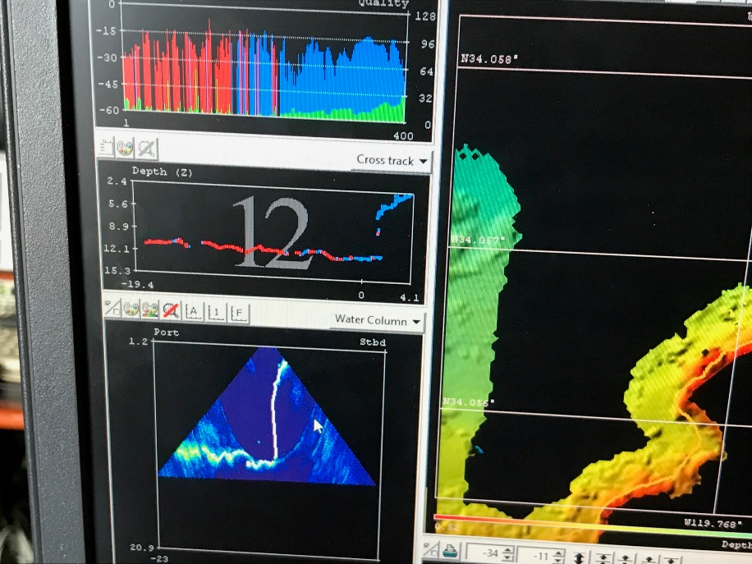
Autonomous Vehicles for Close-quarter Surveying
Continuing hardware and software upgrades (Velodyne, engine FLIR, more cameras, etc.)

Slide 5
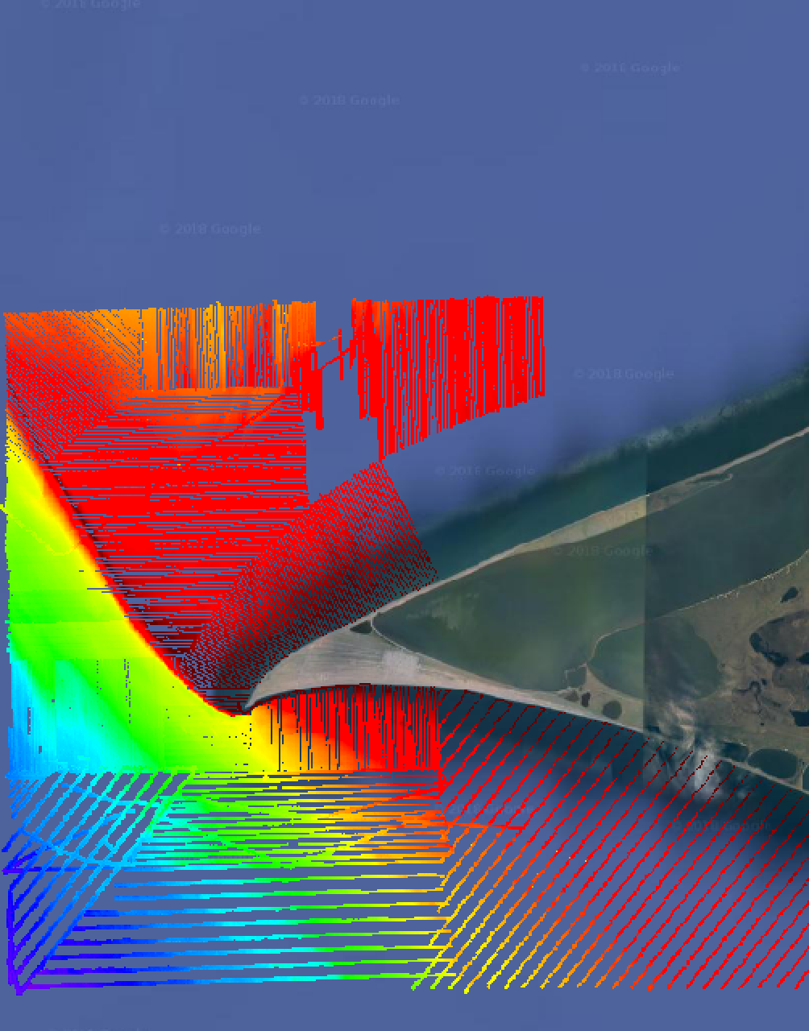
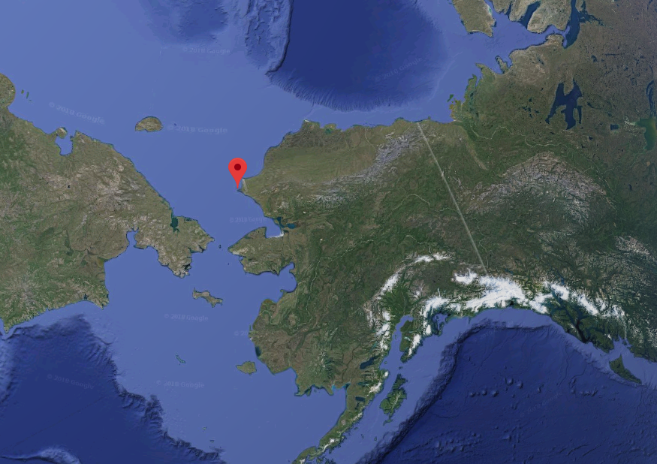
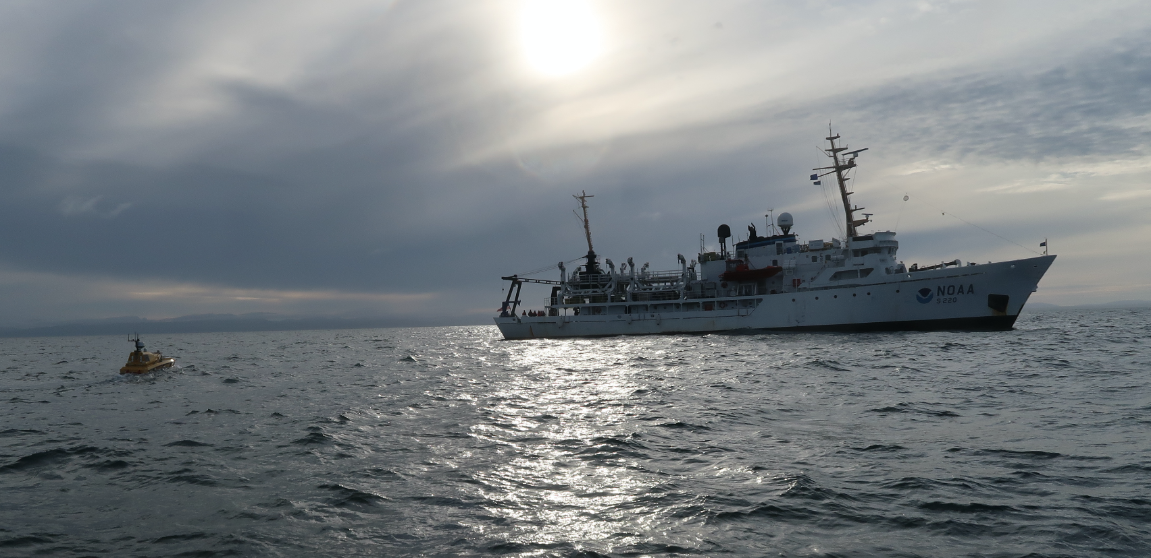
Autonomous Vehicle Operations from NOAA Ship FAIRWEATHER
Fairweather Anchor Locations
Off Point Hope AK – July-Aug 2018
ASV typically provided ~20% of survey coverage each day.
No impact on processing load.
DAY 1
DAY 2
DAY 3
DAY 4-5 Overnight
DAY 4

Slide 6
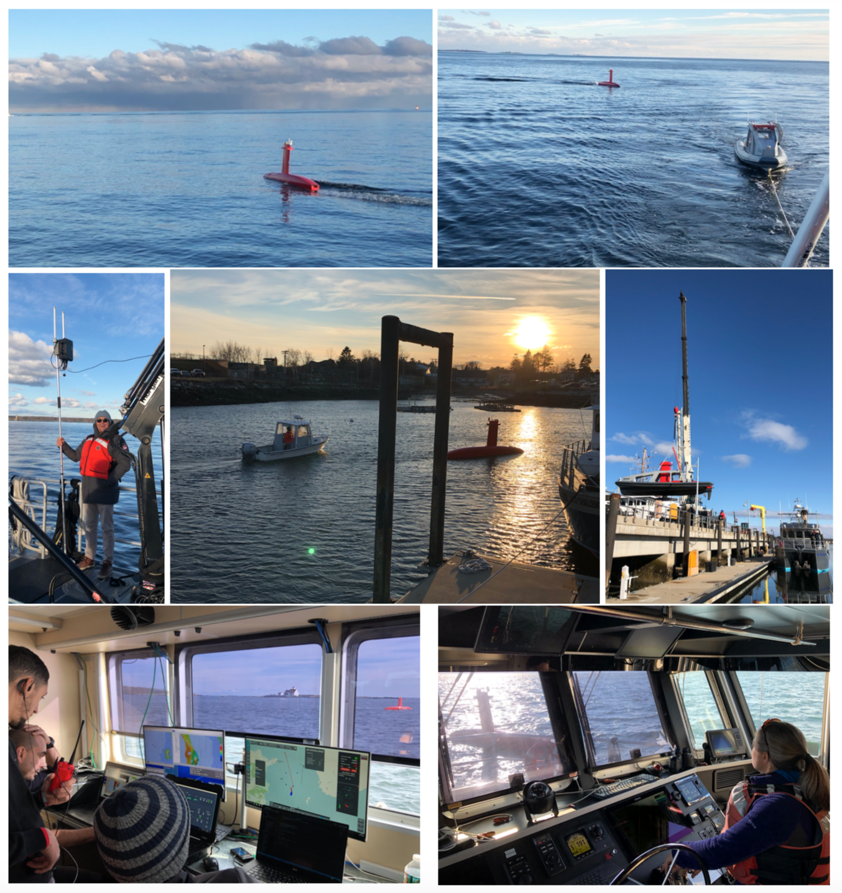
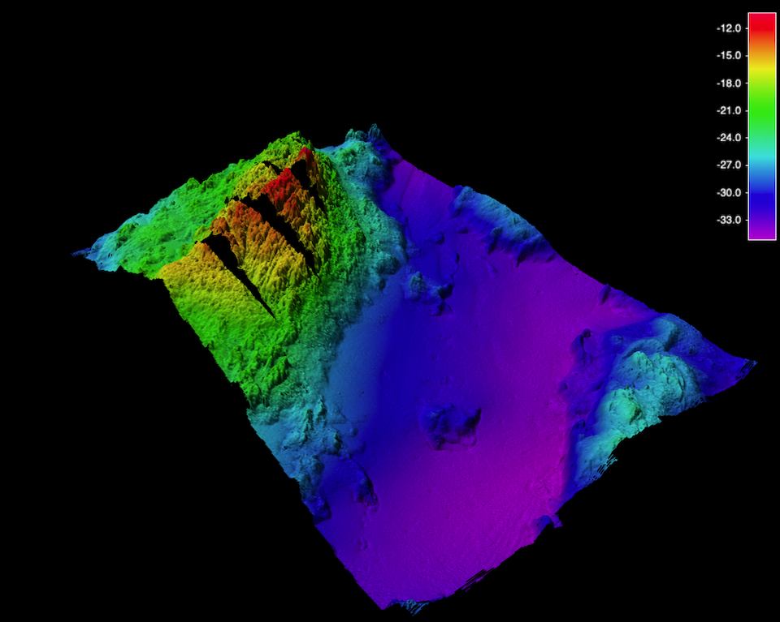
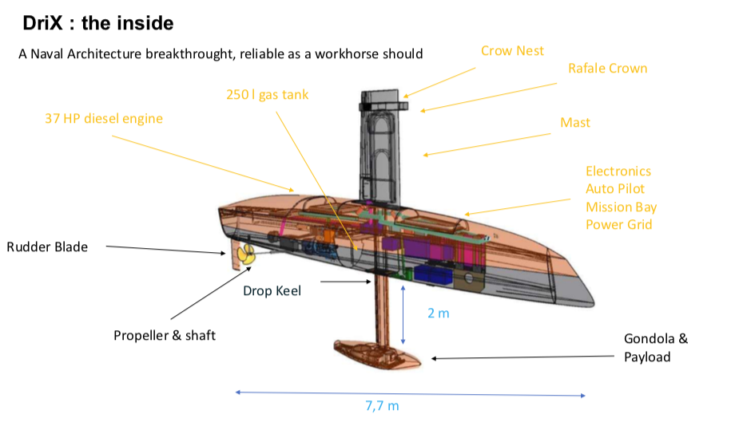
FOCUS AREAS:
Autonomous Surface Vessels: DriX
Virtually no data degradation up to 12 knots
NOAA/JHC/iXBlue Colloaboration
Delivered to JHC – DEC 2018
2 weeks of sea trials completed
adaptors for NOAA davits designed
trials on T.J. scheduled for Aug/Sept.

Slide 7
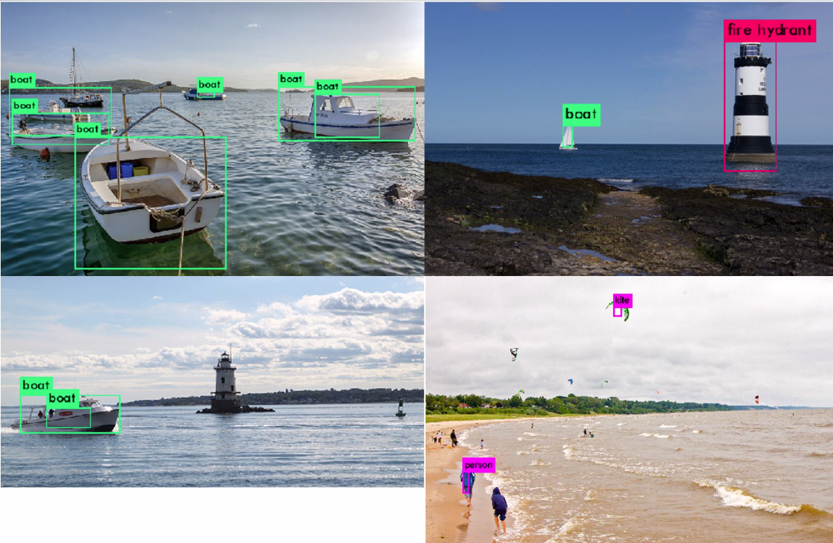
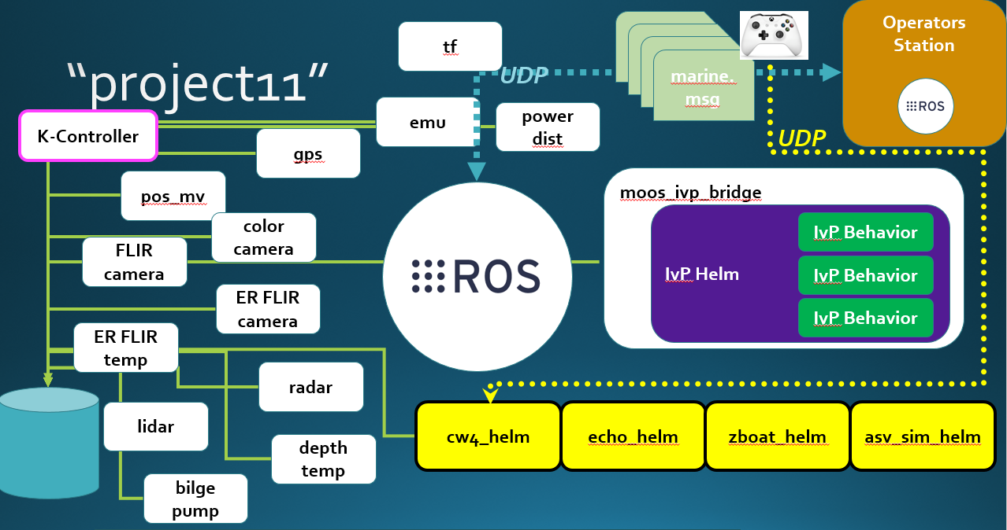
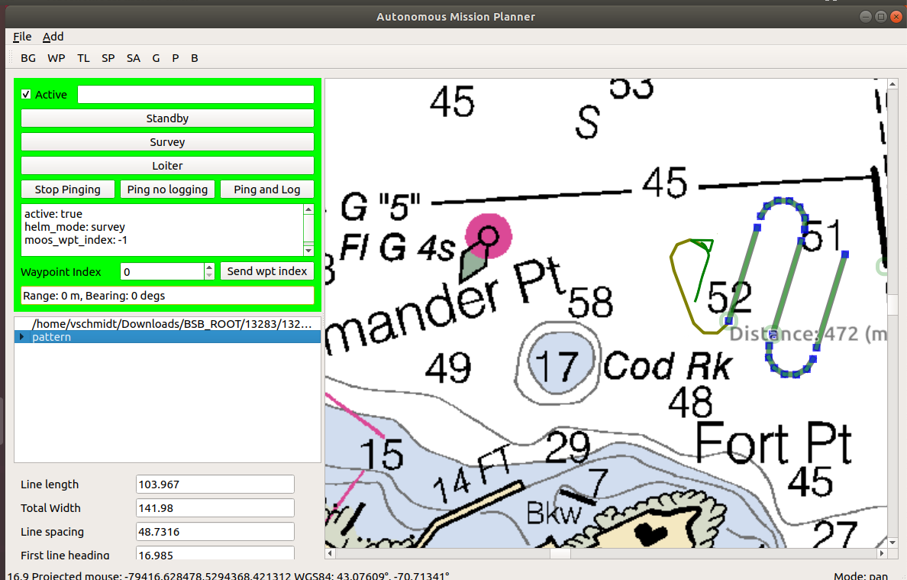
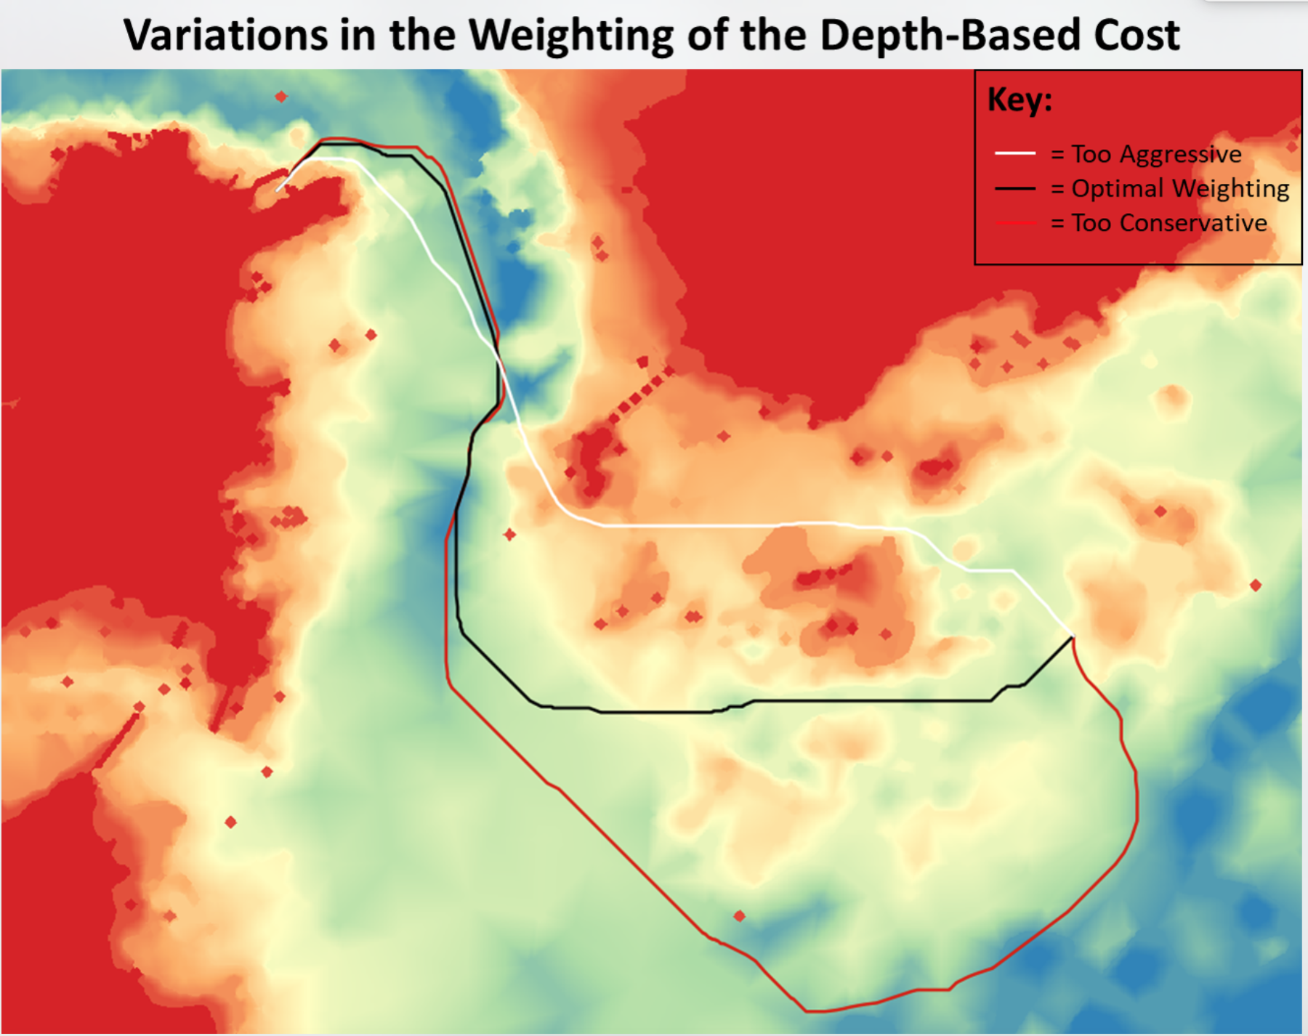
FOCUS AREAS:
Towards Real Autonomy:
Tools for sensor fusion and application of AI/Machine Learning
Autonomous Mission Planner
“Chart-Aware” navigation
Reactive behavior to avoid obstacles

Slide 8
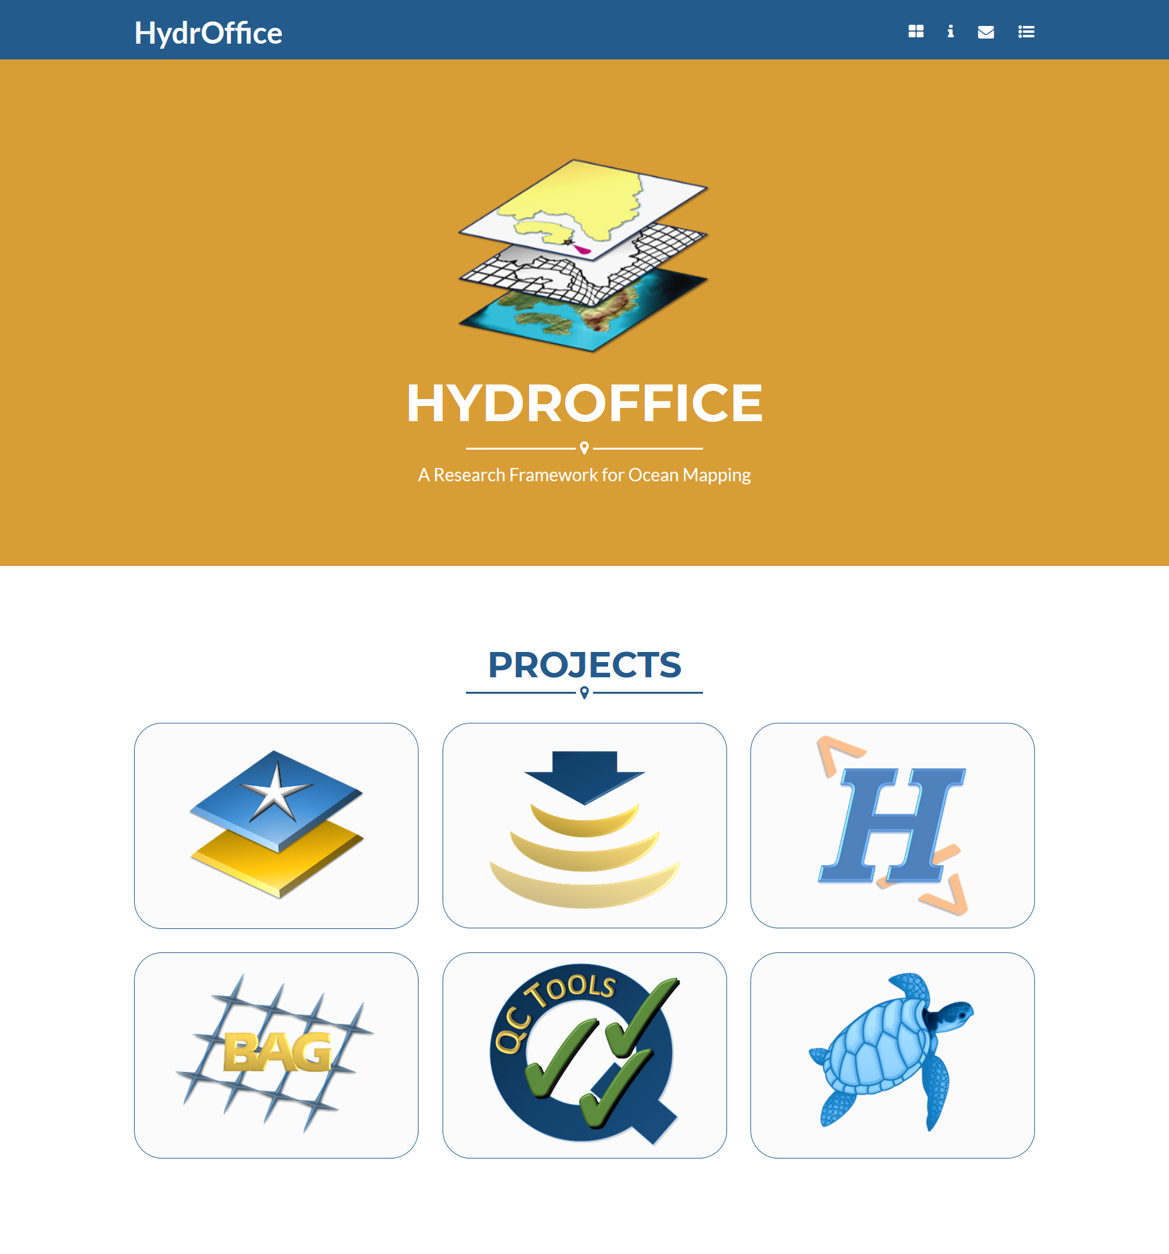
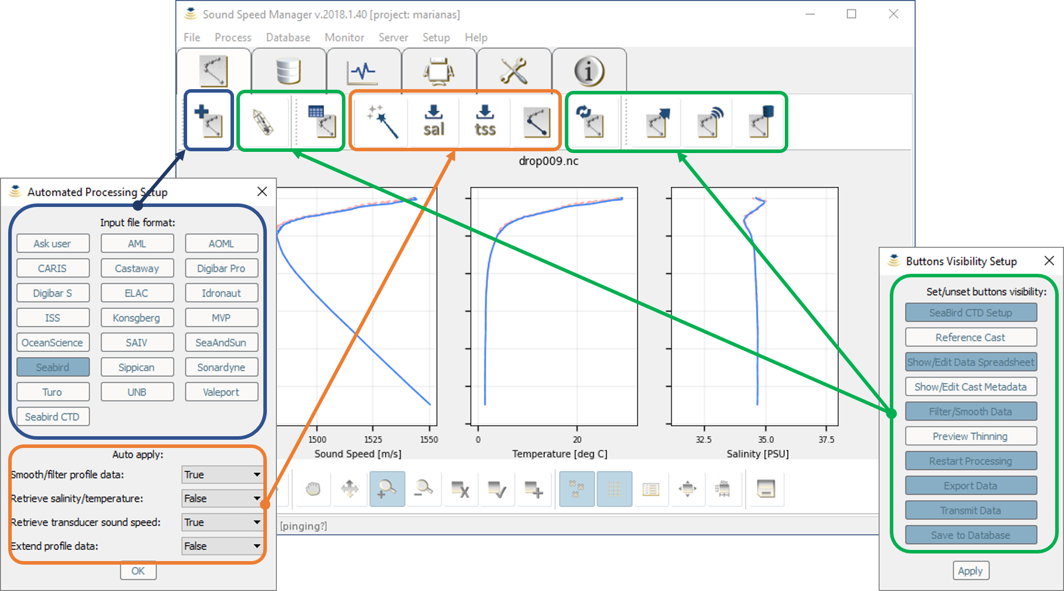
FOCUS AREAS:
Real-time Data Performance Monitoring
“Total cost of ownership…..” – cost to fix increases further downstream from source of problem
Sound Speed Manager in Fleet 2017 feedback → upgrades and wider user base
HydrOffice Tool Kit

Slide 9
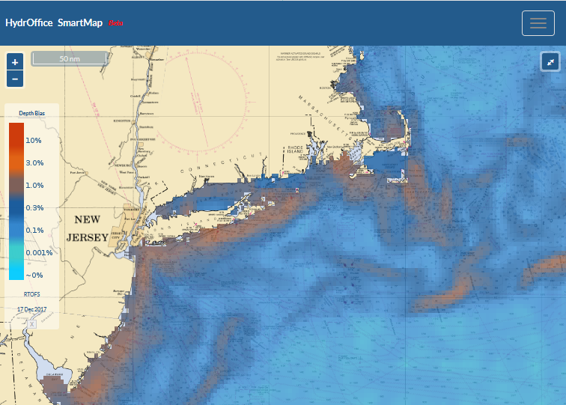
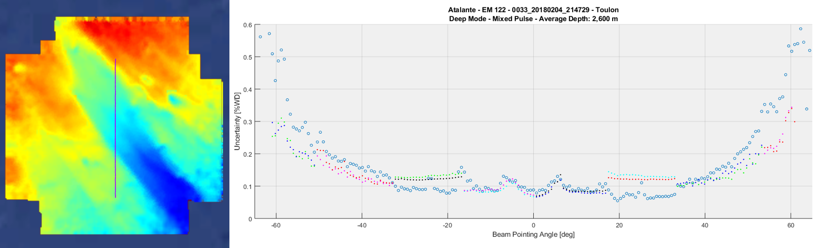
FOCUS AREAS
Real-time Data Performance Monitoring
Multibeam Acquisition Tracker and Explorer (MATE) – tracking many parameters including data uncertainty (SDU)
Smart Map – prediction of oceanographic weather – QF, where
to take SVP, etc.

Slide 10
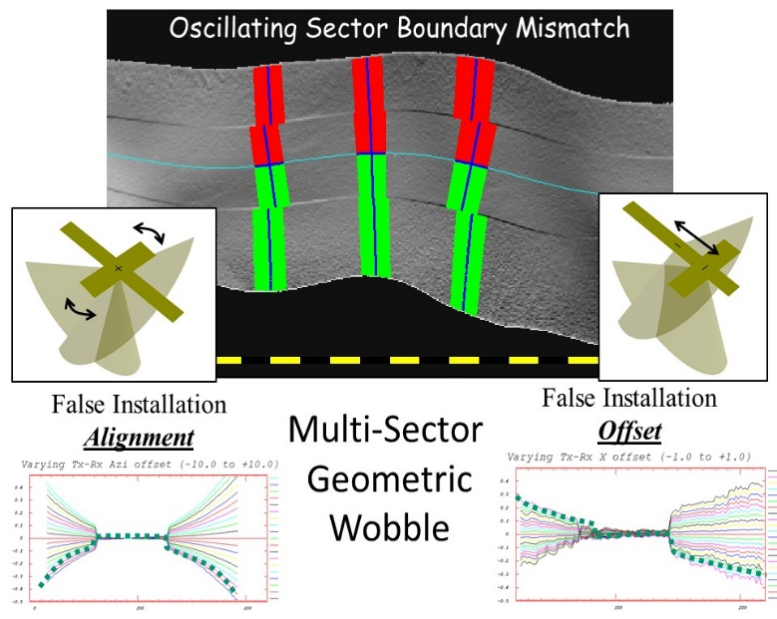
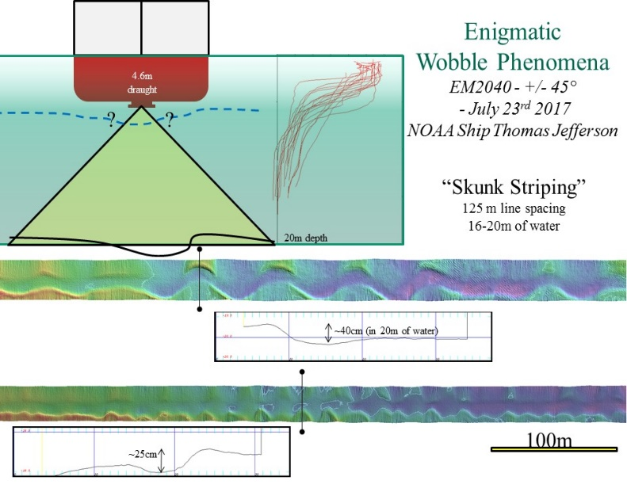
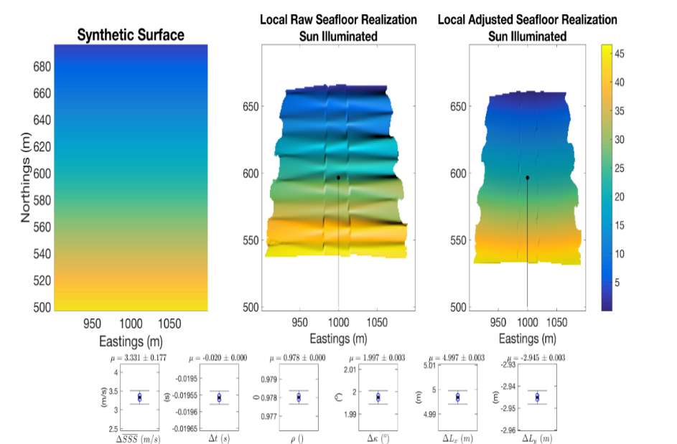
FOCUS AREAS:
Smarter Processing Software to Support Autonomous Vehicles and General Processing:
Deterministic Error Analysis Tools
Multi-sector Wobbles Tx-steering during yaw stabilization
Oceanographically-induced wobbles
Wobble Simulator/Extractor
“Least Square Geometric Calibrator”
Automated Patch Test Tool

Slide 11
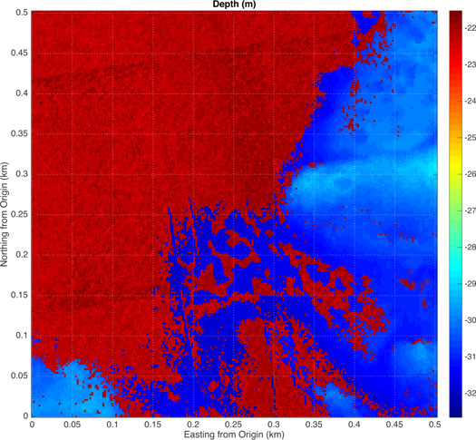
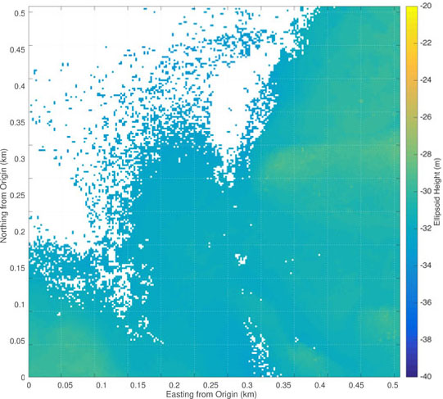
FOCUS AREAS:
Efficient multiresolution processing of high-density data:
CUBE → CHRT
CUBE with Hierarchical Resolution Techniques
Application to Bathy-Topo LIDAR data – powerful discriminator between good and bad data !!!
Extends CUBE to ADAPTIVE variable resolution data and gridding
Parallelizable, efficient and distributable over network
Scientifically rigorous perceptual and cognitively optimized visualizations and interaction methods

Slide 12
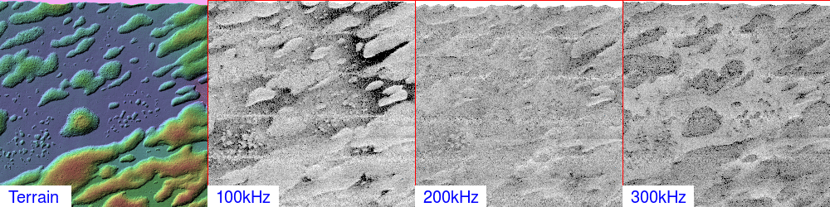
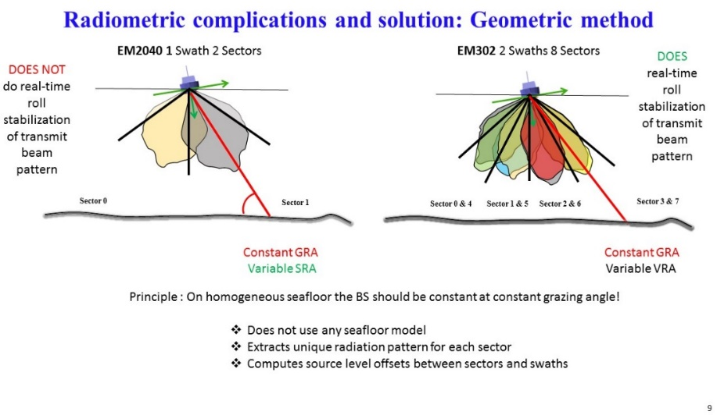
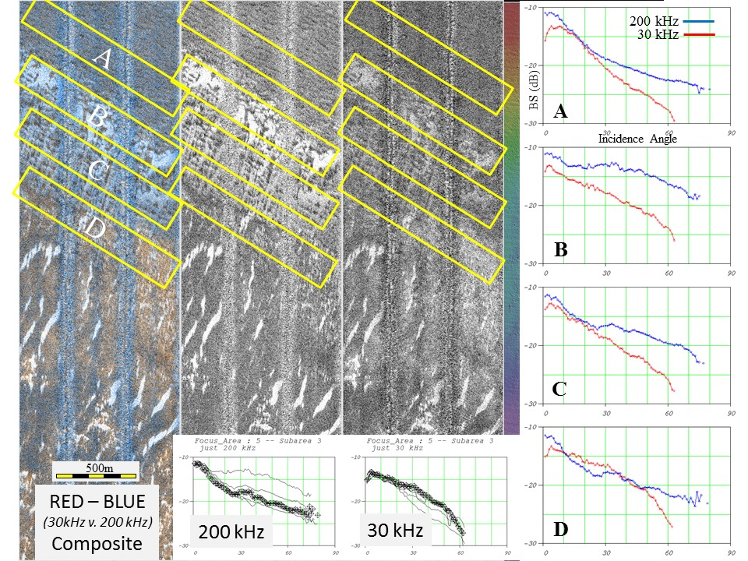
FOCUS AREAS:
Seafloor Characterization Habitat and Resource Mapping Tools:
Taking advantage of bandwidth of new sonars -
Compensating for sector-specific beam patterns
Once compensated for – angular response curve can be extracted for different frequencies – often showing very different response for different sediment types

Slide 13
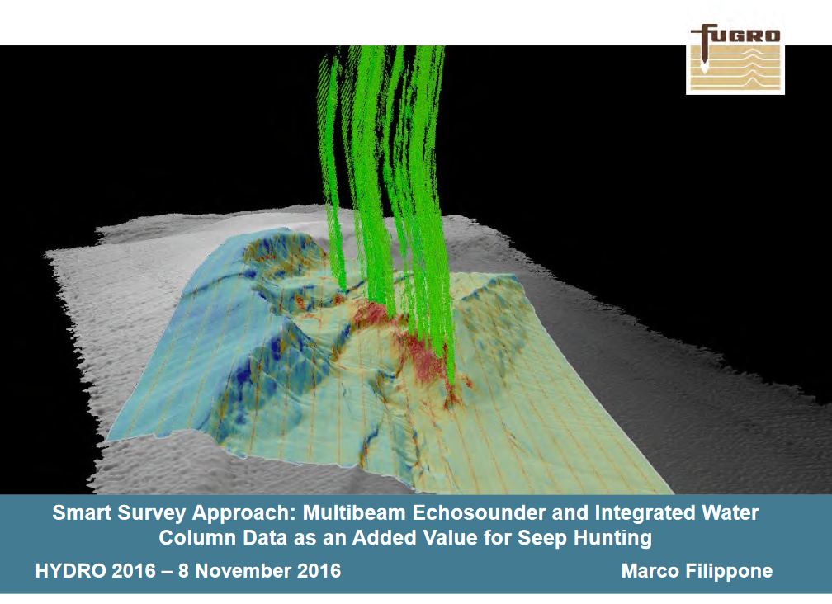
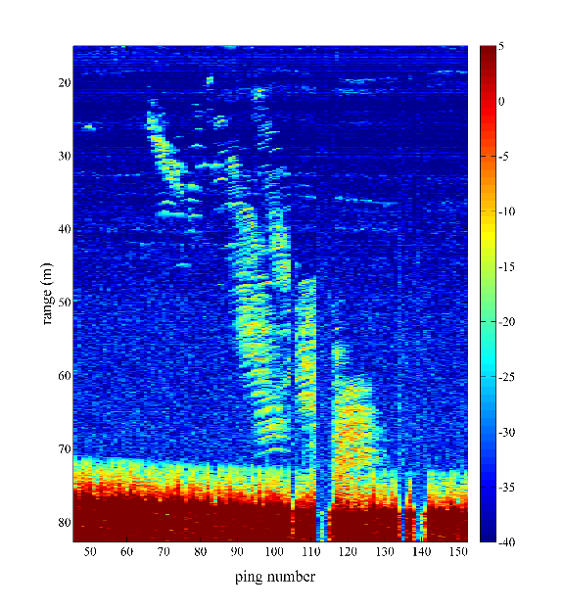
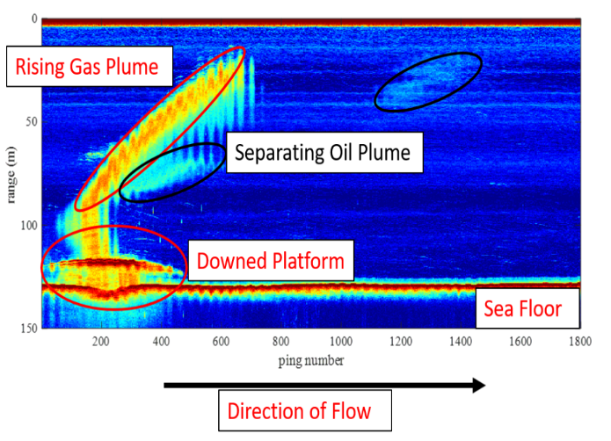
FOCUS AREA:
Water Column Mapping: Mapping Oil and Gas:
Understanding acoustic response of oil droplets and gas bubbles through lab experiments
Identification and location of seeps/leaks
Separating oil from gas at Taylor Energy leak
Estimating gas flux

Slide 14
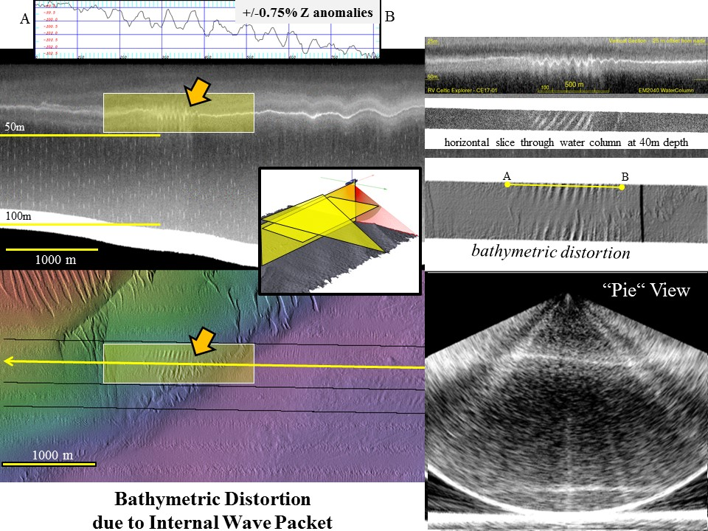
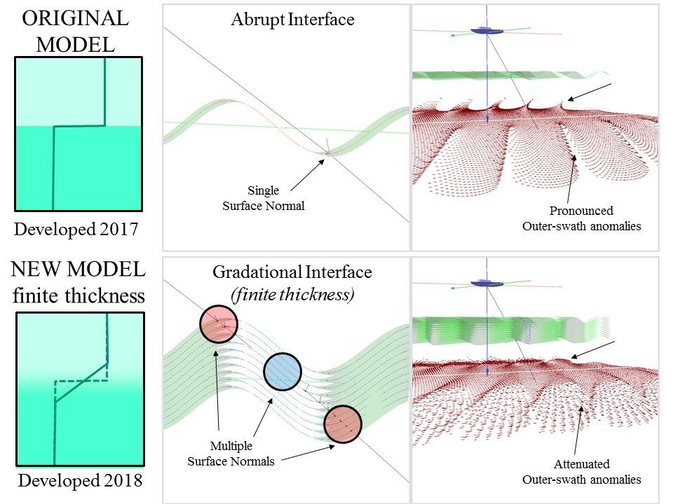
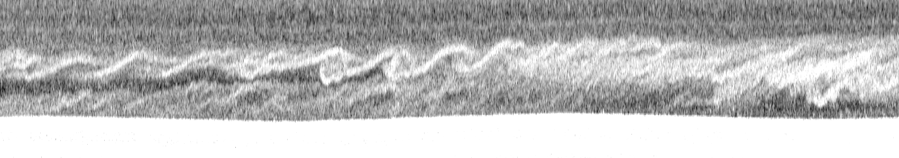
FOCUS AREAS:
Understanding and observing oceanographic phenomena
Real-time monitoring of internal waves to mitigate impacts and modeling

Slide 15
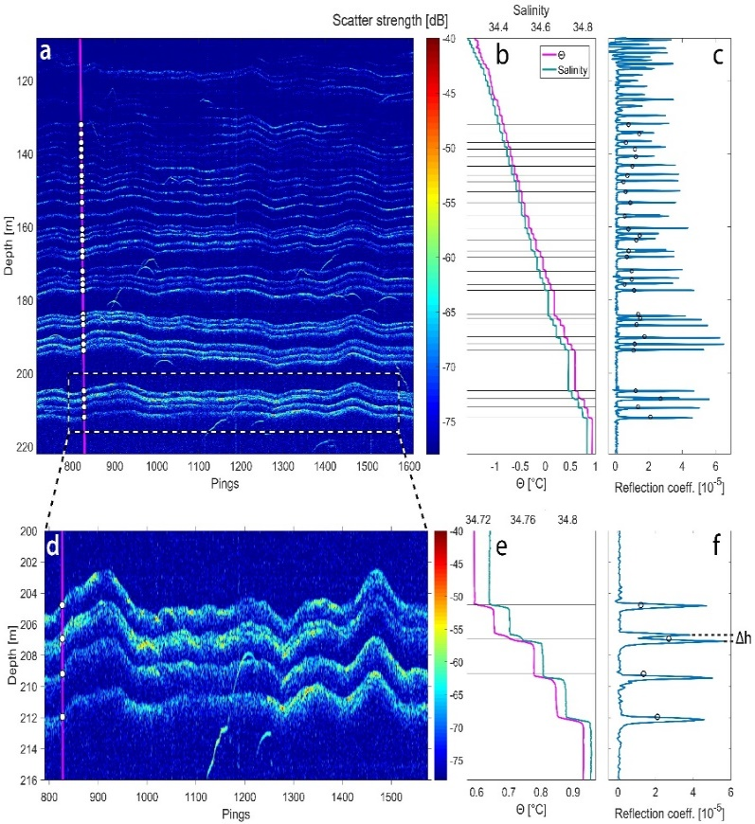
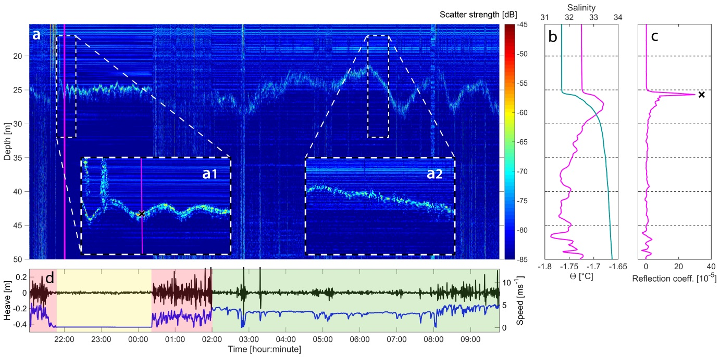
FOCUS AREAS:
Understanding and observing oceanographic phenomena
Real-time monitoring of internal waves to mitigate impacts and modeling

Slide 16
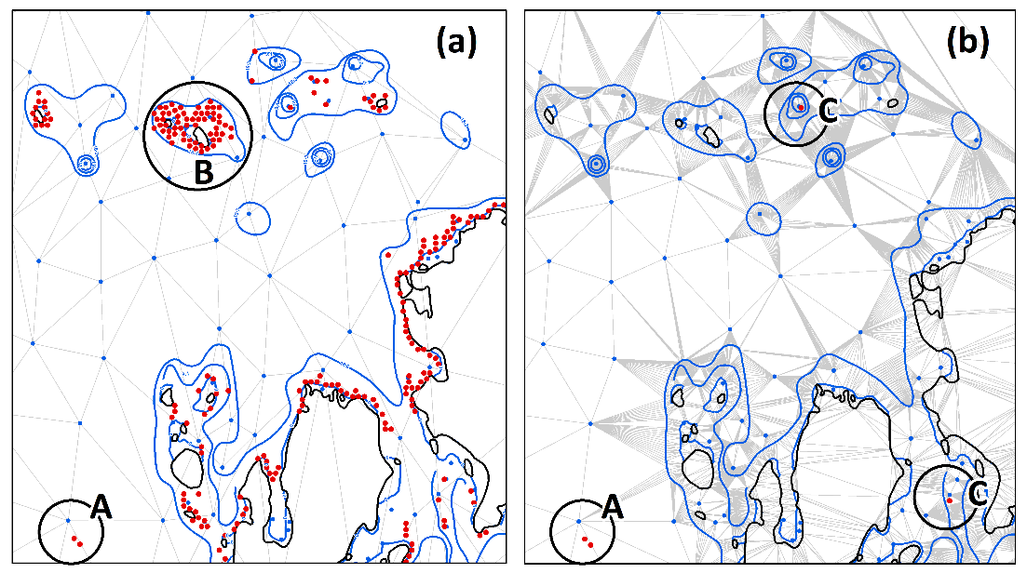
FOCUS AREAS:
Automated Cartographic Support Tools
Meeting the IHO “Safety Constraint” Rules for Nautical Charts
Sounding Selection Verification: Triangle Test Edge Test
The “triangle test” based on a TIN generated by the chart scale soundings can have issues near contours and land areas (red dots with selected sounding depths indicated).
New “hybrid” TIN method using all bathymetric data, depth curves and coastline data greatly reduces false alarms
Source soundings along each triangle edge are evaluated against the depth of the two vertices.

Slide 17
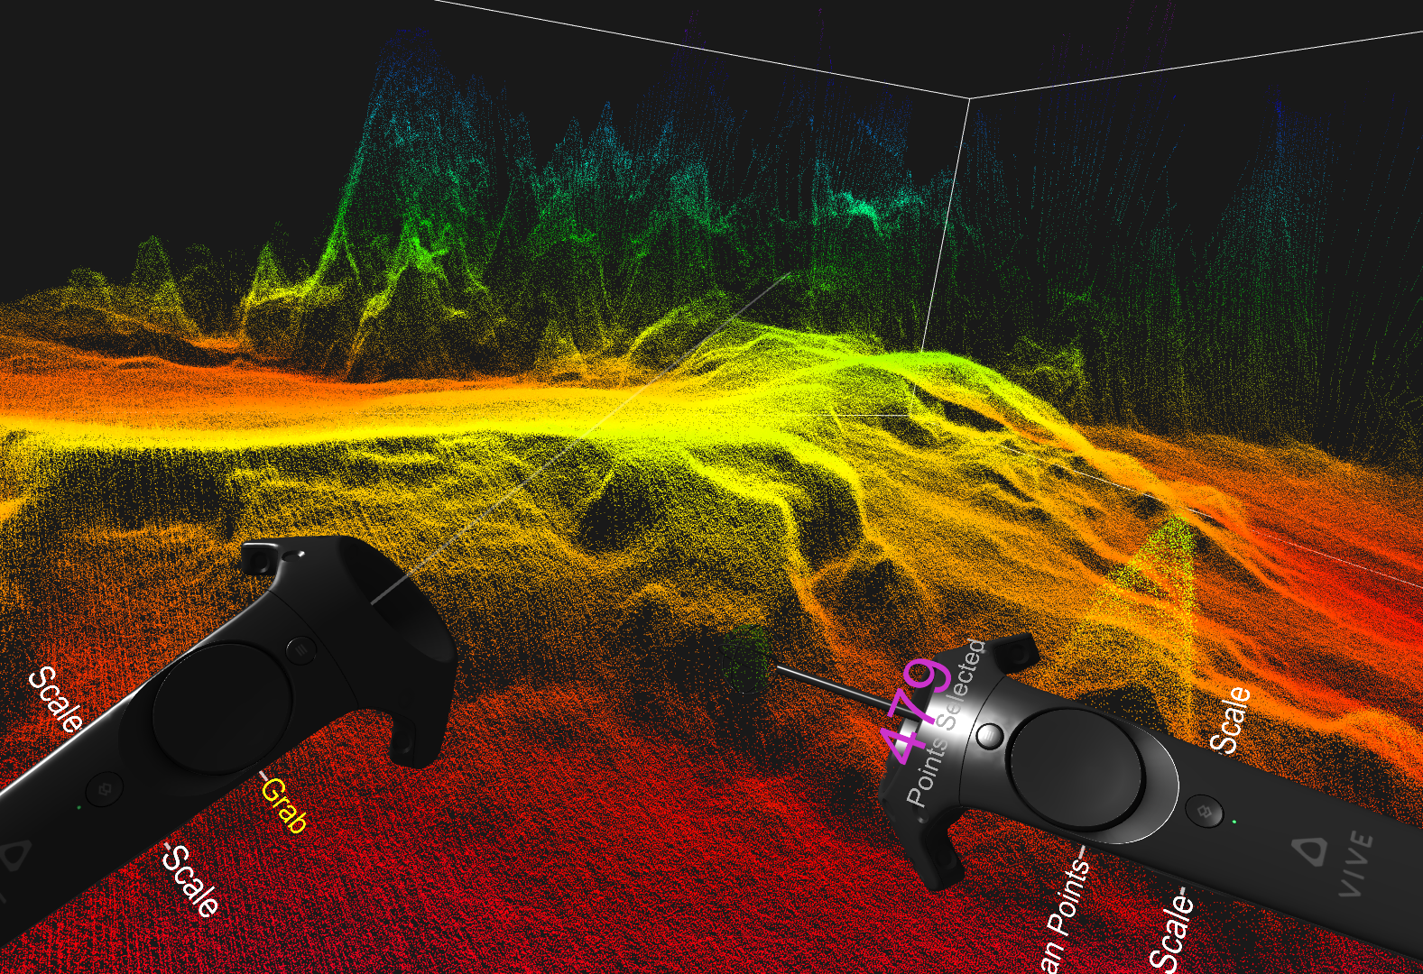
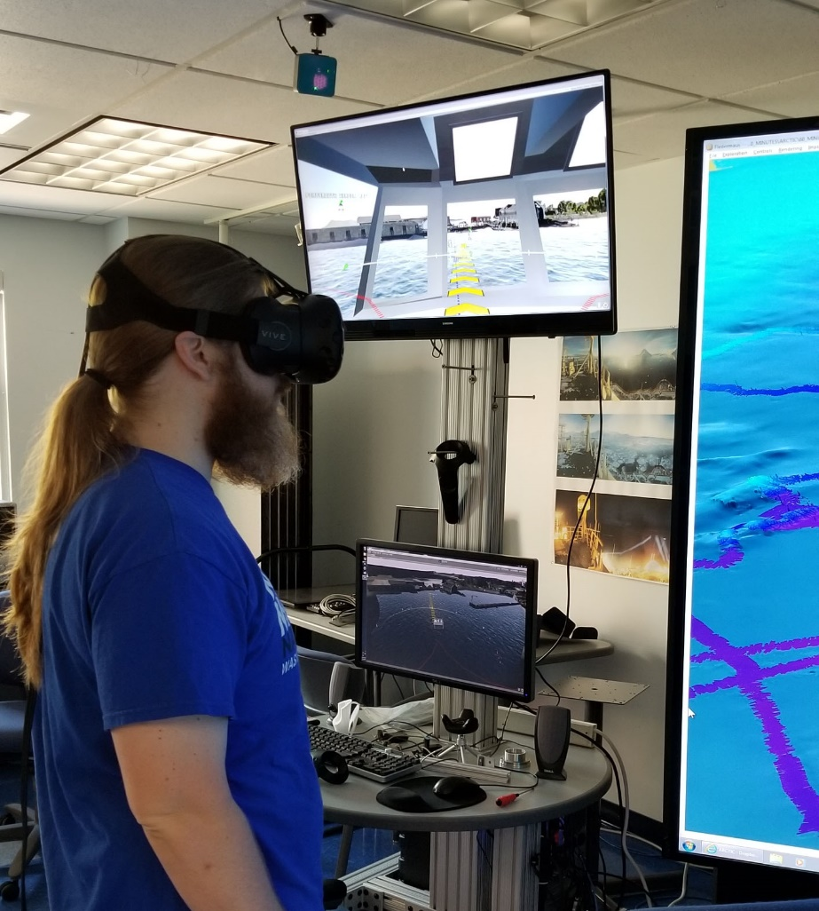
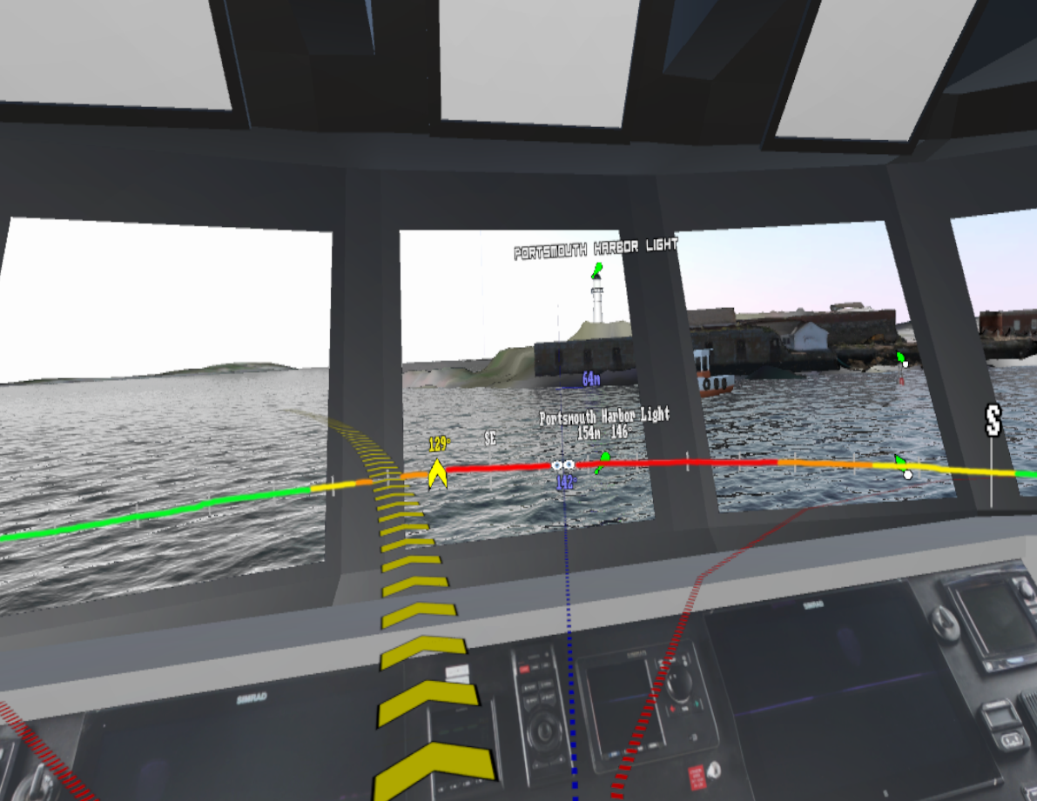
FOCUS AREAS:
Visualization: Hydrographic applications of V/R and A/R
low
.
high

Slide 18
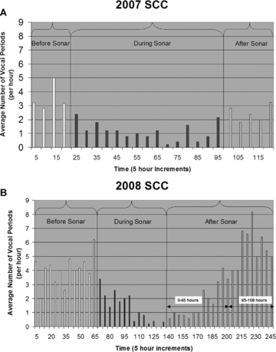
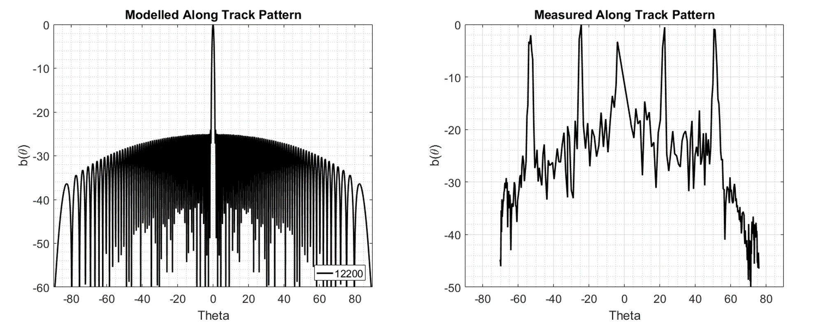
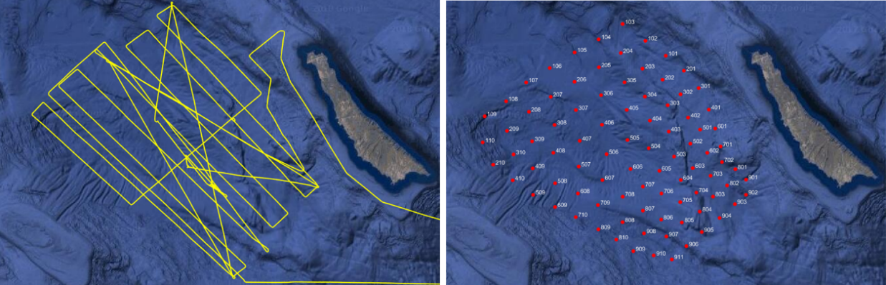
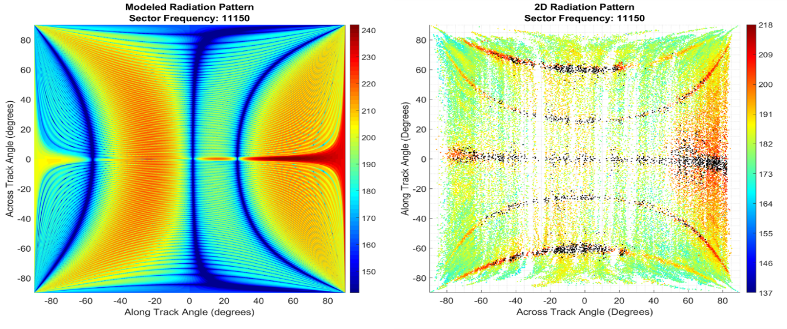
FOCUS AREAS
Impact of Sonar on Marine Mammals
R/V Sally Ride with EM122, EM710, Knudsen SBES and EK80’s at
Navy SCORE Hydrophone Range
OKEANOS EXPLORER with EM-302 at Navy AUTEC Range

Slide 19



FOCUS AREAS
Seabed 2030

Slide 20

FOCUS AREAS
Seabed 2030

